Slide 1


Sybex CCENT 100-101
Chapter 5: VLSMs, Summarization, and Troubleshooting TCP/IP
Instructor & Todd Lammle

Slide 2

Chapter 5 Objectives
The CCENT Topics Covered in this chapter include:
IP addressing (IPv4 / IPv6)
Identify the appropriate IPv4 addressing scheme using VLSM and summarization to satisfy addressing requirements in a LAN/WAN environment.
Troubleshooting
Troubleshoot and correct common problems associated with IP addressing and host configurations.
2

Slide 3
Variable Length Subnet Masks (VLSMs)
VLSM networking: create many networks from a large single network using subnet masks of different lengths
Classful network: all hosts and router interface have the same length subnet mask
Classless network: use VLSMs

Slide 4
Figure 5.1: Typical classful network
Looking at Figure 5.1, you can see that there are two routers, each with two LANs and connected together with a WAN serial link. In a typical classful network design that’s running RIP, you could subnet a network like this:
192.168.10.0 = Network; 255.255.255.240 (/28) = Mask
Problem: bottom-left LAN does not have enough IP addresses, while WAN between routers have more IPs than they need;
Solution: VLSM

Slide 5
Figure 5.2: Classless network design
Now remember that we can use different size masks on each router interface, which is a classless network design enabled by VLSM. If we use a /30 on our WAN links and a /27, /28, and /29 on our LANs, we’ll get 2 hosts per WAN interface and 30, 14, and 6 hosts per LAN interface

Slide 6
Figure 5.3: The VLSM table

Slide 7
Figure 5.4: VLSM network example 1
In Figure 5.4, we have four WAN links and four LANs connected together, so we need to create a VLSM network that will save address space. Looks like we have two block sizes of 32, a block size of 16, and a block size of 8, and our WANs each have a block size of 4.

Slide 8
Figure 5.5: VLSM table example 1

Slide 9
Figure 5.6: VLSM network example 2
Figure 5.6 shows a network with 11 networks, two block sizes of 64, one of 32, five of 16, and three of 4.

Slide 10
Figure 5.7: VLSM table example 2

Slide 11
Design Criteria
Figure out the block size for each LAN
Identify the subnet mask
Identify the valid subnets according to the subnet mask
Start assignment for LAN with a big block size, then process the small size LAN

Slide 12
Route Aggregation or Summarization
It allows routing protocols to advertise many networks as one address
Reduce the size of the routing tables on routers to save memory
Shorten the amount of time IP requires to parse the routing table when determining the best path to a remote network

Slide 13
Route Aggregation or Summarization
Figure 5.12 shows how a summary address would be used in an internetwork.

Slide 14
Figure 5.13: Summarization example 4
The Ethernet networks connected to router R1 are being summarized to R2 as 192.168.144.0/20. Which range of IP addresses will R2 forward to R1 according to this summary?
/20 = 240, so the block size is 16, then the range is 192.168.144.1 to 192.168.159.254
Or /20 means the rest 12 bits change from all 0s to all 1s

Slide 15
Figure 5.14: Summarization example 5
Okay, last one. In Figure 5.14, there are five networks connected to router R1. What’s the best summary address to R2?
172.1.4.0/25 + 172.1.4.128/25 = 172.1.4.0/24
So the summary becomes 172.1.4.0~172.1.7.0 so the summery is 172.1.4.0/22 or 172.1.4.1 to 172.1.7.254

Slide 16
Here are the four troubleshooting steps Cisco recommends:
1. Open a Command window and ping 127.0.0.1. This is the diagnostic, or loopback, address, and if you get a successful ping, your IP stack is considered initialized. If it fails, then you have an IP stack failure and need to reinstall TCP/IP on the host.
2. From the Command window, ping the IP address of the local host If that’s successful, your network interface card (NIC) is functioning. If it fails, there is a problem with the NIC. Success here doesn’t just mean that a cable is plugged into the NIC, only that the IP protocol stack on the host can communicate to the NIC via the LAN driver.
3. From the CMD window, ping the default gateway (router). If the ping works, it means that the NIC is plugged into the network and can communicate on the local network. If it fails, you have a local physical network problem that could be anywhere from the NIC to the router.
4. If steps 1 through 3 were successful, try to ping the remote server. If that works, then you know that you have IP communication between the local host and the remote server. You also know that the remote physical network is working.

Slide 17
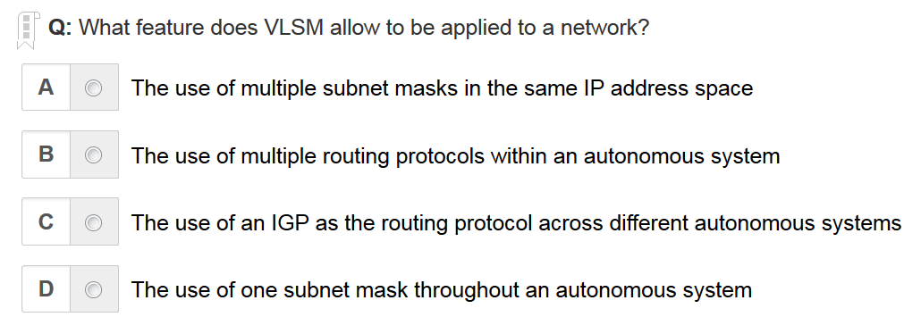
A is the correct answer

Slide 18
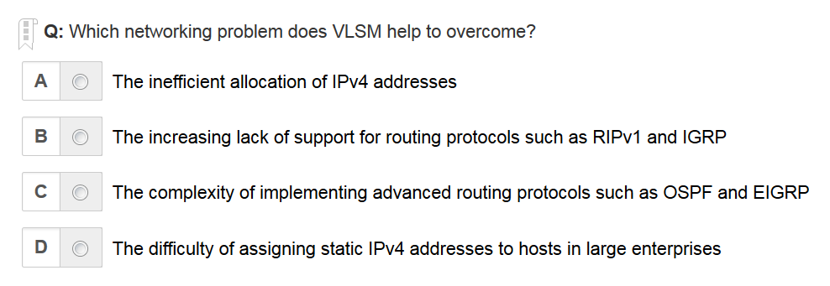
A is the correct answer

Slide 19
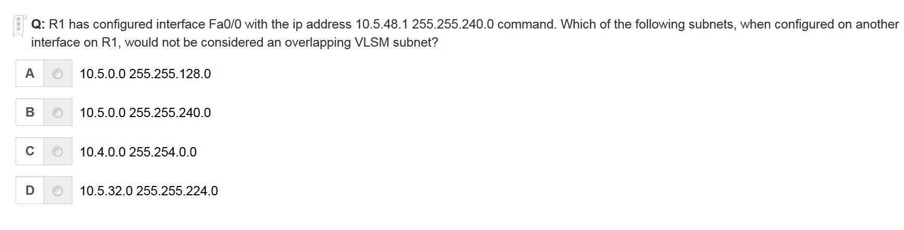
B is the correct answer

Slide 20
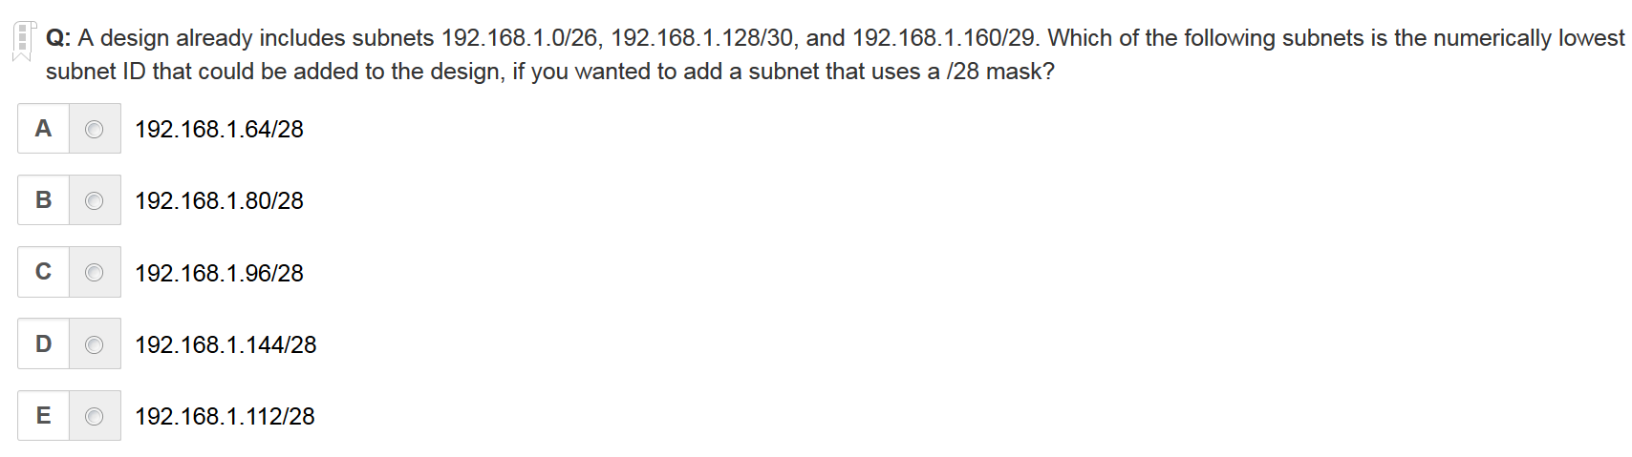
A is the correct answer

Slide 21
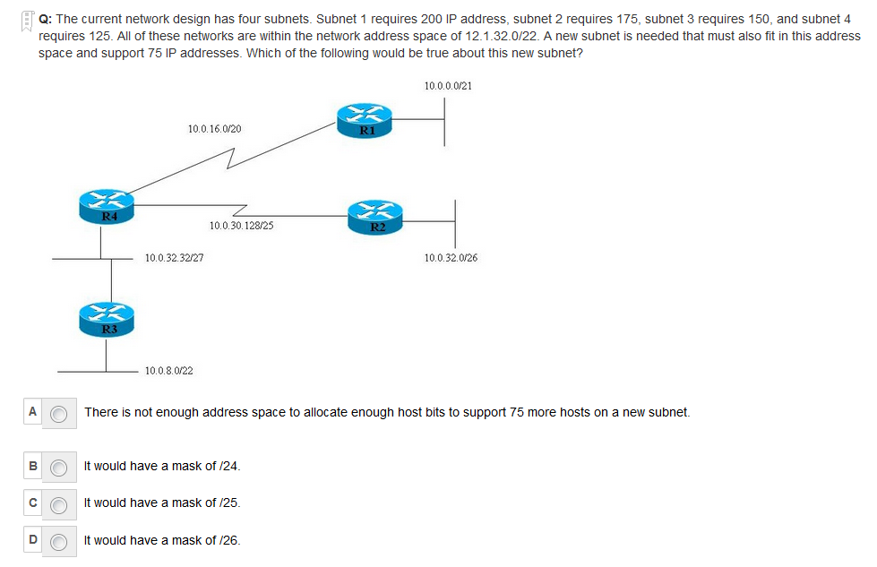
C is the correct answer

Slide 22
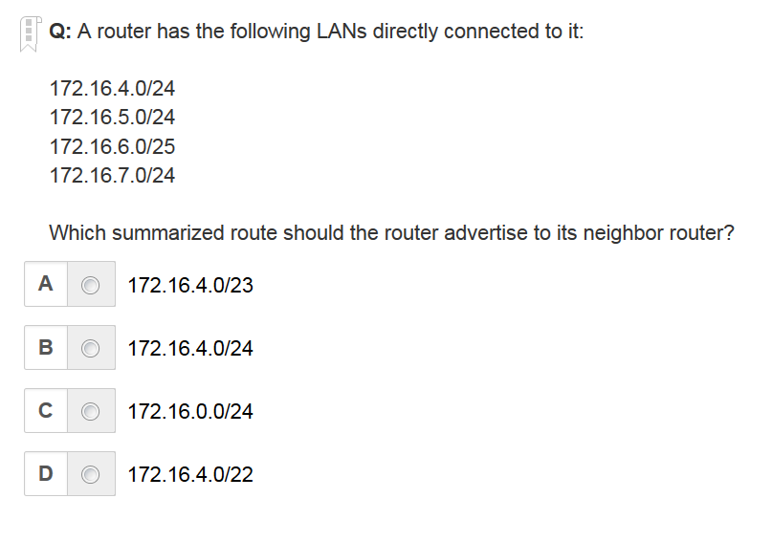
D is the correct answer

Slide 23
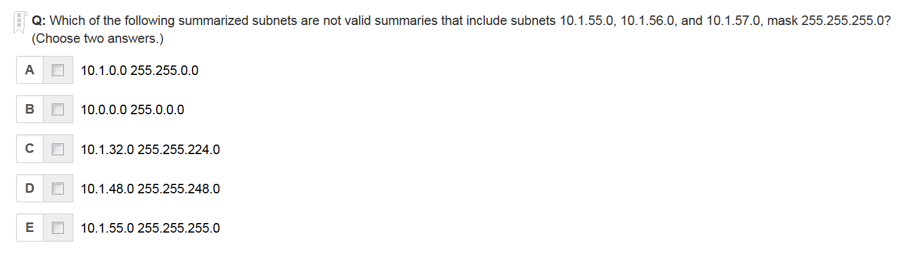
D E are the correct answer

Slide 24
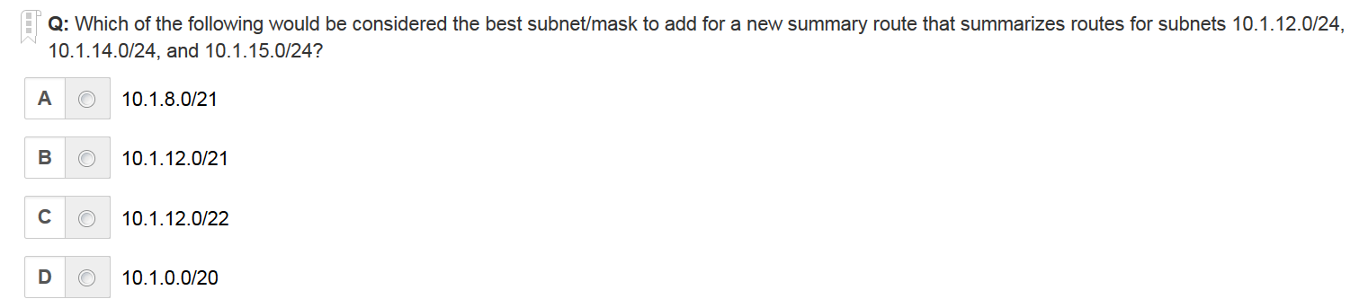
C is the correct answer

Slide 25
Written Labs and Review Questions
Read through the Exam Essentials section together in class
Open your books and go through all the written labs and the review questions.
Review the answers in class.
25

