Slide 1


Sybex CCENT
Chapter 8: Managing Cisco Devices
Instructor & Todd Lammle

Slide 2

Chapter 8 Objectives
The ICND1 Topics Covered in this chapter include:
5.0 Infrastructure Management
5.2 Configure and verify device management.
5.2.c Licensing
5.5 Perform device maintenance.
5.5.a Cisco IOS upgrades and recovery (SCP, FTP, TFTP, and MD5 verify)
5.5.b Password recovery and configuration register
5.5.c File system management
2

Slide 3
Managing the Configuration Register
All Cisco routers have a 16-bit software register that’s written into NVRAM.
By default, the configuration register is set to load the Cisco IOS from flash memory and to look for and load the startup-config file from NVRAM

Slide 4
The configuration register bit numbers
The default configuration setting on Cisco routers is 0x2102. This means that bits 13, 8, and 1 are on, as shown in the table. Notice that each set of 4 bits (called a nibble) is read in binary
Configuration Register |  |  | 2 |  |  |  |  | 1 |  |  |  | 0 |  |  | 2
Bit number | 15 | 14 | 13 | 12 | 11 | 10 | 9 | 8 | 7 | 6 | 5 | 4 | 3 | 2 | 1 | 0
Binary | 0 | 0 | 1 | 0 | 0 | 0 | 0 | 1 | 0 | 0 | 0 | 0 | 0 | 0 | 1 | 0

Slide 5
Checking the Current Configuration Register Value
Router>sh version
Cisco IOS Software, 2800 Software (C2800NM-ADVSECURITYK9-M),
Version 15.1(4)M6, RELEASE SOFTWARE (fc2)
[output cut]
Configuration register is 0x2102
The last information given from this command is the value of the configuration register.
In this example, the value is 0x2102—tells the router to look in NVRAM for the boot sequence.

Slide 6
Recovering Passwords
Turn on bit 6 in configuration register
The default configuration register value is 0x2102, meaning that bit 6 is off. With the default setting, the router will look for and load a router configuration stored in NVRAM (startup-config).
To recover a password, you need to turn on bit 6 to tell the router to ignore the NVRAM contents

Slide 7
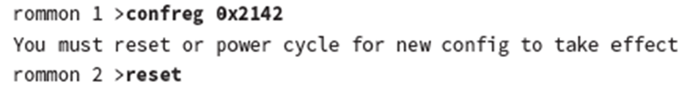
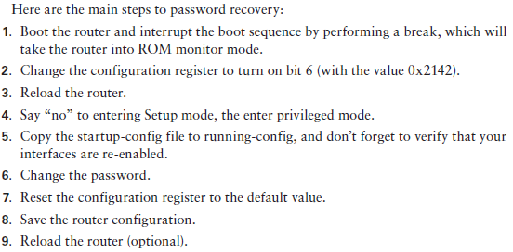
Recovering Passwords

Slide 8
Copying an IOS from a router to a TFTP host (Backing up Cisco IOS)

Slide 9
Verifying Flash Memory
Router#sh flash
-#- --length-- -----date/time------ path
1 45392400 Apr 14 2013 05:31:44 +00:00 c2800nm-advsecurityk9-mz.151-4.M6.bin
18620416 bytes available (45395968 bytes used)
There are about 45 MB of flash used, but there still about 18 MB available.

Slide 10
Restoring or upgrading the IOS
Router#copy tftp flash
Address or name of remote host []?1.1.1.2
Source filename []?c2800nm-advsecurityk9-mz.151-4.M6.bin
Destination filename [c2800nm-advsecurityk9-mz.151-4.M6.bin]?[enter]
%Warning: There is a file already existing with this name
Do you want to over write? [confirm][enter]
Accessing tftp://1.1.1.2/ c2800nm-advsecurityk9-mz.151-4.M6.bin...
Loading c2800nm-advsecurityk9-mz.151-4.M6.bin from 1.1.1.2 (via
FastEthernet0/0): !!!!!!!!!!!!!!!!!!!!!!!!!!!!!!!!!!!!!!!!!!!!!!!!!!!!!!!!!!!!!!!!!!!!!
[OK - 21710744 bytes]
45395968 bytes copied in 82.880 secs (261954 bytes/sec)
Router#

Slide 11
Cisco’s new IOS licensing
Prior to the 15.0 code release, there were eight different software feature sets for each hardware router type.
With the IOS 15.0 code, the packaging is now called a universal image, meaning all feature sets are available in one file with all features packed neatly inside.
So instead of the pre-15.0 IOS file packages of one image per feature set, Cisco now just builds one universal image that includes all of them in the file.
To use the features in the IOS software, you must unlock them using the software activation process.

Slide 12
Iicensing
There are three different technology packages available for purchase that can be installed as additional feature packs on top of the prerequisite IP Base (default), which provides entry-level IOS functionality. These are as follows:
Data: MPLS, ATM, and multiprotocol support
Unified Communications: VoIP and IP telephony
Security: Cisco IOS Firewall, IPS, IPsec, 3DES and VPN
For example, if you need MPLS and IPsec, you’ll need the default IP Base, Data, and Security premium packages unlocked on your router.

Slide 13
Show license UDI command
To obtain the license, you’ll need the unique device identifier (UDI), which has two components: the product ID (PID) and the serial number of the router.
The show license UDI command provides this information in an output as shown:
Router#sh license udi
Device# PID SN UDI
-------------------------------------------------------------------------
*0 CISCO2901/K9 FTX1641Y07J CISCO2901/K9:FTX1641Y07J

Slide 14
Install license

Slide 15
Right-To-Use Licenses
Originally called evaluation licenses, Right-To-Use (RTU) licenses are what you need when you want to update your IOS to load a new feature but either don’t want to wait to get the license or just want to test if this feature will truly meet your business requirements.
Cisco’s license model allows you to install the feature you want without a PAK. The Right-To-Use license works for 60 days before you would need to install your permanent license.
To enable the Right-To-Use license you would use the license boot module command.

Slide 16
Summary of license commands
show license determines the licenses that are active on your system.
show license feature allows you to view the technology package licenses and feature licenses that are supported on your router
show license udi displays the unique device identifier (UDI) of the router, which includes the product ID (PID) and serial number of the router.
show version displays various information about the current IOS version, including the licensing details
license install url installs a license key file into a router.
license boot module installs a Right-To-Use license feature on a router.

Slide 17
Written Labs and Review Questions
Read through the Exam Essentials section together in class.
Open your books and go through all the written labs and the review questions.
Review the answers in class.
17

