Slide 1
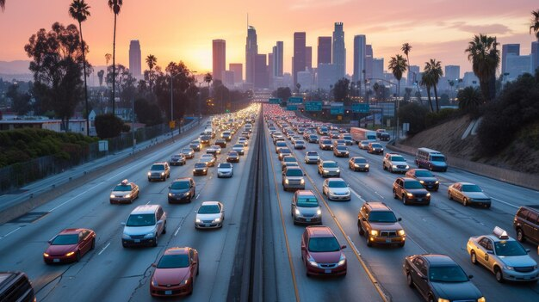
Crash Data Analysis
Data-Driven Approach to Safer Roads
2025 Virginia Datathon
Assya Ba, Parth Parker, Rhys Nordstrom, Luke White

Slide 2

Which areas and conditions contribute most to fatal crashes in Virginia?
Why it Matters:
Over 1.2 million crashes analyzed from 2016–2025
High concentration of fatalities in certain zones
Data-driven insights can inform policy and save lives

Slide 3

Data Sources
Crash Data (primary Datasets)
Source: Virginia Department of Transportation (VDOT) Open Data Portal
Years analyzed: 2016 - 2025
Key fields: VDOT District, Crash Severity, Pedestrians, Alcohol Related, Pedestrian Involvement, Coordinates, etc.
Additional Data: Distracted, Drowsy, Light Condition, Work Zone Related, Large Trucks/Motorcycles
Data File Source:
Detail - CrashData_Details | Virginia Roads
Basic - CrashData_Basic | Virginia Roads

Slide 4
Exploratory Data Analysis
Purpose
Understand crash patterns, contributing factors, and geographic trends in Virginia from 2016–2025 to guide analysis and model development.
Tool used: Tableau
What we explored
Crash Conditions: Lighting, weather, speed, distractions, impairment
Crash Severity: Fatal, Injury
Geography: Hotspot by route and zones

Slide 5
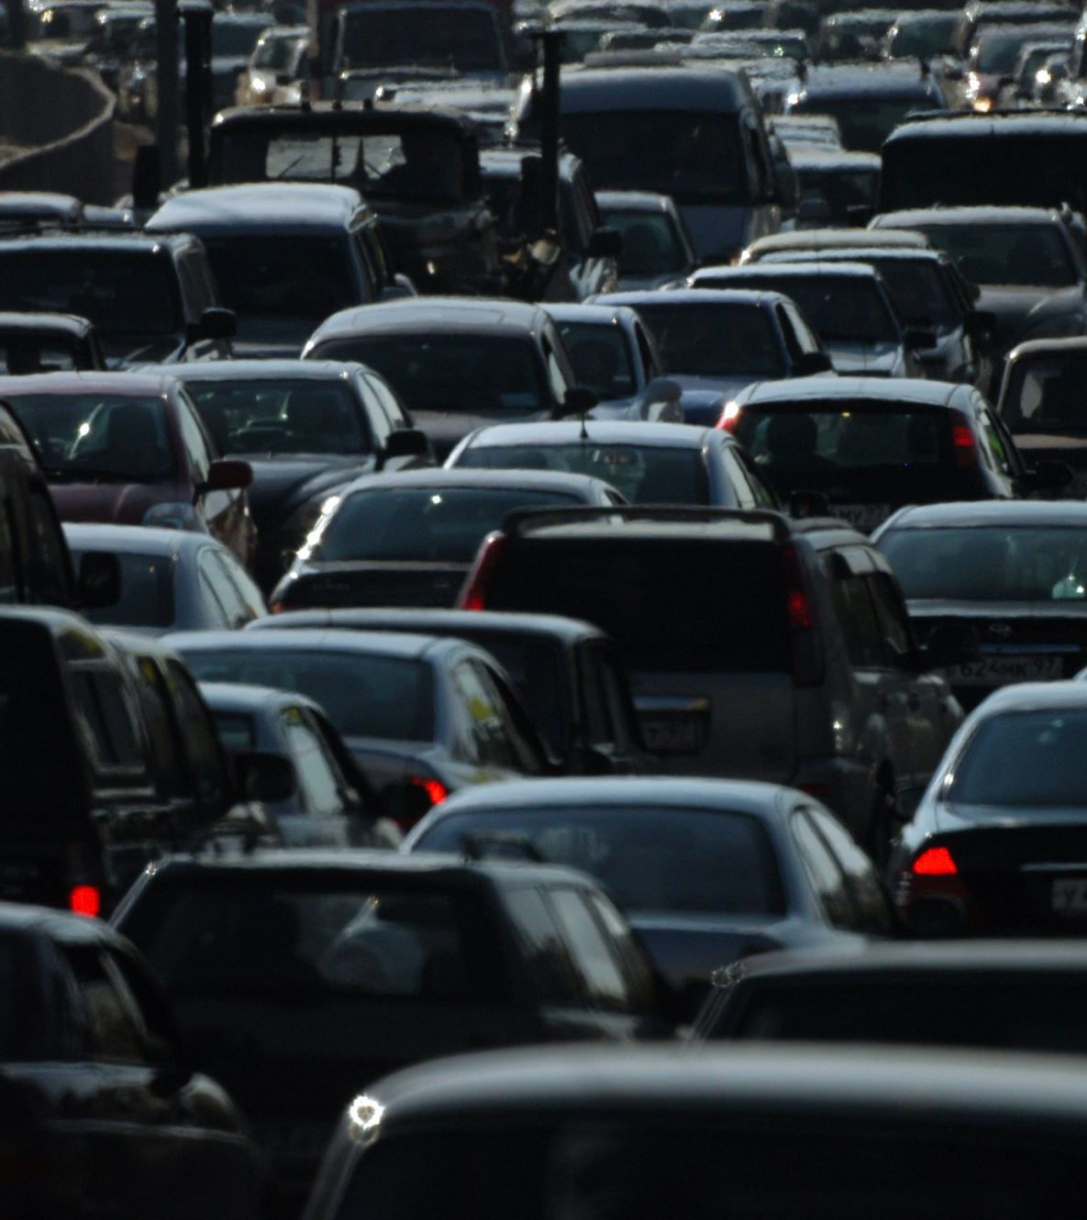
"Zone" Calculation
Created a 10x10 mile grids across the state to identify "hotspots" of serious crashes
These zones were calculated using the coordinates of each crash, converting them to degrees and assigning crashes to the grids they fell in
The numbers that identify them are their position in relation to the center grid square (i.e. 43 across, 20 up)
These helped immensely in finding areas with high crash rates

Slide 6
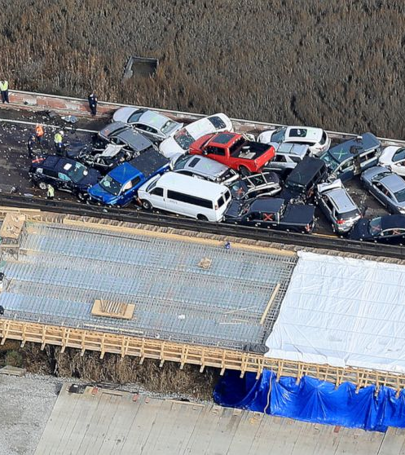
Dangerous Interstate Zones
Key takeaways
Most dangerous interstates are located around Richmond, Virginia Beach, and Northen Virginia
Isolated rural zones suggest risk even outside urban congestion
Multiple years of crashes shows that these are persistent, not one-off spikes

Slide 7
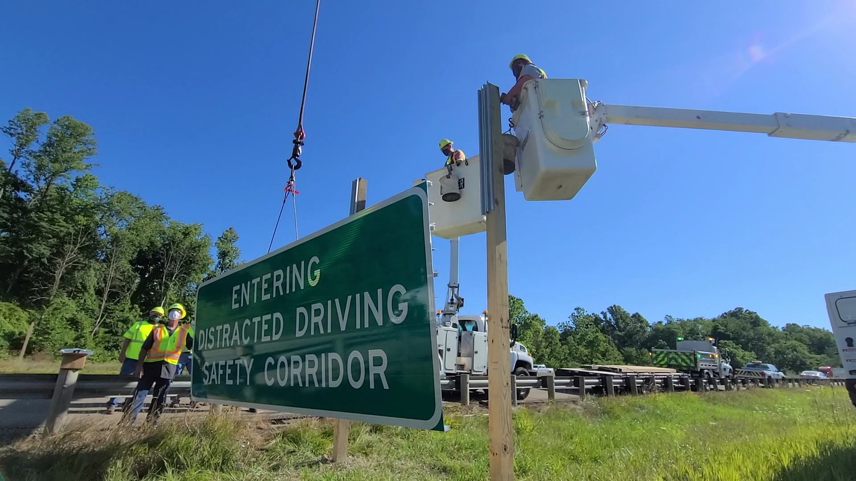
High-Risk Corridors – Non-Interstates
Key Insights:
Clusters of pedestrian-related crashes appear in urban areas like Virginia Beach, Richmond, and Washington, D.C. suburbs.
More pedestrian related incidents occur when it occurs at a 2 or 3 way intersection.
Noticed pockets of high pedestrian involvement showing trends on specific routes.
Possible signs of speeding in areas where the speed limit is < 35 MPH

Slide 8
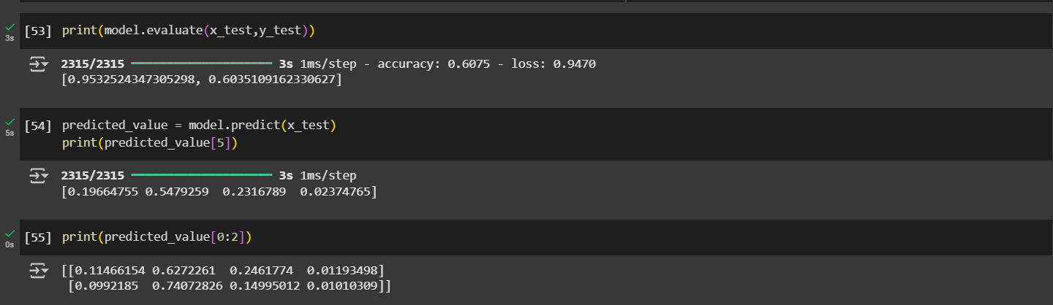
Predicting Crash Severity using Deep Learning
Model Overview:
Input variables (x): Weather, lighting, roadway surface, intersection type, speed limit, etc one-hot coded.
Input (y): One hot coded Crash Severity outcomes.
Output: Probability distribution over crash severity classes.
Model developed: Deep Learning (Sequential Neural Network)
Result:
Limitations Observed:
Imbalanced Dataset
Contextual Features missing (time of the day and traffic volume).
High Variance leading to overfit on train data.
Consistent Accuracy b/w 60-70%

Slide 9
Predicting Crash Severity using a Deep Learning Sequential Neural Network
Why is the deep learning model crucial and how does it help?
Accident severity prediction can save lives by helping establish a strong and well allocated emergency response infrastructure across Virginia.
Enables real-time risk assessment at intersections and stretches of road prone to accidents.
Helps take proactive measure to identify high-risk zones based on environmental and infrastructure features.
Car Alert Systems in the future could integrate this algorithm into navigation apps for driver alerts on risky road sections.
We could also install adaptive lighting or weather sensors in zones flagged as high-risk by the model.

Slide 10
Recommendations
Future Opportunities for Improvement
Neural network utility
Random simulation with predicted probabilities
Finding external variables to improve model performance
Optimize model to improve accuracy!
Improved dashboard interactivity
More time to develop dashboard design
The Road Ahead:
“Data alone isn’t enough. But data, used wisely, can save lives.”
Let’s harness AI to make every intersection smarter and every mile safer.

