Slide 1
SEMESTER PROJECT · PROGRESS UPDATE
Autonomous Warehouse
Robot Fleet Coordination
Using Multi-Agent Reinforcement Learning — what changed since the midterm
Group members
Parth Parmar (2410244) Saket Sarvaiya (2408838) Swarnim Jambhrunkar (2409789)
01 / 12

Slide 2
The Problem, and What We Set Out to Do
Recap — unchanged since the midterm
Domain: robotics and cooperative reinforcement learning
01
Cooperative delivery
Robots share narrow aisles while collecting items and delivering them to dispatch. One robot's shortest route can block another, creating queues, deadlocks or collisions — while a worker corridor must never be entered.
QMIX target: at least 80% task completion at 5 robots.
02
Scalability comparison
QMIX, IQL and a rule-based baseline at 5, 10 and 20 robots.
Problem statement
03
Worker-corridor protection
Learn coordinated actions that improve delivery performance as the fleet grows, while excluding worker corridors.
Zero policy-induced intrusions in 20 dedicated safety episodes.
Scope: simulation only, homogeneous robots. Physical robots and continuous control remain outside the semester scope.
02 / 12

Slide 3
The Plan Going In: QMIX With a Safety Layer
Recap — the architecture as designed before the midterm
Centralised training
Robot observations
and action histories
Individual
Q-networks
Monotonic
QMIX mixer
Joint action
value
A shared team reward trains coordinated behaviour.
Global state: robot positions and task queue
Decentralised execution
Local observation
Robot Q-network
Hard safety check
Allowed move
or safe hold
The mixer is used only during training. Each robot chooses its action from local inputs at execution.
03 / 12

Slide 4
Before → After
Every row below changed between the midterm and today
Aspect | At the midterm | Now
Environment | Flat 20×20 grid, 5 actions, no battery model | Structured v6 environment: racks, bays, chargers, corridors, 7 actions, real battery economy
Safety layer | Action mask was a stub — always returned “allowed” | Enforced in both the mask and the physics step — corridor entry is structurally impossible
Algorithms | QMIX / IQL / DQN scaffolds existed; 0% learned completion | QMIX, VDN and IQL trained with a BC + DAgger warm start — 99–100% sealed completion
Evaluation | One smoke episode, no statistical grounding | SHA-256 sealed manifests, held-out seeds, bootstrap confidence intervals
Frontend / demo | Raw JSON output, no visualisation | Live canvas warehouse, per-robot sensor view, fleet table, compare-all-algorithms mode
Every learned algorithm went from 0% to a validated, safety-verified policy.
04 / 12

Slide 5
The v6 Research Architecture
One shared recurrent actor, three ways to combine it into a team decision
Environment
Structured warehouse
(racks, bays, chargers, corridors)
Egocentric sensors
(348-dim, 5×5×12 FOV)
Battery / charging
economy
Learning
Shared GRU
actor
QMIX / VDN / IQL
value factorisation
BC + DAgger
warm start
Online RL
(masked Double-Q)
QMIX's monotonic mixer, VDN's additive sum and IQL's independent targets are the only difference between the three — everything else (actor, observations, replay, warm start) is identical, so the comparison is fair.
05 / 12

Slide 6
The Safety Layer, Now Actually Enforced
Still entirely non-learned — the guarantee does not depend on model quality
Layer | Mechanism | Type | Purpose
1 | Corridor-entry penalty | Soft (learned) | Reduces how often the hard layers below must fire
2 | Action masking at selection | Hard — non-learned | Corridor-entering actions never reach the argmax, identically in training and evaluation
3 | Physics-level block | Hard — non-learned, redundant | The environment itself refuses the move even if layer 2 is bypassed
Verified result: 0 corridor intrusions across every evaluation run this semester.
Held across trained, untrained and imitation-warm-started policies alike — exactly the claim a non-learned safety layer is supposed to make.
06 / 12

Slide 7
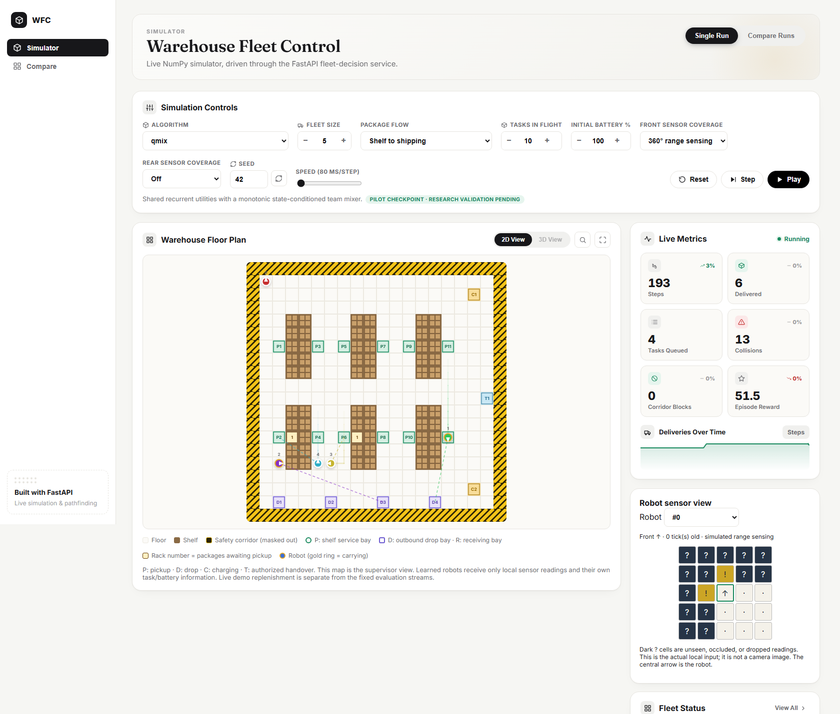
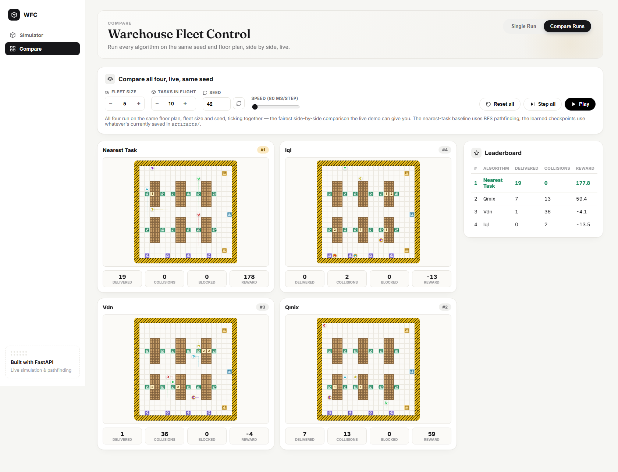
Live Demo
FastAPI service driving the real simulation — not a scripted animation
Single robot, QMIX, running live
All four algorithms, same seed, live leaderboard
07 / 12

Slide 8
Evaluation Methodology
How the numbers on the next slide were actually produced
Design choice | Evaluation plan
Sealed manifests | SHA-256-hashed before any evaluation run; tampering or drift aborts the run rather than silently reporting a wrong number
Held-out seeds | 5 seeds the training process never saw (200000–200004)
Fleet / workload | N = 5, mixed-stock inbound + outbound logistics, curriculum stage C5
Statistics | Percentile bootstrap confidence intervals — not a single-run point estimate
Uncertainty to test: reward weights, training seeds and congestion can all change the outcome — that is exactly why sealed, repeated, held-out evaluation exists.
08 / 12

Slide 9
Results: the Held-Out Sealed Benchmark
N = 5, mixed-stock workload, stage C5 — seeds the training never saw
Policy | Sealed Completion | Avg. Delivery (ticks) | Energy Used (EU) | Collisions | Avoidable Depletions
Centralized Planner (privileged) | 100.0% | 37.21 | 343.48 | 0 | 0
IQL | 100.0% | 50.99 | 354.52 | 0 | 0
VDN | 100.0% | 50.36 | 351.82 | 0 | 0
QMIX | 99.0% | 46.51 | 351.12 | 0 | 0
All three decentralised policies execute strictly from local observations (5% sensor dropout, 1-tick latency) — 0 executed collisions, 0 avoidable depletions, 0 corridor intrusions.
99–100%
0
0
46.51
Sealed completion, all 3 learned policies
Executed collisions, every policy
Avoidable battery depletions
QMIX's mean delivery time (ticks) — fastest of the three
09 / 12

Slide 10
What's Verified, and What's Still Open
Honest status, not a victory lap
Verified
Still open
226 / 228 automated tests passing, confirmed this week
N = 10 / 20 fleet sizes not yet trained or evaluated
Every sealed manifest hash verified unaltered before use
Curriculum stops at core stage C2 — robust stages C3–C5 remain
One known bug: a CUDA device-mismatch crash in IQL/VDN training, identified and tracked, not yet fixed
An adversarial 3-reviewer process (environment, learner, arbiter) caught real defects: a 3-tick service-mode lock, a charger-rejection loop, a joint route going stale
No sim-to-real validation — synthetic physics and battery model only
10 / 12

Slide 11
Next Steps and Remaining Evidence
Main gap
Cooperative benefit at larger fleet sizes still needs experimental evidence.
First risk
A known CUDA bug could silently invalidate future IQL/VDN GPU training runs if left unfixed.
Sequence | Immediate next step | Evidence to produce
1 | Finish the C3–C5 curriculum at N = 5 | Full-stage completion rates and skill-gate pass/fail results
2 | Train fleet-specific mixers at N = 10 and N = 20 | Scalability plots with confidence intervals
3 | Fix the CUDA device-mismatch bug, rerun IQL/VDN on GPU | A clean CI run with zero known failing tests
Later work: generalisation (ID/OOD layouts), a 3D demo, deployment hardening. Beyond scope: physical robots, continuous control.
11 / 12

Slide 12
Thank you
Questions and discussion
Cooperative delivery. Verified safety. Measured, honest progress.
github.com/parthparmar07/Autonomous-warehouse-robot
12 / 12

