Slide 1

Disaster Detection: Harnessing NLP and Machine Learning for Crisis
Classification in Social Media
Arham Hundia (hundia@purdue.edu)
Sowmya Jayaram Iyer (jayarami@purdue.edu)
Parth Patel (pate1384@purdue.edu)
CS57700 (Spring 2023)

Slide 2
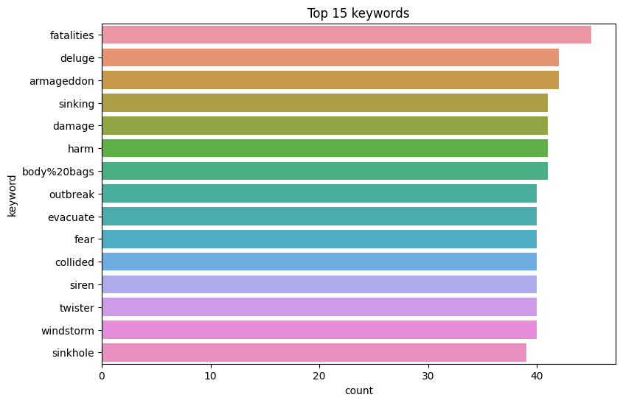
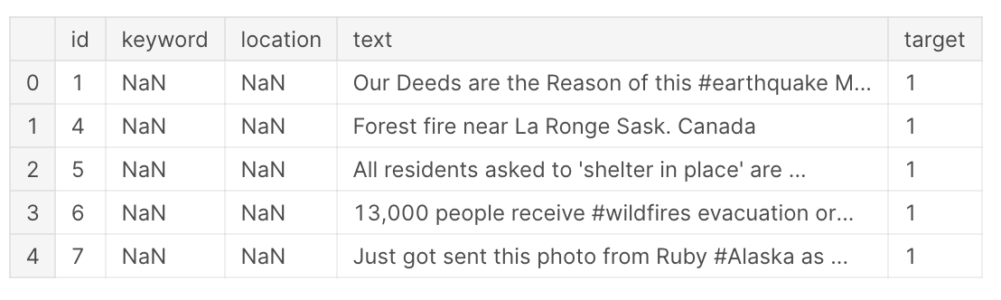
INTRODUCTION
Objective: Develop and compare machine learning models for accurate classification of disaster-related tweets
Importance: Timely and accurate information for disaster response and management
Models: Linear SVM, DAN, RNN, LSTM, Bi-LSTM, and BERT
Dataset: A Kaggle competition dataset that consists of 10,000 hand-classified tweet (Target: disaster-related (1) and non-disaster (0))
Reference(s): [5]

Slide 3
INTRODUCTION
The contributions of this paper aim to answer the following questions:
How can disaster-related tweets be accurately classified using various machine learning and natural language processing techniques?
How do different techniques perform in the classification task, and which method is the most effective?
How do simpler models like SVM with TF-IDF perform compared to more complex models like BERT and LSTM?
What are the limitations of the explored models, and how can they be improved for better performance?
Reference(s): [5]

Slide 4
Methods
Preprocessing steps: Lowercasing, Tokenization, Lemmatization Feature extraction: TfidfVectorizer, GloVe word embeddings and BERT Tokenizer
Linear SVM: SVM works by finding an optimal hyperplane that best separates the data points belonging to different classes. SVM minimizes classification errors by maximizing the margin between the classes.
DAN: Deep Averaging Network (DAN) averages the word embeddings of input tokens and feeds the result through a series of fully connected layers.
RNN: Are designed to process sequential data, with connections that allow information to persist from one step of the sequence to the next.
LSTM: Are a type of RNN architecture that use gated cells to regulate the flow of information and overcome the vanishing gradient problem in standard RNNs.
Bi-LSTM: Processes the input sequence in both forward and backward directions using two LSTMs.
BERT: Based on the Transformer architecture that is bidirectionally context-aware, enabling it to understand the context of words using both preceding and following words in a sentence.
Evaluation metric: Test accuracy, precision, recall, and F1-score
Reference(s): [5]

Slide 5
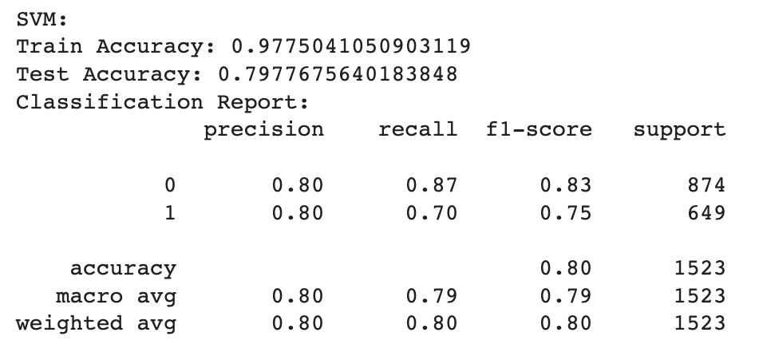
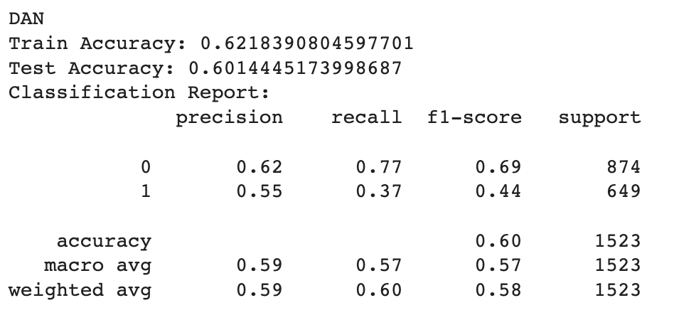
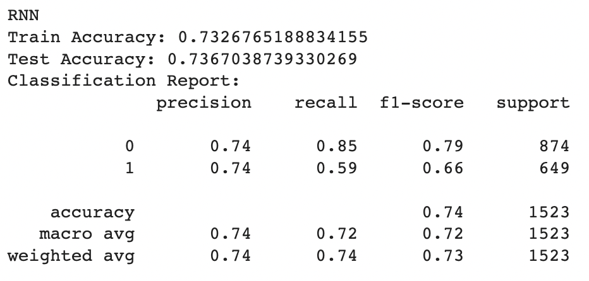
EXPERIMENTATION
Observation: reduced performance on the test data could be indicative of overfitting
Observation: ineffectiveness of the DAN model in tasks which require context
Observation: improved language processing capabilities and context understanding of RNN from DAN
Reference(s): [5]

Slide 6
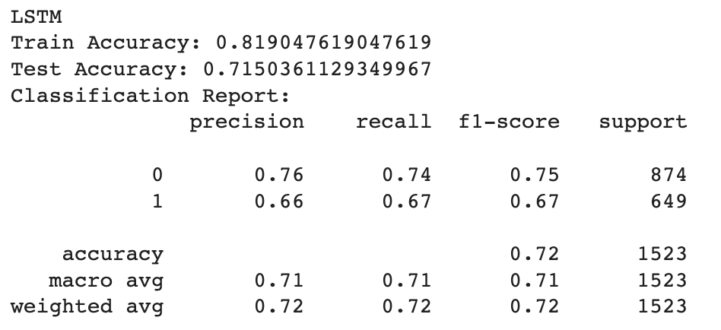
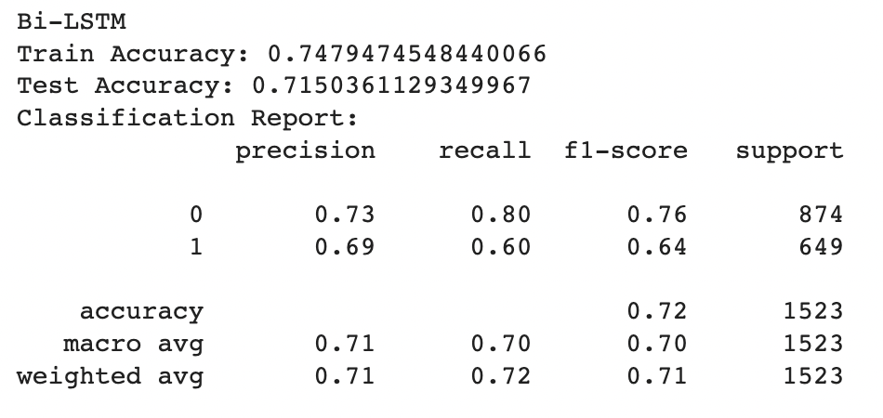
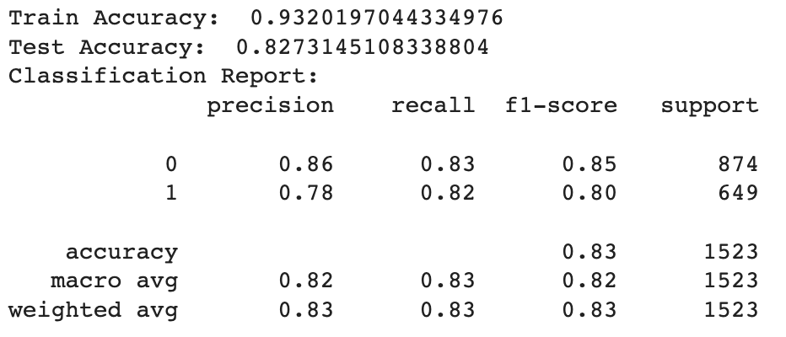
EXPERIMENTATION
Observation: demonstrates the effectiveness of the LSTM model in language processing tasks along with understanding context.
Observation: demonstrates the effectiveness of understanding context in both directions for the given input.
Observation: the effectiveness of the BERT model with attention mechanism in the binary disaster classification task
Reference(s): [5]

Slide 7
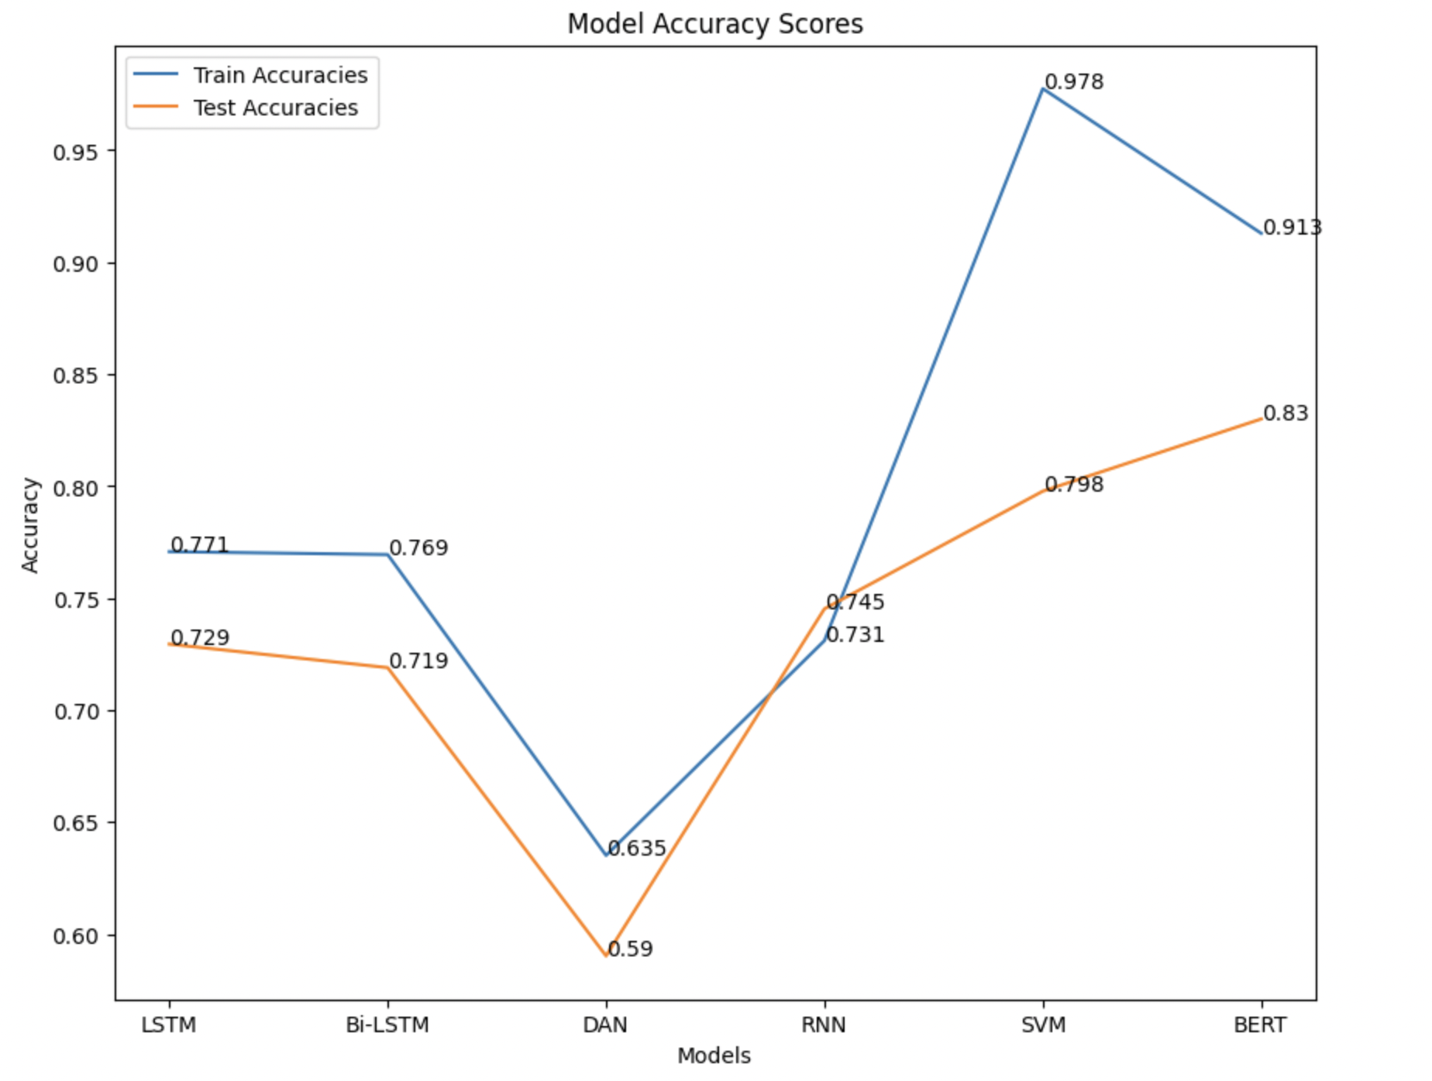
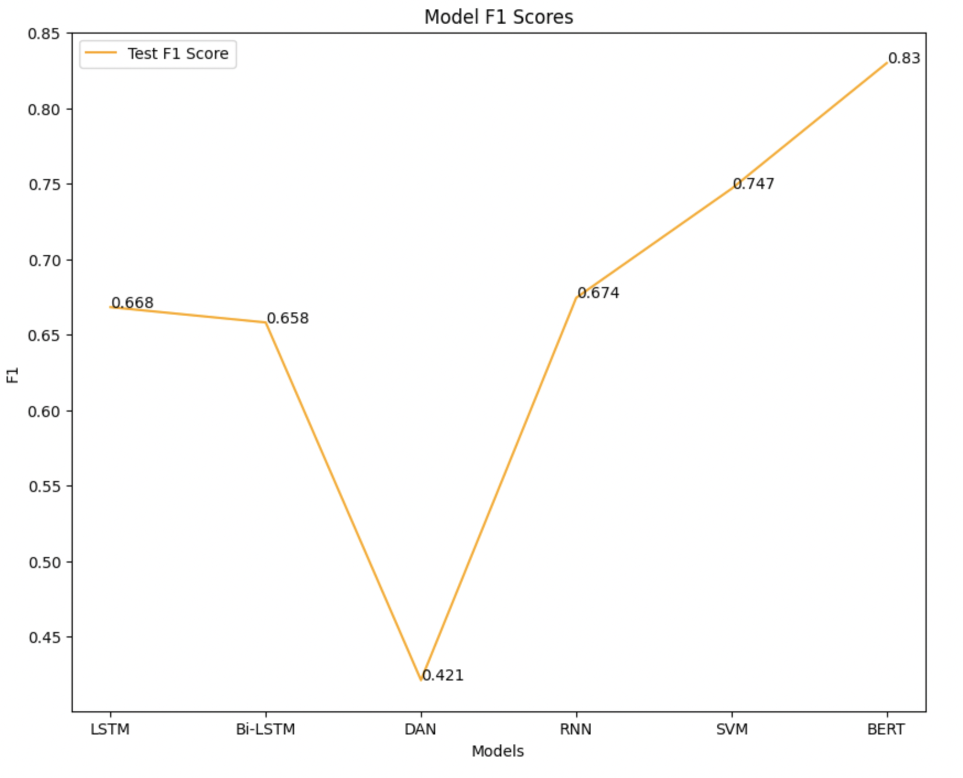
Performance
Reference(s): [5]

Slide 8
Discussions
The Linear SVM model shows good performance with test accuracy of 0.79.
The DAN model falls short with a test accuracy of 0.59.
The RNN and LSTM models exhibit better language processing capabilities with test accuracies of 0.745 and 0.729, respectively.
The Bi-LSTM model further enhances the understanding of context by taking into account bidirectional information, achieving a test accuracy of 0.719.
Overfitting observed in some models: Linear SVM, LSTM, and Bi-LSTM
SVM was able to generalize better than DAN, RNN, LSTM, and Bi-LSTM to the test dataset.
With transfer learning along with attention mechanism, pre-trained BERT model outperforms all other models, achieving an impressive test accuracy of 83%.
Overall, our results demonstrate the effectiveness of BERT in NLP tasks that require a deeper understanding of context and reaffirm its position as state-of-the-art.
Reference(s): [5]

Slide 9
Discussions
Dataset limitations:
Limited size
ambiguity
subjectivity
Lack of additional context: External links, non-ASCII characters, emojis
Language intricacies:
Sarcasm,
metaphors,
misleading keywords or hashtags
Short length of tweets: Limited context and information
We would do numerous things if we had another month/6 months/full phd time on this subject:
First, fixing dataset issues like size and imbalance can improve model performance. More data could reduce overfitting and increase generalization.
We could also leverage attention methods, extra layers,or recent transformer-based models like GPT-3 to better capture context and semantics.
Addressing ambiguity, subjectivity, sarcasm, metaphors, and misleading hashtags is another topic for improvement.
Multilingual embeddings or machine translation can assist creating models for more languages and groups
Reference(s): [5]

