Slide 1
ARTIFICIAL INTELLIGENCE • PROJECT
DIGITAL
PAYMENT
UPI
✓
Fast • Secure • Convenient
Payment
Successful
How AI helps make cashless transactions smarter and safer.
Presented by: ____________________ Class: __________
A step towards a cashless future

Slide 2
1. What Is Digital Payment?
Paying or transferring money electronically instead of using physical cash.
₹
Meaning
↗
Where we use it
✓
Why it matters
Digital payment uses a phone, card, computer, or other electronic device to transfer money.
Shopping online, paying shopkeepers, recharging phones, paying bills, and sending money.
It can make transactions quicker, easier to track, and more convenient.
A SIMPLE DIGITAL PAYMENT
Choose amount
Scan / enter details
Verify securely
Payment complete
1
→
2
→
3
→
4
AI SUBJECT PROJECT • DIGITAL PAYMENT
2

Slide 3
2. Types of Digital Payment
Different methods suit different needs.
₹
UPI
▦
QR Code
▰
Debit / Credit Card
Instant bank-to-bank payments using a UPI app or ID.
Scan a merchant's code and confirm the amount.
Pay online or at a card machine.
▣
Mobile Wallet
⌂
Internet Banking
⇄
NEFT / IMPS / RTGS
Store a balance or payment credentials in an app.
Transfer money through a bank's website or app.
Bank transfer services used for different transaction needs.
AI SUBJECT PROJECT • DIGITAL PAYMENT
3

Slide 4
3. Role of AI in Digital Payments
AI analyses patterns and helps payment systems respond intelligently.
◎
Fraud detection
◇
Risk assessment
✦
Customer support
Flags unusual transactions, suspicious logins, and unexpected spending patterns.
Helps estimate transaction risk and decide when extra verification is needed.
Chatbots answer common questions and guide users through payment issues.
EXAMPLE: HOW AI MAY SPOT FRAUD
Usual pattern
Unusual activity
AI checks risk
Protect the user
Small payments near home
Large payment from a new location
System compares signals and rules
Ask for confirmation or flag the payment
AI SUBJECT PROJECT • DIGITAL PAYMENT
4

Slide 5
4. Advantages of Digital Payment
Convenience improves when users follow safe payment habits.
✓
Fast & convenient
✓
Easy tracking
✓
Less cash to carry
Payments can be completed in seconds.
Digital records help review spending and transactions.
Useful for shopping, bills, and transfers.
✓
Available widely
✓
Supports businesses
✓
AI-assisted safety
Many services work 24/7, depending on the bank and network.
Can make receiving payments simpler for merchants.
Risk checks may help identify suspicious activity.
AI SUBJECT PROJECT • DIGITAL PAYMENT
5

Slide 6
5. Risks and Limitations
Digital payments are useful, but no method is completely risk-free.
!
Common risks
⚠
Limitations
• Phishing links and fake customer-care numbers
• Sharing OTPs, PINs, or passwords
• Network problems or failed transactions
• Privacy concerns and device theft
• Requires a suitable device and connectivity
• Some users need help learning the apps
• Mistaken transfers may be difficult to reverse
• AI can make errors or flag genuine payments
REMEMBER
Never share
Check carefully
Use official apps
Report quickly
OTP, UPI PIN, or passwords
Name and amount before paying
Avoid unknown links and APK files
Contact your bank if you suspect fraud
AI SUBJECT PROJECT • DIGITAL PAYMENT
6

Slide 7
6. Real-Life Examples
Common digital payment options in India.
UPI
BANK
CARD
UPI apps
Banking apps
Cards
Google Pay, PhonePe, Paytm and other supported apps.
Banks offer transfers, bill payments, and account services.
Debit and credit cards are used in shops and online.
AI works behind the scenes in some payment systems to help identify risk, personalise support, and improve service.
AI SUBJECT PROJECT • DIGITAL PAYMENT
7

Slide 8
CONCLUSION
Digital payment is an important part of a modern cashless economy.
AI can make digital transactions smarter by helping detect suspicious activity, assess risk, and support customers.
GO DIGITAL • STAY ALERT • PAY SAFELY
Thank you!
AI SUBJECT PROJECT • DIGITAL PAYMENT
8

Slide 9
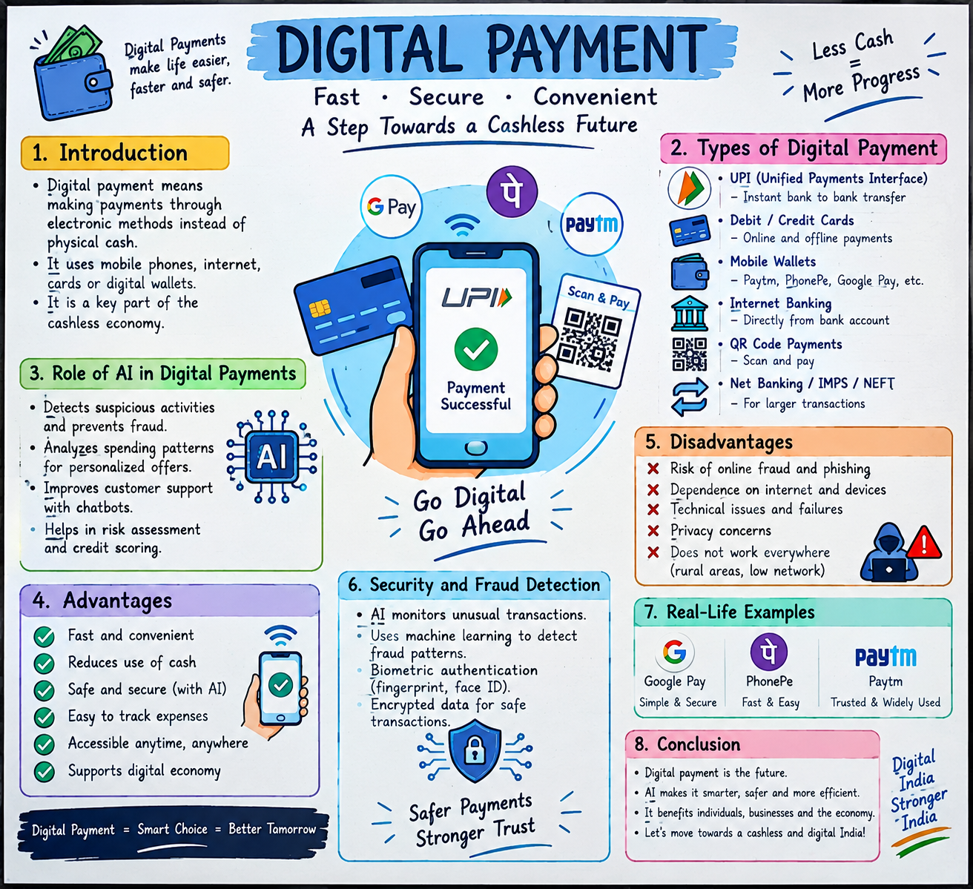
PROJECT CHART / QUICK REVISION
AI SUBJECT PROJECT • DIGITAL PAYMENT
9

