Slide 1

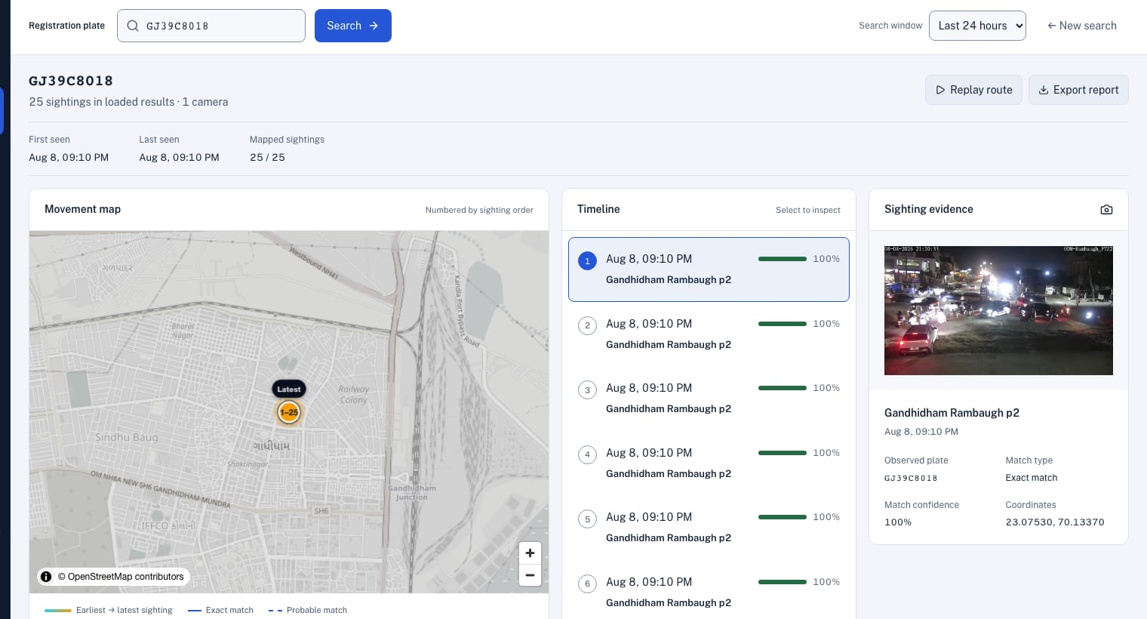


GUJARAT POLICE INNOVATION CHALLENGE 2026
Sentinel
Route traced across cameras
Find any vehicle, across every government camera in Gujarat — in seconds.
One platform that connects the cameras departments already run, reads number plates where they are filmed, and alerts officers the moment a vehicle of interest is seen.
Watchlist alert raised
Grand Finale · i-Hub Gujarat, Ahmedabad · 12–13 October 2026
Notes:
Open with the outcome, not the technology. "Sentinel lets an officer type a registration number and see where that vehicle went, across every government camera, in seconds — and be told the moment it is seen again." If the jury gives the vehicle number now, go straight to the demonstration (slide 6) and come back.

Slide 2





THE CHALLENGE
When a vehicle disappears, every minute counts
~80,000
26
7–15
~1,000
cameras already installed across the State
departments, each with its own system
days before footage is overwritten
km between the farthest camera sites
Today: a stolen car leaves Ahmedabad for Rajkot.
Tracing it means phone calls to several departments — each with its own viewer, its own login and its own retention — while the footage ages out and the vehicle moves on.
02
Notes:
Paint the picture for the non-technical members of the jury. Gujarat already has the cameras — around eighty thousand of them across twenty-six departments. What it does not have is a way to use them together. When a stolen car leaves Ahmedabad for Rajkot, tracing it is phone calls, separate logins and manual review, while the footage quietly ages out after a week or two.

Slide 3



WHAT CHANGES
From phone calls to one search
Today
With Sentinel
26 systems, 26 logins, no shared map
Every camera on one map, behind one login
A vehicle traced by phoning departments
Type a plate; see its route and evidence in seconds
Watchlists checked by hand, if at all
Every plate read is checked automatically, around the clock
Footage ages out before anyone asks
Sightings stay searchable, with the frame as evidence
Integration means replacing systems
Works with the cameras and VMS already installed
03
Notes:
This is the whole pitch on one slide. Read the right-hand column. Nothing on the left is replaced — every department keeps its cameras and its system — Sentinel sits across them.

Slide 4



THE PLATFORM
One platform, three jobs
See
Find
Alert
Every camera, from every department, on one map and one live wall — with its health at a glance.
Any vehicle by its registration number: its route, the evidence at every stop, and a signed report.
Stolen, wanted and missing vehicles flagged the moment any camera reads them — on every console and phone.
For control rooms
For investigators
For patrol and command
Plus people counting, zone intrusion and camera-tamper alerts — in English, Hindi and Gujarati.
04
Notes:
Three jobs, one console. See: every camera from every department on one map and one live wall, with its health. Find: any vehicle by its plate — route, evidence and a report you can hand over. Alert: stolen, wanted and missing vehicles are checked against every read, and officers are told immediately.

Slide 5
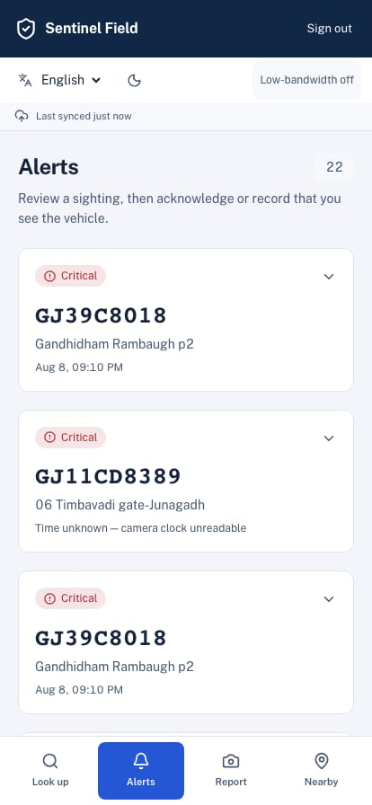



WHO IT SERVES
Built for everyone who keeps Gujarat safe
Control-room operator
Investigating officer
One live wall for every department’s cameras; alerts arrive with a sound, on screen.
Route, timestamps and evidence frames for any plate, exported as a case-ready report.
Officer on patrol
Leadership
Alerts and plate lookup on a phone, with an offline mode for weak signal.
A statewide view of the camera network: what works, what is down, where gaps are.
The field app, on an officer’s phone
05
Notes:
Make it personal. The operator gets one screen instead of many. The investigator gets the route and a report they can put in a case file. The officer on patrol gets alerts and a plate lookup on their phone — it even works on a poor connection. Leadership gets a statewide picture: which cameras are working, where coverage is missing.

Slide 6
LIVE DEMONSTRATION
On today’s cameras, in front of you
1
2
3
Connect and see
Trace the vehicle
Get alerted
Today’s cameras on the map and the live wall, with their health.
The registration number you give us, traced camera by camera, with a report to hand over.
A watchlist vehicle flagged on every open screen the moment it is read.
If the venue network fails, we say which fallback we are on: our own cameras, then a recorded copy of the government grid.
06
Notes:
Say what you will do before you do it. The narrator faces the jury; the driver only clicks. If the vehicle number was already given, run step 2 first.

Slide 7
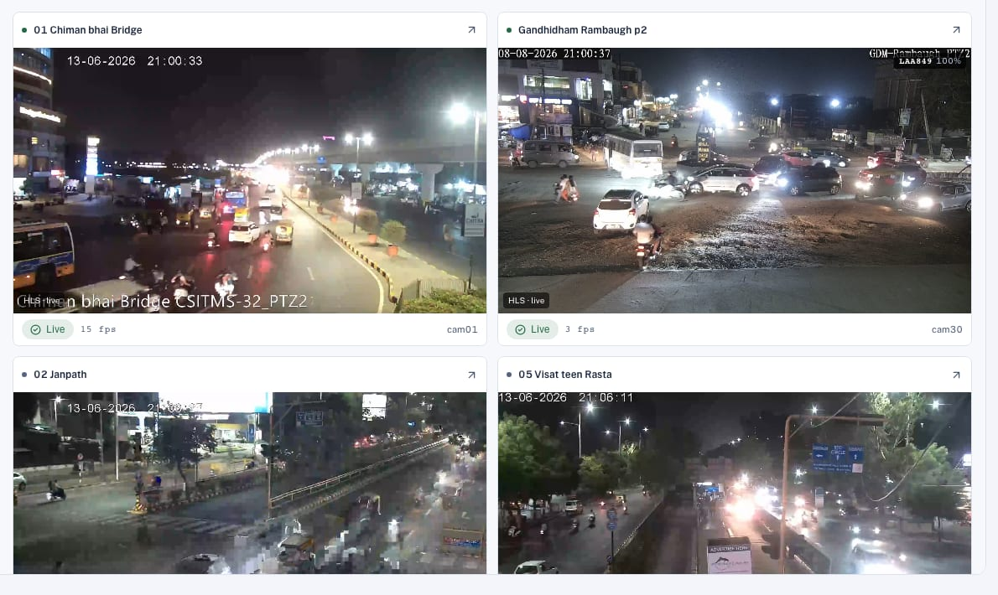




1 · CONNECT AND SEE
Works with the cameras you already have
Upload a camera list
Every row checked before anything is added; one bad row never blocks the rest.
Or discover devices
Find a camera’s or recorder’s streams on the network and add them (ONVIF, Hikvision, Dahua).
Nothing installed
Read-only access. Each department’s own system and recording keep running untouched.
Secure viewing
One connection per camera, however many watch. Passwords never reach a browser.
07
Notes:
Nothing is replaced and nothing is installed on a department’s system. A camera list, a device on the network or a department’s catalogue — each is onboarded in minutes and appears on the map and the live wall. For the technical jury: RTSP, ONVIF, Hikvision and Dahua drivers; one connection per camera however many people watch; credentials never reach a browser.

Slide 8



2 · TRACE THE VEHICLE
Type a plate. See where it went.
The camera’s own clock
Each stop is timed by the clock printed on its evidence frame.
Impossible journeys flagged
A hop no vehicle could make is marked — a cloned plate stands out.
A report to hand over
Route, times and evidence frames as PDF and CSV, sealed with a tamper-evident fingerprint.
The real console on recorded government footage: GJ39C8018 at Gandhidham, 8 Aug 2026, 21:10 — the time printed on the frame.
08
Notes:
Type the number — spacing and case do not matter. Every sighting appears on the map and the timeline, in the order the cameras’ own clocks give. Open a stop: the camera, the time printed on the frame, the plate as read, the snapshot with faces blurred. Arm a watch for future sightings. Then export the Movement Report and hand it over.

Slide 9
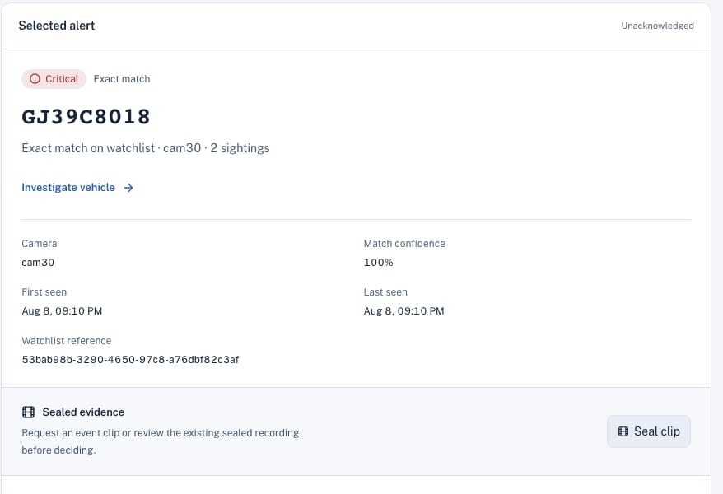

3 · GET ALERTED
Flagged the moment it is seen
It catches the misreads cameras make
Exact match
The plate, read as it is
Alert
Look-alike characters
0 for O, 1 for I, 8 for B, 5 for S
Alert
One character off
Shown with the plate as actually read
Confirm
Ready for the State’s databases
VAHAN, SARTHI, eGujCop, AFIS and NAFIS connectors are built. Access, once granted, is a setting.
09
Notes:
Every plate any camera reads is checked against the watchlist — stolen, wanted, missing — automatically. A match raises a prioritised alert on every open console and on officers’ phones, with a sound, and repeat sightings at a red light do not flood anyone. It also catches the misreads cameras make: a zero read as an O, a one as an I. Anything less than an exact match is shown as probable, for an officer to confirm on the frame.

Slide 10
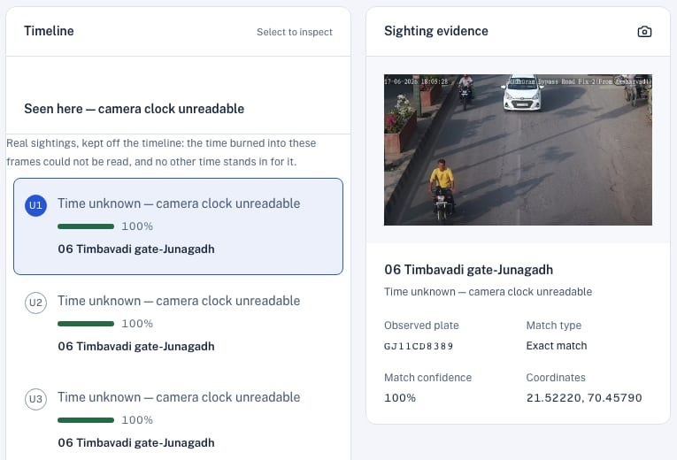



EVIDENCE AND PRIVACY
Evidence that holds up. Privacy by default.
The time on the frame is the time in the report
Read from the camera’s own clock. If it cannot be read, we say “time unknown” — never a guess.
Faces blurred by default
Seeing an original needs a stated reason, and is recorded.
A log no one can quietly edit
Every search, export and reveal. Change one entry and verification fails.
Each department sees its own
Access scoped in the database itself; private cameras only with current consent.
A sighting whose clock cannot be read stays a sighting — listed, clearly labelled, and kept off the timeline.
10
Notes:
For the legal and leadership side of the room. The time we report is the time the camera printed on its own frame — and if it cannot be read, we say “time unknown” rather than guess. Faces are blurred by default; revealing one needs a reason and is logged. Every search, export and reveal is in a tamper-evident log. We do no face recognition at all.

Slide 11






BEYOND NUMBER PLATES
More than plates — never identities
Vehicle type
Vehicle colour
People counted
Car, motorcycle, bus or truck — on every read.
Body colour attached to each sighting.
Counted per camera and held to zones. Never identified.
Restricted zones
Traffic rules
Camera tamper
Intrusion and loitering, drawn on any camera.
Wrong-way and stopped vehicles, per zone.
Covered, blurred or moved — flagged on the camera.
No face recognition, by decision. Faces are detected only so they can be blurred.
11
Notes:
The same cameras answer more questions at no extra effort: what kind of vehicle, what colour, how many people, did anyone enter a restricted zone or loiter, is a vehicle going the wrong way, has a camera been covered or moved. And one thing we will not do: identify faces.

Slide 12



WHY IT SCALES
Send meaning, not video
Send all video to the centre
Sentinel: analyse where filmed
Network backbone, statewide
160 Gbps
≈140 Mbps
~1,000× less
Storage for one week
12.1 PB
≈390 TB
~30× less
When a district’s link drops
Analysis stops
Keeps reading & alerting
up to 72 h
What travels is a small event and a snapshot per sighting. Video stays in the district — and in each department’s own system — until someone needs it.
12
Notes:
This is why the design scales where others cannot. Pulling every camera’s video to one centre would need a 160-gigabit backbone from sites a thousand kilometres apart, and petabytes of storage for a single week. Sentinel reads plates in the district where the video is filmed and sends only what it found — a few kilobytes per sighting. And if a district’s link drops, it keeps reading and alerting locally.

Slide 13


HOW IT WORKS AT 80,000 CAMERAS
Five layers, each doing one job
Consumers
Live alerts · open APIs
Command centres · Field app · VAHAN · SARTHI · eGujCop · AFIS · NAFIS
State core · high availability + disaster recovery
≈563 events/s · RPO 15 min
Event bus → watchlist matching → alerts · searchable sighting history
District edge ×34 (+ edge boxes at remote sites)
AI runs here
One connection per camera → plate reading and analytics → 72 h offline queue
Department systems · unchanged
Read-only: RTSP · ONVIF · SDK
Cameras, recorders and VMS keep their own 7–15 day retention
80,000 cameras, tiered
Tier set per camera
Continuous · sampled · motion-triggered · view-only
13
Notes:
For the technical jury, bottom to top. Cameras, tiered by how much analysis they need. Department systems stay — we pull read-only. Each district decodes and analyses its own video and queues what it finds if its link drops. The state core is about search and storage, not throughput, with a warm disaster-recovery site. And the consumers: control rooms, the field app and the national and state databases. What you saw today is the district layer, on a laptop: the same code.

Slide 14

AI WHERE IT MATTERS
Not every camera needs the same attention
Continuous
Check-posts, highways, city entry points
9,600 cameras
Sampled
Junctions, markets and public spaces
22,400 cameras
80,000
Motion-triggered
Godowns, offices and quiet premises
28,000 cameras
cameras
View only
Indoor, admin and consented private feeds
20,000 cameras
Each department sets the tier, and can change it live — a camera moves to continuous for a bandobast and back afterwards.
14
Notes:
A highway check-post and a ration-shop godown are different jobs. About one camera in eight reads plates continuously; a quarter are view-only. The tier is a setting each department controls and can change live — a camera goes to continuous for a bandobast and back afterwards. That is what makes eighty thousand cameras tractable.

Slide 15





WHY SENTINEL
What sets Sentinel apart
Sentinel traces a vehicle across every department’s cameras — on the systems Gujarat already owns, with evidence that holds up.
Proven on Gujarat’s own cameras
Evidence that holds up
Fits what Gujarat already owns
Not a lab demonstration: built and tested on the government’s own camera grid.
Every sighting carries the camera’s own time, its frame, and a record no one can quietly change.
Any vendor’s cameras and VMS, nothing replaced, analysis in each district.
Proof
Proof
Proof
All 30 grid cameras onboarded from the live catalogue; plate reading measured on 81 hand-checked plates from that footage.
Times read off the frame — “time unknown” when unreadable, never a guess; impossible journeys flagged; reports digitally sealed.
RTSP, ONVIF, Hikvision and Dahua; about 1,000× less network than centralising; keeps alerting offline for 72 hours.
English, Hindi and Gujarati
VAHAN, eGujCop and more: ready
Open standards, no lock-in
No face recognition
15
Notes:
This is the answer to “why you”. Three things, each with its proof. One: it is already proven on Gujarat’s own cameras — we connected the government grid from its live catalogue and measured plate reading on its footage, not on demo videos. Two: the evidence holds up — every time is the camera’s own, every stop has its frame, nothing is ever guessed, and the record cannot be quietly changed. Three: it fits what Gujarat already owns — any vendor, nothing replaced, analysis in each district so it keeps working when links drop. Then point at the strip: Gujarati, the State’s databases, open standards, and no face recognition.

Slide 16



CHOOSING AN APPROACH
How Sentinel compares
Separate department systems
Centralise every camera
Sentinel
Trace a vehicle across all departments
Phone calls and manual review
Yes
One search, seconds
Watchlist alerts statewide
Each system on its own
Yes
Every read, automatically
Departments’ systems left untouched
Untouched, but isolated
All video re-routed centrally
Read-only access
Network the State must provide
Little — nothing is shared
≈160 Gbps, sustained
≈140 Mbps
When a district’s link drops
Works locally, still isolated
Analysis stops
Keeps reading and alerting
Approaches compared, not named products. Network figures are for ~80,000 cameras, from our scale plan.
16
Notes:
There are really two other ways to do this. Leave every department on its own system — nothing changes, and nothing connects. Or pull every camera into one central system — it connects everything, but it re-routes all the video, needs a backbone the State does not have, and stops when a link drops. Sentinel gets the reach of the second without disturbing anything in the first. We compare approaches here, not named products.

Slide 17

PROVEN, NOT PROMISED
Measured on real government footage
78%
16
600+
5.7 s
plates read exactly
frames a second, on one laptop
automated tests
to restore a million records
On 81 hand-checked real government plates; 88% of characters correct
End-to-end live analysis on a CPU — the on-site set-up
Plus interface tests in three languages and two themes
Disaster-recovery drill, with tampering detected
Stated plainly
Plate accuracy is below our own 85% target
Statewide compute is sized from vendor benchmarks
Matching vehicles with no readable plate is designed, not built
The pilot replaces every estimate with a measurement
17
Notes:
Say “we measured that”. The plate accuracy is measured on hand-checked plates from the government grid — and it is below our own target, which we say plainly; it started at under ten percent and the measurement is what drove it up. The rest is the discipline behind it: a laptop handling live analysis, more than six hundred automated tests, and a disaster-recovery drill that restores a million records in seconds and proves nothing was altered.

Slide 18
PATH TO STATEWIDE
Useful from the first district. No big-bang switch-over.
Pilot · 0–3 months
Expand · 3–9 months
Statewide · 9–21 months
Complete · 21–36 months
~500
~5,000
~30,000
80,000
cameras
cameras
cameras
cameras
1 district, 2 departments
4 districts, 6 departments
All 34 districts
Plus consented private cameras
Plate reading validated on live feeds; operators sign off
Main VMS vendors connected; VAHAN and eGujCop live
Statewide vehicle tracking; operations centre in place
Full coverage, with policy and audit established
18
Notes:
Each phase is useful on its own and none needs a big-bang cutover: one district pilot in three months, four districts and the main VMS vendors by nine, every district by twenty-one months, and consented private cameras in the last phase.

Slide 19


THE NEXT STEP
Start with a 90-day pilot in one district
A camera inventory
Read-only access
Database access
One template per department: cameras, recorders, network, locations — and whether each feed shows the date and time.
To the streams or each VMS. Nothing installed on department infrastructure.
When ready: VAHAN, SARTHI, eGujCop, AFIS, NAFIS — switched on as a setting the day it is granted.
Type a plate. See where it went.
Thank you — questions welcome.
19
Notes:
Close on the ask, then the line. Hand over the Movement Report from the demonstration if it has not been handed over already. Questions: see docs/13-SHOWCASE-PREP.md §10.

