Slide 1
SENTINEL
One operating picture for 80,000 cameras.
Unified CCTV integration and AI video analytics — running today against the real government camera grid.
Gujarat Police Innovation Challenge 2026

Slide 2
02 · THE PROBLEM
Cameras everywhere. No single picture.
A getaway car crosses four jurisdictions in twenty minutes. Tracing it takes phone calls.
26
~80,000
0
separate districts and commissionerates
cameras, many vendors, no shared registry
places an officer can ask one question
The cameras already exist. What is missing is the layer that makes them answer questions together.

Slide 3
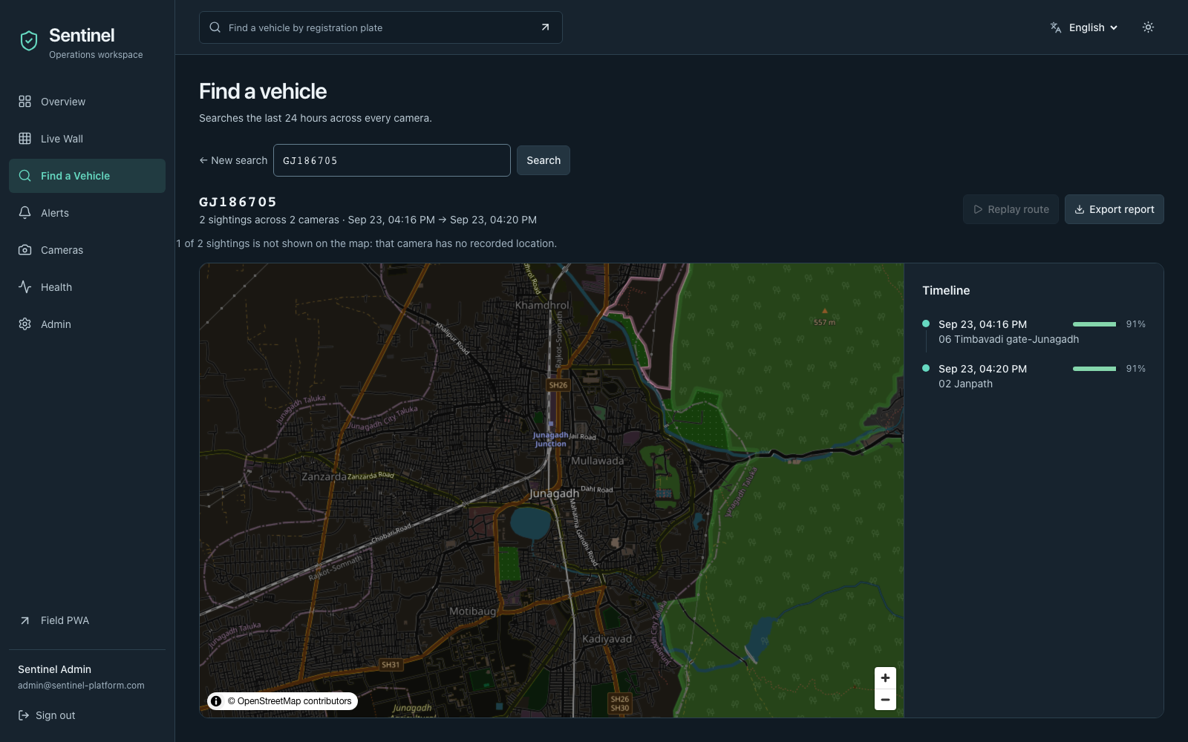
03 · WHAT WE BUILT
A plate in. A route out.
Type a registration number. Get every sighting, every camera, on a map — in seconds.
Onboards heterogeneous feeds into one registry
Continuous ANPR with watchlist correlation
Prioritised alerts with a plain-language reason
Timestamped cross-camera route, replayable
Real screenshot. Real government cameras. Not a mock-up.

Slide 4
04 · ARCHITECTURE CHOICE
Hybrid 1 + 2 + 3, selective 4.
Four integration models were on the table. We took the three that scale and used the fourth sparingly.
1
Unified registry
Mandatory. One catalogue, one identity for every camera.
2
Federated access
Departments keep their systems. We adapt to them, not the reverse.
3
Edge analytics
Inference next to the camera. Meaning travels, video does not.
4
Central video
Only on demand, only for the cameras being watched.

Slide 5
05 · THE REJECTED OPTION
Why we did not centralise the video.
Streaming all 80,000 cameras to one data centre is not a budget problem. It is a physics problem.
160 Gbps
12.1 PB
₹20+ cr
sustained ingest, 24×7, from sites up to 1,000 km apart
hot storage for a single week, before redundancy or DR
per month at cloud object pricing, for storage alone
We put this number in the deck because a jury should see the option we rejected, and why.

Slide 6
06 · ARCHITECTURE
Three planes, one contract.
Every camera becomes a CameraDescriptor. Every read becomes an Event. Nothing downstream cares about the vendor.
EDGE
CORE
SURFACE
Capture · decode · ANPR · secondary analytics
Registry · correlation · alerts · evidence · audit
Operator console · Admin portal · Field PWA
Runs beside the cameras. Sends ~1 KB events, not 2 Mbps streams.
PostGIS + TimescaleDB. Row-level tenancy per department.
Three audiences, one design language, three languages.
Video stays local. Meaning travels.

Slide 7
07 · INGEST & FEDERATION
A new department is a driver, not a release.
One call discovered and onboarded the entire government grid. Zero failures, zero hard-coded camera IDs.
ONVIF + RTSP driver SDK, with a conformance suite
Four vendor shims: Hikvision, Dahua, Milestone, Genetec
Catalogue re-read every run — the camera set can change
VAHAN / SARTHI / eGujCop / AFIS registry clients
30 / 30
cameras onboarded from the live catalogue in a single call — 0 failed
POST /api/v1/cameras/discover

Slide 8
08 · ANPR PIPELINE
Detect, track, read, then vote.
A plate is never trusted from one frame. Reads are held until several frames agree.
Vehicle detect
Track
Plate detect
Rectify
OCR
Temporal vote
~14.7 fps
4.0 frames
No accuracy %
full chain, single-threaded, Apple Silicon M2
voted per read on real traffic (max 20)
claimed — needs a hand-labelled holdout we do not have
The third box is the one worth reading.

Slide 9
09 · WATCHLIST CORRELATION
The camera read it wrong. We still caught it.
A matching ladder, not a string compare. Rung two collapses the characters OCR habitually confuses.
WATCHLIST GJ186705
8→B 0→O 5→S
ALERT RAISED
match_rung: ambiguity_class
CAMERA READ GJ1B67OS
Verified end to end on live government reads, not a unit test.
Every alert carries the reason it fired, in words an operator can act on — never a bare score.

Slide 10
10 · BEYOND PLATES
Measured on real traffic, not fixtures.
Secondary analytics ran against the live government grid for ten minutes across six cameras.
172
124
208
1
plate reads
distinct plates
zone events fired
camera flagged tampered
186 intrusion + 22 wrong-way events. The wrong-way detections are the meaningful ones: they need real vehicle tracks and a heading computed over time, which a synthetic fixture cannot produce.
Vehicle colour is an HSV heuristic. Coarse-make was not attempted.

Slide 11
11 · RESILIENCE
We broke it on purpose.
Chaos drills against the live stack — and anything that could not be tested honestly is recorded as skipped, never as a pass.
Feed killed mid-analysis
PASS
Noticed in 33s. Recovered unattended 14s after the feed returned, reconnect counted.
RTSP port blocked
PASS
The same capture layer fell back to HLS and decoded frames.
Loop-point scene cut
SKIPPED
Our fixture provably cannot produce a PTS discontinuity. Refused to claim a pass.
Network throttle
SKIPPED
Needs root-level link shaping. Documented, not simulated.

Slide 12
12 · SCALE
The 80,000-camera arithmetic.
Tiered analytics, district GPUs, and an edge that never ships raw video to the centre.
Tier A — continuous
Highways, borders, critical sites
Always-on ANPR
≈ ₹80 cr
indicative capex, phased
Tier B — sampled
Arterial roads and junctions
Duty-cycled inference
₹0 software licences —
fully open-source stack
Tier C — motion-gated
Low-traffic and interior cameras
Wakes on motion only
This is arithmetic from a documented model, not a deployment we have run. Stated as such.

Slide 13
13 · SECURITY & PRIVACY
Built for evidence, not just for demos.
Every item below is running code with a test behind it.
Faces blurred by default
At the edge, before storage. Revealing one needs an admin, a reason, and leaves a record.
Department tenancy in the database
Postgres row-level security under a non-superuser role — not a WHERE clause we remember to add.
Hash-chained audit log
Tamper-evident. We edited a row directly in Postgres and the verifier caught it immediately.
mTLS from edge to core
Client certificates terminated at a gateway; no certificate, no ingest.
Signed, expiring media URLs
A video link works without a login for minutes, not forever.

Slide 14
14 · WHAT IS REAL
What works, and what we are not claiming.
A reviewer should not have to reverse-engineer which parts are load-bearing.
RUNNING TODAY
NOT CLAIMED
Capture, reconnect and PTS timing
ANPR with real open-source models
Registry, search, alerts, evidence
Watchlist correlation, both rungs
Zones, tamper, vehicle colour
mTLS, RLS, audit chain, signed URLs
An ANPR accuracy number
Coarse-make classification
Face recognition (excluded by choice)
Government registry credentials
80,000 cameras actually deployed
The right-hand column is why you can trust the left.

Slide 15
Ready for a pilot.
Running today
The full platform, against the real grid, on one laptop.
What we need
Catalogue access per department and a district to pilot in.
First 90 days
One district, Tier A cameras, measured against a baseline.
Sentinel · Gujarat Police Innovation Challenge 2026

