Slide 1

FatalCrash Explorer
I am SPEED!
I never crash!
By: Parth Patel, Sakshat Patil, Shivani Jariwala

Slide 2
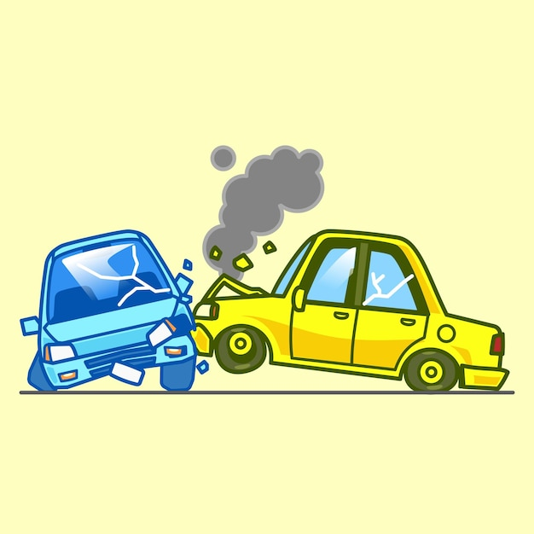
Introduction
Dataset: NHTSA Traffic Fatalities dataset (2015 – 2010). Comprising of accident records across the U.S.
Motivation: Traffic fatalities are a critical public safety concern; data analysis can drive informed policy and lifesaving interventions.
Target Audience: Designed for safety officials, EMS, law enforcement, urban planners, and researchers aiming to identify and mitigate risk
Challenges: Managed a complex schema complexity of 100+ tables.
Tools used: SQL, BigQuery, Looker Studio

Slide 3
Features
Accidents over the Past 5 Years
Monthly Variation in Accident Counts
Hourly Distribution of Crashes
Statewide and City-Level Accident Breakdown
Vehicle Types Involved and Helmut Usage
EMS Response Time Distribution
Types of Violations Charged
Top Causes of Driver Distraction by State
Common Factors in Non-Motor Fatal Crashes

Slide 4
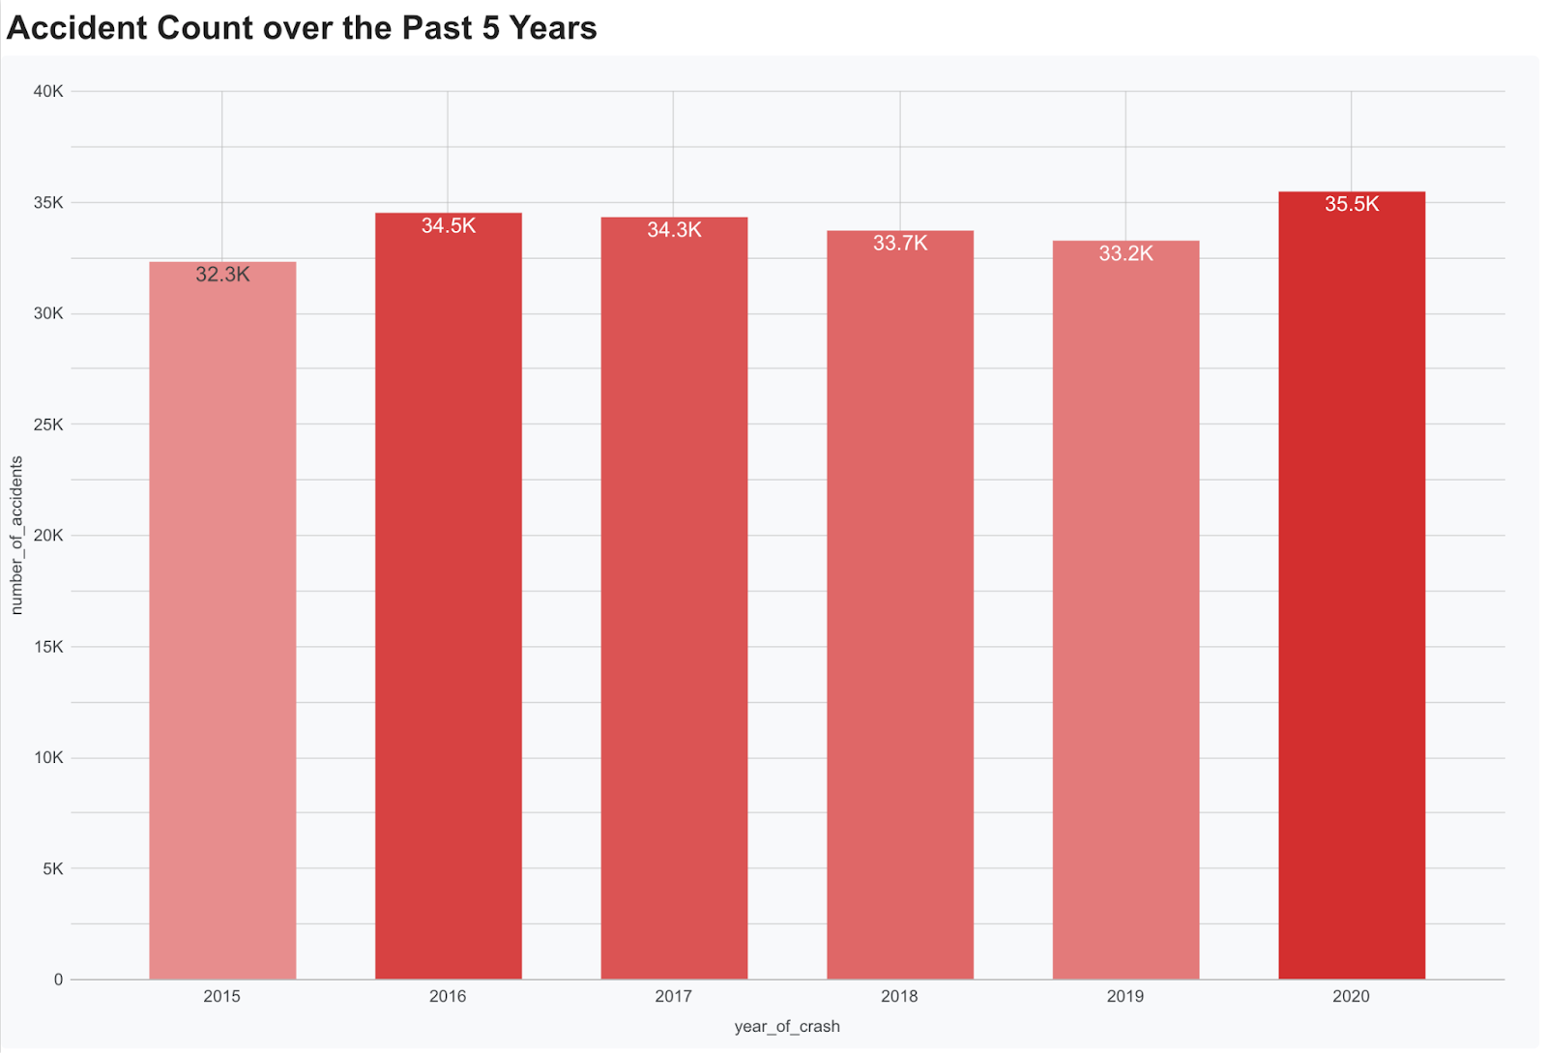
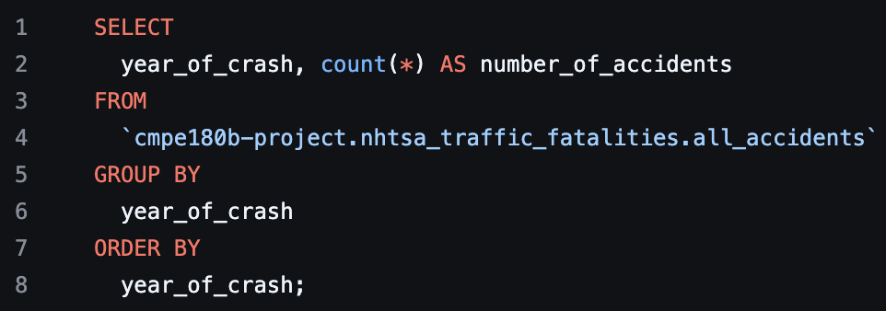
Accidents over the Past 5 Years
To understand long-term trends in fatal motor vehicle crashes, we aggregated crash data by year from 2015 to 2020. This visualization highlights the annual variation in the number of fatal accidents, providing insights into whether traffic safety conditions have improved, worsened, or remained stable over time.

Slide 5
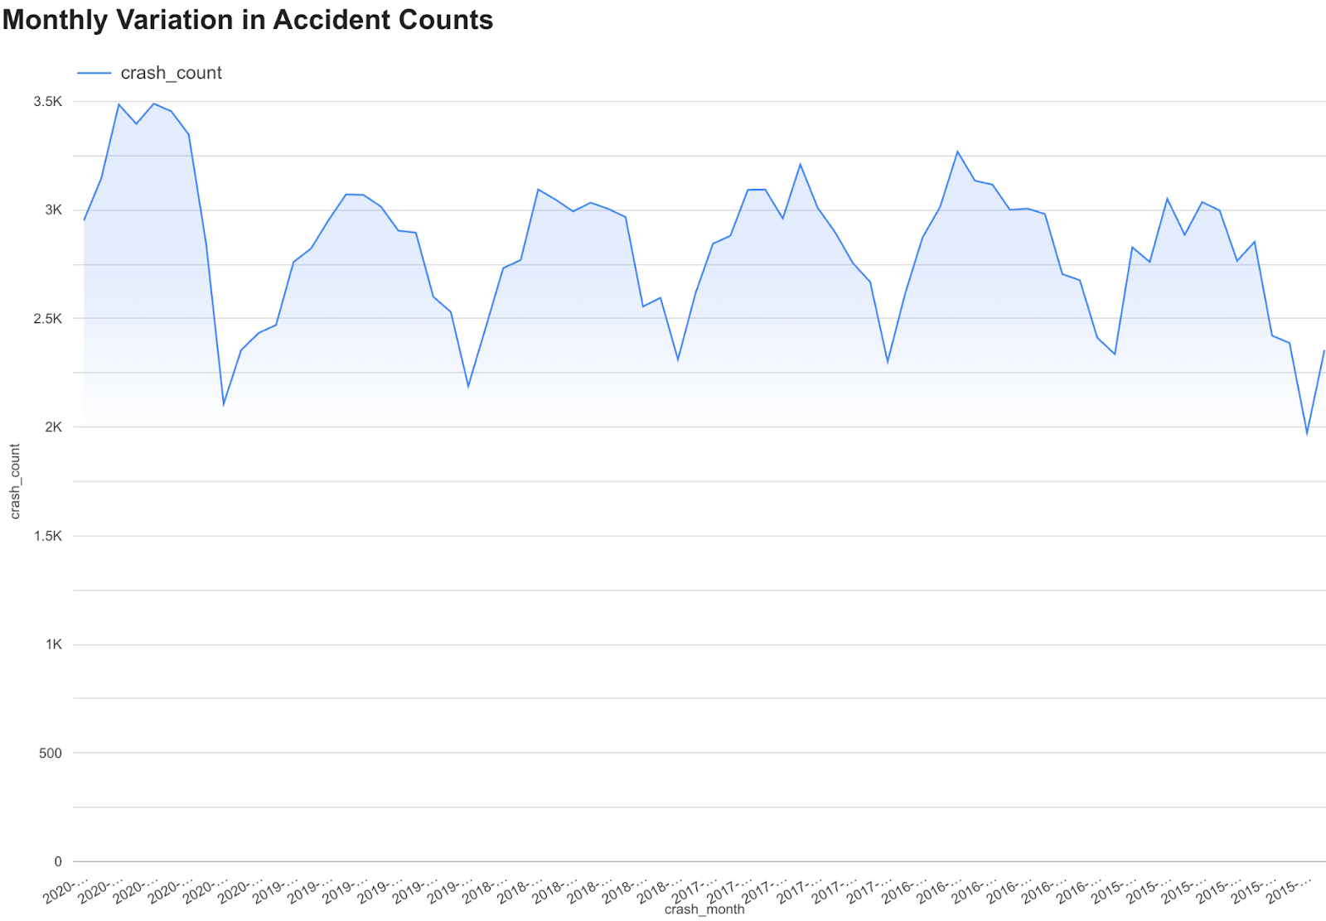
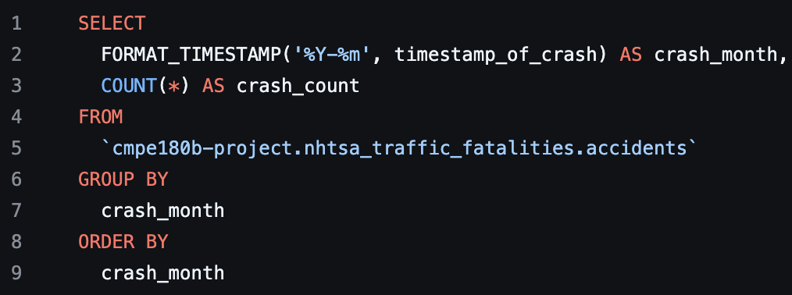
Monthly Variation in Accident Counts
To further analyze temporal trends, we extracted the month and year of each crash and aggregated the total number of crashes by month. This approach allowed us to visualize seasonal patterns and observe fluctuations in fatal crash counts over time, highlighting periods with higher or lower incident rates.

Slide 6
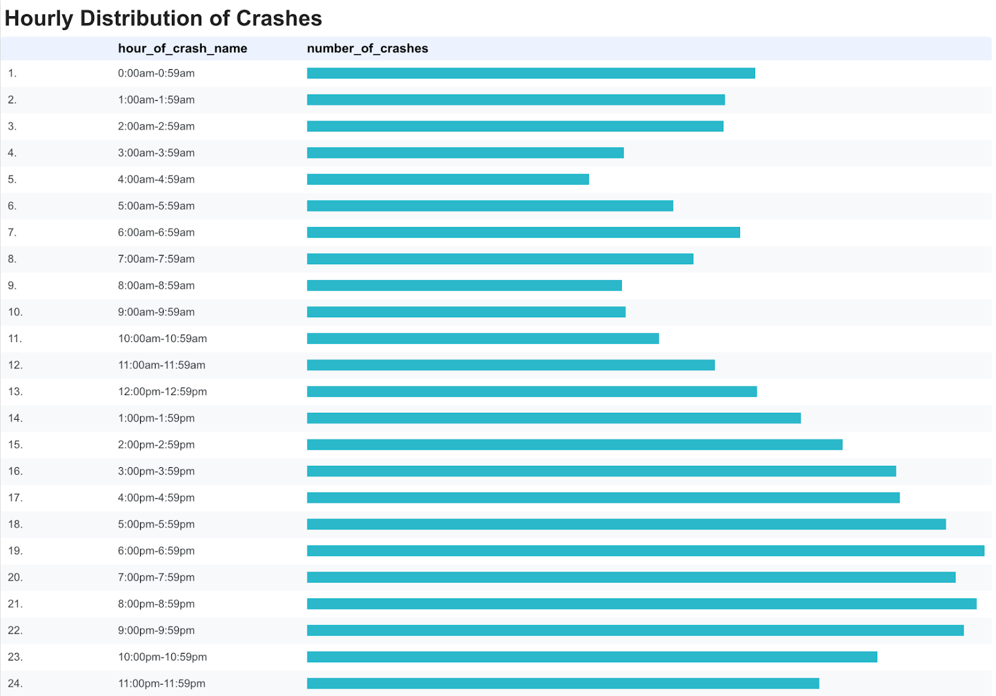
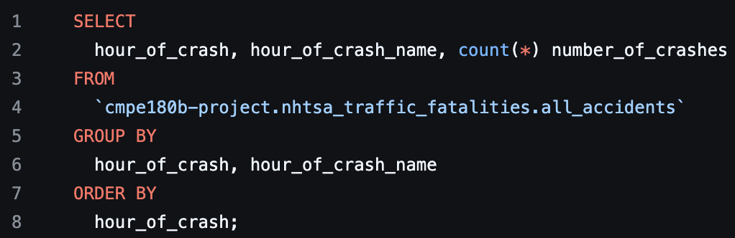
Hourly Distribution of Crashes
To analyze the relationship between the time of day and fatal crash occurrences, we extracted the hour from each recorded crash event and aggregated the number of crashes for each hour. This visualization reveals patterns in crash frequency throughout a 24-hour period, helping to identify peak hours of risk.

Slide 7
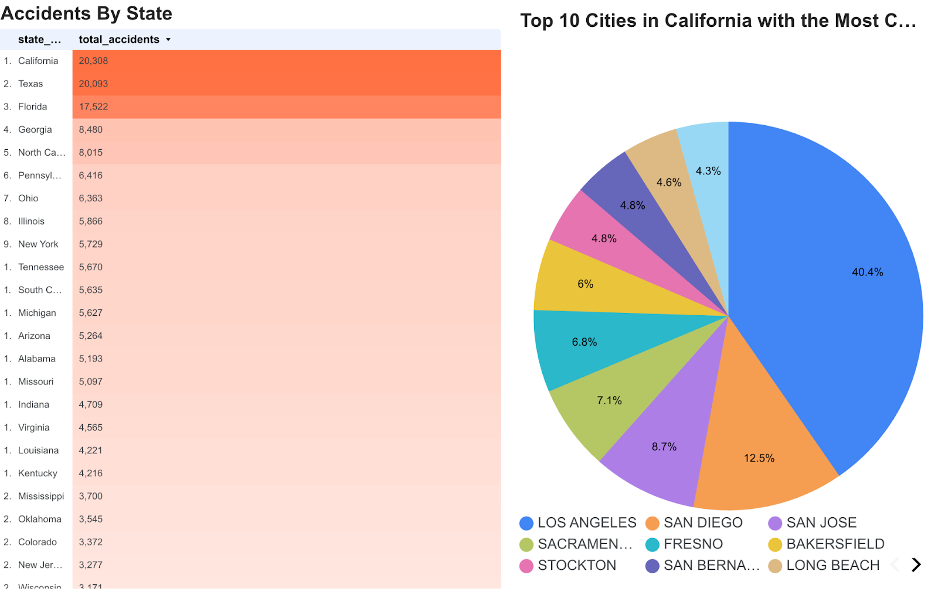
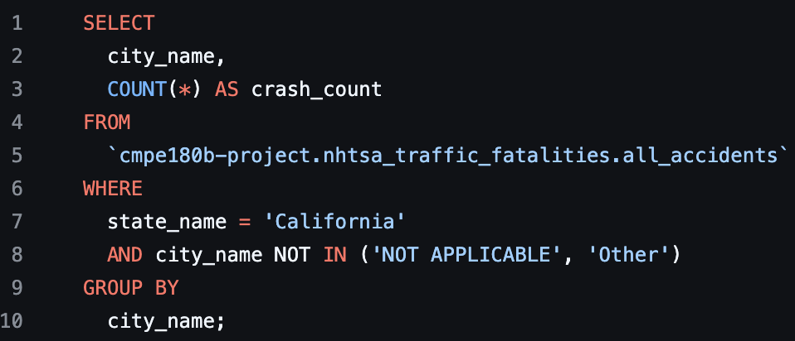
Statewide and City-Level Accident Breakdown
To explore the geographic distribution of fatal crashes, we aggregated accident counts at the state level. The first visualization highlights differences in fatal crash counts across states. Additionally, the page dives deeper into the city-level distribution within California, the state with the highest number of fatal accidents. Together, these visualizations help identify areas with higher concentrations of fatal traffic incidents.

Slide 8
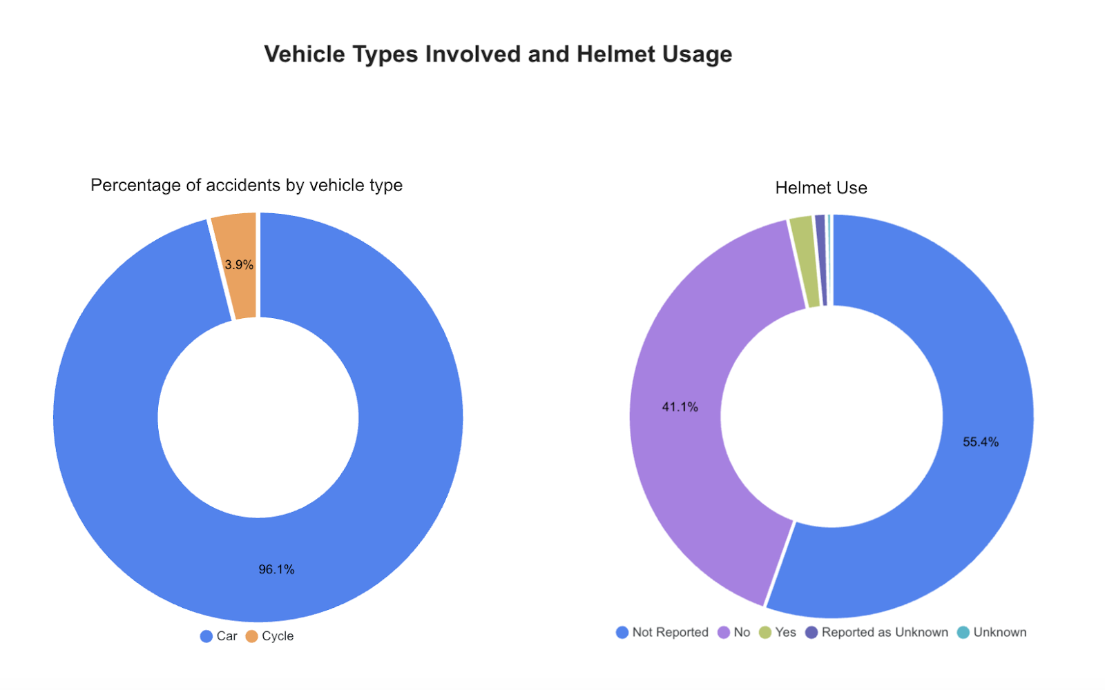
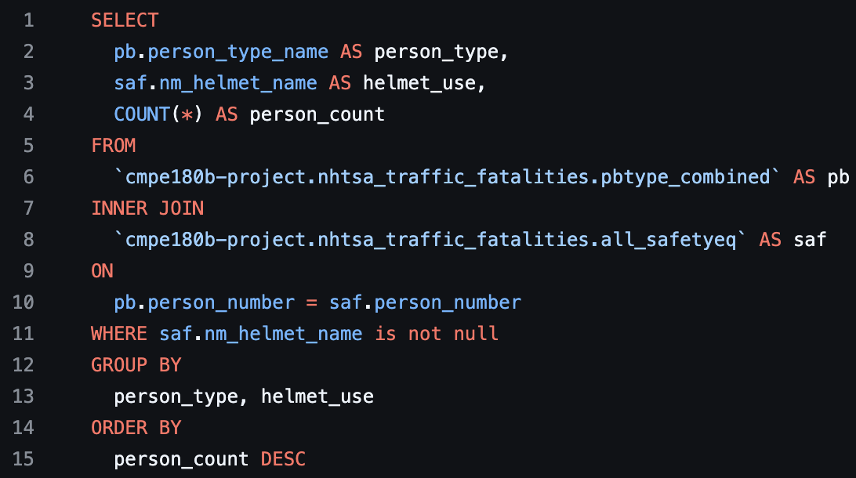
Vehicle Types Involved and Helmut Usage
To analyze the usage of helmets and other safety equipment among pedestrians and cyclists involved in crashes, we joined the all_pbtype and all_safetyeq tables. This query identifies the relationship between helmet usage and the types of non-motorists affected.
To examine the vehicle distribution, we aggregated accidents based on vehicle type and found that only a minority of accidents involve motor vehicles.

Slide 9
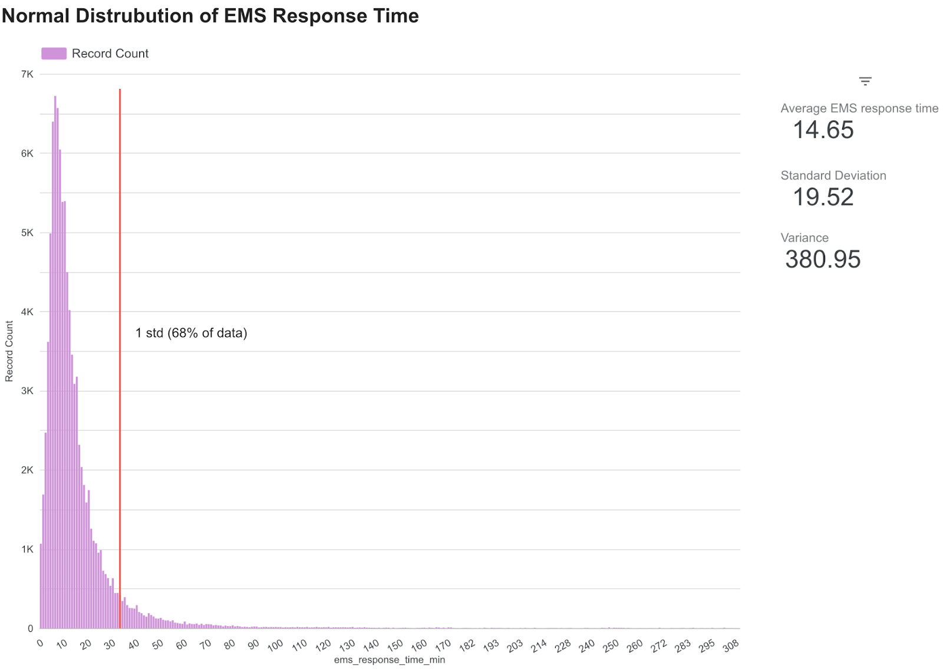
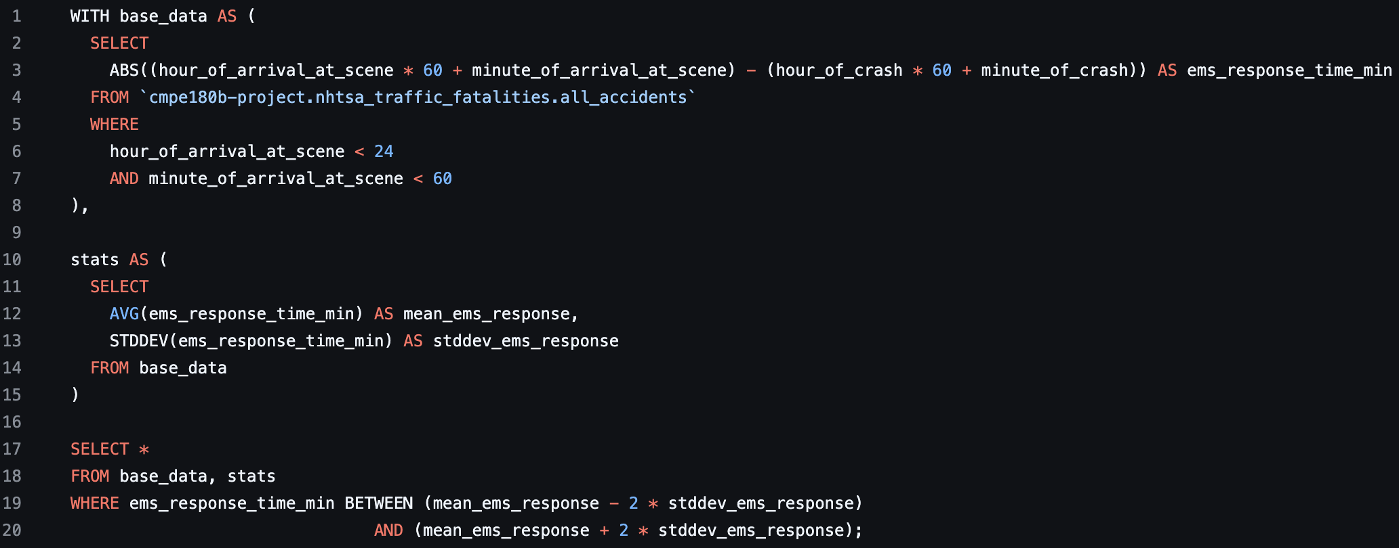
EMS Response Time Distribution
This page analyzes the distribution of Emergency Medical Services (EMS) response times following fatal crashes. The histogram displays EMS response time in minutes (X-axis) against the number of incidents (Y-axis), illustrating how quickly emergency services typically arrive at crash scenes. To ensure a clean and reliable analysis, extreme outliers were removed based on a ±2 standard deviation filtering method.

Slide 10
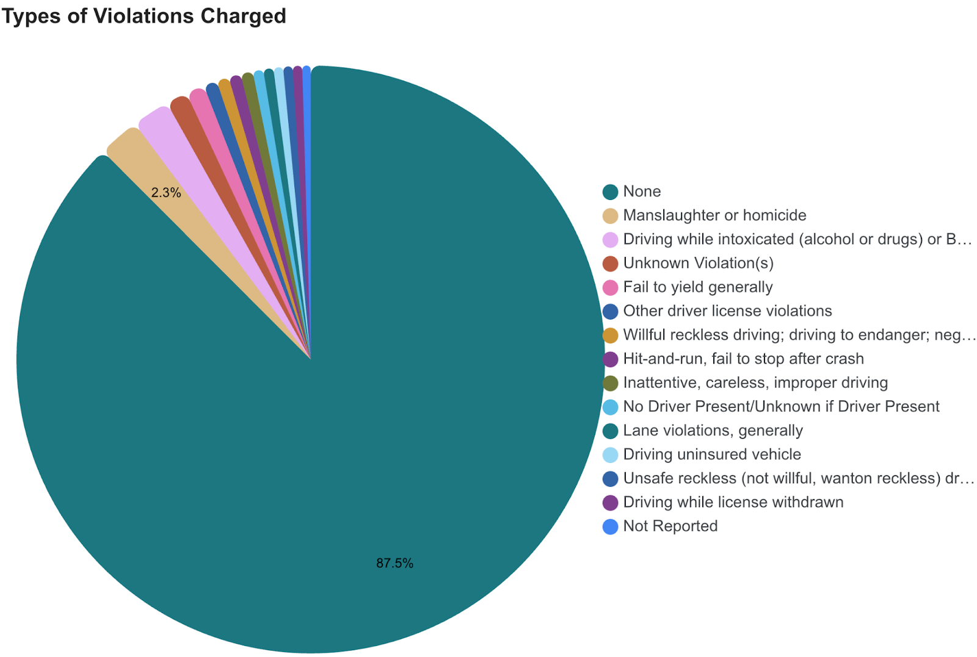
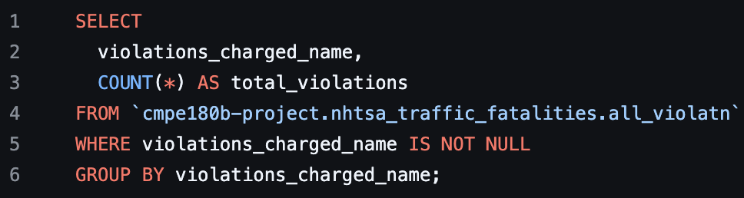
Types of Violations Charged
This pie chart displays the distribution of violation types, allowing for a quick visual comparison of the most common contributing violations, such as speeding, impaired driving, and failure to yield. Note that a significant portion of records are categorized as "None," since many crashes involve minor violations such as parking infractions or speeding that were not formally recorded as contributing factors to the fatality.

Slide 11
Top Causes of Driver Distraction by State
This analysis identifies the most frequent driver distraction involved in fatal crashes for each U.S. state. The query filters out ambiguous categories such as "Not Reported" and "Unknown" to highlight meaningful distraction causes like cell phone use, passenger interference, or external distractions. The output presents a clear, state wise breakdown that reveals how distraction types vary across different regions.

Slide 12
Common Factors in Non-Motorist Fatal Crashes
This analysis highlights the most frequently recorded actions or behaviors of non-motorists—such as pedestrians and cyclists—that contributed to fatal crashes. The query excludes generic or uninformative entries like "Unknown" and "None Noted" to surface meaningful contributing factors such as jaywalking, failure to yield, and poor visibility. The output presents a ranked list of risky behaviors attributed to non-motorists, offering valuable insight into behavioral patterns that often precede fatal collisions.

Slide 13
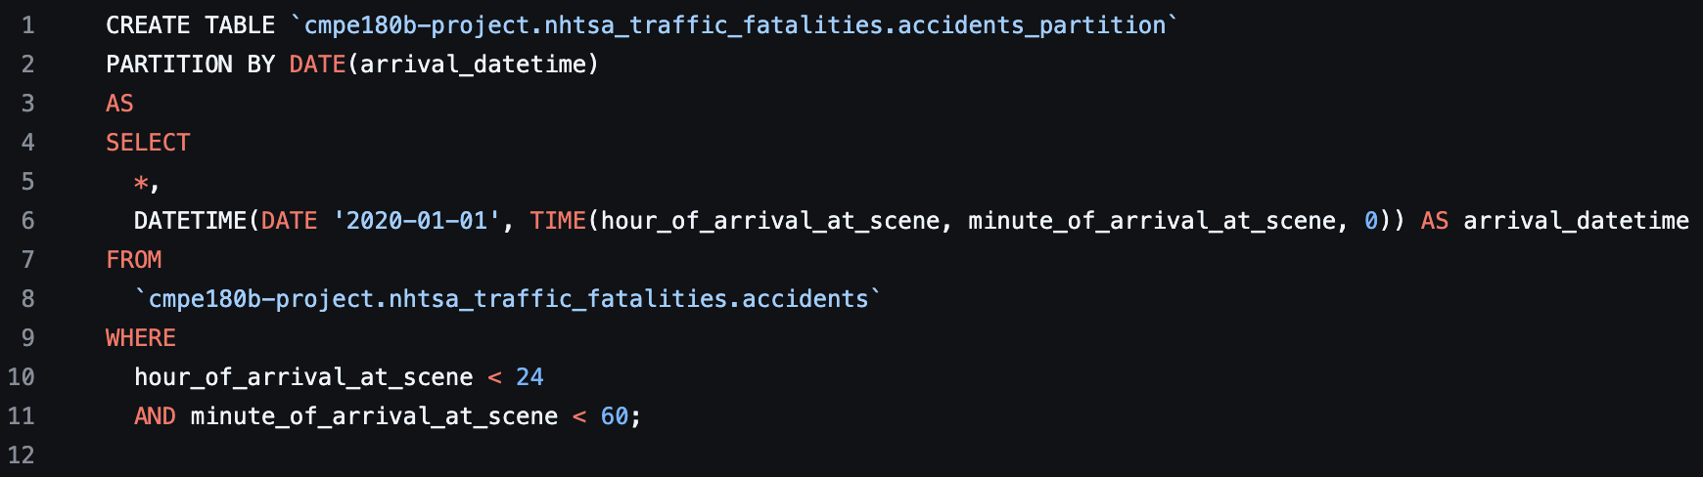
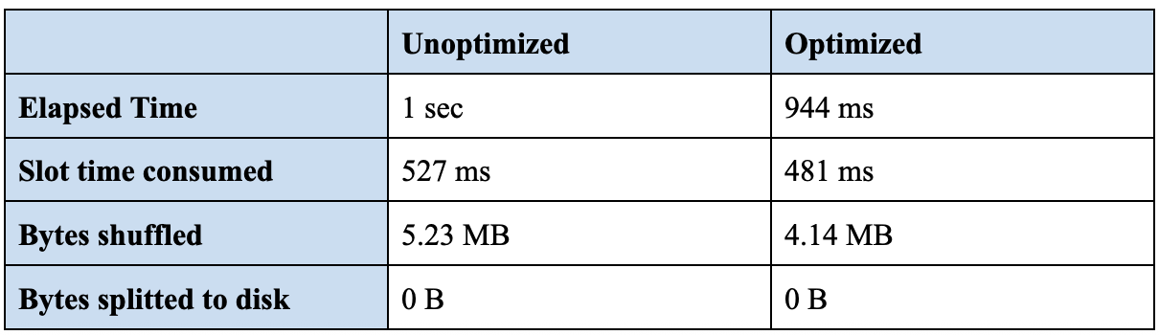
Query Optimization (IOs)
Partition:
Execution metrics:
Since BigQuery does not support manually creating indexes like traditional databases, it does allow partitioning and clustering. To take advantage of this, we created a partitioned version of the original table called accidents_partition, where we synthesized a DATETIME column using hour_of_arrival_at_scene and minute_of_arrival_at_scene, and partitioned the table on the resulting date. By running the same query on this partitioned table, we observed improved performance.

Slide 14
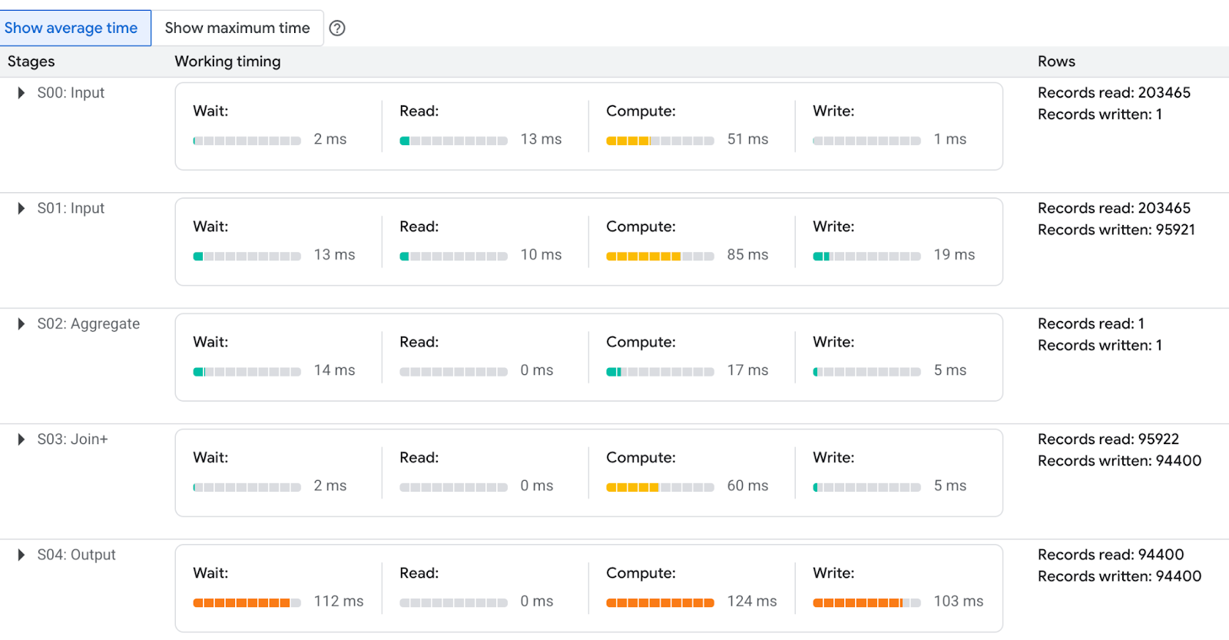
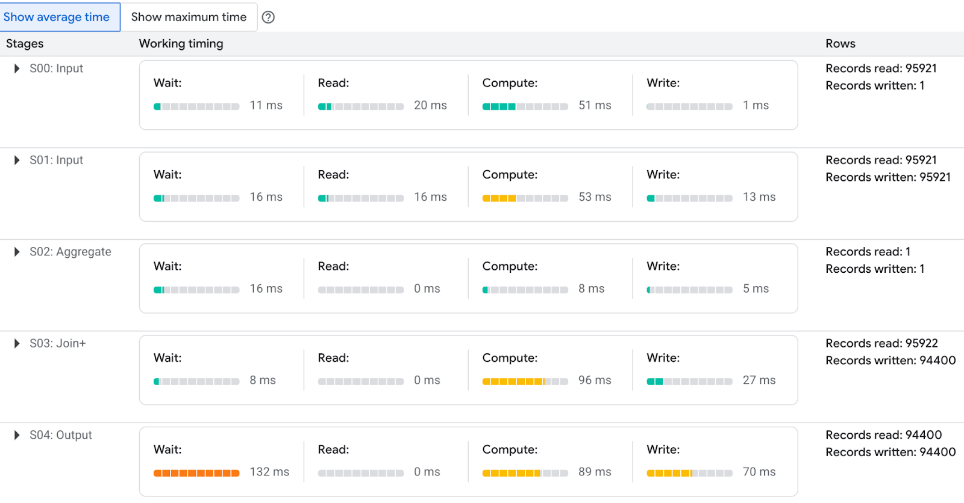
Query Optimization (performance)
Unoptimized
Optimized
The unoptimized query read 203,465 records, whereas the optimized version used partitions and read 95,921 records, resulting in a 52% reduction in records scanned.

Slide 15
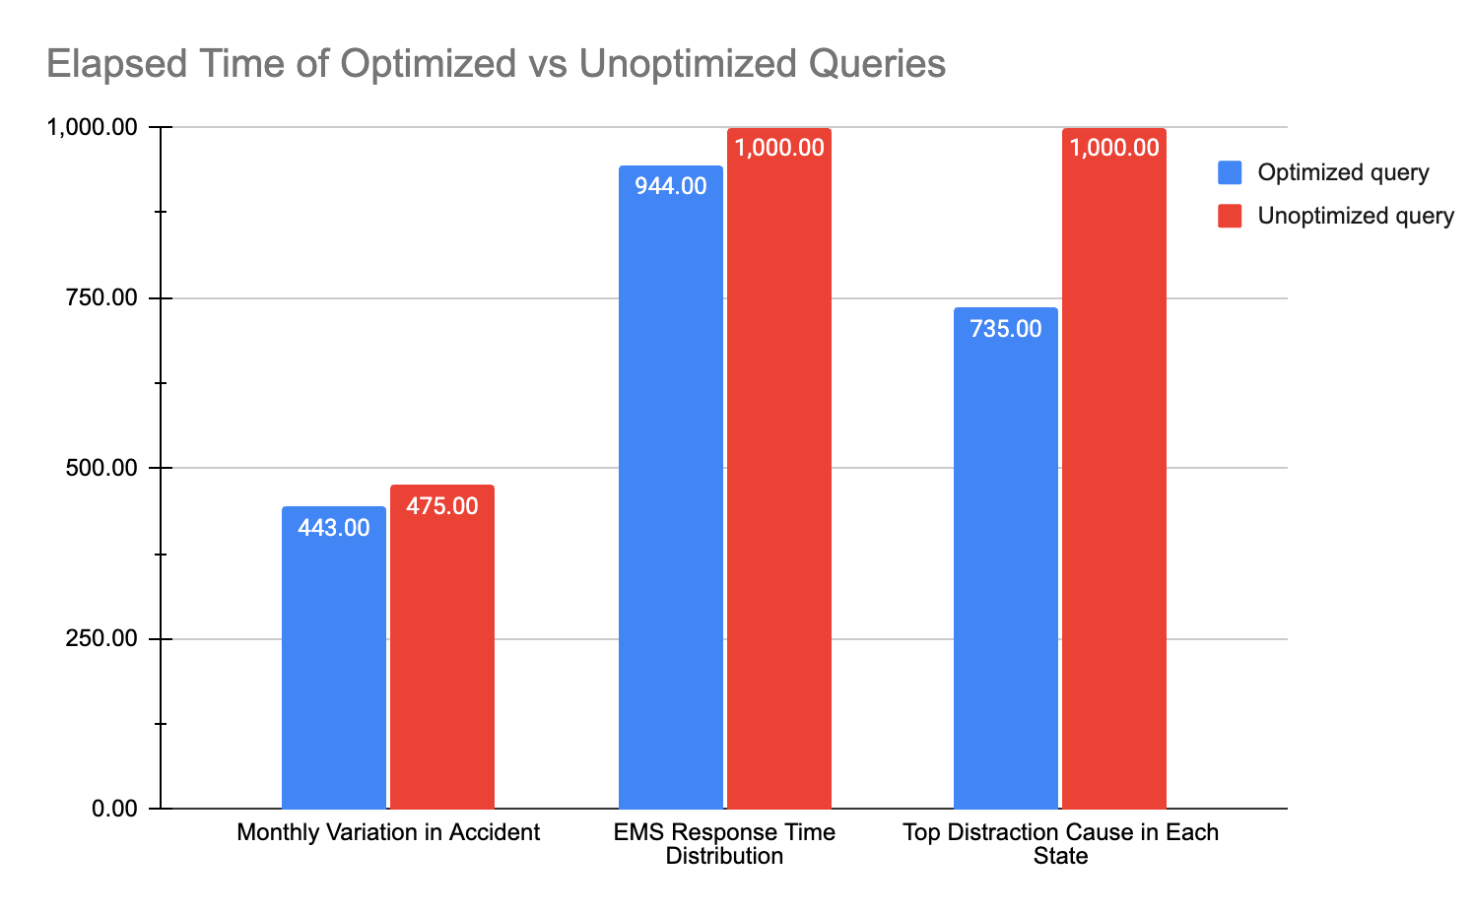
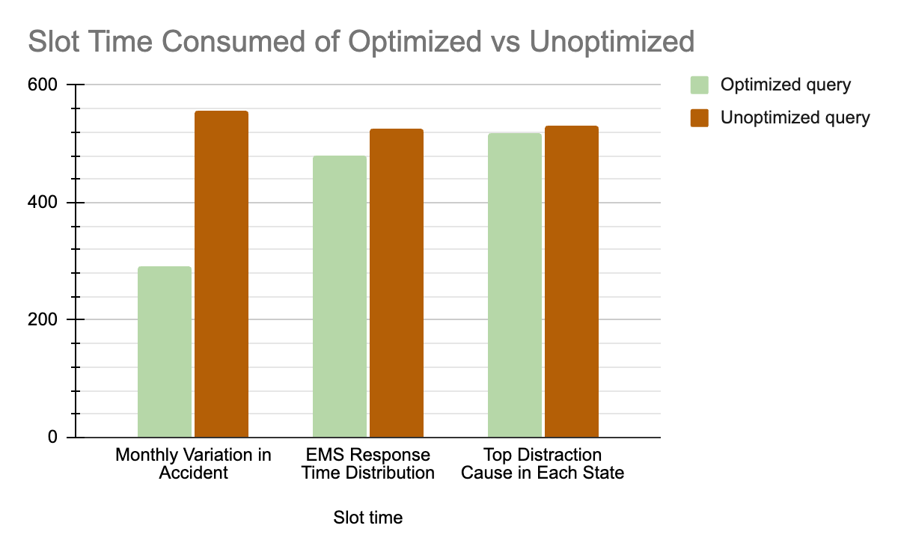
Optimized vs Unoptimized
We measured both the elapsed time and slot time for three queries, each executed in both optimized and unoptimized forms. While the optimized versions consistently showed improved performance, the reduction in execution time was relatively minor.

Slide 16
FatalCrash Explorer
https://lookerstudio.google.com/reporting/0e3ecd30-6e6b-4b6e-b7d5-486ac4a8ca74

Slide 17

Questions?

