Slide 1
🎓 CareerPath AI
Discover Your Career. Bridge Your Skill Gaps. Build Your Future.
AI-Powered Career Guidance & Personalized Skill Roadmap Platform for Indian Students
👑 Parth Patil
💻 Aditi Vispute
🎨 Asmita Lokhande
🗺️ Suyog Pawar
Lead & Backend
Frontend & Assessment
UI/UX & Career Universe
Roadmap & Presentation
🏆 Hack2Ignite 2026–27 | Team: 404 Brain Not Found | Problem: ED-02 — EduTech Track
🌐 careerpath-ai-jade.vercel.app

Slide 2
The Problem 🚨
Why 80% of Indian Engineering Graduates Miss Industry Benchmarks
❓ Career Blindness
📄 Resume Inflation
Students only know 3–4 'safe' paths.
High-growth domains like Cloud, AI & DevOps are invisible.
Skills are self-reported without proof.
No verification = no employer trust.
🗓️ No Roadmap
📊 TPO Blindspot
Generic advice leaves students without
a concrete week-by-week learning plan.
Placement cells use static spreadsheets.
Skill gaps discovered only after rejections.
💡 "Students don't lack tutorials — they lack direction, honest feedback & disciplined execution."

Slide 3
Our Solution — CareerPath AI ✅
From Career Confusion to Job-Ready Competency
🎯
60/25/15 Match Engine
🔴🟡🟢
Tri-Color Skill Gap
🗺️
Adaptive Roadmap
Deterministic math: 60% Skill Depth
25% Interest Overlap + 15% Academics
✅ Matched ⚡ Needs Upgrade ❌ Missing
Clear visual diagnosis for every career
4 / 8 / 12-week time-boxed plans
Curated open-source resources per task
💼
Live Job Telemetry
🤖
AI Career Mentor
📊
Progress Dashboard
Real Indian job vacancies + salaries
via Adzuna Developer API (live data)
Groq Llama 3.3 70B < 500ms
Google Gemini 2.0 Flash failover
3D Holographic Progress Orb
Task completion → atomic % update

Slide 4
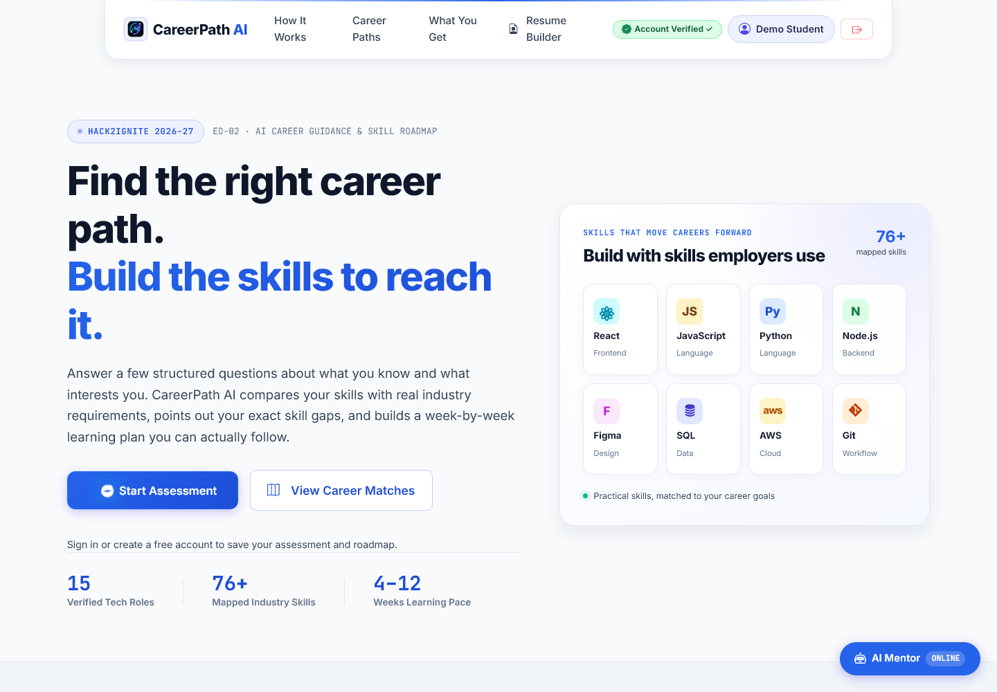
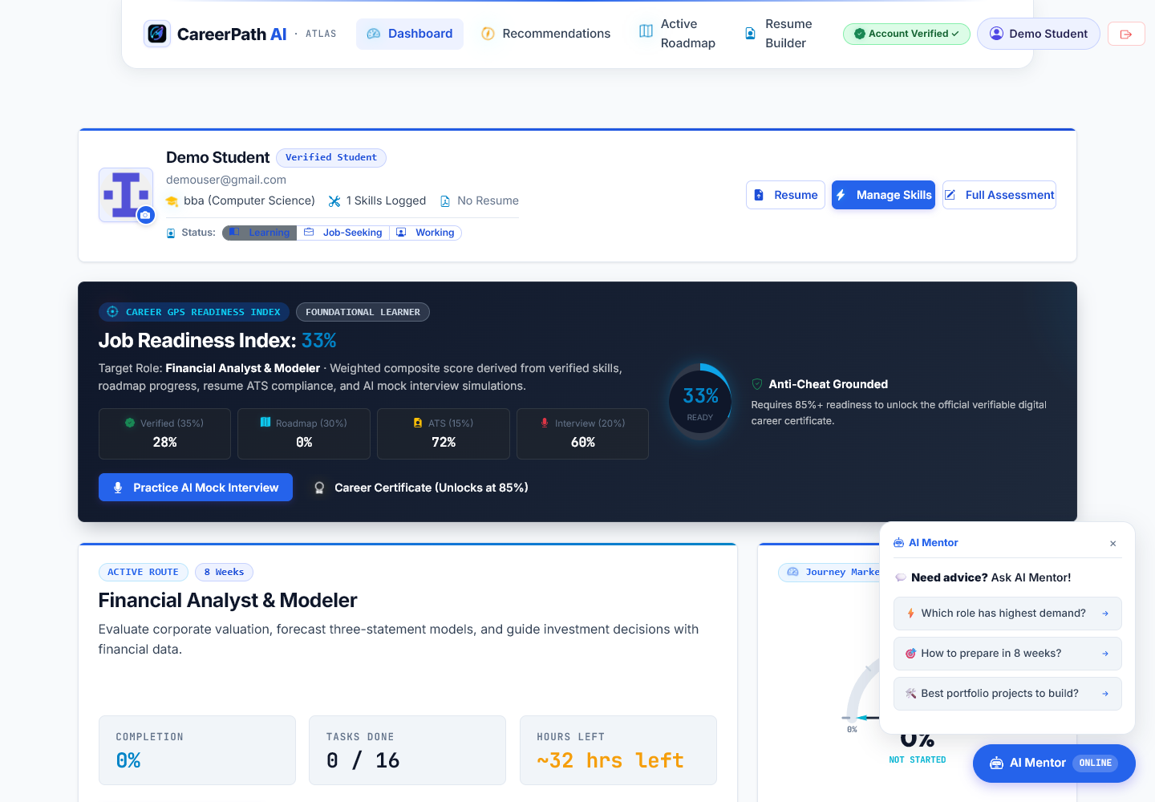
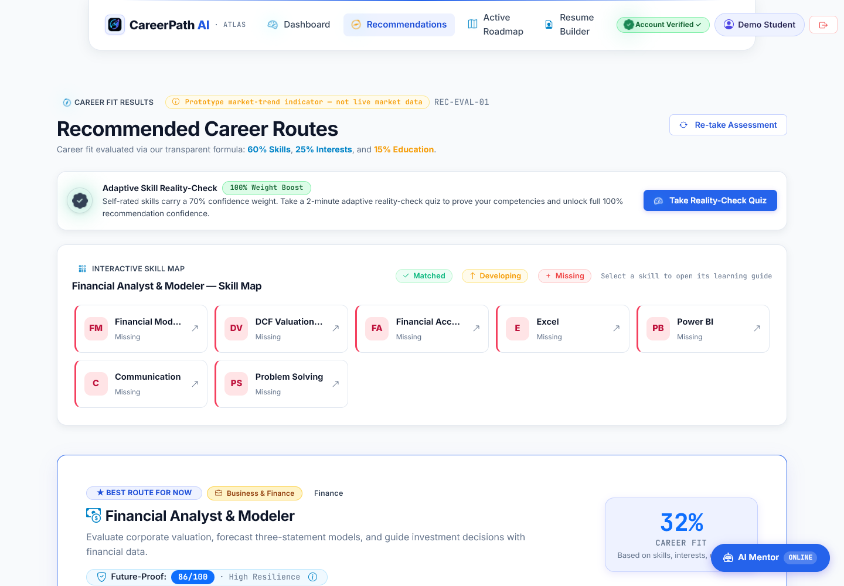
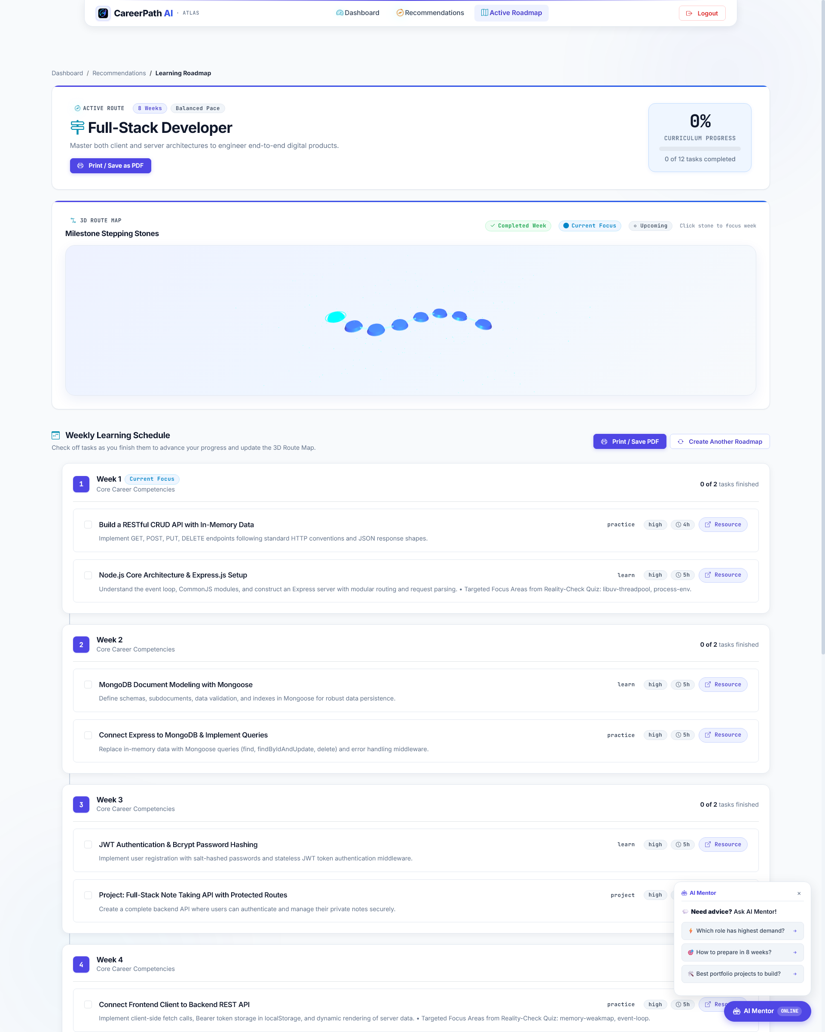
Live Platform Showcase 📸
Production-Deployed at careerpath-ai-jade.vercel.app
🌌 Landing Page & 3D Career Universe
📊 Student Dashboard & Progress Orb
🎯 AI Recommendations & Skill Gaps
🗺️ Personalized Learning Roadmap

Slide 5
3-Minute Demo Flow ⚡
Zero Friction — Evaluate the Full Platform in Under 3 Minutes
1️⃣ Register
2️⃣ Assessment
3️⃣ Recommendations
4️⃣ Live Jobs
5️⃣ Roadmap
6️⃣ AI Mentor
Enter any email & password
→ JWT token, instant access
Academics + Interests
+ 45+ Skills profiling
60/25/15 score
+ Tri-color skill gaps
Real Adzuna vacancies
+ Indian CTC ranges
8-week plan, task
toggle → live progress
Ask career questions
< 500ms Groq response
🌐 Try it live → careerpath-ai-jade.vercel.app

Slide 6
Tech Stack & Architecture 🛠️
Production-Ready, Sub-500ms Multi-Model Infrastructure
🌐 Frontend
Vanilla JS (ES6+) + Three.js 3D WebGL
CSS Grid/Flexbox — Hosted on Vercel CDN
⚡ Backend
Node.js + Express REST API
Rate Limiting + Helmet Security — Render Cloud
🗄️ Database
MongoDB Atlas Cloud Cluster
Mongoose ODM + JWT Stateless Auth
🤖 AI Layer
Groq Llama 3.3 70B (< 500ms) + Gemini 2.0 Flash Failover
860+ line Offline Question Fallback Bank
💼 APIs
Adzuna Developer API — Live Indian Jobs & Salaries
Cloudinary — Resume & Avatar File Storage

Slide 7
Why CareerPath AI Wins 🏆
Competitive Matrix vs Existing Solutions
Feature
Generic Quizzes
YouTube / Blogs
CareerPath AI ✅
Recommendation Basis
Black-box personality
Generic search query
60/25/15 Deterministic Math
Skill Verification
❌ Self-reported
❌ None
✅ GitHub + AI Quiz
Actionable Roadmap
❌ Ends at quiz
⚠️ Scattered videos
✅ 4/8/12-Week Plan
Progress Tracking
❌ None
❌ None
✅ Live % + Tasks
Live Market Salaries
❌ Static estimates
⚠️ Outdated posts
✅ Adzuna API Live
Student Cost
₹500–₹5,000/report
Free
100% Free Always 🎉

Slide 8
Business Model 💰
Sustainable B2B2C Talent & Telemetry Flywheel
🎓 Free for Students — Always.
🏫 College Placement SaaS
🏢 Recruiter Talent Pass
📜 Certification Referrals
₹1.5L – ₹3.5L / year
₹24,999 / month
15–25% Revenue Share
Annual TPO portal license:
Batch skill heatmaps + NAAC/NIRF reports
Direct access to pre-screened,
proof-of-work engineering candidates
Contextual, labeled sponsored
certification vouchers
High-volume student pipeline → institutional monetization → no student ever pays.

Slide 9
Future Roadmap 🚀
The Vision Beyond the Hackathon
Phase 1
MVP — Now ✅
Phase 2
Q4 2026
Phase 3
Q1–Q2 2027
✅ 60/25/15 Matching Engine
📄 AI Resume ATS Parser (OCR)
🎙️ AI Voice Mock Interviewer
✅ Tri-color Skill Gap Analysis
💻 In-Browser Code Sandbox
📱 WhatsApp Streak Bot
✅ Three.js 3D WebGL Universe
🔗 GitHub Commit Proof-of-Work
🏫 College TPO Admin Portal
✅ Live Adzuna Job Telemetry
🌐 Multilingual UI (Hindi/Marathi)
🏢 Corporate Hiring Gateway
✅ Groq + Gemini AI Mentor
👥 Peer Study Circles
📜 Verified Certifications
✅ Adaptive 4/8/12-wk Roadmap

Slide 10
Thank You! 🙏
CareerPath AI — The GPS for Engineering Careers in India
✅ Solves Problem ED-02 with explainable, market-grounded AI career guidance
✅ 100% Original — Built from scratch by Team 404 Brain Not Found
✅ Live & Production-tested on Vercel (frontend) + Render (backend) + MongoDB Atlas
✅ < 500ms AI inference | < 50ms recommendation engine | 60 FPS Three.js 3D
🌐 Try Now → careerpath-ai-jade.vercel.app
👑 Parth Patil
💻 Aditi Vispute
🎨 Asmita Lokhande
🗺️ Suyog Pawar
Lead & Backend
Frontend & Assessment
UI/UX & Career Universe
Roadmap & Presentation
We are now open for your questions! ❓

