Slide 1
Jawahar Education Society’s
A. C.Patil College of Engineering, Kharghar
Department of Artificial Intelligence & Data Science
Human Behaviour-Based Authentication System
Name of Students
05 Sudiksha Dumbre
26 Parth Patil
32 Vedant Rajmane
39 Vaishnavi Savekar
Guide : Dr. J.V.Terdale

Slide 2
Introduction
Human Behaviour Based Authentication is a modern security technique that verifies users based on their behavioural patterns.
It combines traditional authentication methods such as password, PIN and biometrics with behavioural biometrics.
Behavioural data such as typing speed, touchscreen gestures and login patterns are analysed.
This helps detect unauthorized users even if login credentials are stolen.

Slide 3
Motivation
Cyber attacks and account takeover incidents are increasing rapidly.
Passwords alone are not sufficient for secure authentication.
Users often reuse passwords which makes systems vulnerable.
Behavioural biometrics adds an additional invisible security layer.

Slide 4
Objective
To develop a behavioural biometric based authentication system.
To improve the security of online banking and financial applications.
To analyse typing speed and keystroke patterns.
To integrate OTP verification and location based security.

Slide 5
Literature Survey – Paper 1
Research Paper Name | Methodology/Architecture | Results
1.Keystroke | User enters credentials using | The study showed that
Dynamics for User | keyboard. | keystroke dynamics can
Authentication | System captures typing | effectively distinguish
 | behaviour such as keystroke | legitimate users from
 | timing, dwell time, and flight | attackers. It improved
 | time. | authentication accuracy
 | Behavioral features are | and provided an additional
 | extracted from typing patterns. | security layer without
 | Machine learning or statistical | requiring extra hardware.
 | models are used to create user
 | typing profiles.
 | Real-time typing patterns are
 | compared with stored patterns to
 | authenticate the user.

Slide 6
Literature Survey – Paper 2
Research Paper Name | Methodology/Architecture | Results
2.Touchscreen | The system captures touchscreen | The results
Gesture Based | gestures during user interaction. | demonstrated that
Authentication for | It records parameters such as | gesture-based
Smartphones | swipe direction, gesture speed, | authentication provides
 | movement path, and touch | reliable user
 | duration. | identification and
 | The collected gesture data is | improves smartphone
 | stored as a behavioural pattern for | security. It can detect
 | each user. | unauthorized users
 | Pattern matching algorithms are | even if they know the
 | used to compare current gestures | password.
 | with stored gesture profiles.
 | If gesture patterns match the
 | stored profile, the user is
 | authenticated.

Slide 7
Literature Survey – Paper 3
Research Paper Name | Methodology/Architecture | Results
3.Behavioral | The system collects user | The research concluded
Biometrics in | interaction behaviour such as | that behavioral biometrics
Mobile Devices | typing patterns, scrolling | significantly improves
 | behaviour, and touch gestures. | mobile security and
 | Behavioural data is | enables continuous
 | continuously monitored during | authentication without
 | device usage. | disturbing the user
 | The system builds a | experience.
 | behavioural profile for each user
 | using collected data.
 | Machine learning algorithms
 | analyze the behavioural features.
 | Continuous authentication
 | verifies the user during the
 | session.

Slide 8
Literature Survey – Paper 4
Research Paper Name | Methodology/Architecture | Results
4.Location-Based | The system captures the user’s | The results showed that
Authentication | geographic location using GPS | location-based
Systems | or network location services. | authentication helps detect
 | The login location is compared | suspicious login attempts
 | with previously recorded login | and fraud, especially in
 | locations. | banking and financial
 | If the login location is unusual, | applications.
 | the system marks the attempt as
 | suspicious.
 | Additional authentication
 | methods such as OTP or security
 | questions are triggered.
 | Location data is stored for
 | future login verification.

Slide 9
Literature Survey – Paper 5
Research Paper Name | Methodology/Architecture | Results
5.Multi-Factor Authentication in Banking Systems | The system uses multiple authentication factors such as password, biometric verification, and OTP. First, the user enters login credentials. The system verifies credentials with the stored database. An OTP is generated and sent to the registered mobile number. The user enters the OTP for final verification. | The study found that multi-factor authentication greatly reduces the risk of unauthorized access and identity theft in online banking systems.

Slide 10
Literature Survey – Paper 6
Research Paper Name | Methodology/Architecture | Results
6.Machine Learning Techniques for Behavioural Authentication | Behavioural data such as typing speed, gesture patterns, and login behaviour are collected. Feature extraction techniques identify important behavioural parameters. Machine learning algorithms are used to train a classification model. The model compares real-time behavioural data with trained data. The system classifies the user as legitimate or suspicious. | The results showed that machine learning improves the accuracy of behavioral authentication systems and helps detect abnormal user behavior effectively.

Slide 11
Summary of Literature Review
Behavioural biometrics is an effective security mechanism.
Typing behaviour and gesture patterns provide unique user signatures.
Location and OTP verification improve authentication reliability.
However, many systems use only one behavioural parameter.

Slide 12
Research Gap / Findings
Existing systems often use only passwords or biometrics.
Few systems combine multiple behavioural parameters.
Limited integration of typing behaviour, gestures, location and OTP.
There is a need for a unified behavioural authentication framework.

Slide 13
Research Objectives
To implement models for user verification.
To enhance user convenience and security.
Design a behavioural authentication framework.
Monitor typing speed and keystroke patterns.
Detect unusual login location.
Implement OTP verification when suspicious activity is detected.

Slide 14
Problem Statement
Unauthorized access to banking systems is a major concern.
Traditional authentication systems cannot always detect attackers.
If credentials are stolen, attackers may gain access.
A behavioural authentication system can help identify legitimate users.

Slide 15
Proposed System
The proposed system is an Human Behaviour Authentication System for secure applications such as banking.
It combines traditional login methods (username/password, PIN, or biometrics) with behavioral biometrics.
The system asks security questions and monitors typing behaviour and touchscreen gestures.
It also checks the login location if permission is granted.
OTP is sent to the registered mobile number for additional verification.
Based on behaviour analysis and verification, the system grants or denies access

Slide 16
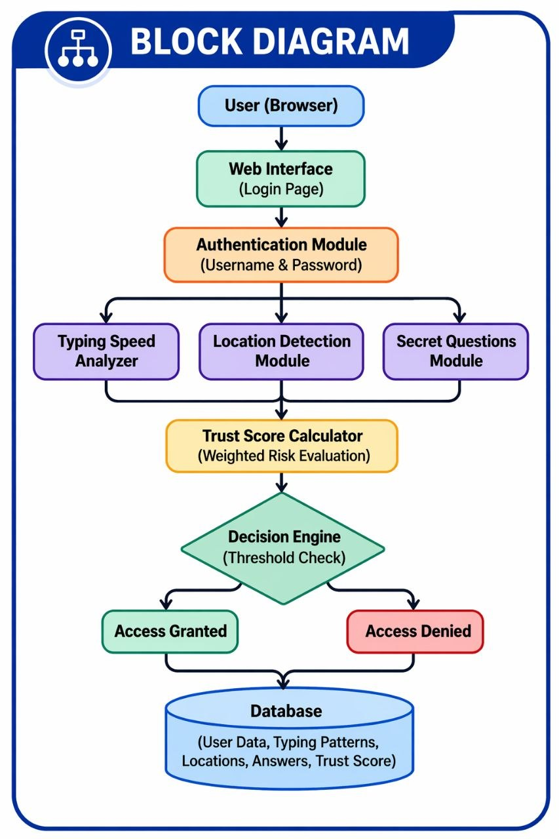
Block Diagram

Slide 17
Architecture
1. User
The person who wants to access the system Enters login details
2. Login (Email + Password)
User provides credentials
System checks : Whether user exists and Whether password is correct
3. Behavior Capture
System records user activity: Typing speed , Key hold time , Mouse movement ,Clicks and Location (latitude, longitude)
4. Backend Processing (Flask)
Receives data from frontend
Performs : Password verification , Behavior comparison and Algorithm execution

Slide 18
Architecture
5. Database (User + Behavior Data)
Stores:User credentials and Behavioral patterns
Used to:Fetch stored data during login and Compare with current behavior
6. Trust Score Calculation
Calculates score using:
Typing data and Mouse data
Uses Weighted Trust Score Algorithm
7. Decision (Threshold)
Compares trust score with limits:
≥ 75 → Login success
50–74 → Security question / OTP
< 50 → Access denied

Slide 19
System Design
User Interface Layer
Application Layer – Behaviour Analysis Engine
Security Layer – OTP and Multi-factor Authentication
Data Layer – Database storing behavioural profiles
Integration Layer – APIs for SMS and location services

Slide 20
Algorithm
Keystroke dynamics : used to enhance security by analyzing the user's typing behavior. It helps identify genuine users, detect abnormal activity, and prevent unauthorized access even if the password is compromised.
Weighted Trust Score Algorithm : It is a decision-making algorithm that calculates a final score by combining multiple factors with different importance (weights).
Trust=(Typing×0.3)+(Gap×0.2)+(Hold×0.2)+(Mouse×0.3)

Slide 21

Algorithm
Euclidean Distance Algorithm :It is a mathematical algorithm used to calculate the distance between two points in 2D space.
Anomaly Detection Algorithm :An Anomaly Detection Algorithm is used to identify unusual or abnormal behavior by comparing current data with normal (stored) data.

Slide 22
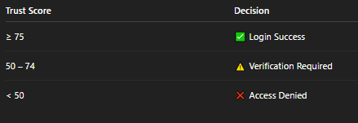
Algorithm
Aggregation Algorithm:An Aggregation Algorithm is used to combine multiple values into a single result, such as sum, average, count, etc.
Example (Typing gap average)
keyTimes.reduce((a,b)=>a+b) /keyTimes.length
Example (Hold time average)
holdTimes.reduce((a,b)=>a+b) / holdTimes.length
Threshold-Based Decision Algorithm : It is a rule-based algorithm that makes decisions by comparing a value with predefined limits (thresholds).

Slide 23
Database / Data Requirements
User account details.
Encrypted passwords or PIN.
Security question answers.
Typing behaviour data.
Touch gesture patterns.
Login location history.
OTP verification records.

Slide 24
Technologies Used
JavaScript is used for client-side logic and capturing user behavior (typing, mouse movement)
Python is used as the backend programming language
Flask framework is used to build the web application and handle routes/APIs
SQLite is used as the database to store user data and behavioral data
Geolocation API is used to capture the user’s location
JavaScript event listeners (keydown, keyup,) are used to track user activity
SMTP (Simple Mail Transfer Protocol) is used to send OTP to user
Bcrypt is a password hashing algorithm used to securely store passwords.

Slide 25
Working of the Project
User registers and system records behavioural baseline.
During login credentials are verified.
Typing speed and gesture patterns are analysed.
Location information is checked.
OTP is sent if any suspicious activity is detected during login.
If behaviour matches stored profile access is granted.

Slide 26
Conclusion
Behavioural authentication improves security.
It provides an additional invisible layer of protection.
The system can detect suspicious login attempts.
It is highly useful for banking and financial applications.
Future systems can integrate AI based behaviour prediction.

Slide 27
References
F. Monrose and A. D. Rubin, “Keystroke dynamics as a biometric for authentication,” Future Generation Computer Systems, vol. 16, no. 4, pp. 351–359, 2000.
A. H. M. A. Hossain and P. K. Atrey, “Location-based authentication: Techniques and challenges,” IEEE Internet Computing, vol. 19, no. 1, pp. 46–53, Jan.–Feb. 2015.
M. Frank, R. Biedert, E. Ma, I. Martinovic, and D. Song, “Touchalytics: On the applicability of touchscreen input as a behavioral biometric for continuous authentication,” IEEE Transactions on Information Forensics and Security, vol. 8, no. 1, pp. 136–148, Jan. 2013

Slide 28
References
S. Patel, J. M. H. Elmirghani, “Active authentication using behavioral biometrics,” IEEE Communications Magazine, vol. 53, no. 6, pp. 170–176, June 2015.
A. Morales, J. Fierrez, R. Vera-Rodriguez, and R. Tolosana, “Keystroke dynamics recognition based on deep learning,” IEEE Access, vol. 6, pp. 15668–15677, 2018.
C. C. Aggarwal, “Outlier analysis for anomaly detection in user behavior,” ACM Computing Surveys, vol. 50, no. 3, pp. 1–36, 2017.

Slide 29
1
Thank you

