Slide 1
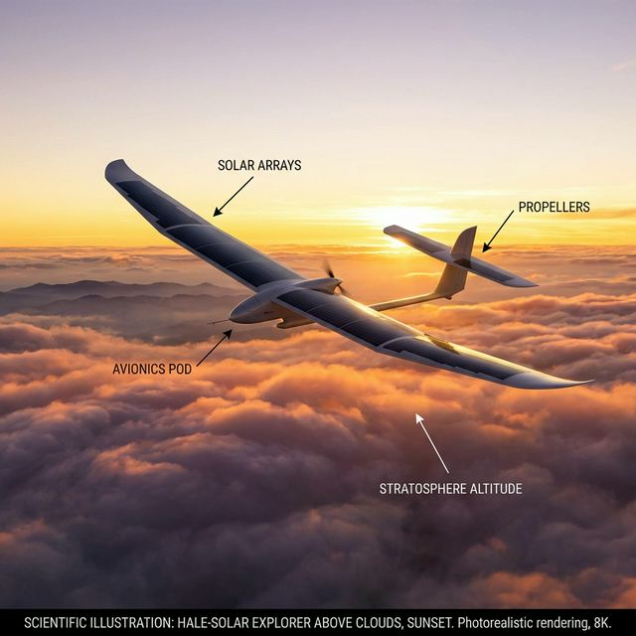
HIGH ALTITUDE LONG ENDURANCE (HALE) UNMANNED AERIAL VEHICLES
Sustained Flight Through Renewable Energy
Parth Patil (22BTRAS031)
Advisor: Dr Amalesh Barai
Department of Aerospace Engineering, JAIN (Deemed-to-be University)
2025-2026

Slide 2
Presentation Agenda
1
Project Motivation & Aims
2
Literature Review — Existing HALE UAVs
3
Design Requirements & Constraints
4
Conceptual Design Overview
5
Aerodynamic, Propulsion & Structural Design
6
Performance Analysis & Results
7
Stability, Trade-offs & Validation
8
Conclusions & Future Work

Slide 3
Project Motivation & Aims
Why HALE UAV? [1][2]
Project Aim [1-4]
• Bridge gap between conventional aircraft and satellites
• Operate at altitudes above 18 km for days/weeks
• Enable persistent surveillance & communication relay
• Reduce reliance on expensive satellite infrastructure
Conceive, analyse, and assess a theoretically sound solar-powered HALE UAV achieving multi-week endurance with payload versatility and operational reliability.
Target: Continuous flight above 18 km for minimum 24 hours, with ambition for several days [1][2]

Slide 4
Project Objectives
Primary
Develop comprehensive conceptual design satisfying mission endurance, payload, and safety requirements [1-4]
Literature Survey
Review existing solar UAVs: aerodynamic configs, materials, energy storage [1-4][39-44]
Design Limitations
Assess energy-storage limits, low-Re aerodynamics, structural/fatigue constraints [8-15]
Performance Evaluation
Predict endurance, energy budgets, and mission reliability via simulation [5-7]
Design Improvements
Recommend modifications: propulsion optimisation, aeroelastic analysis [42][44]
Energy Integration
Quantify renewable energy impact on endurance and reliability [39][43][45]

Slide 5
Literature Review — Key Existing HALE UAVs
Platform | Mass (kg) | Wingspan (m) | AR | Endurance | Ref
Zephyr S | 53 | 25 | 24 | 25+ days | [3][4]
Helios | 730 | 75 | 30 | 14+ hours | [3][4]
EAV-3 (KARI) | 53 | 19.5 | 17.4 | Stratospheric test | [40]
AtlantikSolar | 6.9 | — | — | 81 hours | [39]
Present Design | ~114* | 32 | ~30 | Target: 24+ hours | —
*Structural estimate derived from energy feasibility analysis. Not MTOW.
Key Insights [1-3][14][39]:
• High-aspect-ratio monoplane configurations dominate (AR 17.4 to 30+)
• Triple-junction GaAs cells achieve 25–30% efficiency — practical upper bound

Slide 6
Design Requirements & Constraints
Mission Requirements [1][2]
Technical Constraints [6-29]
• Altitude: 18–22 km (stratospheric)
• Endurance: Minimum 24 hours (target: multi-day)
• Cruise speed: ~80 km/h
• Payload: 5-10 kg for instruments & comms
• Low Reynolds number flows (10⁵–10⁶)
• Structural stiffness for flutter avoidance
• Energy storage for night-time operation
• Environmental: cloud, wind shear, temperature
25-30
>18 km
>24 hrs
Lift-to-Drag Ratio
Service Ceiling
Endurance

Slide 7
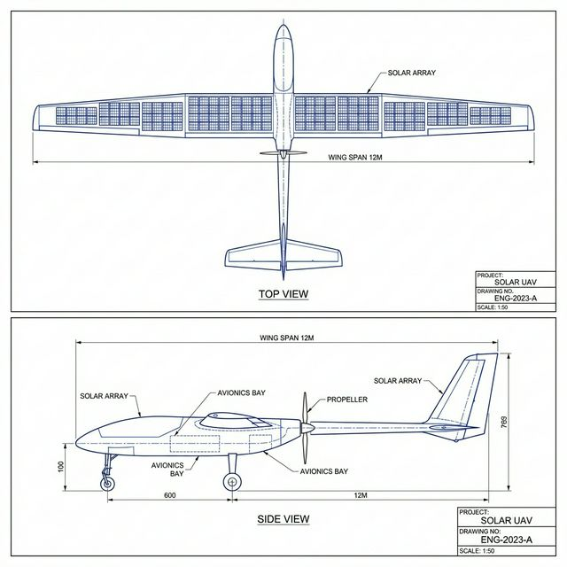
Conceptual Design Overview
Top-Level Design Approach [1-4]
Configuration Choice [1][18-20]
• High-aspect-ratio monoplane configuration
• Solar cells on wing & fuselage surfaces
• Hybrid energy: solar + batteries + fuel cell
• CFRP composite ultra-lightweight structure
• Distributed propulsion system
Selected Design Parameters
Monoplane with high aspect ratio selected over biplane, BWB, and joined-wing based on manufacturing simplicity and proven technology readiness.
Wingspan: 32 m
Aspect Ratio: ~30
Structure Est: ~114 kg
Payload: 5-10 kg

Slide 8
Aerodynamic Design
Wing Geometry [6][7][40]
Key Considerations [5-7]
• Wingspan: 32 m
• Aspect Ratio: ~30
• Low-Reynolds-number airfoil selection
• High-lift, low-drag optimization
• Low Re flows (10⁵–10⁶): viscous effects
• Target L/D: 25-30
• Minimise induced drag with high AR
• CFD + analytical methods for validation
Configuration Comparison [1][18-20]
Configuration | Pros | Cons
Monoplane | Simple, proven | Tip deflection
Biplane | High payload | Interference drag
BWB | Higher L/D | Complexity
Joined-wing | Span eff 1.4-1.5 | Struct. complexity
30
Aspect Ratio [40]

Slide 9
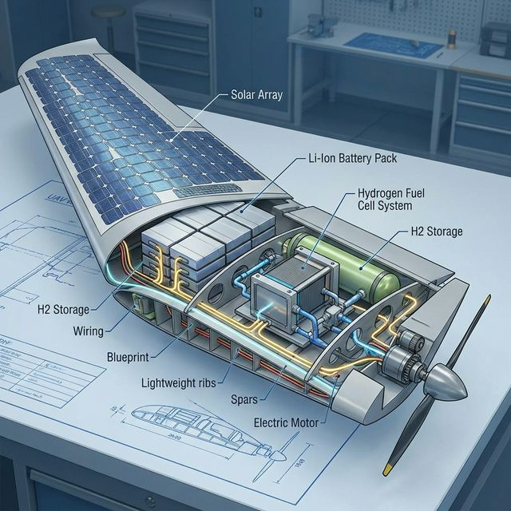
Propulsion & Energy Architecture
Hybrid Energy Architecture [10][14]
Solar (Day)
~9 kW
Triple-junction GaAs
25-30% efficiency
Storage (Night)
~24 kWh
Li-Ion + Fuel Cell
Cruise Power
~2 kW
Reasoning for Hydrogen Fuel Cell [10][39]:
Electrical demand
• Night requirement (~24 kWh) requires ~95kg of batteries.
• H2 System: ~1.44kg H2 + Tank + BOP ≈ 4.3kg.
• Massive weight saving enables multi-day endurance.

Slide 10
Structural Design
Material Selection: CFRP Composites [8][9]
Structural Analysis [5][22][44]
• Carbon-fibre reinforced polymers (T-800/T-300)
• High stiffness-to-weight ratio (5x Al)
• Anisotropic tailoring for load paths (bending/torsion)
• ANSYS Workbench for FEA (large-displacement)
• Static deflection: tip deflection 10-15% of semi-span
• Aeroelastic coupling analysis (Murua et al.)
Weight Breakdown (Component Level) [40]
Component | Mass (kg) | Notes
Airframe | ~22 | CFRP primary structure
Solar panels | ~15 | GaAs arrays
Energy storage | ~5 | Fuel cell system
Avionics/Payld | ~10-15 | Combined
Total (MTOW) | ~62 | Estim. w/ Payload

Slide 11
Performance Analysis
>24 hrs
18-22 km
25-30
~80 km/h
Endurance
Altitude
L/D Ratio
Cruise Speed
Key Analysis Results [10][15][42]
• Cruise power: ~2 kW electrical
• Solar power available: ~9 kW (stratospheric irradiance 1360 W/m²)
• Night-time energy storage: ~23.9 kWh for 12-hr dark period
• Altitude power penalty: ~3.5% per km
• Propulsion optimisation potential: 19% efficiency improvement

Slide 12
Stability & Control
Stability Analysis [12][13][40]
Control Surfaces [27]
• Longitudinal & directional stability
• Static margin: min 5% MAC (EAV-3 ref: 28.4%)
• CG remains stable (no fuel burn shift)
• Conventional tail (elevator, rudder)
• Ailerons for roll control
• Larger deflections required at low air density
• Redundant actuator architecture
Flutter Analysis [22][44]
High-aspect-ratio flexible wings introduce aeroelastic coupling. Conventional doublet-lattice methods insufficient. Used Murua et al. methodology: geometrically exact beam FE + Unsteady Vortex Lattice Method (UVLM) for accurate flutter boundary prediction.

Slide 13
Design Trade-offs & Decisions
Decision | Trade-off | Resolution
Aspect Ratio 30 | Mfg vs performance | Practical compromise
Fuel cell > Battery | Complexity vs mass | 95kg vs 4.3kg
Monoplane config | Simplicity | Proven technology
GaAs cells | Cost vs Efficiency | Optimum power
Critical Trade-off: Battery vs Fuel Cell [10][39]
Night-time storage of ~23.9 kWh makes pure lithium-ion solution infeasible:
• Battery mass: ~95.7 kg
• Hydrogen system: ~4.3 kg total
→ Fuel cell selected for multi-day endurance

Slide 14
Results Summary
Parameter | Value | Status
Wingspan | 32 m | Target met
Aspect Ratio | ~30 | Within range [40]
MTOW (Comp.) | ~57-62 kg | Estimated
Endurance | >24 hrs | Achievable [39]
Altitude | 18-22 km | Stratospheric
L/D Ratio | 25-30 | Target met [40]
Night Storage | ~23.9 kWh | Fuel Cell Used [10]
Fuel Cell Mass | ~4.3 kg | vs 95kg Battery
Note: ~114 kg energy feasibility mass includes margin for battery trade-study. Component build-up (~62kg) reflects operational weight.

Slide 15
Validation & Limitations
Validated Conceptually (Green)
Limitations (Red)
✓ Energy balance closure verified [39]
✓ Power realistic (~2 kW) [10]
✓ Solar power adequate (~9 kW) [14]
✓ Fuel cell mass savings confirmed [10]
✓ L/D targets achievable [40]
⚠ No wind tunnel/flight testing
⚠ No high-fidelity CFD validation [5]
⚠ Aeroelastic effects conceptual [44]
⚠ PV integration losses est. [43]
⚠ Mass budget reconciliation required
This is a CONCEPTUAL DESIGN study. Detailed computational modelling, prototype fabrication, and experimental flight testing are recommended for full validation.

Slide 16
Conclusions
Objectives Achieved
✓ Comprehensive conceptual design developed
✓ Literature review expanded
✓ Energy system feasibility confirmed (Fuel Cell)
✓ Design parameters aligned with benchmarks
✓ Trade-offs analyzed
Key Findings
• Solar-powered HALE UAV technical feasibility confirmed for multi-day endurance
• Hybrid energy storage essential for night operations
• Propulsion optimisation reduces power demand significantly
• High-AR wings require advanced aeroelastic analysis

Slide 17
Future Work & Recommendations
Near-Term (Research)
Long-Term (Development)
• Detailed CFD and wind tunnel validation
• Composite wing segment testing [44]
• Energy mgmt algorithm [39]
• Scaled demonstrator fabrication
• Flight testing
• Mission system integration
Emerging Technologies [45]
• Morphing wings
• Solid-state batteries
• Ultra-light flexible solar arrays
• Supercapacitor hybrid storage

Slide 18
Key References
[1] Goraj et al. (1999). Design concept of a HALE UAV. Aircraft Design
[2] Goraj, Z. (2004). HALE UAV of a new generation.
[3] Romeo et al. (2004). HELIPLAT: Design & analysis.
[10] Boukoberine et al. (2019). Energy storage for UAVs.
[39] Oettershagen et al. (2017). AtlantikSolar UAV.
[40] Hwang et al. (2016). KARI EAV-3 aerodynamic design.
[42] Dantsker et al. (2020). Propulsion optimisation.
[43] Lopusiewicz & Ksiazek (2024). PV integration.
[44] Murua et al. (2011). Stability of very flexible aircraft.
[45] Liller et al. (2025). Battery-free solar UAV.

Slide 19
Questions & Discussion
Thank You
Parth Patil | 22BTRAS031
Dr Amalesh Barai (Advisor)

