Slide 1


Virtual Tech Culture Developed By: Milan Sarvaiya (16BCA088) Parth Soni (16BCA096)
Talpada Vinod (16BCA113) Under Guidance of Internal Guide Dr. Hetal Patel
Smt. Chandaben MohanBhai Patel Institute of Computer Applications CHARUSAT Changa

Slide 2
Sr. No |  | Subject | Page Number
1 |  | Project Profile | 4-5
2 |  | System Study
 | 1 | Existing System | 7
 | 2 | Proposed System | 7
 | 3 | Scope of the Proposed System | 8
 | 4 | Aim and Objective of the Proposed System | 9
3 |  | System Analysis
 |  | Requirements Specification (along with System Modules)
 |  | Use Case Diagram | 11-12
 |  | Activity Diagram | 13
 |  | Class Diagram | 14
4 |  | System Design
 |  | Data Dictionary | 16-18
 |  | Screen Layouts | 19-27
5 |  | Future Enhancement | 28
6 |  | Bibliography | 29

Slide 3
Virtual Tech Culture

Slide 4
Academy Duration :- 6 Months
Developed by :- Parth Soni
Talpada Vinod
Milan Sarvaiya
Team size :- 3
Internal Guide :- Dr. Hetal Patel
Front End :- HTML, CSS, JavaScript
Back End :- MYSQLI
Tool used :- Notepad++

Slide 5
Project Definition
1
It is educational e-learning website for students, where they can refer download various materials and can give quiz. This provide a good source of knowledge to students who are engaged in IT.

Slide 6
System Study

Slide 7
Existing System
Existing systems provides limited option for students. Today’s systems are lacking in interactive designs due to which a smaller number of students are attracted towards such e-learning websites. Secondly, sources by which contents are delivered are limited and mostly descriptive, so student finds it boring and learn little or nothing from it. Websites are not responsive enough to students and also, they are lacking in user friendly Interface.
Proposed System
Propose system is totally web based system. Our website is offering e-courses which are free. We are also providing new and advanced features like e-books and audio books Proving a quality n trending content. Admin can view all registered student information and details as well as their valuable feedback in admin panel.

Slide 8
Scope of the Proposed System:
It is for students who are interested to gain knowledge in IT, as well as who are techno freak.

Slide 9
Aims and Objective of the Proposed System
To educate students digitally who wants to imbibe some extra knowledge apart from books along with doubt solving.
To enable students to acquire a body of knowledge in a specific discipline.
To improve a student`s level of confidence and self-esteem through the accomplishment of long-term academic goals.
To provide students with the most comprehensive and current information available in their field of study.
To develop a self-learning attitude in students.

Slide 10
System Analysis

Slide 11
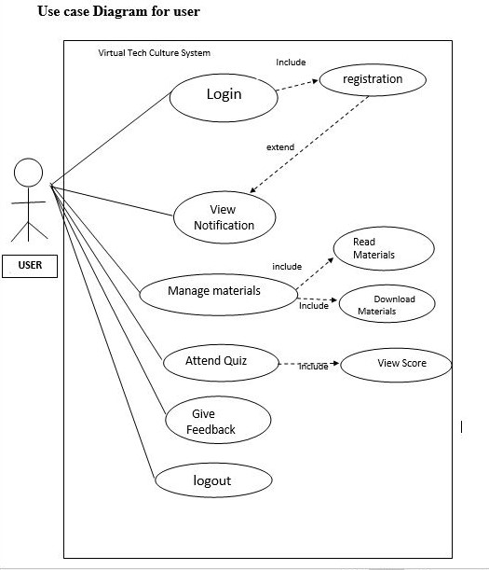

Slide 12
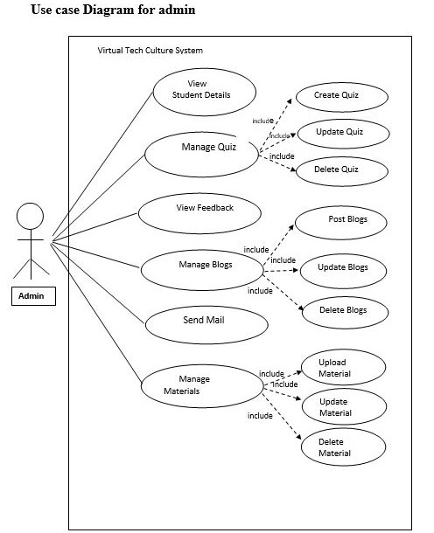

Slide 13
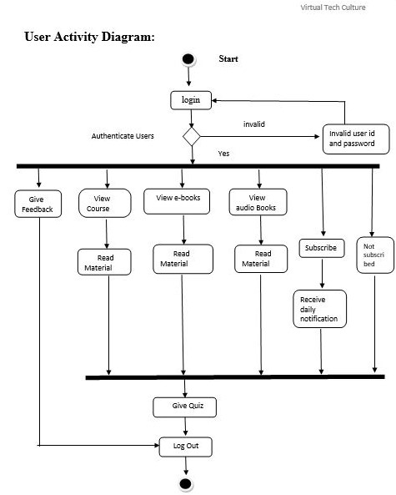

Slide 14
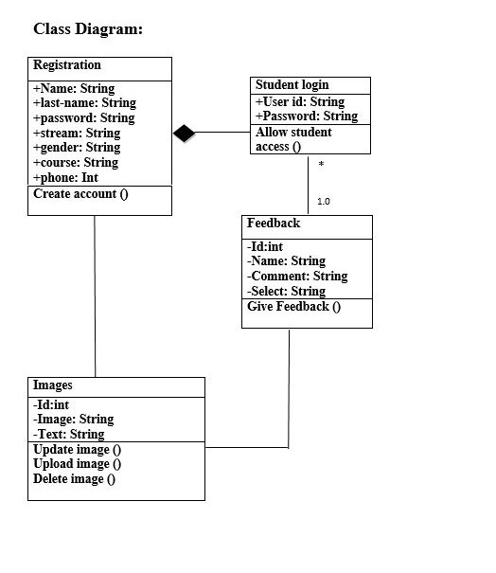

Slide 15
System Design

Slide 16
registration
Column name | Datatype | Size | Constraint | Description
Id | int | 4 | Primary key | Id of students
Name | varchar | 10 | Not null | First name
Last name | varchar | 10 | not null | Last name
Email | varchar | 25 | not null | Student email
Password | varchar | 20 | not null | Student password
Current stream | varchar | 6 | not null | Enter stream
Subscribe | varchar | 3 | Not null | Our letter
Gender | char | 6 | Not null | Gender
Phone | int | 10 | Not null | phone

Slide 17
image
Column name | Datatype | Size | Constraint | Description
Id | int | 2 | Primary key | image ID
Image | varchar | 50 | not null | Name of image
Text | text | 20 | not null | title

Slide 18
feedback
Column name | Datatype | Size | Constraint | Description
Id | int | 4 | Foreign Key | feedback
Name | varchar | 10 | not null | Student name
Comment | varchar | 100 | not null | Student comment
select | varchar | 9 | Not null | review

Slide 19
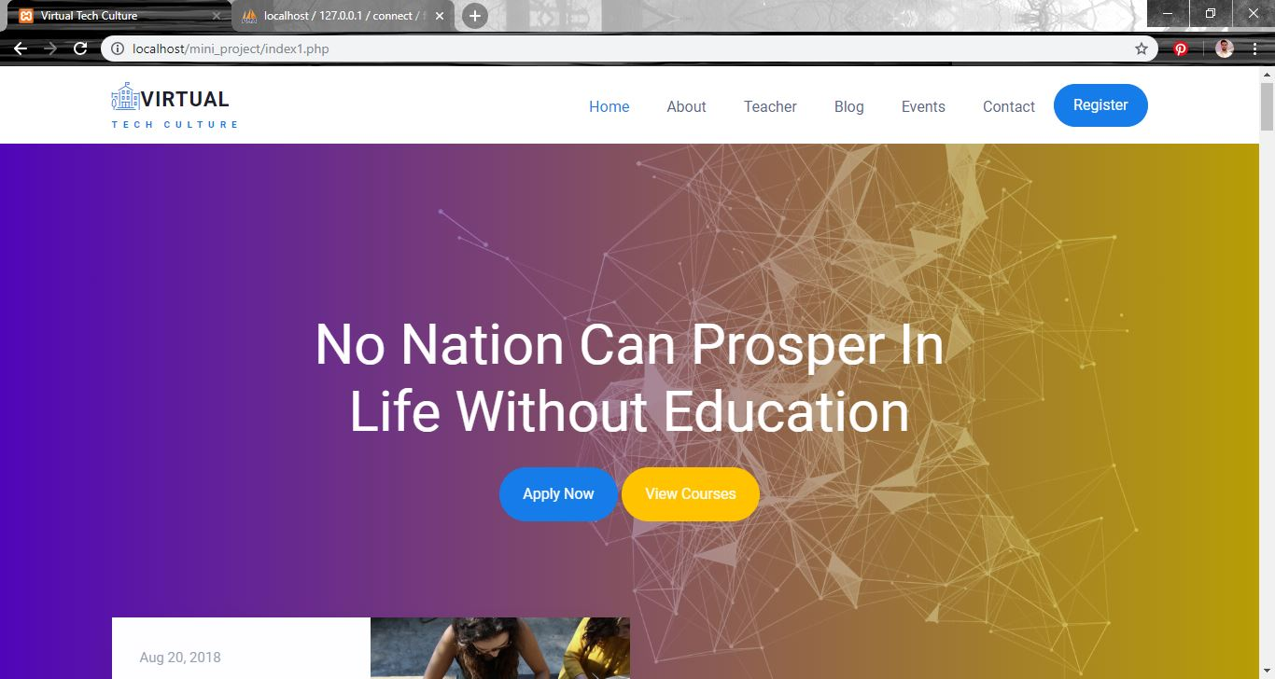
Screen Layouts home page

Slide 20
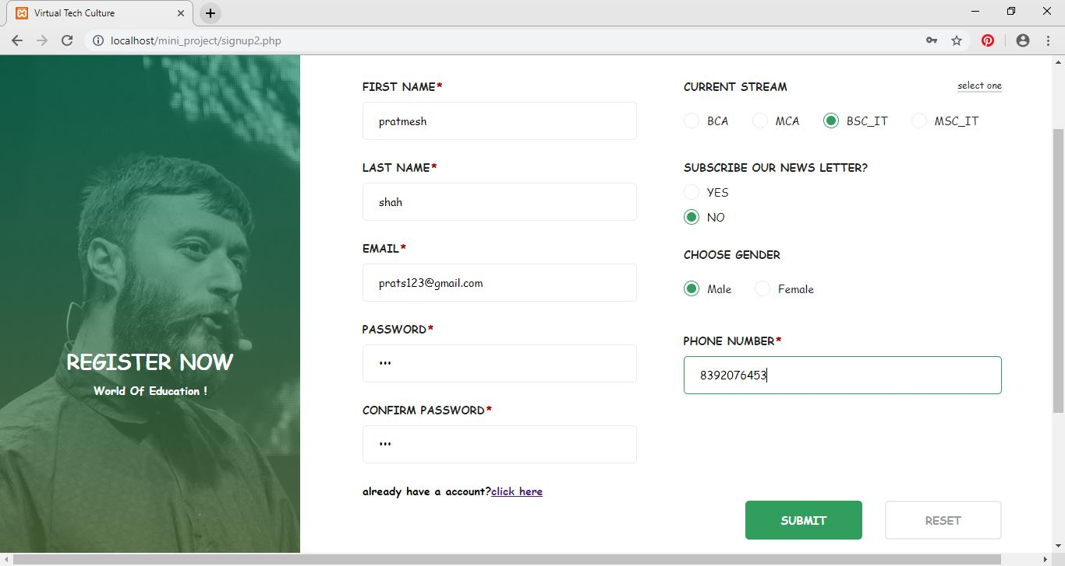
Registration

Slide 21
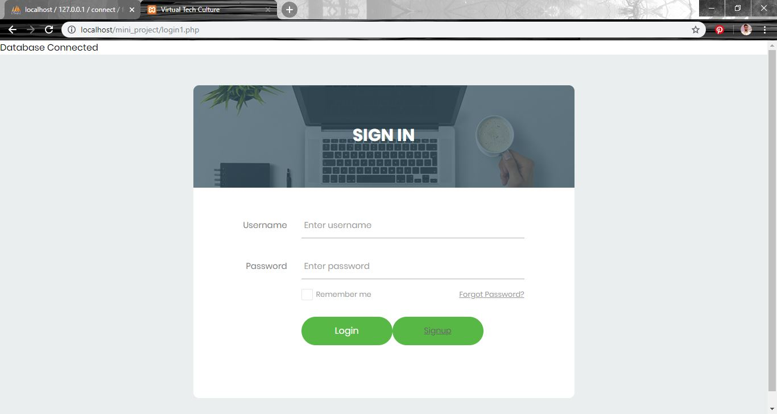
Login

Slide 22
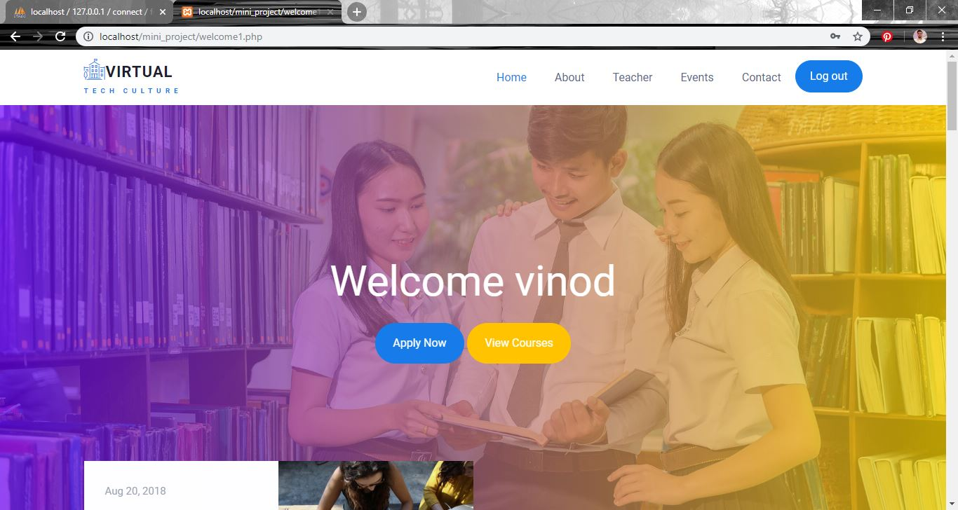
Welcome

Slide 23
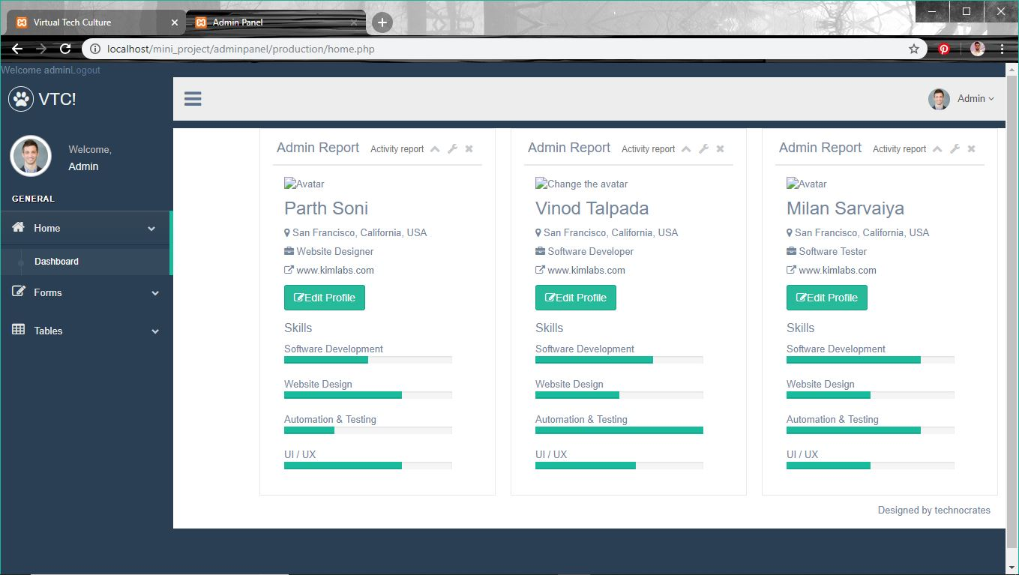
Home page for admin

Slide 24
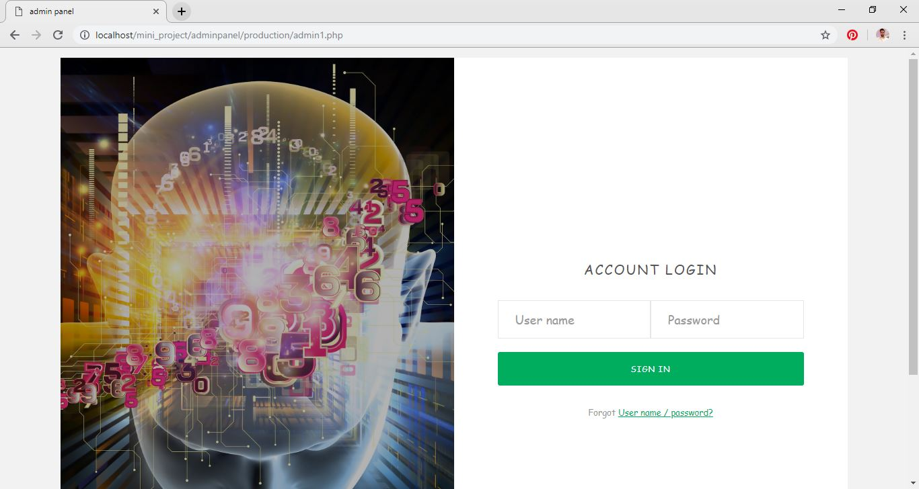
Login page for admin

Slide 25
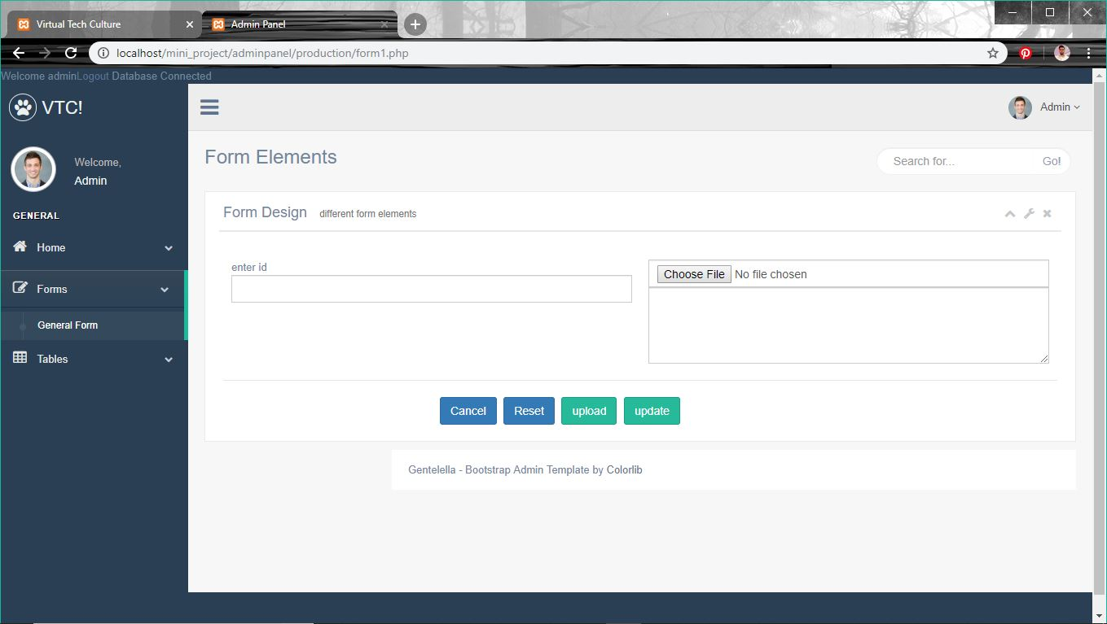
Form layout for admin

Slide 26
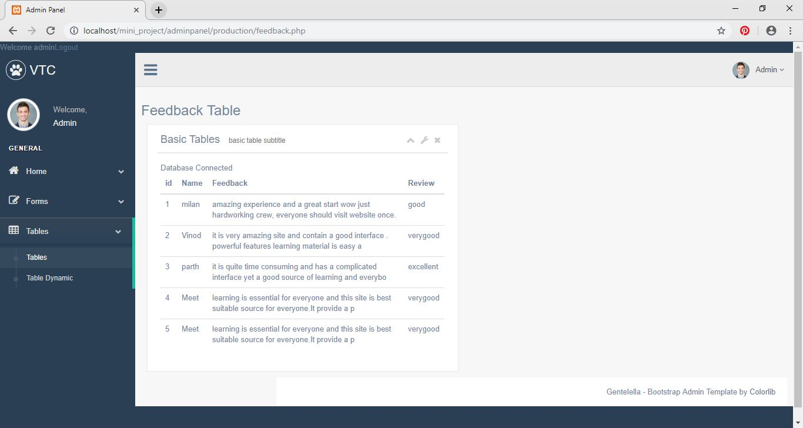
Feedback table

Slide 27
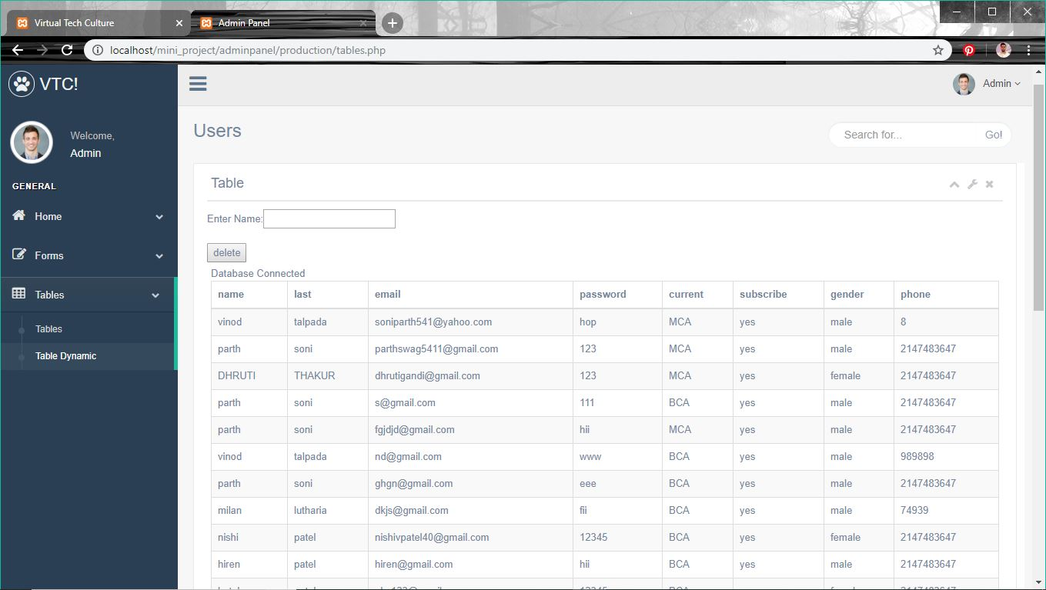
Student registration Table

Slide 28
Future Enhancements:
1. Chatting option can be added in which user can chat with experts and can solve their doubts.
2. In future we can also develop android application for online learning website.
3. We can also add actor like tutor who take live sessions and give assignments to students.

Slide 29
Bibliography:
www.w3schools.com
www.sourcecodester.com
www.colorlib.com

Slide 30
Thanks!
Any questions?
You can find us at:
talpadavinod1@gmail.com

