Slide 1
Disclose, Disclose,Disclose
Marcie Roggow,
ABR/M, CCIM, CRB, CRS, DREI, GRI, SRS

Slide 2

What’s your Biggest Concern?

Slide 3
Disclosure Turns Deadly!!
“Disclosure has backfired on the real
estate industry…the disclosure form has
given attorneys a lot of creative ideas.
It’s like a checklist of ways you can
craft a lawsuit against somebody with
deep pockets.”
Agency Law Quarterly, Fall 1994

Slide 4

Broker’s Duty to Disclose
Broker’s are held accountable for what they know or should have known!
Fox/Lazlo -off site
Code of Ethics
License Law/Rules and Regulations

Slide 5
Illegal Practices Under 93A
Here’s the scary one to start!
Fraudulent or willful intent need not be proven for claim to be considered illegal!
Making incorrect statements
Failing to disclosure relevant information
Puffing is ‘now’ illegal-but does distinguish between opinion and fact
Oppressive or otherwise unconscionable act or statement
Fraud or misrepresentation such as misstatement of facts in negotiations that lead to a contract
Broker is vicariously liable for seller’s misstatements if they didn’t check them out and then repeated them

Slide 6
Continued…
Making a false claim about a property’s construction, durability safety or strength or how it can be repaired or maintained
Making false claims regarding financing terms/availability
Bait and Switch in advertising
Offering guarantees without disclosing the nature and extent of the guarantee
Advertising misstatements even if later corrected
Representations concerning any real or personal property that directly or by omission, serves to deceive a buyer in any material respect
Even though the true facts are subsequently made know to the buyer, the law is violated if the first contact or interview is secured by deception

Slide 7

Company Risk Management Plan
Office Policy and Procedures Manual is a MUST!!
Have a GREAT attorney.
Develop your own risk management forms that apply to your state laws.
Risk
Management
Forms
Risk
Management
Forms

Slide 8
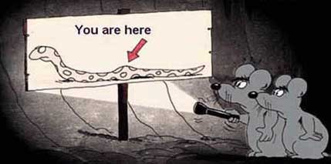
What do those forms do?
Provide a Roadmap for Disclosure

Slide 9

Who Are YOU to ME?

Slide 10

Penalties of Breach of Statutory Duties
Forfeiture of commission
Actual damages
Punitive damages
Loss of License
Ethics violation
Recision of contract

Slide 11
Contracts Termination By:
Mutual agreement
Cancellation/revocation
Fulfillment of the contract
Lapse of time/expiration
Death or insanity of either party

Slide 12

Unauthorized Practice of Law
Realtors practicing law
Writing addendum's
Drawing escrow agreements
Giving advice
Making decisions
Recommending they not need an attorney

Slide 13
Legal Liability
Vicarious
Subagency issue
Communicable
Seller used to be responsible for the actions of all agents
Limited
Limited by authority
Can be limited to actions of only the seller, buyer or brokerage company

Slide 14
Signing of Agreements
xxx

Slide 15
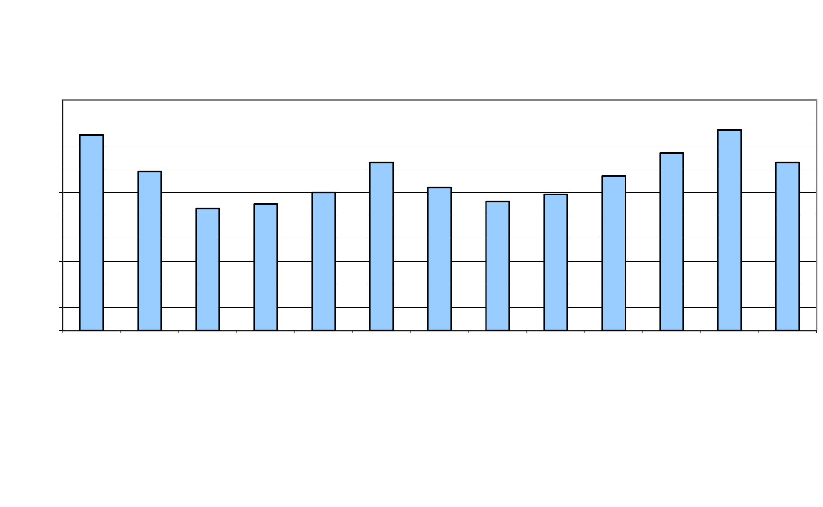
Training is the Key

Slide 16
Disclose, Disclose, Disclose
Thanks for coming!

