Slide 1
Understanding Procuring Cause
Marcie Roggow,
ABR/M, CCIM, CRB, CRS, DREI, GRI, SRS

Slide 2
Today’s Questions
How has procuring cause changed?
What is procuring cause and why does anyone care about it?
How do disputes arise?
How does the Code of Ethics affect procuring cause issues?
How has Buyer Representation affected procuring cause issues?

Slide 3
Today’s Questions, continued:
How does the Hearing Panel determine who was the procuring cause when there is a dispute?
Are there Case Studies that can help us understand how cases are decided?
What risk management techniques can be implemented to avoid procuring cause situations?

Slide 4

REALTOR’S involvement with
Customers
Clients
Co-brokers
Grievance and Pro Standards Members/Arbitration Panel

Slide 5
How has the industry changed to affect procuring cause issues?
Since 1976 NAR has studied on 5 different occasions procuring solutions!

Slide 6
Procuring Cause:
The proximate cause:
Originating a series of events
Without a break in continuity
Results in the accomplishment of the sale
The inducing cause: Direct or proximate cause
A broker will be regarded as the “procuring cause of the sale” if his efforts are the foundation on which negotiations resulting in a sale are begun.

Slide 7
Who/What “caused” the
Successful Transaction?
“successful transaction” is defined as “a sale that closes or a lease that is executed”

Slide 8

There is not “1” Determination of Procuring Cause

Slide 9
Myths re: Procuring Cause
He who shows the property is the procuring cause (threshold)
He who has the buyer rep agreement is the procuring cause
He who writes the offer is the procuring cause
He who closes the transaction is the procuring cause
Once the transaction has closed and money dispersed the deal is sealed.

Slide 10

Factors that determine
Procuring Cause
Who FIRST introduced the buyer to the property?
Were negotiations continuous?
What related services were given?
What were the terms of the sale?
How did the second broker get involved?

Slide 11

4 Contracts that may exist:
Listing contract between seller and listing broker
Contract between listing broker and co-op brokers
Purchase or sales contract between seller and buyer
Buyer broker agreement between buyer and their broker

Slide 12
Code of Ethics –
Article 3 and Article 17
“compensation/arbitration”

Slide 13
Article 3
REALTORS® shall cooperate with other brokers except when cooperation is not in the client’s best interest. The obligation to cooperate does not include the obligation to share commissions, fees, or to otherwise compensate another broker. (Amended 1/95)

Slide 14
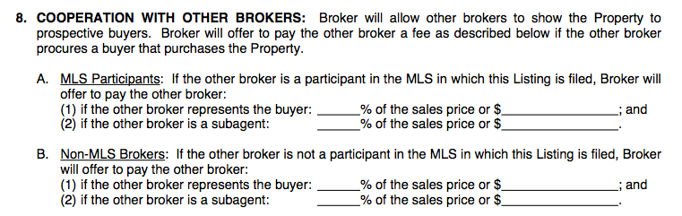
Compensation applications!
Entitlement to compensation is determined by cooperating brokers performance as procuring cause…of the sale or lease!!

Slide 15
Article 17
In the event of contractual disputes or specific non- contractual disputes as defined in Standard of Practice 17- 4 between REALTORS® (principals) associated with different firms, arising out of their relationship as REALTORS®, the REALTORS® shall mediate the dispute if the Board requires its members to mediate. If the dispute is not resolved through mediation, or if mediation is not required, REALTORS® shall submit the dispute to arbitration in accordance with the regulations policies of their Board of Boards rather than litigate the matter.

Slide 16
Article 17 continued
In the event clients of REALTORS® wish to mediate or arbitrate contractual disputes arising out of real estate transactions, REALTORS® shall mediate or arbitrate those disputes in accordance with the policies regulations of their Board, provided the clients agree to be bound by the decision any resulting agreement or award.
The obligation to participate in mediation and arbitration contemplated by this Article includes the obligation of REALTORS® (principals) to cause their firms to mediate and arbitrate and be bound by any resulting agreement or award. (Amended 1/01; Amended 1/12)

Slide 17
Examples of non-contractual disputes
Listing broker has compensated a coop brokerage and another cooperating brokerage claims to be the procuring cause
A buyer/tenant representative is compensated by the seller/landlord and not by the listing broker who has reduced the fee and now another buyer rep is claiming procuring cause

Slide 18
3) A buyer/tenant rep is compensated by the buyer/tenant and the listing broker reduced their fee from the seller and now another buyer rep claims procuring cause
4) 2 or more listing brokers claim entitlement to compensation pursuant to open listings with a seller/landlord
5) Buyer/tenant rep is compensated by the seller/landlord and listing broker reduces fee but then THEY claim PC.

Slide 19
Arbitration Issues via Article 17
“the terms ‘dispute’ and ‘arbitrable matter’ are defined as those contractual issues and questions, and specific non-contractural issues and questions defined in SOP 17-4, including entitlement to commission and compensation in cooperative transactions, that arise out of the business relationships between REALTORS® and or their clients and customers.

Slide 20
Arbitrability
Stems from a successful transaction, which is a closed sale or executed lease
Is determined by the grievance committee, which establishes the procedures for reviewing a request for arbitration….

Slide 21

6 Factors for Consideration
No predetermined rule of entitlement
“Rules of thumb”, prior decisions by other panels in other matters, etc. must be disregarded
Agency relationships themselves don’t determine entitlement to compensation
No board rules regarding awards
Arbitration

Slide 22
6 Factors for Consideration
Arbitrability and appropriate parties
Relevance and admissibility
Generally state law controls this
Any relevant evidence is admissible
Ethics complaints cannot come of this
Arbitration

Slide 23
6 Factors for Consideration
  Possible ethics violations in arbitration hearings
  Can be considered as part of the evidence
  Cannot be used to withhold on otherwise substantiated award
  Arbitration panel shall not make referrals of ethical concerns which arise during the hearing
Arbitration

Slide 24
6 Factors for Consideration
  4. Communication and contact- abandonment and estrangement
  Abandonment: did the broker loose interest or disengaged from the transaction
  Estrangement: the purchaser terminate the relationship
Arbitration

Slide 25
6 Factors for Consideration
  Conformity with state law
  Consideration of the entire course of events… “ The list”
Arbitration

Slide 26
Framework for Analysis
Nature and status of transaction
Nature status and terms of agreements
Nature, status and terms of offer of compensation
Roles and relationships of parties
Initial contact with purchaser
Conduct of brokers
Continuity and breaks in continuity
Conduct of the buyer
Conduct of the seller

Slide 27
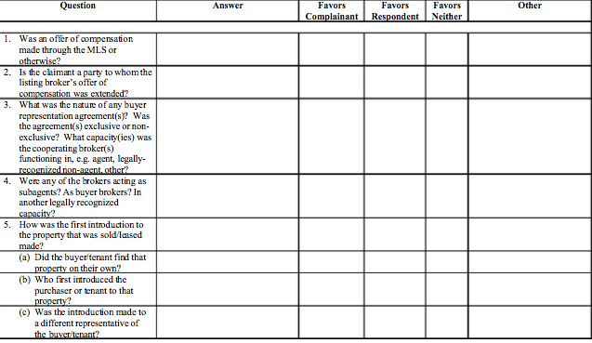
Let’s see how they would decide?

Slide 28
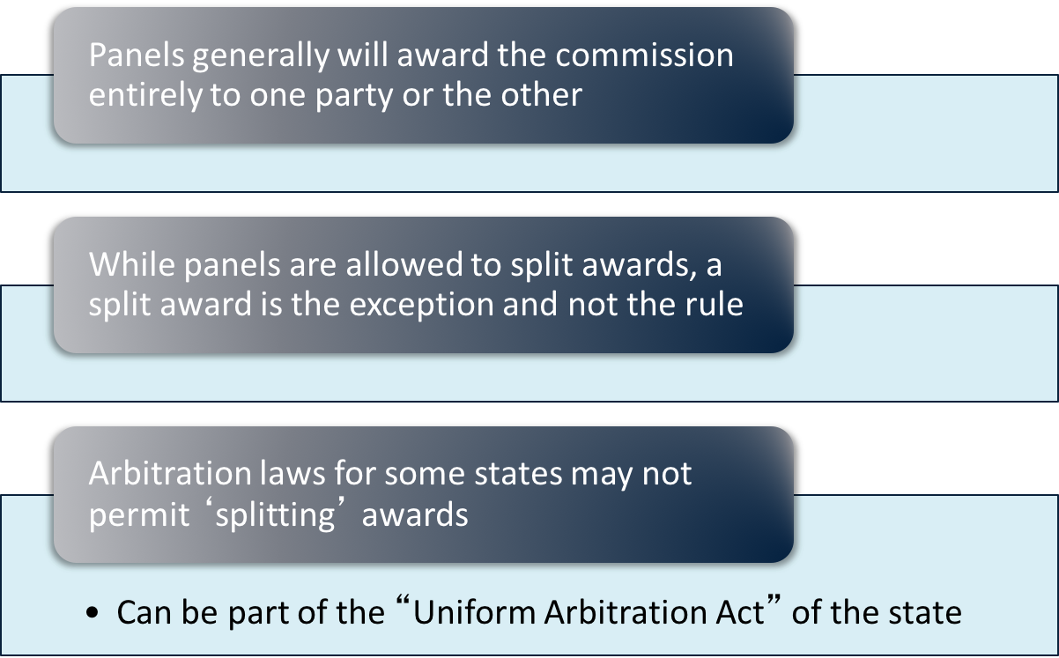
Procuring Cause Concepts
© 2014 Council of Real Estate Brokerage Managers - SRS Designation

Slide 29
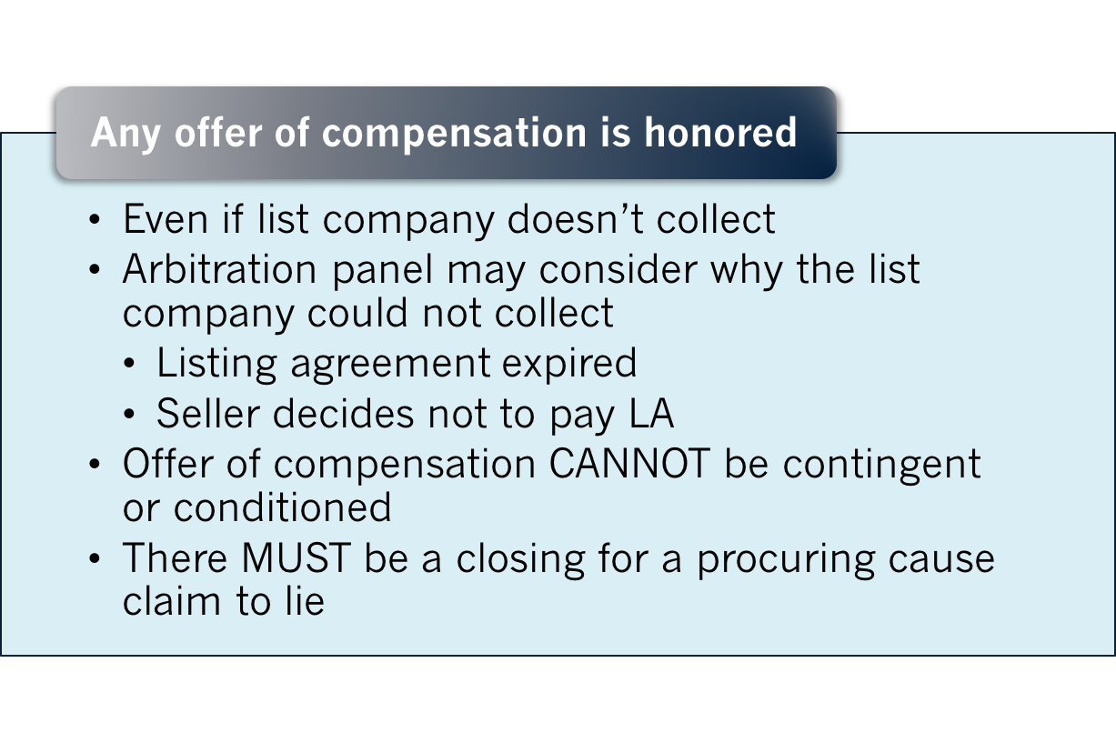
Procuring Cause Concepts
© 2014 Council of Real Estate Brokerage Managers - SRS Designation

Slide 30
Case Studies to Consider
Group Exercise

Slide 31

Guidelines for the Hearing Panel
Arbitration awards cannot include findings of fact
Right to testify
Decision of the panel is binding
Party’s right to recourse
NAR limits $

Slide 32
7 Risk Reduction Techniques
Get the seller to sign an Exclusive right to sell agreement
Keep detailed written records of showings
Keep telephone log of all phone calls with clients and customers
Attempt to avoid controversies

Slide 33
7 Risk Reduction Techniques, etc
Keep communication lines open
Always ask if the buyer if they have already seen the property with another agent
Explain to the buyer thoroughly when they would be responsible for a fee.
Apply the Golden Rule

