Slide 1
CONFLICTS OF INTEREST IN THE REAL ESTATE TRANSACTION
Marcie Roggow, ABR/M, CCIM, CRB,CRS, DREI, GRI, SRS
Instructor

Slide 2

Conflict defined

Slide 3

Where’s the conflict?

Slide 4

Agency Conflicts
Single Agency
Sellers
Buyers
Dual Agency
Duties are conflicting
Duties that “go away”

Slide 5
13 Things you CAN DO!
Disclose material defects
Treat both parties honestly
Provide helpful hints about the property and neighborhood/HUD
Respond accurately to questions
Convey buyer’s questions to the seller and vice versa
Disclose ability of buyer/seller to buy/sell

Slide 6
13 CAN Do, cont
Explain terms and procedures
Assist with property inspections
Explain closing costs/procedures
Help the buyer obtain financing
Provide comparable property information
Assist with standard PA form
Work diligently to complete the sale

Slide 7
4 Things you CAN’T Do!
Disclose price the seller will accept, buyer will pay
Disclose terms not in agreements
Disclose motivation of parties
Disclose anything that hinders the bargaining position of the parties
Without the clients’ written consent!!

Slide 8

II. Personal Conflicts of Interest
Rules of Conduct: Disclosure
Code of Ethics
License Law/Rules & Regulations

Slide 9
Personal Conflicts!!!
Affiliated Business Arrangement Disclosure
This is to give you notice that your REALTOR has business relationships with the following entities. Because of this relationship, this referral may provide the REALTOR a financial or other benefit. You are NOT required to use the listed provider(s) as a condition for doing business with this REALTOR or any of their affiliates. YOU ARE FREE TO SEEK OTHER PROVIDERS TTO DETERMINE THAT YOU ARE RECEIVING THE BEST SERVICES AND THE BEST RATE FOR THESE SERVICES.
Professional Service Estimated Cost*

Slide 10
II. Personal Conflicts of Interest
Rules of Conduct: Disclosure
Code of Ethics
License Law/Rules & Regulations

Slide 11
Personal Conflicts!!!
Affiliated Business Arrangement Disclosure
This is to give you notice that your REALTOR has business relationships with the following entities. Because of this relationship, this referral may provide the REALTOR a financial or other benefit. You are NOT required to use the listed provider(s) as a condition for doing business with this REALTOR or any of their affiliates. YOU ARE FREE TO SEEK OTHER PROVIDERS TTO DETERMINE THAT YOU ARE RECEIVING THE BEST SERVICES AND THE BEST RATE FOR THESE SERVICES.
Professional Service Estimated Cost*

Slide 12
II. Personal Conflicts of Interest
Rules of Conduct: Disclosure
Code of Ethics
License Law/Rules & Regulations

Slide 13
Personal Conflicts!!!
Affiliated Business Arrangement Disclosure
This is to give you notice that your REALTOR has business relationships with the following entities. Because of this relationship, this referral may provide the REALTOR a financial or other benefit. You are NOT required to use the listed provider(s) as a condition for doing business with this REALTOR or any of their affiliates. YOU ARE FREE TO SEEK OTHER PROVIDERS TTO DETERMINE THAT YOU ARE RECEIVING THE BEST SERVICES AND THE BEST RATE FOR THESE SERVICES.
Professional Service Estimated Cost*

Slide 14
Code says…
Article 4
REALTORS® shall not acquire an interest in or buy or present offers from themselves, any member of their immediate families, their firms or any member thereof, or any entities in which they have any ownership interest, any real property without making their true position known to the owner or the owner’s agent or broker. In selling property they own, or in which they have any interest, REALTORS® shall reveal their ownership or interest in writing to the purchaser or the purchaser’s representative. (Amended 1/00)

Slide 15
Risk Management
• Standard of Practice 4-1
For the protection of all parties, the disclosures required by Article 4 shall be in writing and provided by REALTORS® prior to the signing of any contract. (Adopted 2/86)

Slide 16

III. Conflicts during Negotiations
Code of Ethics
SOP 1-6 Submit
Offers
Article 7 Double Compensation
SOP 1-13 Inform Buyers
SOP 1:12 - 15 Multiple Offer Situations

Slide 17
Group Discussion
What if the Buyer’s agent asks about other offers on the property?
Should the seller give blanket consent at the time of the listing to disclose?
Are contract terms considered confidential in Georgia?
How do you present a confidentiality agreement?

Slide 18

Compensation Issues
  Variable rate commissions
  Negotiating commissions in order to make the “deal” go together
  Disclosure of discriminatory commissions to sellers and buyers to the transaction

Slide 19
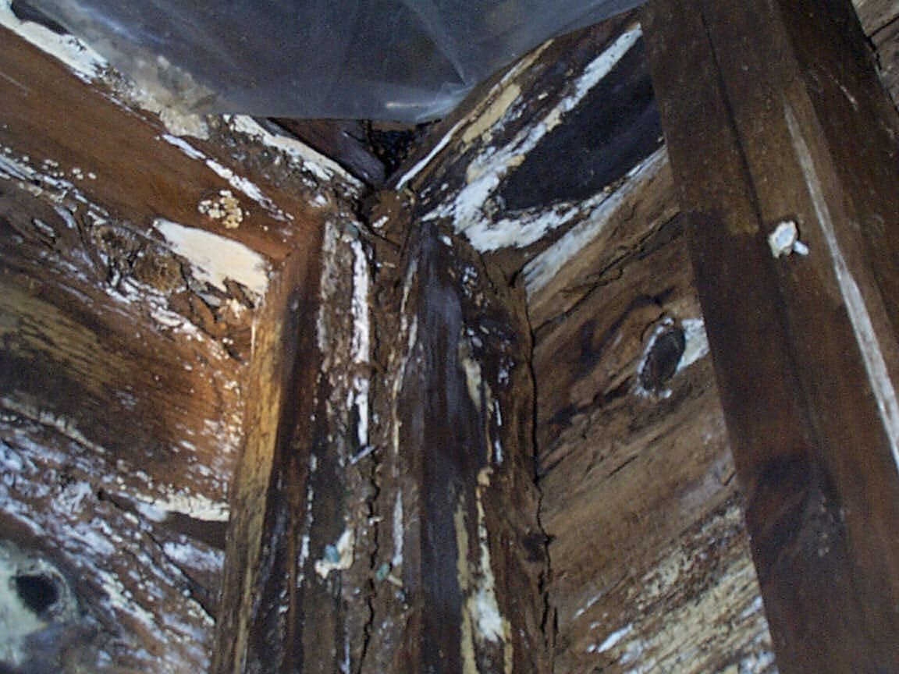

Material Facts vs. Adverse Facts

Slide 20
THE QUESTION TO ASK IS “WHO WOULD WANT TO KNOW THIS INFORMATION?”
Would you if you were the buyer?

Slide 21
Conflicts in Confidential Information
In obtaining a listing
In working with buyers
With “business” knowledge

Slide 22
THE QUESTION TO ASK IS “WHO WOULD WANT TO KNOW THIS INFORMATION?”
Would you if you were the buyer?

Slide 23
Conflicts in Confidential Information
In obtaining a listing
In working with buyers
With “business” knowledge

