Slide 1
Gossip! MAA MathFest 2017, Chicago, IL
Parth Sarin
A&M Consolidated HS
parthsarin@tamu.edu
Dr. Philip Yasskin
Texas A&M University
yasskin@math.tamu.edu
Representing the Texas A&M University Math Circle

Slide 2
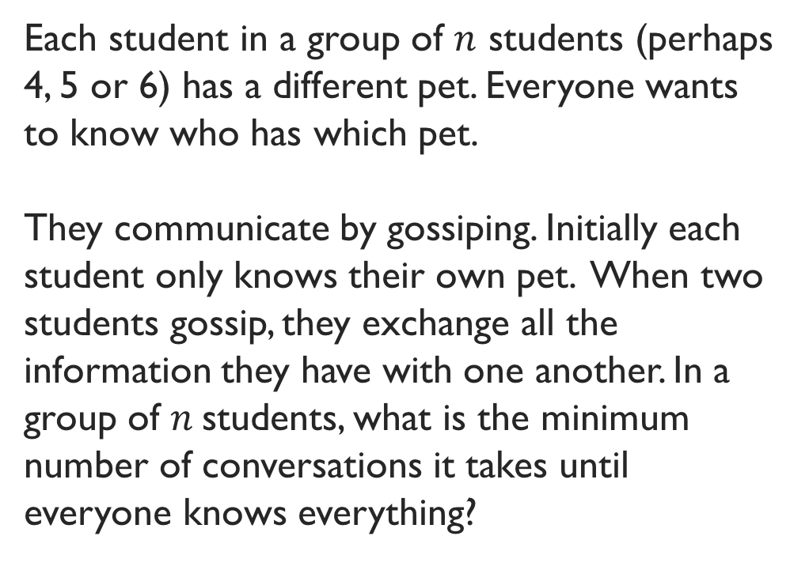
The problem
Each student in a group of $n$ students (perhaps 4, 5 or 6) has a different pet. Everyone wants to know who has which pet.
They communicate by gossiping. Initially each student only knows their own pet. When two students gossip, they exchange all the information they have with one another. In a group of $n$students, what is the minimum number of conversations it takes until everyone knows everything?
Actually, we’re studying “Gossip networks”!

Slide 3
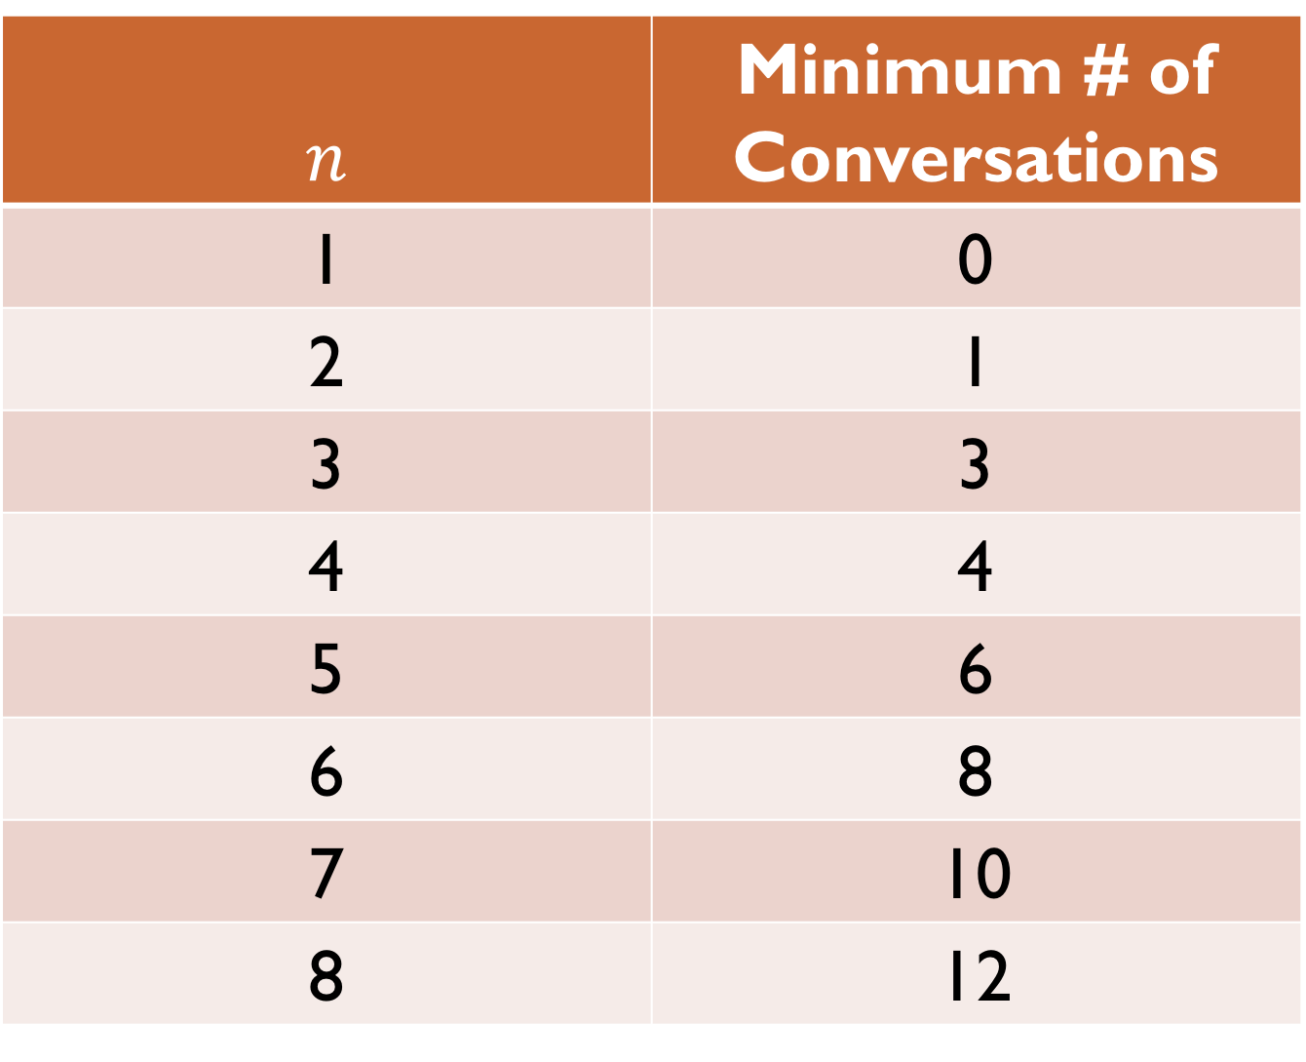
$$n$$ | Minimum # of Conversations
1 | 0
2 | 1
3 | 3
4 | 4
5 | 6
6 | 8
7 | 10
8 | 12

Slide 4
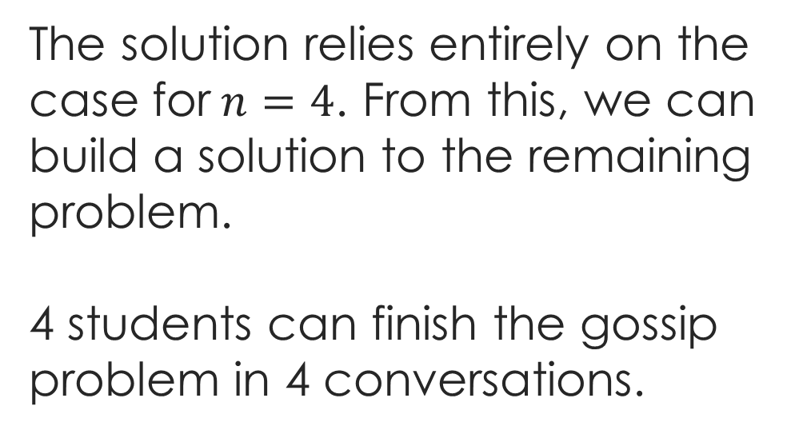




The solution
A
B
C
D
The solution relies entirely on the case for$n=4$. From this, we can build a solution to the remaining problem.
4 students can finish the gossip problem in 4 conversations.
A
$$3$$
B
$$1$$
$$2$$
C
$$4$$
D

Slide 5

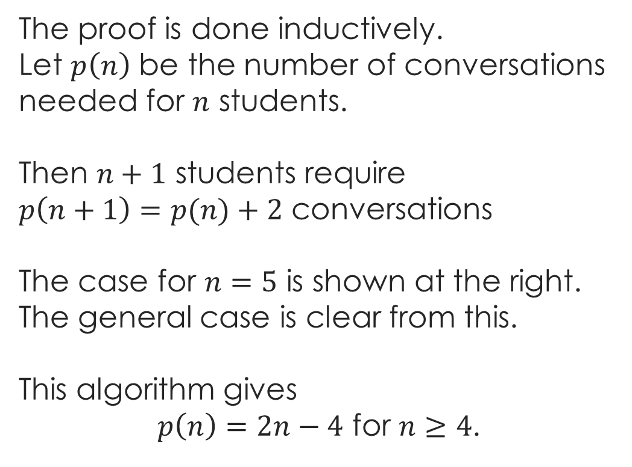





The solution
A
B
The proof is done inductively.
Let $p\left(n\right)$ be the number of conversations needed for $n$ students.
Then $n+1$ students require
$p\left(n+1\right)=p(n)+2$ conversations
The case for $n=5$ is shown at the right. The general case is clear from this.
This algorithm gives
$p\left(n\right)=2n−4$ for $n≥4$.
E
C
D
A
$$4$$
B
$$2$$
$$3$$
$$1$$
E
$$6$$
C
$$5$$
D

Slide 6
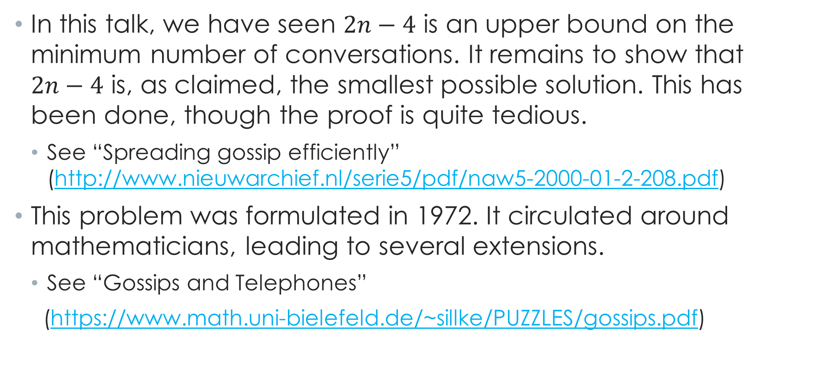
Some housekeeping... (and references)
In this talk, we have seen $2n−4$ is an upper bound on the minimum number of conversations. It remains to show that $2n−4$ is, as claimed, the smallest possible solution. This has been done, though the proof is quite tedious.
See “Spreading gossip efficiently” (http://www.nieuwarchief.nl/serie5/pdf/naw5-2000-01-2-208.pdf)
This problem was formulated in 1972. It circulated around mathematicians, leading to several extensions.
See “Gossips and Telephones”
(https://www.math.uni-bielefeld.de/~sillke/PUZZLES/gossips.pdf)

