Slide 1

G2M Case Study
Parth Shah
13-06-2021

Slide 2
Background –G2M(cab industry) case study
XYZ is a private equity firm in US. Due to remarkable growth in the Cab Industry in last few years and multiple key players in the market, it is planning for an investment in Cab industry.
Objective : Provide actionable insights to help XYZ firm in identifying the right company for making investment.
The analysis has been divided into four parts:
Data Understanding
Forecasting profit and number of rides for each cab type
Finding the most profitable Cab company
Recommendations for investment

Slide 3
Data Exploration
15 Features.
4 derived features(Month, Year, Day, Margins).
Total data points 355,032.
Assumptions:-
Profit of rides are calculated keeping other factors constant and only Price_Charged and Cost_of_Trip features used to calculate profit.

Slide 4
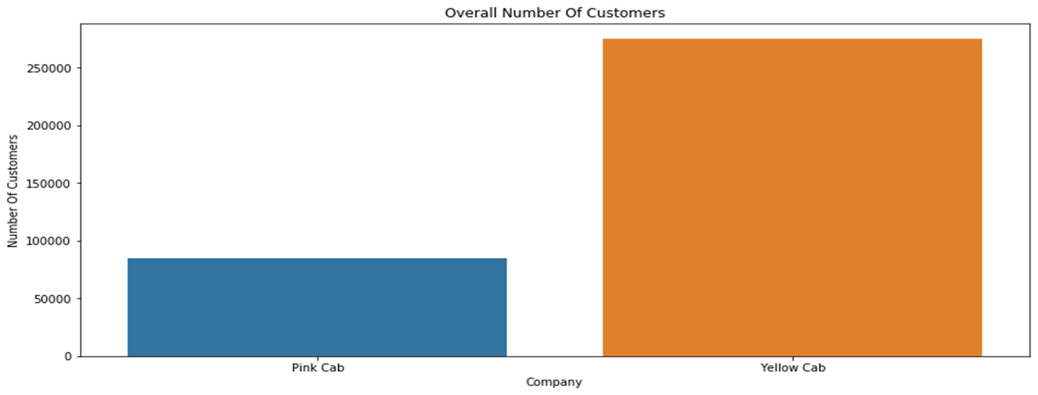
Data understanding
Yellow cab has the majority of transactions between the two cabs.

Slide 5
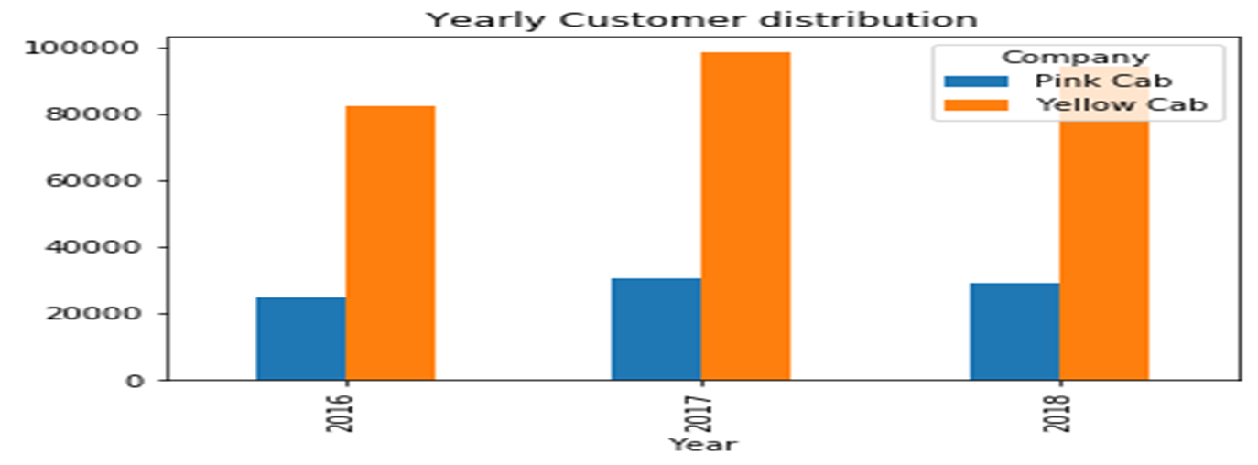
Profit Analysis
Yearly Customer Distribution
Yellow Cab has had the majority of customers across the three years.

Slide 6
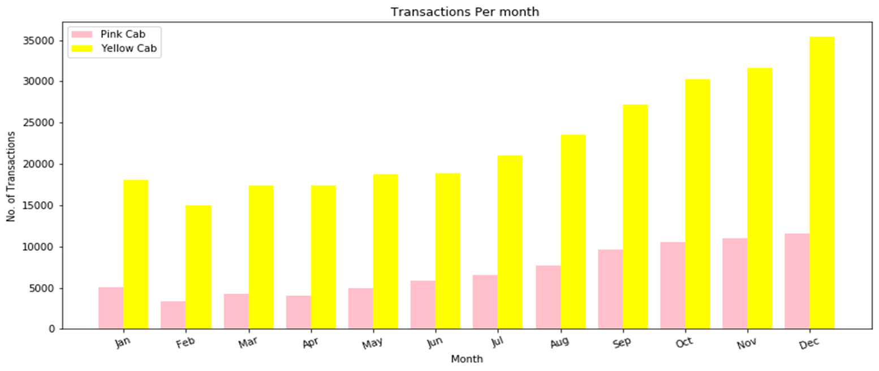
Monthly Transactions Analysis
The busiest Months are the holiday months heading towards January for both Cabs with Yellow cab taking the lions share.

Slide 7
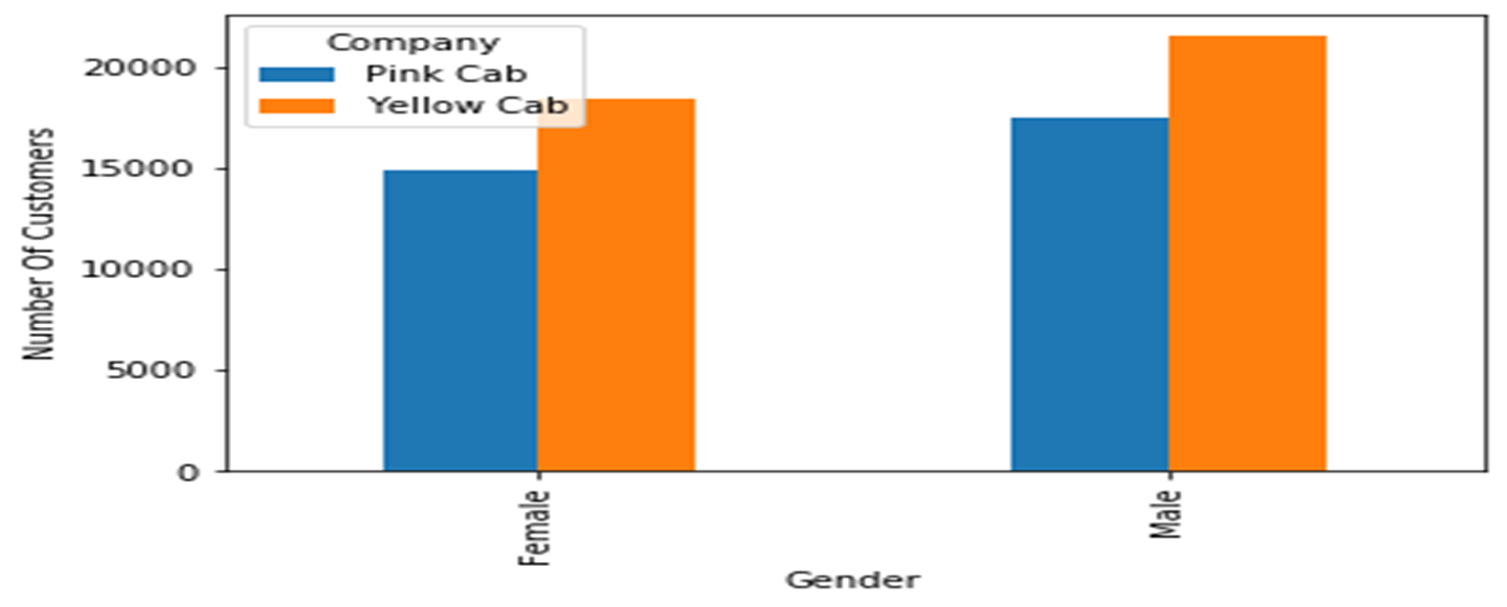
Gender Distribution
Most of the customers for both Cabs are Male with the Yellow Cab taking the lions share in both.

Slide 8
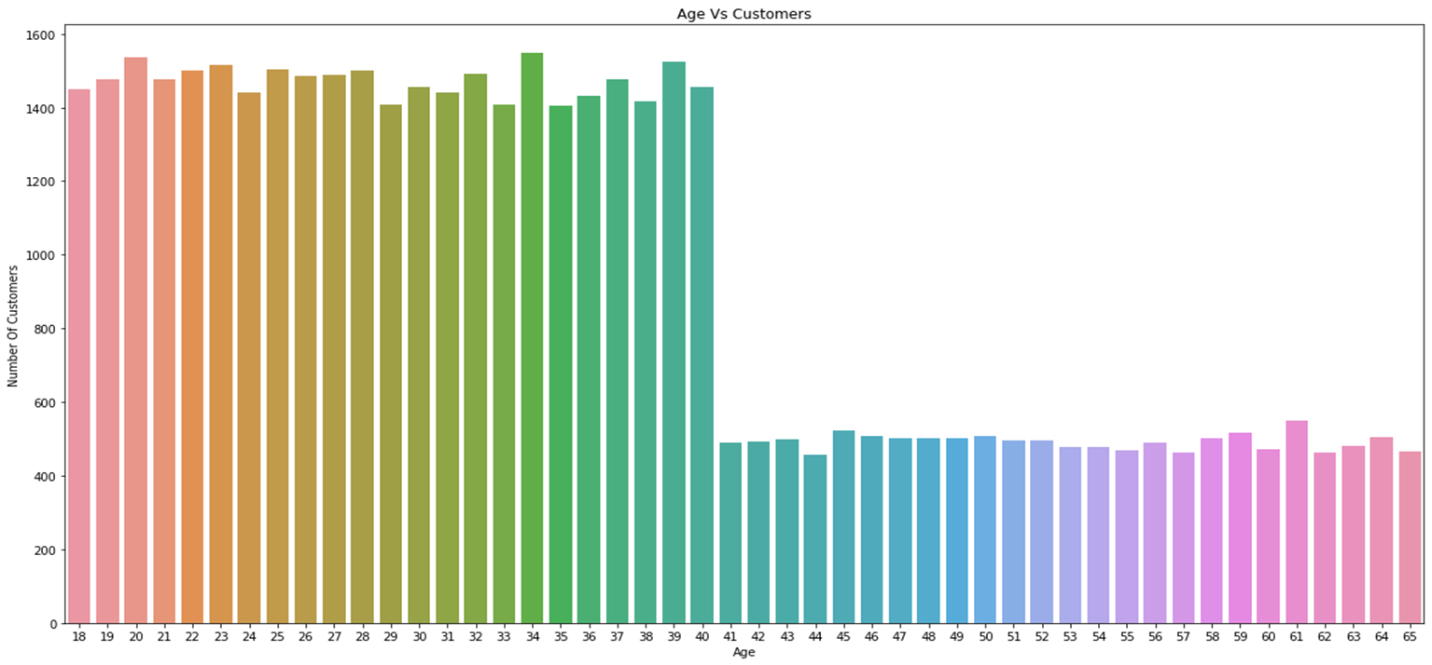
General Age Distribution Analysis
Most of the Customers are Young. i.e below 40 Years of age.

Slide 9
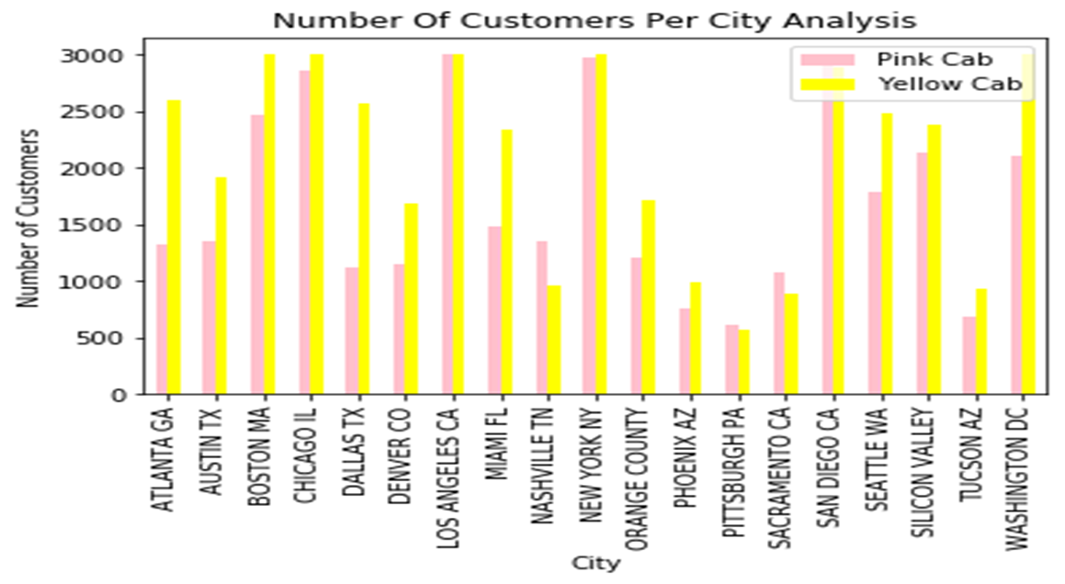
Customers per City Analysis
Yellow cab leads on most of the cities with Pink Cab only leading in 4 cities:-
San Diego
Nashville
Sacramento
Pittsburgh

Slide 10
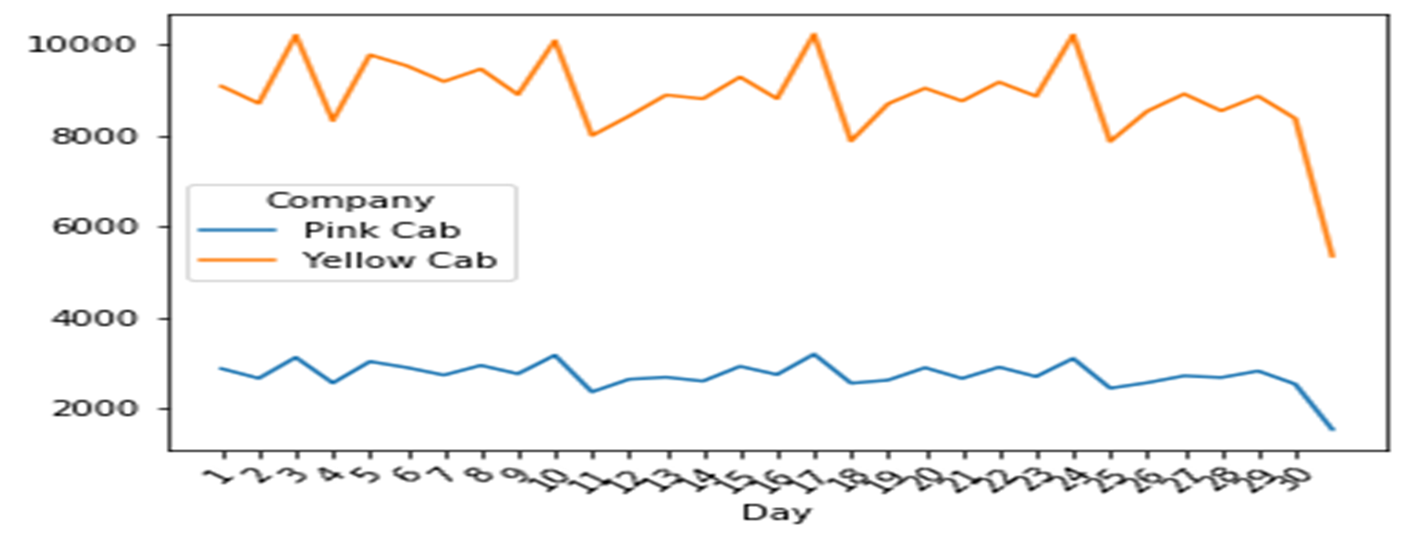
Day Of the Month Analysis

Slide 11
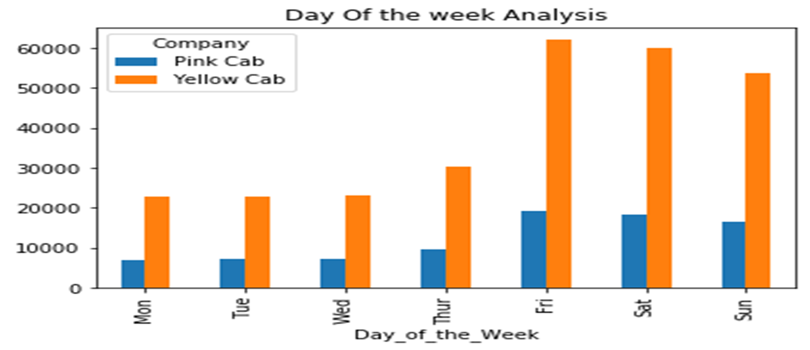
Day Of the Week Analysis
On average most of the customers use the cabs as from Friday heading into the weekend.

Slide 12
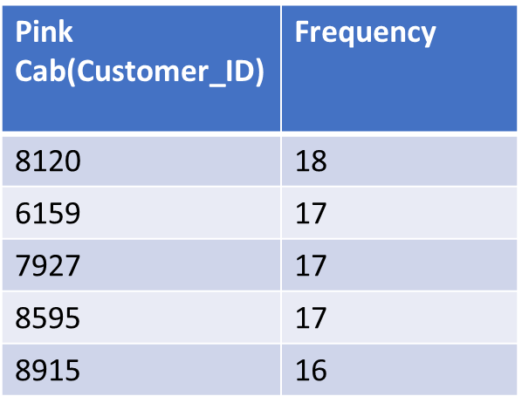
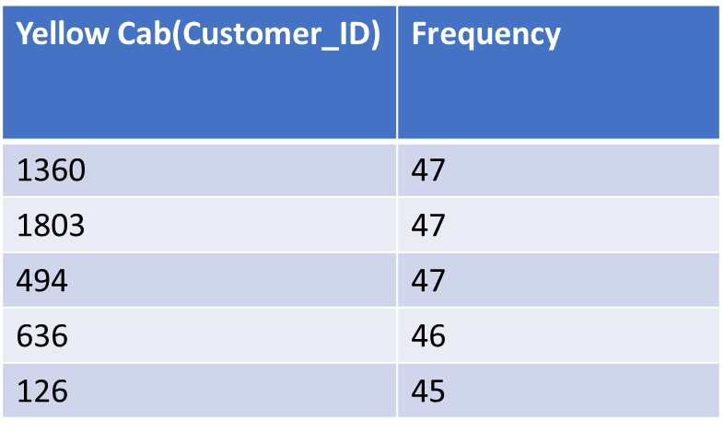
Most frequent Customers for both Cabs(Customer Retention)
Yellow cab customers frequent the cabs more often showing that they have a high customer retainability. Also the most frequent Pink Customers are also Yellow Cab Customers.

Slide 13
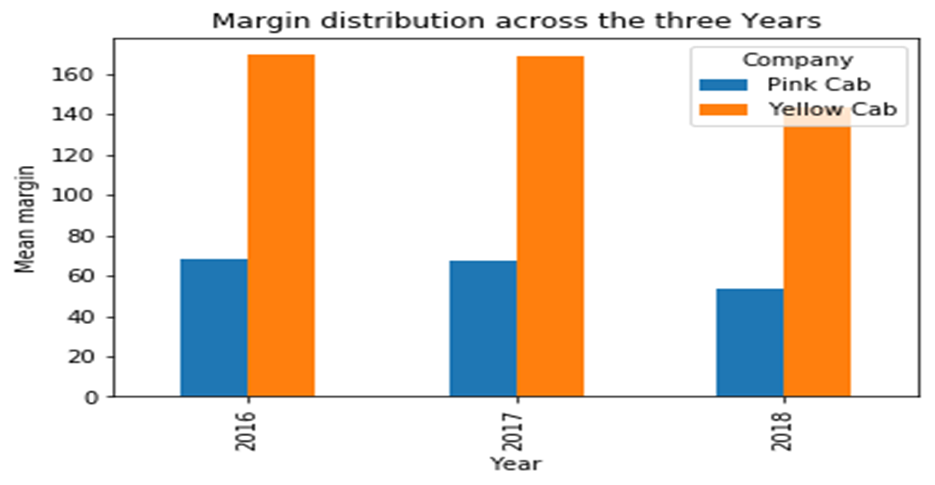
Margin Analysis
Yellow cab has had the most Profit compared to Pink Cab across the three years this very little fluctuations(Decrease in profit).

Slide 14
Recommendations and Conclusion
I believe that Yellow cab is going to maintain its monopoly in the market for a longer period of time because:-
Yellow cab has a very high customer retainability rate compared to Pink Cab.
Through the three Years yellow cab has had the most customers and is not showing any signs of letting go off this trend.
Yellow cab a high customer following in high population cities like New York.
Most of the young aged customers prefer Yellow Cab. It is to be noted that the young aged customers are the biggest consumers in this cab business.
Yellow cab seems to be making higher profit margin compared to pink cab.

Slide 15
Thank You

