Slide 1
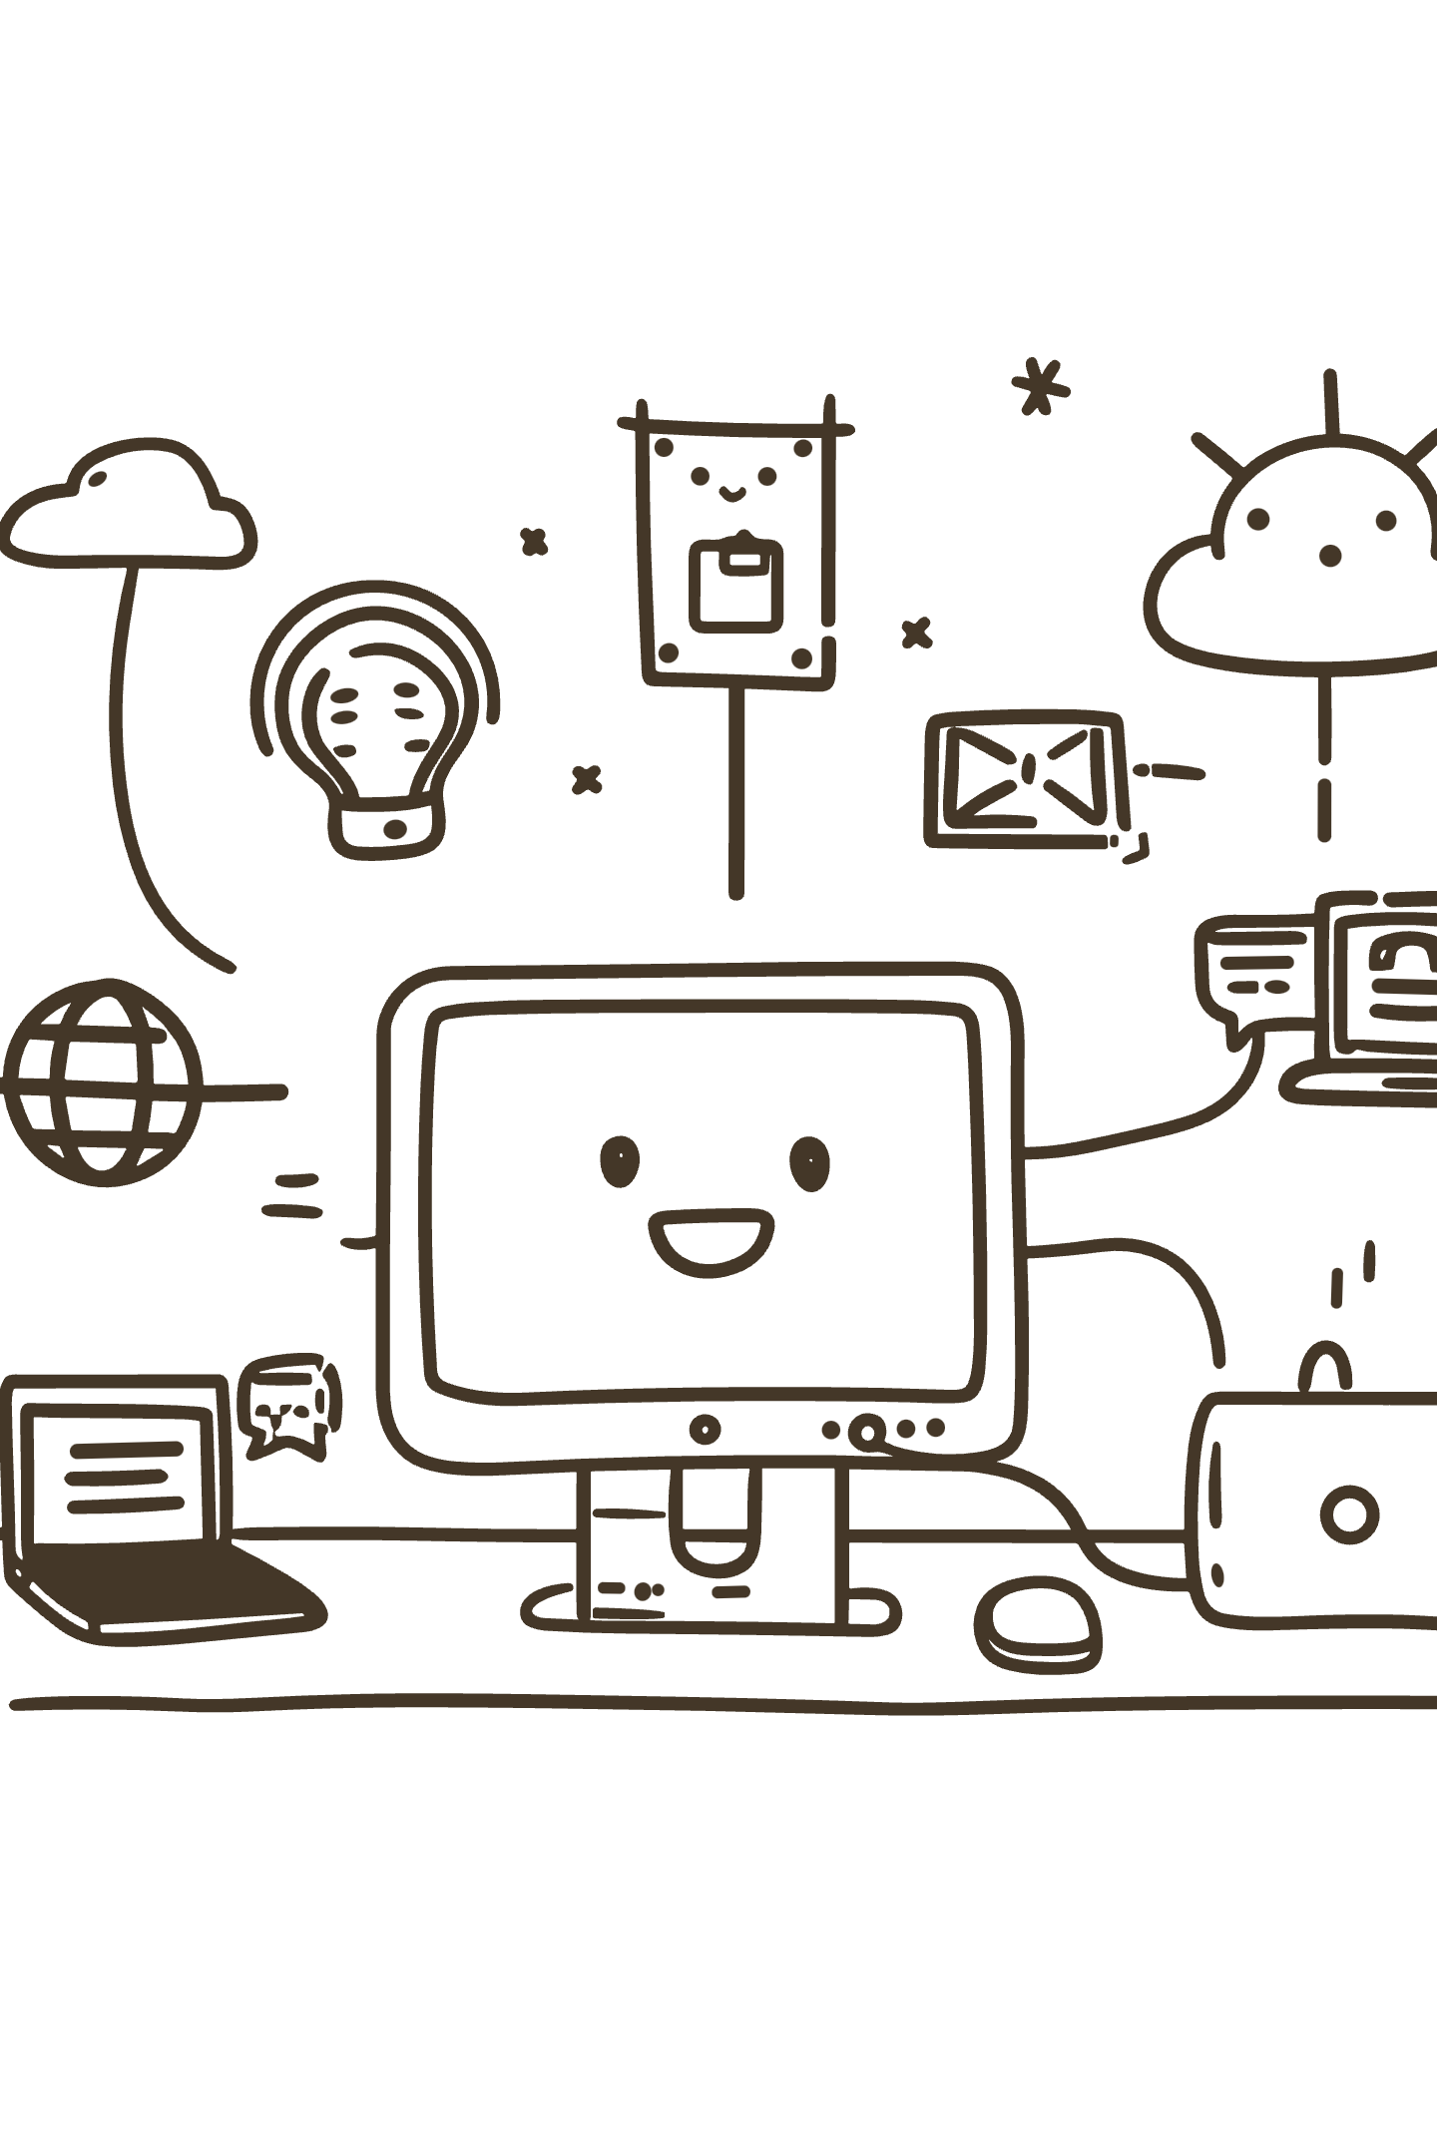
Digital Literacy in the 21st Century
More than just "using a computer" — it's about being confident, critical, and capable in an increasingly connected world.
DIGITAL SKILLS WORKSHOP

Slide 2
What Is Digital Literacy?
The ability to find, evaluate, create, and communicate information across digital platforms — the essential survival skill for 21st-century learning and future careers.
1
2
Finding
Evaluating
Searching effectively and locating credible sources online.
Spotting fake news versus verified facts with a critical eye.
3
4
Creating
Communicating
Producing meaningful digital content, from slides to portfolios.
Connecting with others responsibly and professionally online.

Slide 3
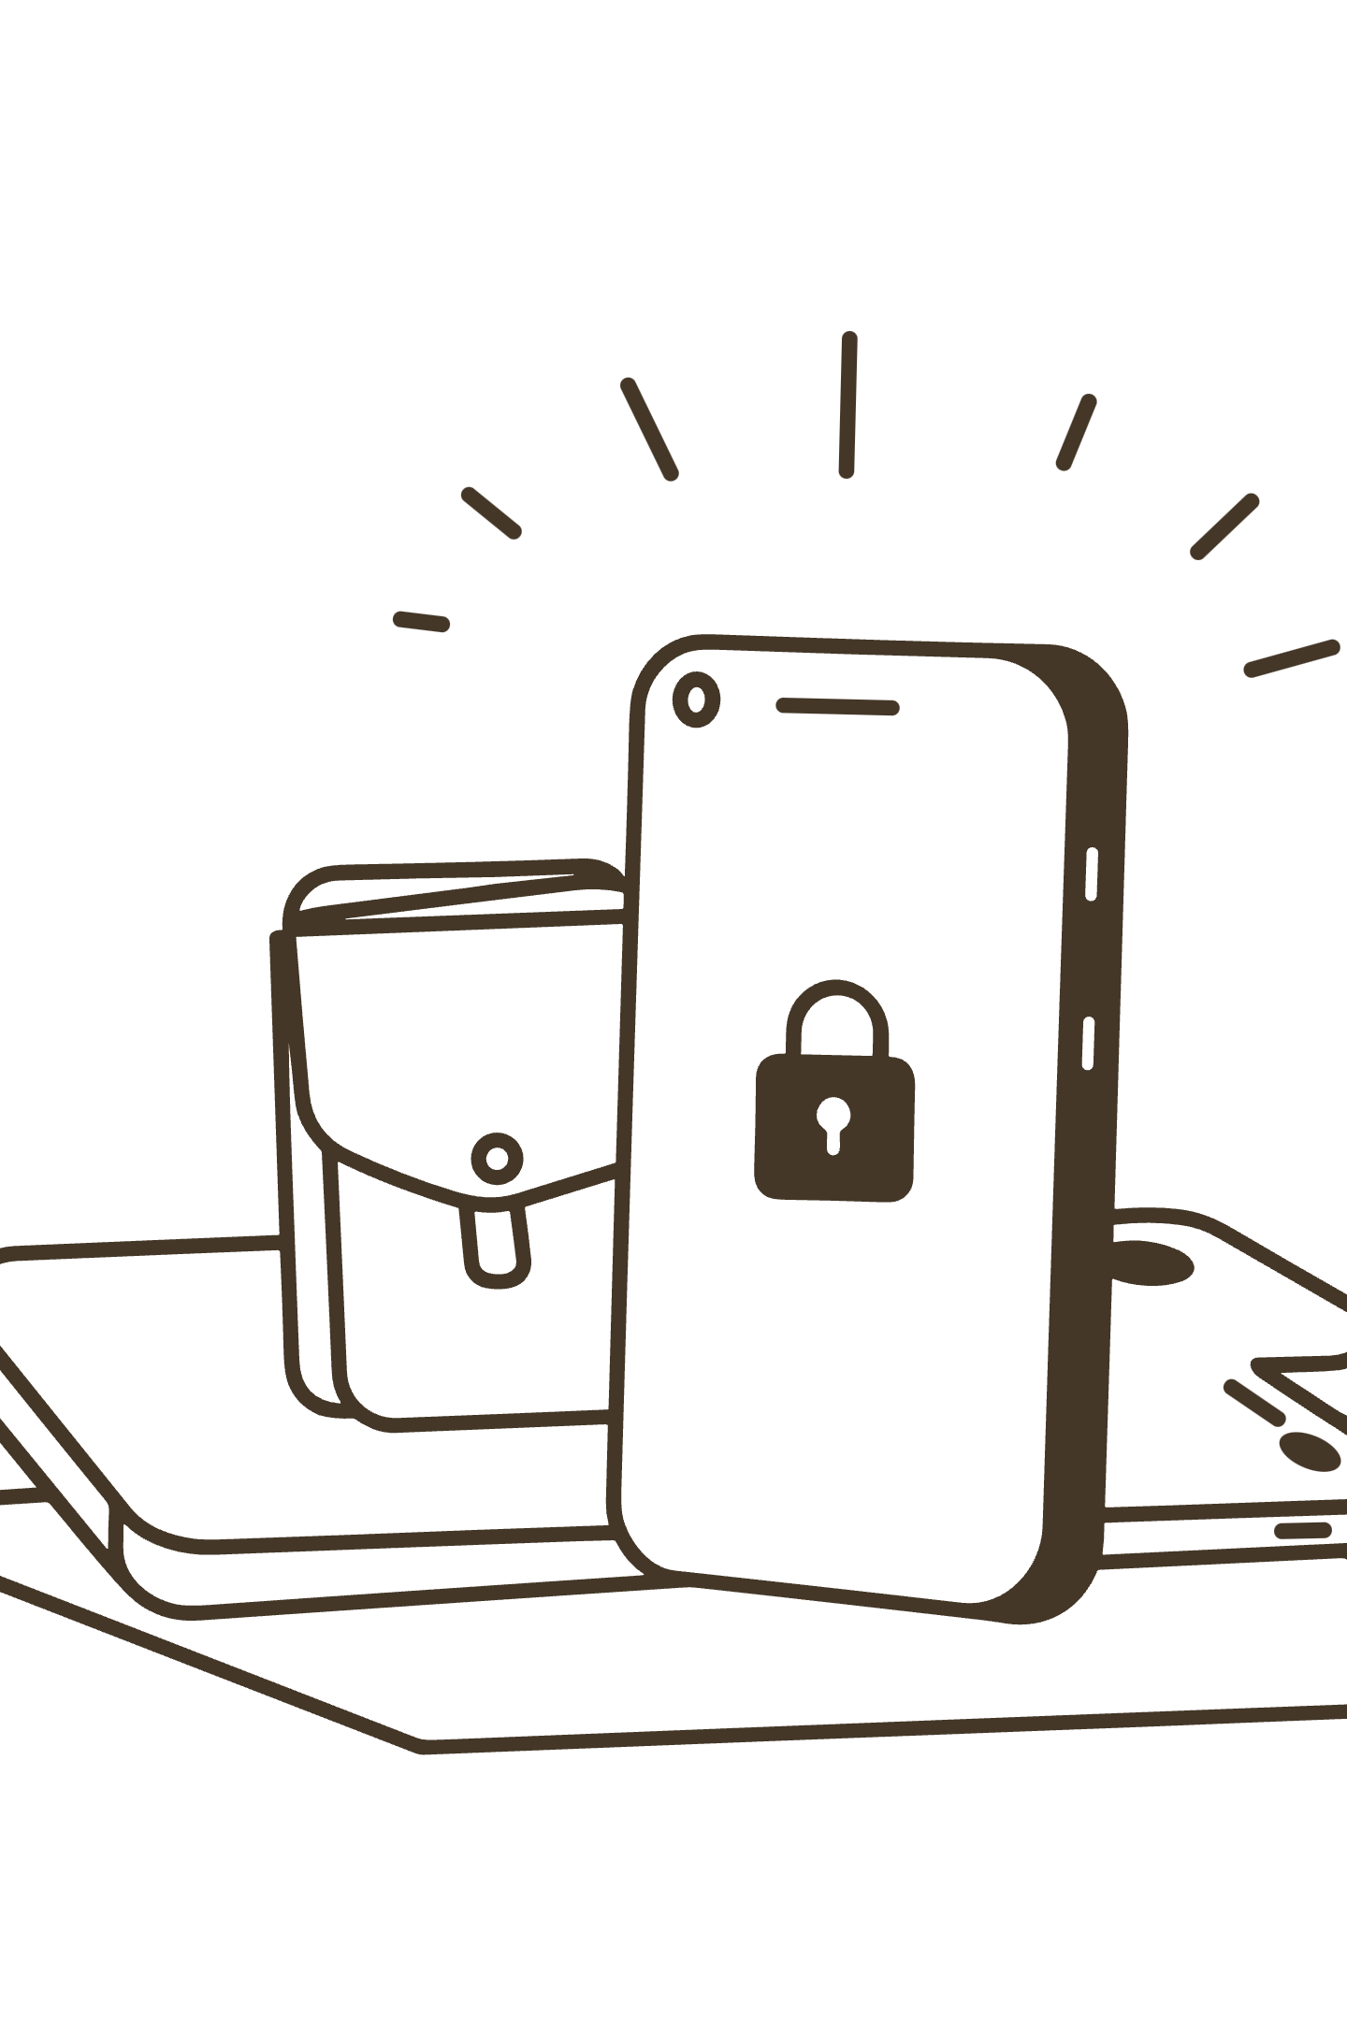
Safe Internet Practices
Protecting your Digital Self starts with smart habits — before you click, post, or share.
The Passphrase Rule
Use long, unique strings like Blue-Giraffe-Coffee-2026! instead of simple words.
Think Before You Click
Hover over links to verify the URL. Urgent, suspicious emails are almost always phishing scams.
Audit Your Privacy
Regularly review who can see your location and personal data on social media apps.
The "Grandma" Test
Never post anything you wouldn't want a grandmother — or a future employer — to see.

Slide 4
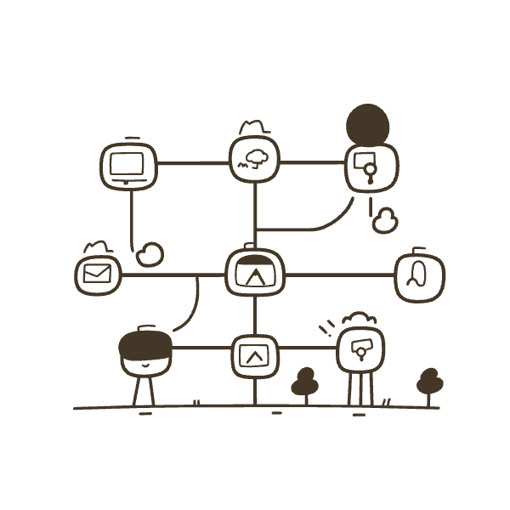
YOUR DIGITAL FOOTPRINT
Professional Online Presence
Your digital footprint is always working — make sure it's working for you, not against you.
LinkedIn Is Your Billboard
Google Yourself
Keep your profile updated with skills, projects, and a professional headshot.
See what others find. Bury unwanted content by publishing positive contributions.
Stay Consistent
Network Thoughtfully
Use the same professional name and tone across GitHub, LinkedIn, and portfolio sites.
Leave insightful comments for industry leaders rather than just liking their posts.

Slide 5

Design Process & Reflections
Why Canva?
Key Takeaway
Canva's robust icon library and grid systems made it easy to maintain a clean, professional layout. A "pathway" design was used to show that digital literacy is a continuous journey — not a single destination. High-contrast colors and bold headings keep information scannable for busy students.
Just because our generation grew up with technology doesn't mean we inherently use it professionally or safely. That's the core insight behind "Digital Natives vs. Digital Literacy."
The hardest challenge: condensing complex topics like cybersecurity into short, actionable points — prioritizing need-to-know over nice-to-know.
The infographic centers on three pillars: defining literacy, staying safe, and building a professional footprint.

Slide 6

Design Tips for Your Infographic
Great design communicates without noise. Apply these principles to make your infographic instantly readable and visually compelling.
Icons Over Text
Embrace White Space
Replace descriptive phrases with icons. A lock icon communicates "strong password" instantly.
Don't crowd your slide. Give the eye room to breathe — less is always more.
Color Code Each Topic
Assign a distinct color per section — e.g., Blue for Literacy, Red for Safety, Green for Professionalism.
💬 Which design tool are you planning to use? Share your choice and let's discuss the best approach for your infographic.

