Slide 1
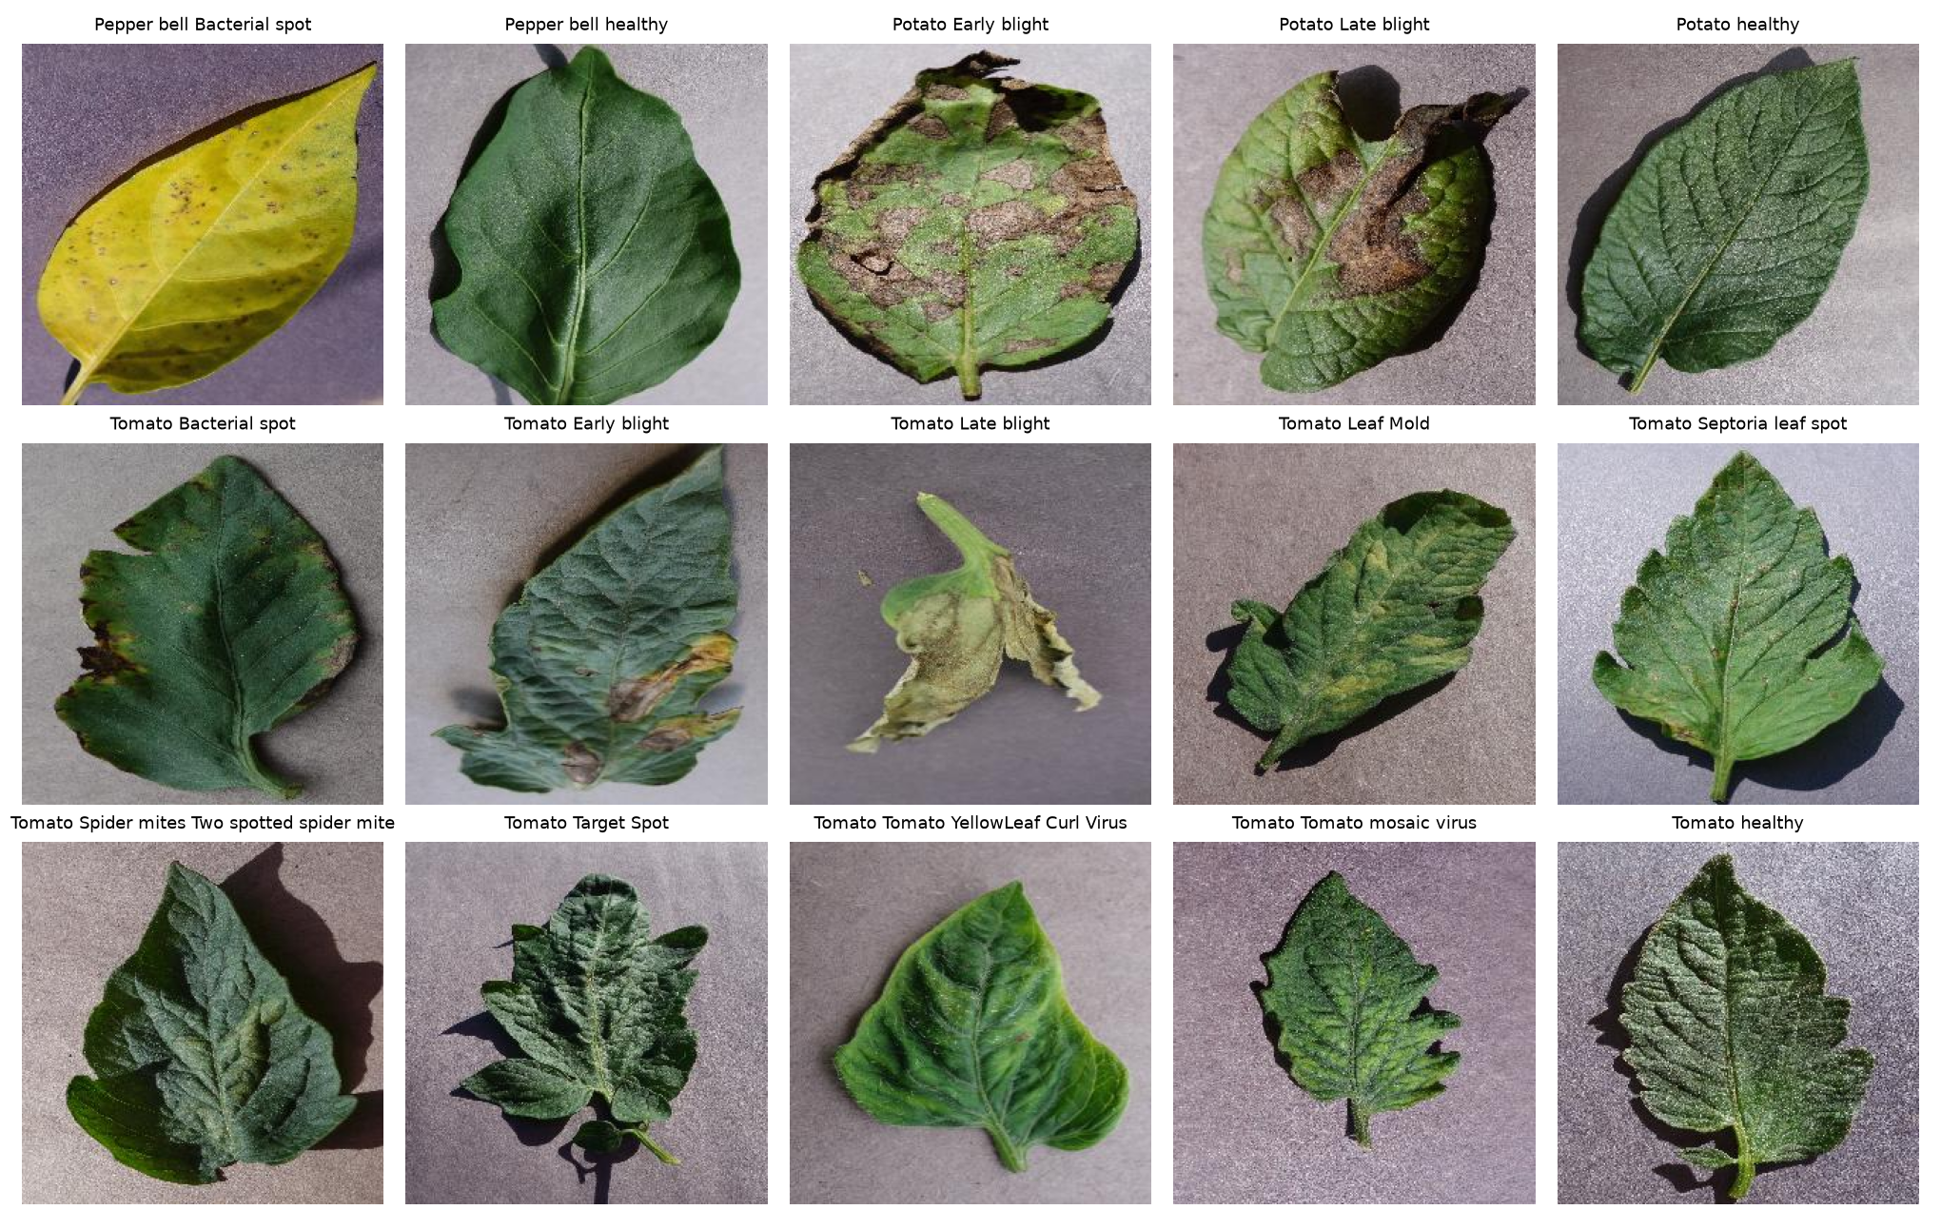
PhytoShield AI
Explainable plant-disease detection on a leakage-free dataset
Parth Sharma (23BAI1528)
Aarav Chatley (23BAI1062)
Final project review · Explainable AI
Notes:
Introduce the project in one sentence: a plant-disease classifier that also explains itself, and whose test result we can trust because we found and fixed a data leak.

Slide 2
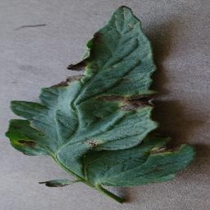
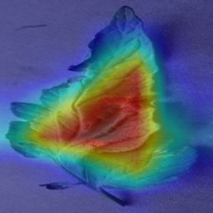
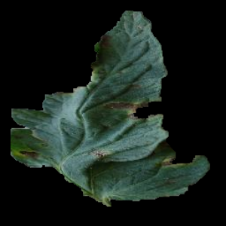
Why explain a plant-disease model?
Catch disease early
A label is not enough
The Clever Hans risk
Spotting a foliar pathogen early lowers treatment cost and warns growers before it spreads.
A black-box answer gives no reason to trust it. We show where the model looked and how sure it is.
A model can be right for the wrong reason. With the background removed, our accuracy falls to 74.8%.
PhytoShield AI shows where the model looked, how sure it is, and how far to trust the explanation.
Notes:
Three reasons. Early detection saves money and protects neighbouring plants. A label alone gives the farmer no reason to trust it. And models can cheat: the Clever Hans story is about a horse that seemed to do arithmetic but was reading its trainer's body language. A model can look right while using a shortcut such as the background. The third picture is our own test: with the background removed, accuracy falls from 98.1% to 74.8%.

Slide 3

What PhytoShield AI does
Leaf photo
EfficientNet-B0 diagnosis
7 explanation engines
6 quality scores
Report and guidance
98.13%
20,624
15
7
test accuracy, 3,107 unseen photos
unique images after cleaning
crop-disease classes
post-hoc explanation engines
Notes:
Walk left to right: a leaf photo goes in, EfficientNet-B0 names the disease, seven engines show where it looked, six metrics score those explanations, and the app writes a report with guidance. The screenshot is the real diagnosis card from our app.

Slide 4
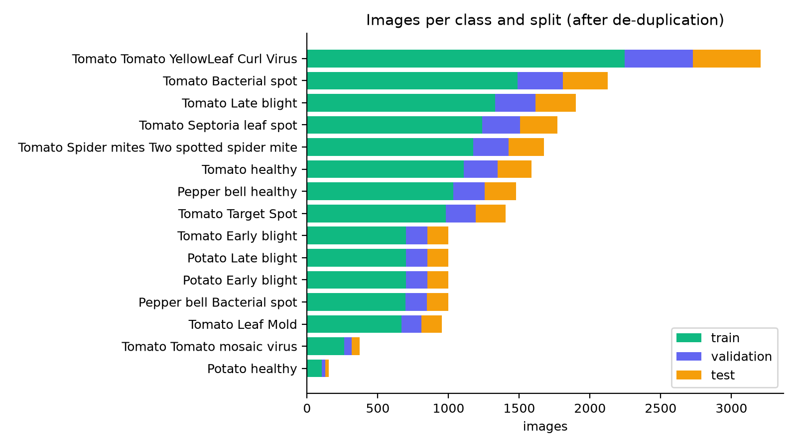
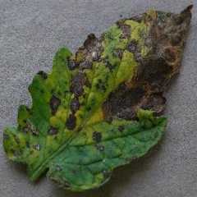
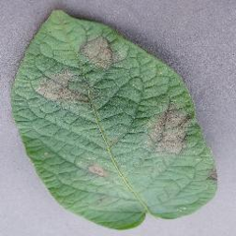
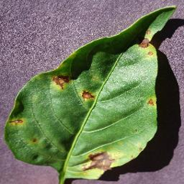
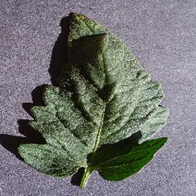
Dataset: a 15-class PlantVillage subset
PlantVillage: about 54,300 leaf photos, 38 classes
We use 15 classes (pepper, potato, tomato), taken from the Kaggle copy
A small corpus on purpose: test the pipeline and its compute cost before training on all 38
20,624
15
3
Tomato early blight
Potato late blight
Pepper bacterial spot
Tomato healthy
unique images
classes
crops
Notes:
PlantVillage has about 54,300 labelled leaf photos in 38 classes. We used 15 classes on purpose: a small corpus lets us test the whole pipeline and its compute cost first, then scale to all 38 classes later. The four photos are real examples from our test split.

Slide 5
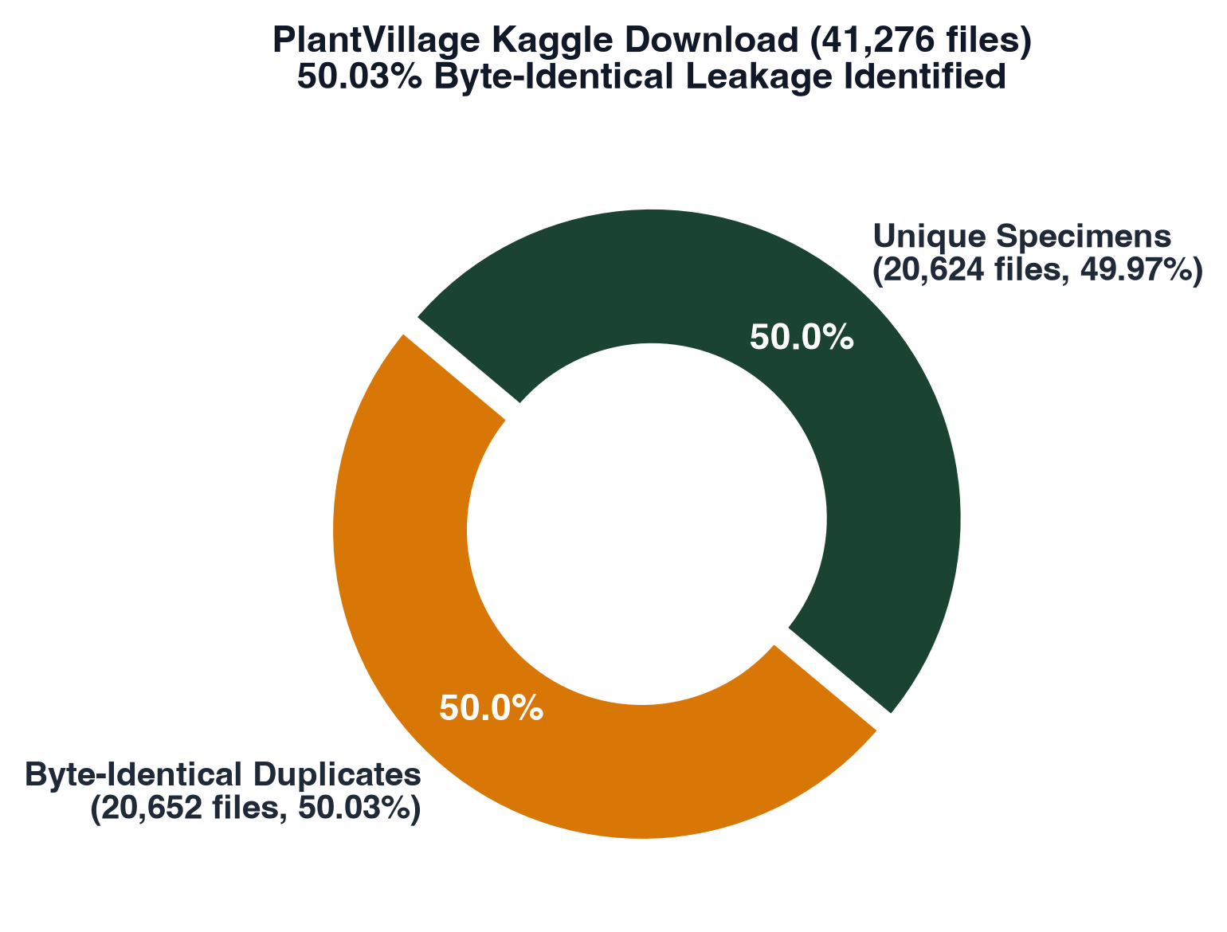
A data leak inflated our first result
99.48%
98.13%
first result, inflated by the leak
honest result, no duplicates
Train-test contamination
Test-set information leaks into training, so the metrics look better than the model really is. A model that memorised its test photos tells us nothing about new leaves.
Cause: the download held a second copy of every class folder, so a random split put the same photo in both train and test.
Notes:
Our first model scored 99.48 percent, which felt too good. EDA showed that about half of the files were byte-identical copies, because the download contained a second copy of every class folder. A random split then put the same photo in training and in test. That is train-test contamination: the test score is optimistic because the model has seen the answers.

Slide 6
How we fixed it: the code
1
Fingerprint
# data/dataset_splitter.py
def deduplicate_by_content(class_map):
seen = {}
for c in sorted(class_map):
for p in sorted(class_map[c]):
digest = md5(p.read_bytes())
if digest not in seen:
seen[digest] = p # keep one copy
# copies are dropped before the split
# tests/test_dataset_integrity.py
assert not train & test # no shared image
MD5 hash of every file's bytes
2
Drop copies
Keep one file per fingerprint
3
Then split
70 / 15 / 15, stratified by class
4
Guard
A test fails if any image is in two splits
Result: 41,276 files became 20,624 unique images, with zero overlap between train, validation and test.
Notes:
Walk through the code: every image is fingerprinted with MD5. Two files with identical bytes have the same fingerprint, so we keep one and drop the rest before splitting. MD5 here is for finding copies, not for speed. The test at the bottom fails the build if any image ever appears in two splits.

Slide 7
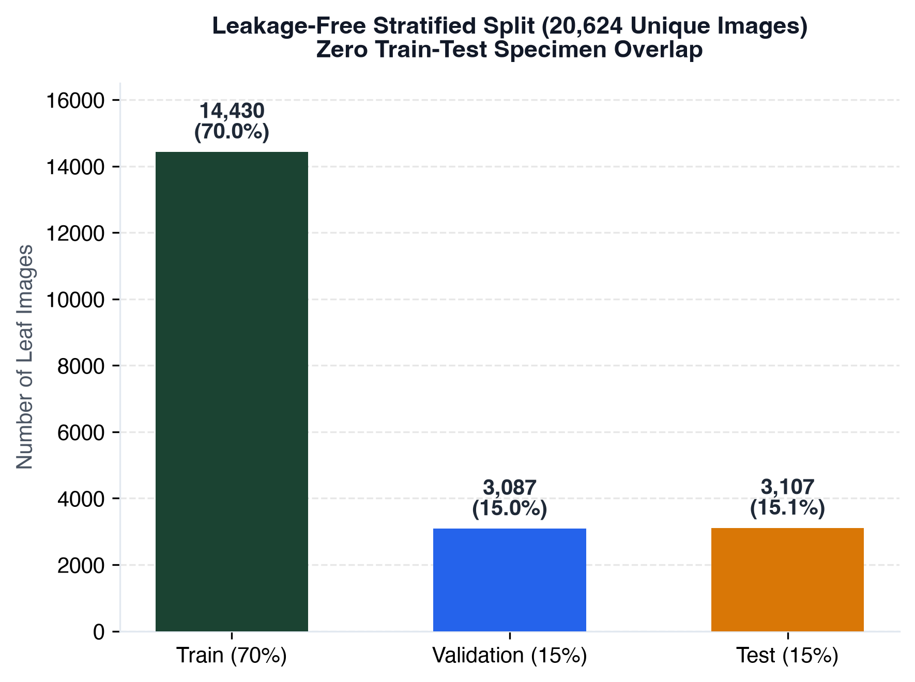
Clean split: 70 / 15 / 15
Stratified
1
Every class is split 70 / 15 / 15
Reproducible
2
Fixed seed 42, same split every run
Verified
3
Hash check: zero shared files between splits
Used once
4
Validation picks checkpoints and fits the temperature; test is touched once
Notes:
After cleaning we split each class separately so every class appears in train, validation and test in the same proportion. The seed is fixed at 42 so the split can be reproduced.

Slide 8
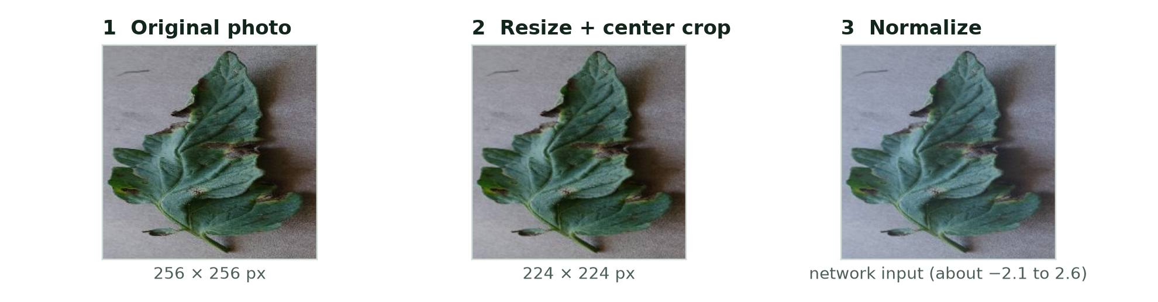
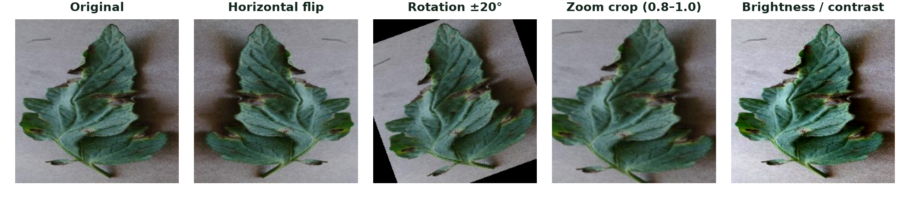
Preprocessing and augmentation
Every image
Resize to 224 × 224, center crop, normalize with ImageNet mean and std.
Training only
Zoom crop, flip, rotation ±20°, brightness and contrast jitter 0.2.
Not used: CutMix, random cutout, elastic distortion. They can hide or bend the lesion pattern the model must learn.
Notes:
Every image gets the same three steps before the network sees it; the pictures are a real leaf from our test split. During training only, we add four mild augmentations that imitate real field variation. We deliberately avoided cutout and CutMix style tricks because they can hide or distort the lesion we want the model to learn.

Slide 9
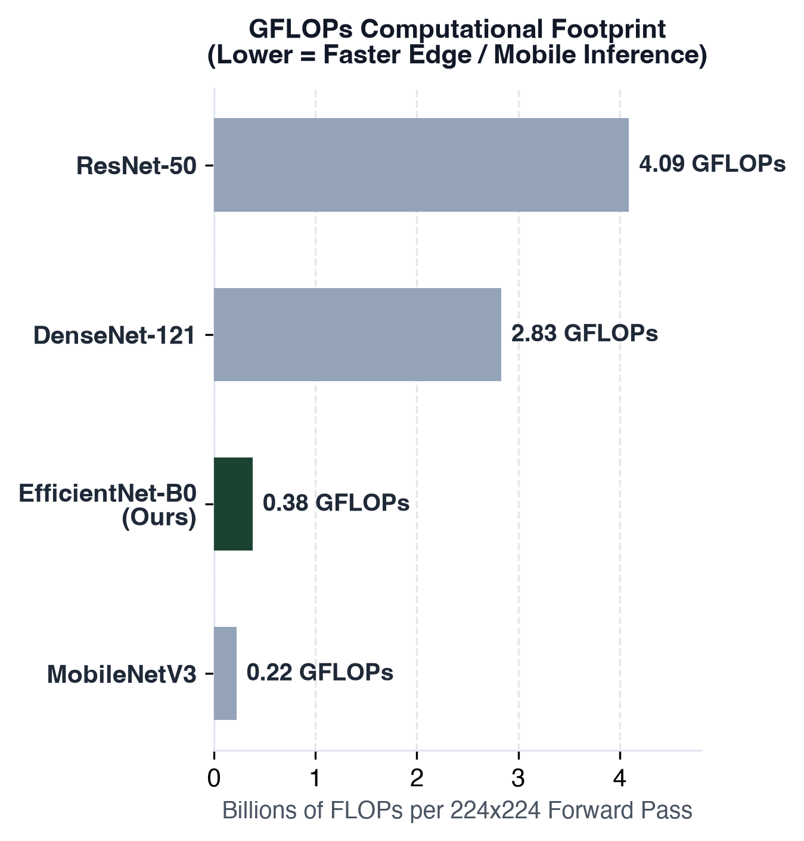
Why EfficientNet-B0?
4.03 M
0.38
trainable parameters
GFLOPs per image
15.65 MB on disk, ≈83% smaller than ResNet-50 (≈94 MB in fp32)
ResNet-50 needs 4.09: about 91% fewer operations
7 × 7
98.13%
feature maps at the last block
test accuracy
A clean layer for Grad-CAM to read
Measured on 3,107 photos the model never saw
Notes:
We wanted a balance of accuracy, computing cost and explanation quality. EfficientNet-B0 is small: about 4 million parameters and 15.7 MB on disk, roughly 83 percent smaller than ResNet-50 in 32-bit weights. It needs 0.38 billion operations per image against 4.09 for ResNet-50. Its last convolution block gives 7 by 7 feature maps that Grad-CAM can use.

Slide 10
Architecture comparison
Architecture | Scaling idea | Params (M) | GFLOPs | Latency (ms) | Status
EfficientNet-B0 (ours) | Compound scaling | 4.03 | 0.38 | 4.6 | Trained, 98.13%
MobileNetV3-Large | Hardware search + hard-swish | 3.97 | 0.22 | 3.6 | Not trained
ResNet-50 | Residual skip connections | 23.54 | 4.09 | 3.6 | Not trained
DenseNet-121 | Feature reuse (concatenation) | 6.97 | 2.83 | 8.3 | Not trained
ResNet-50 is slightly faster on this GPU despite 6× the parameters. We chose EfficientNet-B0 for size, compute cost and a layer that suits Grad-CAM. Latency: one 224 × 224 image on Apple MPS; candidates use untrained weights, so their accuracy is not compared.
Notes:
This table is measured on our machine with random weights for the candidates: parameters, operations and latency only. Only EfficientNet-B0 was trained. Be honest about latency: on this Apple GPU ResNet-50 is actually a bit faster per image, so we did not choose EfficientNet for raw speed but for size, compute cost and how well it works with the explanation methods.

Slide 11
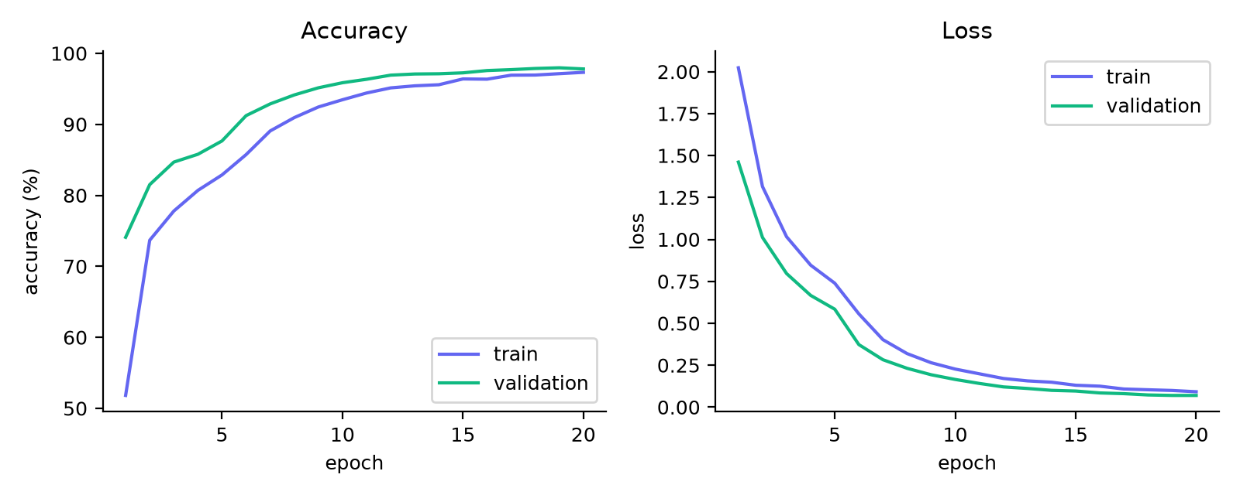
Two-stage transfer learning
EfficientNet-B0 feature blocks 0 to 8
0
1
2
3
4
5
6
7
8
Head
Frozen in both stages: edges and textures
Unfrozen in stage 2
Dropout 0.3 + linear (15)
Training schedule
Stage 1: head only, 5 epochs, lr 1e-4
Stage 2: blocks 6 to 8, lr 1e-5, up to 20 epochs
AdamW, weight decay 1e-4, batch 32
Early stopping (patience 5), best-validation checkpoint, seed 42
Notes:
Stage 1 freezes the ImageNet backbone, which already knows edges and textures, and trains only the new classifier head. Stage 2 unfreezes the last blocks, 6 to 8, with a much smaller learning rate so the network learns disease-specific patterns without forgetting what it knew. We keep the best checkpoint by validation accuracy and stop early if it stops improving.

Slide 12
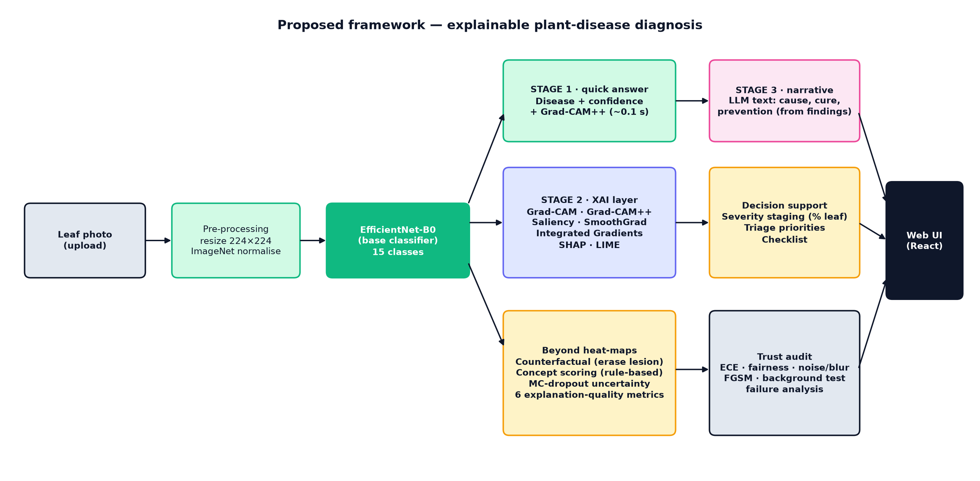
System architecture
Notes:
This is the end-to-end design. Data is cleaned and split, the model is trained in two stages, the API serves predictions and explanations, and the evaluation scripts score everything and produce the figures in this deck.

Slide 13
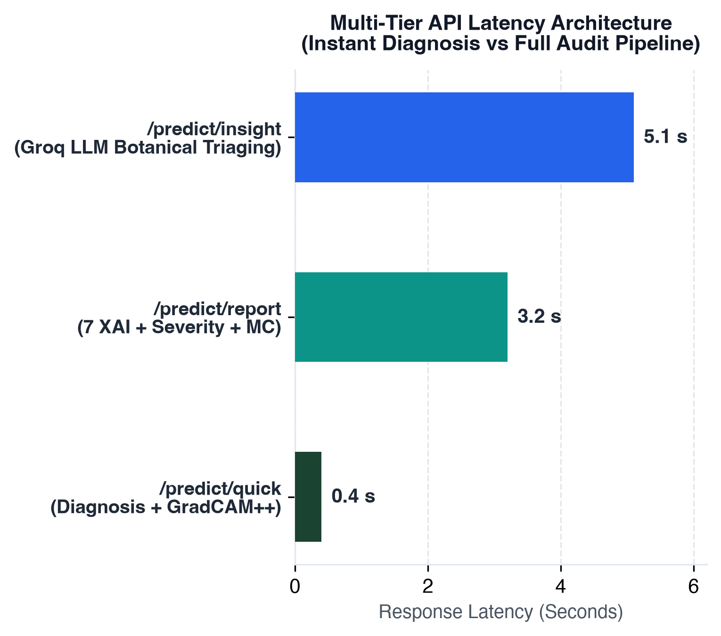
Serving: diagnosis first, detail behind it
1
/predict/quick
well under 1 s
Label, calibrated confidence and the first heatmap (Grad-CAM++)
2
/predict/report
about 3 s
7 explanations, 6 quality scores, leaf damage, concepts, uncertainty
3
/predict/insight
about 2 s
Groq-hosted LLM writes guidance from this image's findings
FastAPI + PyTorch backend · React + Vite frontend · Apple MPS, CUDA or CPU
Notes:
The app does not make the user wait for everything. The first call returns the diagnosis and one heatmap very quickly. The second call computes all seven explanations and the metrics. The third asks the language model for guidance written from what was measured in this image. The chart shows when each part appears on our machine.

Slide 14
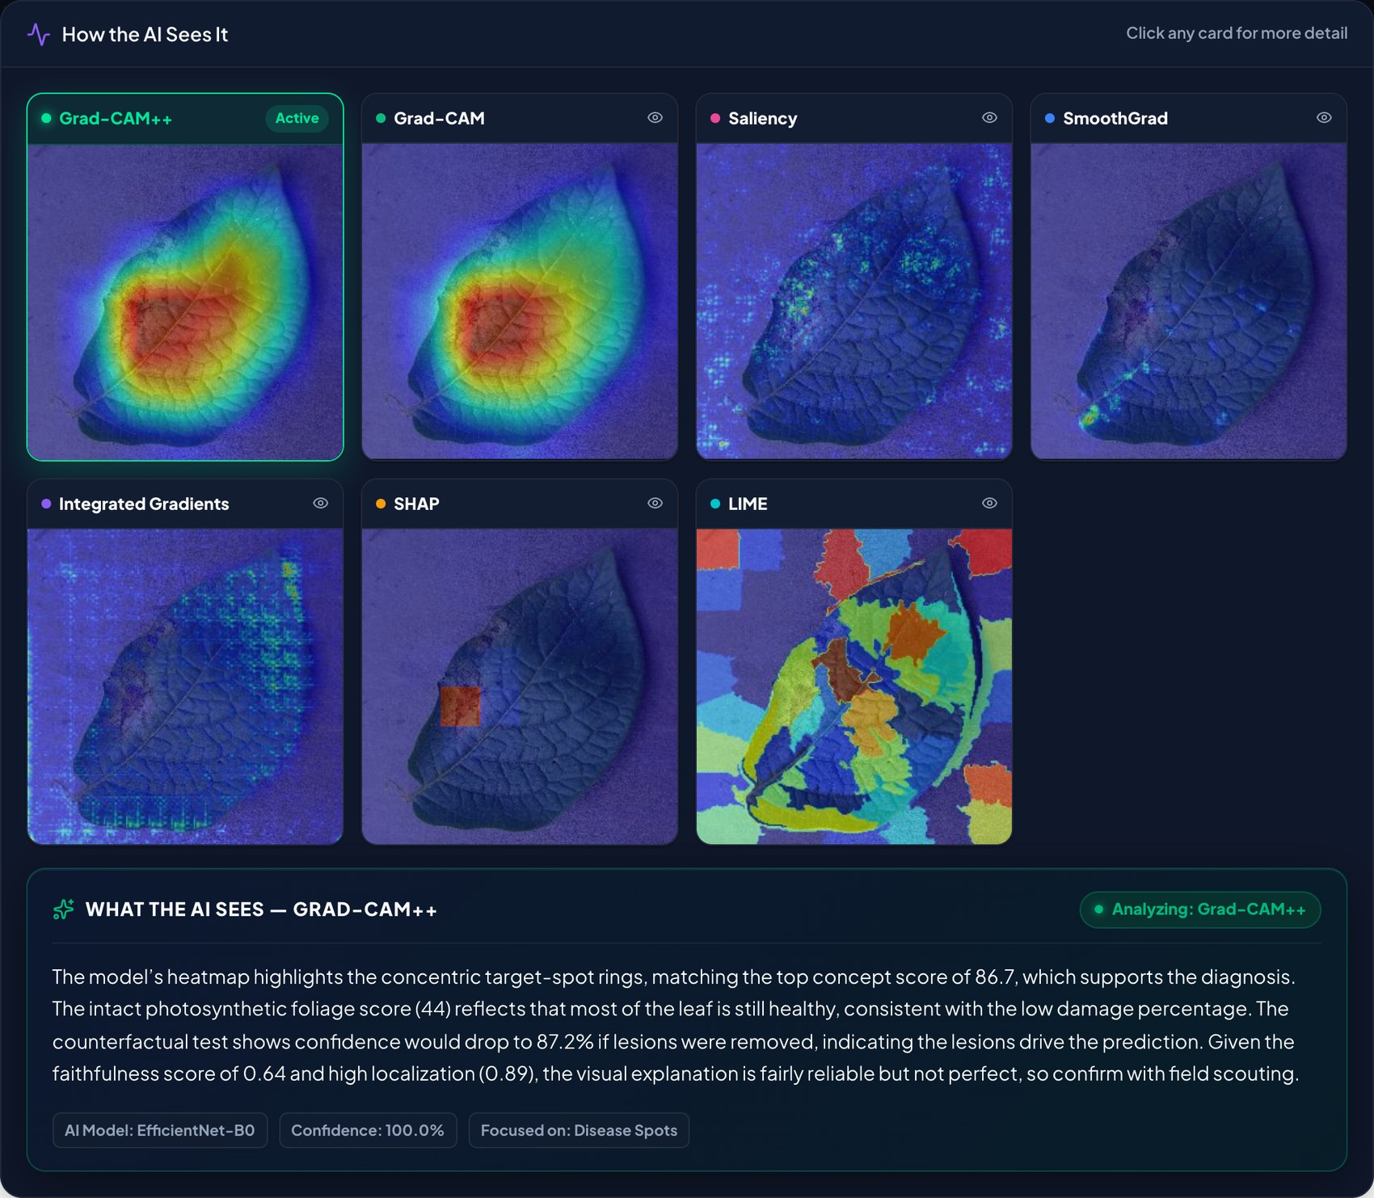
The app: diagnosis and seven explanations
1
Diagnosis
Disease name, calibrated confidence and the diagnosis time.
2
Seven views
Grad-CAM++, Grad-CAM, Saliency, SmoothGrad, Integrated Gradients, SHAP and LIME on the same photo.
3
Explanation text
Click a view to read what that method shows for this leaf.
Notes:
This is a real screenshot of the app. At the top is the diagnosis with the calibrated confidence and time. Below it, all seven explanation views are shown side by side and the user can click any of them to get a plain-language explanation of that method for this exact image.

Slide 15
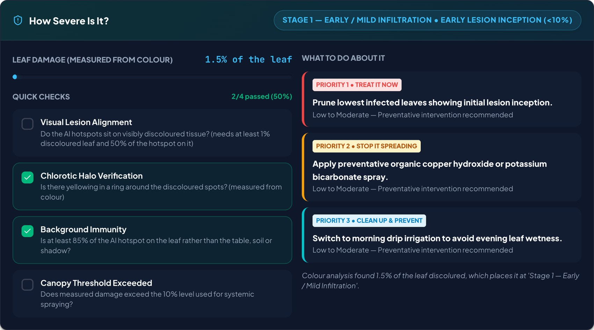
The app: how severe is it?
Measured damage
Share of the leaf that is discoloured, from pixel colour.
Four checks
Computed from this photo; each one can pass or fail.
Prioritised actions
Treatment steps matched to the stage (1, 2 or 3).
Notes:
This is the real damage card. The percentage is measured from colour, not from the heatmap. The four quick checks are computed from this photo and can fail: here the lesion check fails because the leaf has under 1 percent discoloured tissue, which is the honest result. The actions on the right depend on the stage.

Slide 16
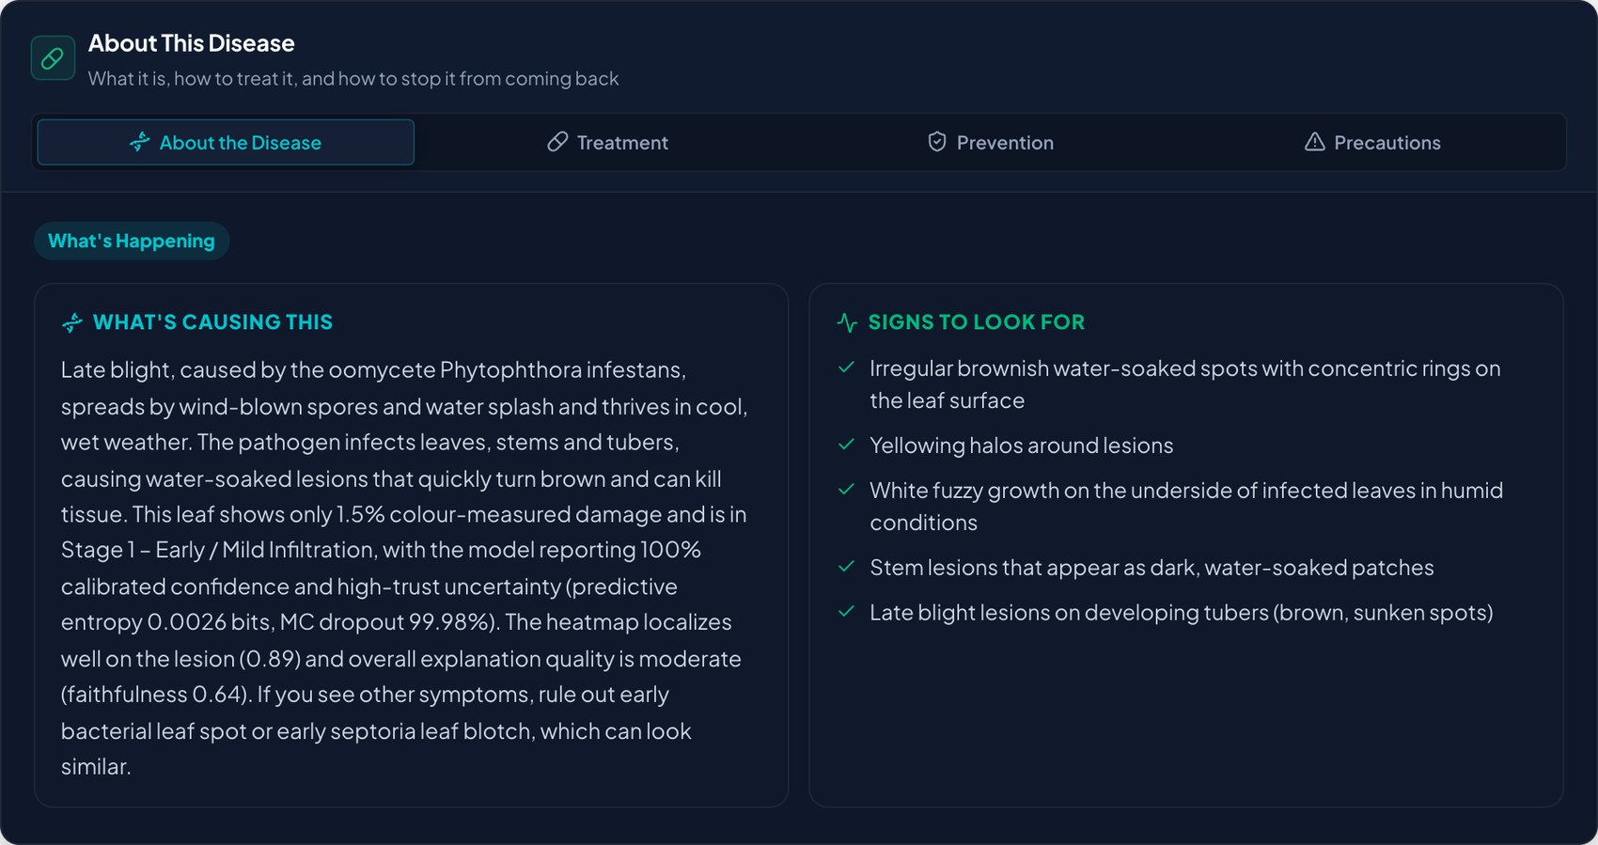
The app: written guidance
Written for this leaf
Uses the measured damage, confidence and uncertainty.
Four tabs
About the disease, treatment, prevention, precautions.
No canned text
If the LLM is unreachable, the panel says so.
Notes:
This is the real guidance panel. The text is written by a Groq-hosted language model from this image's own measurements, so two different leaves with the same disease get different wording. Tabs hold treatment, prevention and precautions. If the model cannot be reached the panel says so instead of showing generic text.

Slide 17
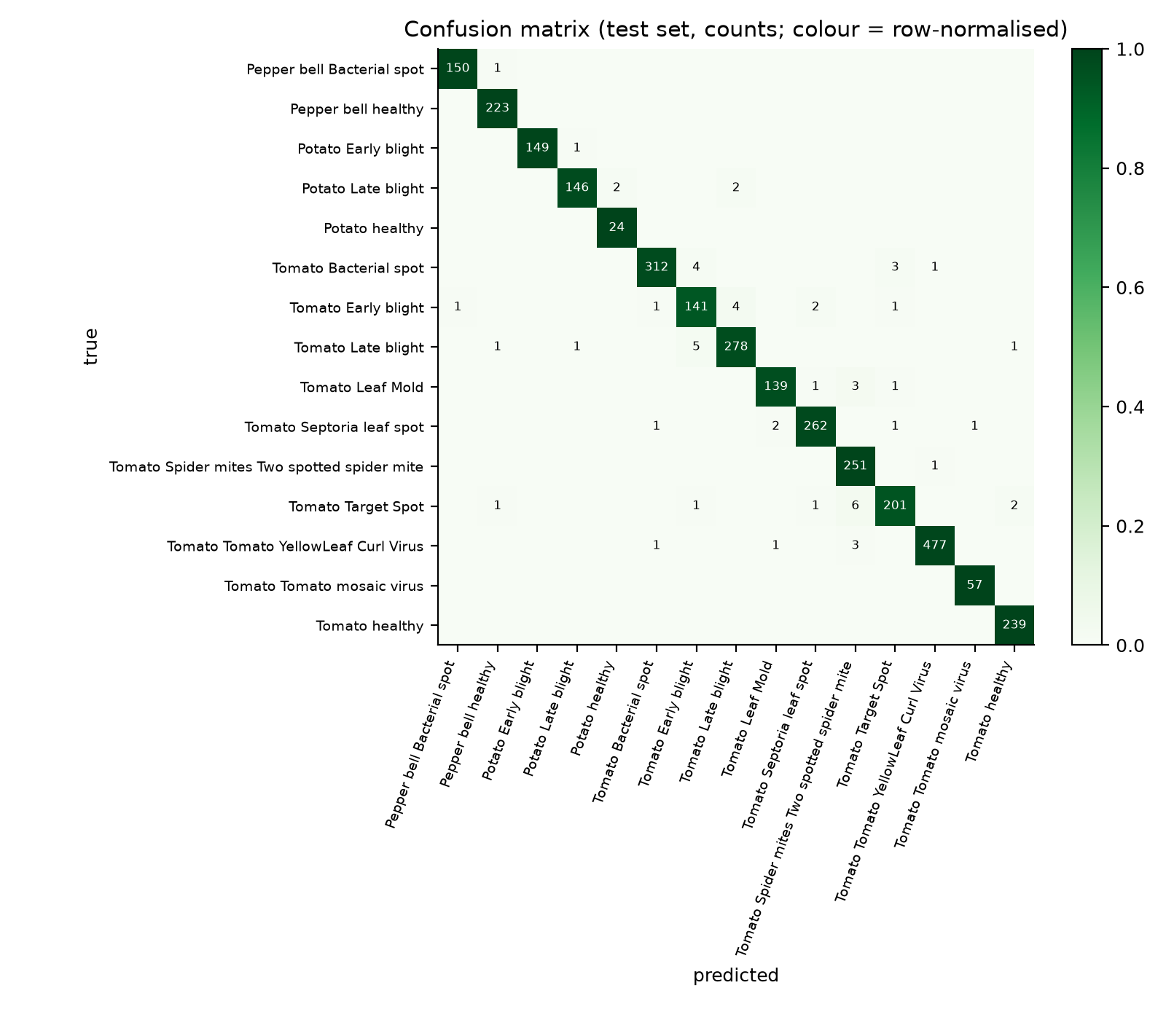
Base model results
98.13%
0.979
test accuracy (3,107 images)
macro F1 over 15 classes
58
0.0056
mistakes in 3,107 photos
calibration error after scaling
Most common mix-up: Target Spot predicted as Spider mites (6 photos), then Late and Early blight confused both ways (5 + 4).
Notes:
This is the plain classifier before any explanation. 98.13 percent on 3,107 test photos the model never saw, macro F1 of 0.979. The confusion matrix shows the mistakes are between look-alike diseases, mostly blights and spots on tomato.

Slide 18
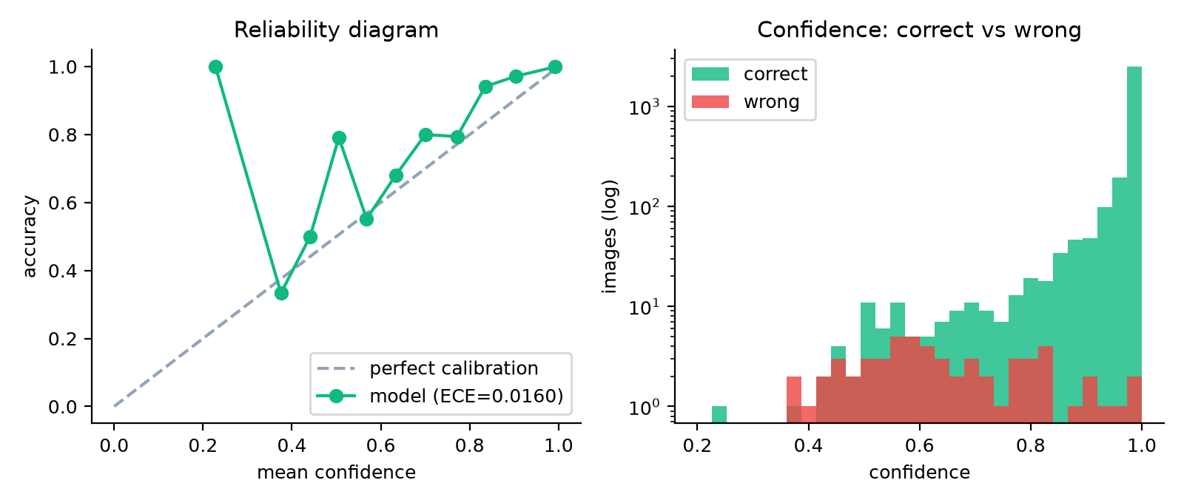
Confidence: MC-Dropout and temperature scaling
MC-Dropout: how unsure?
Run the same photo 20 times with dropout on. Different answers each time means the model is unsure. We report the spread as a trust level.
0.016 → 0.0056
calibration error (ECE) on the test set, accuracy unchanged
Temperature scaling: how sure?
Divide the scores by T = 0.778, fitted on validation data. The class never changes; the confidence matches reality better.
Confidence also flags mistakes: AUROC 0.96 for spotting wrong predictions.
Notes:
Two tools make the confidence score honest. MC-Dropout keeps dropout switched on at test time and runs the same photo many times. If the answers differ, the model is unsure about that photo. Temperature scaling divides the logits by one number fitted on the validation set. It never changes the predicted class, it only makes the stated confidence match how often the model is really right.

Slide 19
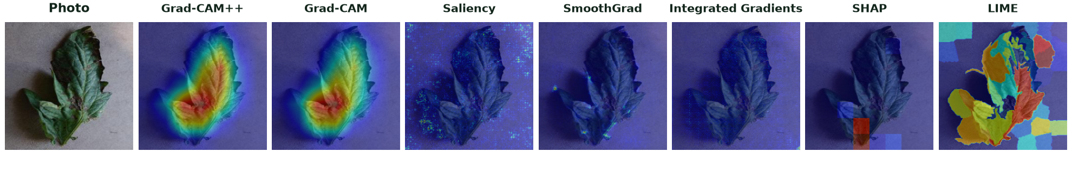
Seven post-hoc explanation engines
Activation-based
Gradient-based
Perturbation-based
Grad-CAM — regions that pushed the class score up
Grad-CAM++ — better at several separate lesions
Saliency — pixels whose change moves the score
SmoothGrad — saliency averaged over noisy copies
Integrated Gradients — credit added up from a blank image
SHAP — hide patches, see the score drop
LIME — a simple model imitates the CNN nearby
Notes:
Post hoc means the explanation is produced after the model has already made its decision, without changing the model. The strip shows all seven on one real leaf. We group the engines by how they work: activation-based, gradient-based and perturbation-based.

Slide 20
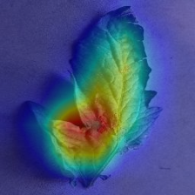
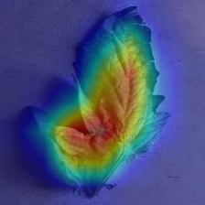
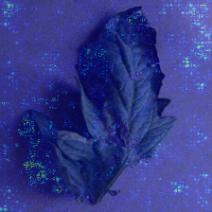
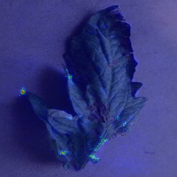
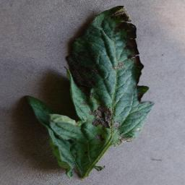
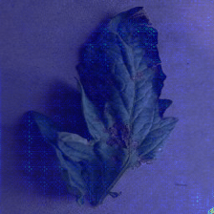
Gradient-based engines: how they differ
Grad-CAM
Grad-CAM++
Saliency
SmoothGrad
Photo
Integrated Gradients
Grad-CAM and Grad-CAM++
Saliency and SmoothGrad
Integrated Gradients
Regions that raised the class score
Read the last convolution layer, so maps are smooth
Grad-CAM++ weights feature maps with higher-order gradients
Which pixels change the score if they change a little
Saliency is noisy; SmoothGrad averages 15 noisy copies
Move from a blank image to the photo in 20 steps and add up the gradient
Fair credit per pixel, but faint on leaves
Notes:
Grad-CAM looks at the last convolution layer and draws a smooth blob where the evidence is. Grad-CAM++ uses higher-order gradient information to weight the feature maps, so several small disease spots can each light up. Saliency looks at single pixels and is noisy. SmoothGrad fixes that by averaging many noisy copies. Integrated Gradients adds up credit along a path from a blank image to the photo. The thumbnails are real outputs on one leaf.

Slide 21
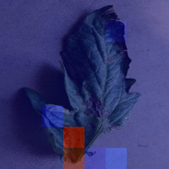
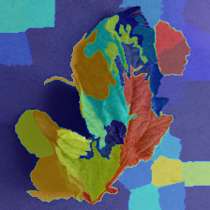
Perturbation-based engines: SHAP and LIME
SHAP (occlusion)
LIME
1
Divide the image into an 8 × 8 grid of patches
1
Split the leaf into superpixels
2
Hide patches and re-run the model
2
Switch superpixels on and off in about 40 copies
3
A patch's importance is the score drop it causes
3
Record the CNN's answer for each copy
4
Paint the importances as a heatmap
4
Fit a simple linear model that imitates the CNN nearby
Idea from cooperative game theory: each patch is a player sharing credit.
Model-agnostic and post hoc: a simple surrogate explains a complex model.
Notes:
Both of these treat the model as a black box. SHAP hides patches of the leaf and measures how much the prediction drops, which borrows ideas from cooperative game theory: each patch is a player. LIME makes many altered copies, records the model's answers, and fits a small linear model that imitates the CNN around this one photo.

Slide 22
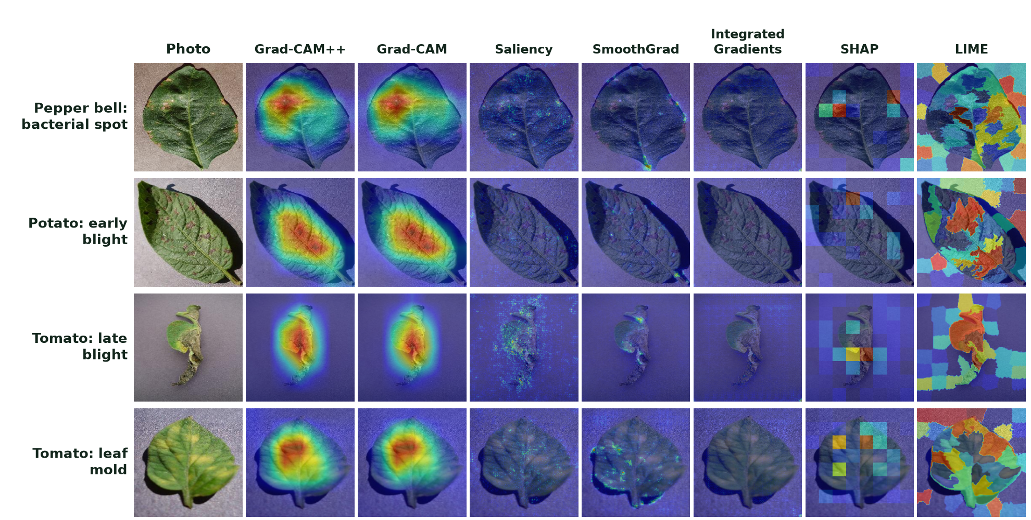
What the engines show on real leaves
Grad-CAM, Grad-CAM++: smooth blobs on the lesions
Saliency, SmoothGrad: fine, speckled edges
Integrated Gradients: faint on these leaves
SHAP and LIME: coarse patches / superpixels
Notes:
These are real outputs from our test set, one leaf per row. Grad-CAM and Grad-CAM++ give smooth blobs on the lesions. Saliency and SmoothGrad are speckled. SHAP is coarse because it works on patches. LIME shows superpixels. Integrated Gradients is faint here, which matches its weaker score in the metrics.

Slide 23
Judging predictions on three criteria
Interpretability
Explainability
Trustworthiness
How far a person can understand how the model works inside.
Post-hoc techniques that show why one prediction was made.
Whether the system can be relied on, and says when it cannot.
In this project
In this project
In this project
EfficientNet-B0 with a known last convolution layer that we read directly.
Seven engines: heatmaps, a counterfactual test and concept scores.
Calibrated confidence, MC-Dropout uncertainty, robustness tests, six explanation metrics, failure analysis.
Interpretable model
Explained predictions
Trusted decisions
Notes:
We use three words carefully. Interpretability is about understanding how the model works inside. Explainability is the set of post-hoc techniques that say why a particular prediction was made. Trustworthiness is whether we can rely on it: calibrated, robust and honest about its limits.

Slide 24
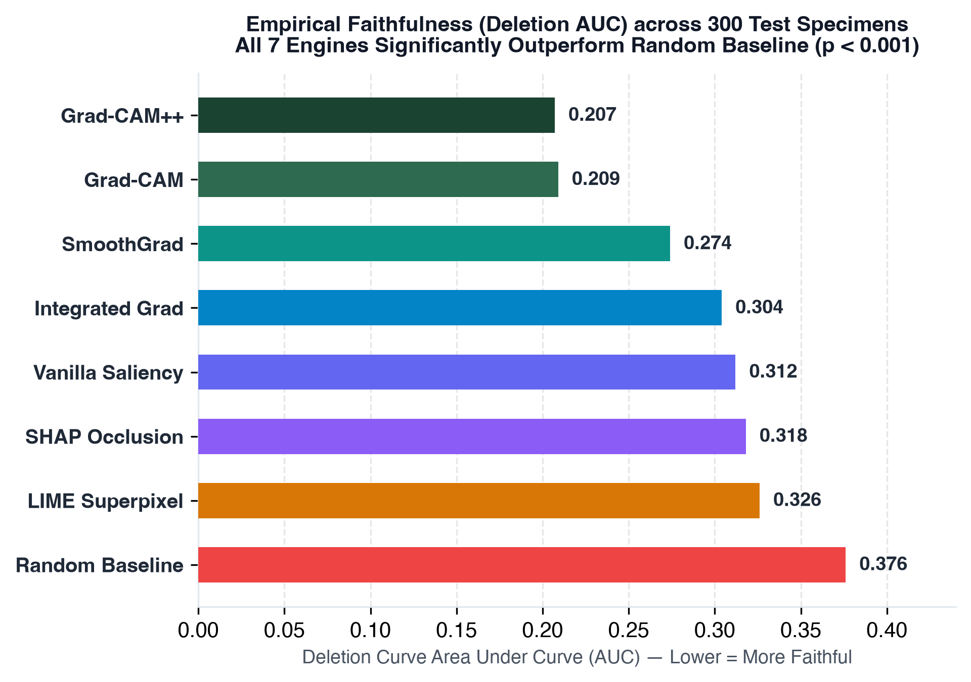
Scoring the explanations, not just showing them
Six quality metrics
Faithfulness: deletion and insertion curves
Stability: same map under small noise
Consistency: do methods agree
Robustness: map under lighting change
Sparsity: focused or smeared
Localization: attention on the leaf
300 test images (75 for LIME). Each method is compared with a random heatmap (Wilcoxon test).
Notes:
Deletion AUC asks: if we remove the pixels the method calls important, how fast does the model's confidence fall? Lower is better. A random heatmap scores 0.326. Grad-CAM, Grad-CAM++ and SHAP are clearly better than random. Integrated Gradients is worse than random in this setup, which is an honest negative result.

Slide 25
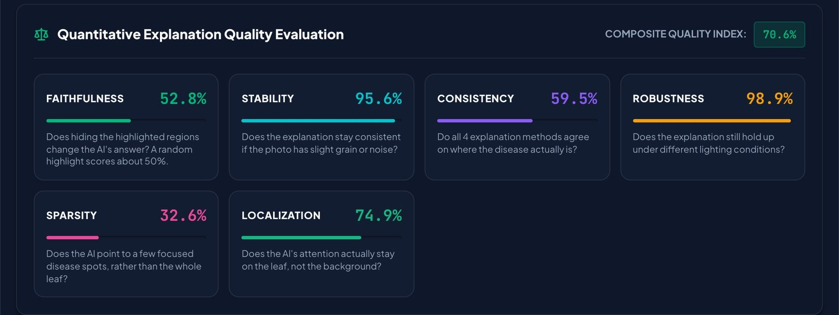
The app: explanation quality, scored per photo
Faithfulness vs chance
Stable and robust
Broad maps
Shown next to the score a random heatmap gets, so about 50% means no better than chance.
The map barely moves under noise or lighting changes.
Low sparsity: the heat is spread over a region, not a few pixels. Composite weights are a design choice.
Notes:
The same six metrics are computed for every photo and shown in the app, next to a random-heatmap baseline for faithfulness so the number can be read honestly. The composite index at the top combines them with design weights that we have not validated.

Slide 26
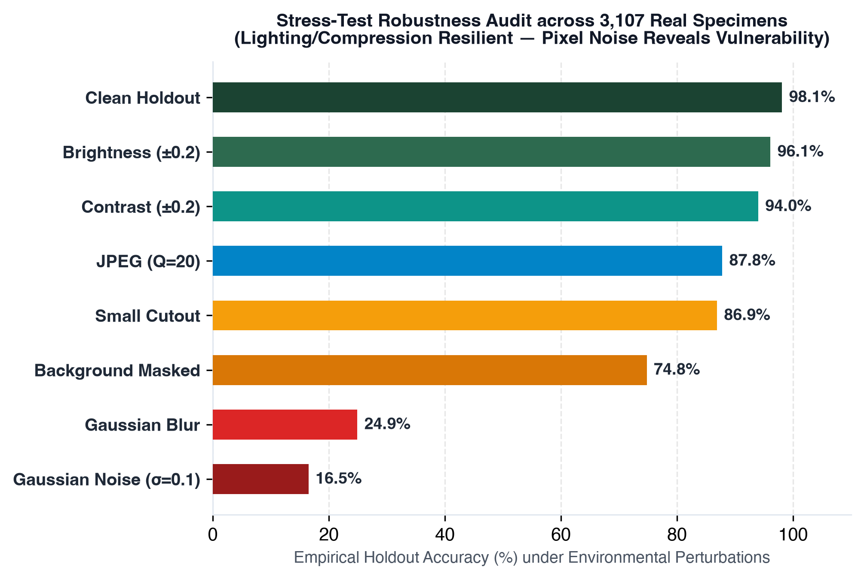
Robustness: fine on light, weak on noise
What this tells us
Lighting and compression: fine
Losing the background costs 23 points
Noise (σ 0.10) and blur: accuracy collapses
Next: train with noise and blur
Notes:
We changed every test image in eight ways and re-measured accuracy. Lighting and mild compression barely matter. Noise and blur are a real weakness: accuracy falls to about a quarter and a sixth. This is a limit we report openly, and a reason to add noise and blur augmentation next.

Slide 27
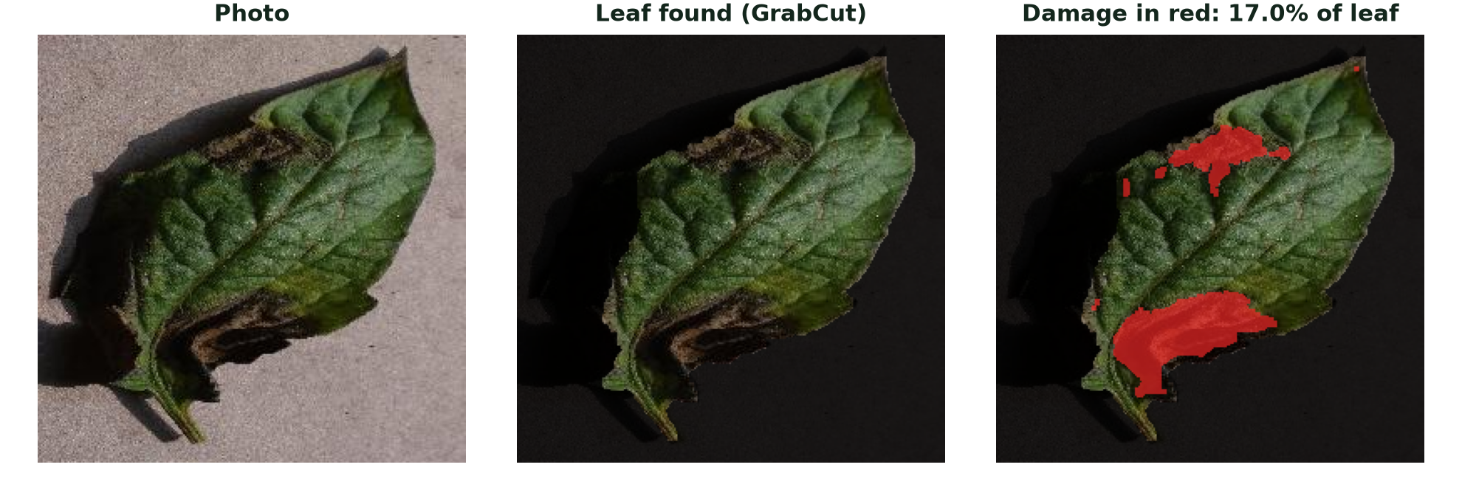
Leaf damage and decision support
Checked against known truth
0.1%
median on 120 real healthy leaves (93% under 5%)
1.6 pts
1
Find the leaf
2
Count damage
average error on painted lesions (r = 0.97, stage right 94%)
GrabCut mask seeded by green regions
yellow, brown, dark or pale pixels
3
Percent of leaf
4
Stage
Painted lesions are synthetic: no expert lesion masks exist, so accuracy on real lesions is not measured.
damaged ÷ leaf pixels
1: < 10% 2: 10–25% 3: > 25%
Notes:
Leaf damage used to be taken from the heatmap, which only shows where the model looked. We now measure it from colour: find the leaf, then count the pixels that are not healthy green. The three pictures are a real late-blight leaf from our test split. We tested the method two ways. On real healthy leaves it reads close to zero. On healthy leaves where we painted lesions of known size, the error is small. The painted test is synthetic, because PlantVillage has no expert lesion masks.

Slide 28
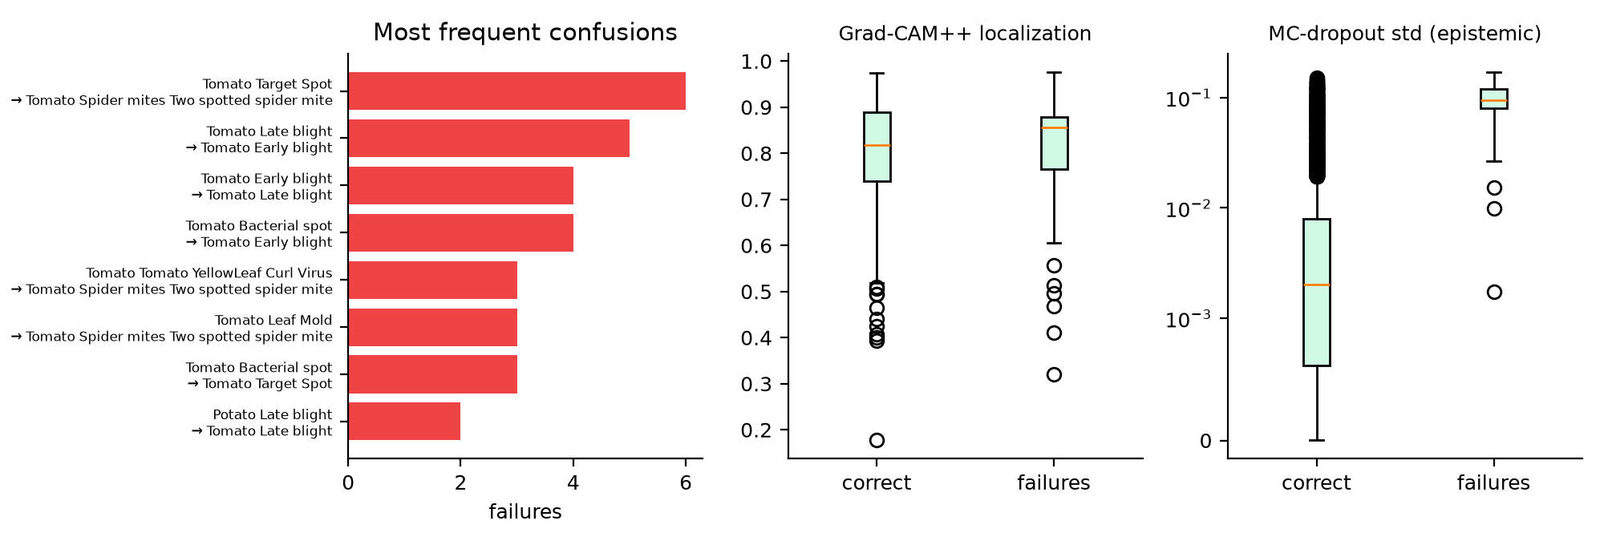
Learning from the 58 mistakes
Look-alike diseases: Blights and spot diseases, not random errors
Every error explained: Four engines plus a counterfactual test
Warning signs: Lower confidence and higher MC-Dropout spread
Notes:
We explained every wrong prediction with four engines and a counterfactual test. The errors are not random: they are look-alike diseases, such as early and late blight, or target spot and spider mites. Confidence is usually lower on these cases, which is why the trust level matters.

Slide 29
How this compares with earlier work
Study | Model | Reported accuracy | Shows explanations | Scores explanations
Mohanty et al., 2016 | AlexNet, GoogLeNet | 99.35% | No | No
Ferentinos, 2018 | VGG and other CNNs | 99.53% | No | No
Brahimi et al., 2017 | AlexNet, GoogLeNet (tomato) | 99.18% | Saliency, occlusion | No
Toda and Okura, 2019 | CNN, visualised | not the focus | Feature visualisation | Qualitative only
PhytoShield AI (ours) | EfficientNet-B0 | 98.13% (de-duplicated) | 7 engines + counterfactual | Yes: 6 metrics vs random
Accuracies are as reported by each paper on its own data and splits, so they are not directly comparable. Check against the original papers before citing.
Notes:
Earlier plant-disease studies mostly reported accuracy. Few showed explanations, and fewer scored them. Our contribution is the combination: a duplicate-free evaluation, seven engines under one protocol, and measured explanation quality. The accuracies are as reported by each paper on its own data and are not directly comparable.

Slide 30
Honest limits and next steps
Limits
Only identical copies removed; near-duplicates may remain
Lab-style photos: field performance untested
Fragile to noise and blur
Faithfulness about 58% against 50% for random
Expert ratings still pending
Next steps
Train on all 38 classes (about 54,300 images)
Add field photos, noise and blur augmentation
Detect near-duplicate photos
Expert lesion masks and expert ratings
Compare more backbones once trained
Now: 15 classes
Next: all 38 classes
Then: field photos
Finally: expert review
Notes:
Say the limits before the examiner does. Only identical copies were removed, so near-duplicates may remain. PlantVillage photos are lab-style. The model is fragile to noise and blur. Our faithfulness score is about 58 percent against 50 for random, so the explanations are useful but not proof. Expert ratings are pending. Next we will scale to all 38 classes and add field photos.

Slide 31
Takeaways
Honest data
Small and accurate
Found that 50% of files were duplicates, fixed it, retrained: 98.13% is the real number.
EfficientNet-B0: 4.03 M parameters, 0.38 GFLOPs, 98.13% on unseen photos.
Explanations that are scored
Calibrated confidence
Seven engines compared with a random baseline on six metrics.
Temperature scaling and MC-Dropout say how sure, and when not to trust.
Thank you. Questions?
Notes:
Close with four sentences: we found and fixed a leak and report the honest number; the model is small and accurate; the explanations are scored, not just shown; and confidence is calibrated and uncertainty-aware. Then invite questions.

