Slide 1

Exploratory Data Analysis
Hate Speech Detection Using Transformers
Team – Solitude Ensemble
27-Feb-2024

Slide 2
Agenda
Executive Summary
Problem Statement
Approach
EDA
EDA Summary
Code walkthrough

Slide 3
Executive Summary
As a part of final internship project, we want to create a machine learning model which can classify the tweets in two parts whether it is hateful tweet or not.

Slide 4
Problem Statement
Objective : The term hate speech is understood as any type of verbal, written or behavioural communication that attacks or uses derogatory or discriminatory language against a person or group based on what they are, in other words, based on their religion, ethnicity, nationality, race, colour, ancestry, sex or another identity factor. In this problem, We will take you through a hate speech detection model with Machine Learning and Python. But, before that we are going to do analysis of data and based on analysis we will modify for better performance of our model.

Slide 5
Approach
Data Understanding
Data Cleaning and manipulation
Analysing and visualizing data
Recommendations of machine learning models

Slide 6
Data Exploration
2 datasets: Training and Test
3 features in total in training data with 2 input features and 1 target
2 features in total in test data with 2 input features
Total Data:
1) training dataset : 31962
2) test dataset : 17197

Slide 7
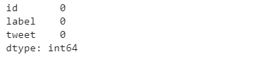
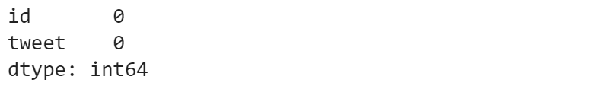
Data Analysis
Finding Empty data in dataset
in Training Data
in Test Data
So, here as you can see there is no empty data in our both datasets. So, we do not need to fill up that space.

Slide 8
Data Modification
Removing unnecessary words
In our datasets we have some unnecessary words such as user names , special characters , website links or numbers which do not have any impact in predictions. So, we need to remove that to create better and faster machine learning model.

Slide 9
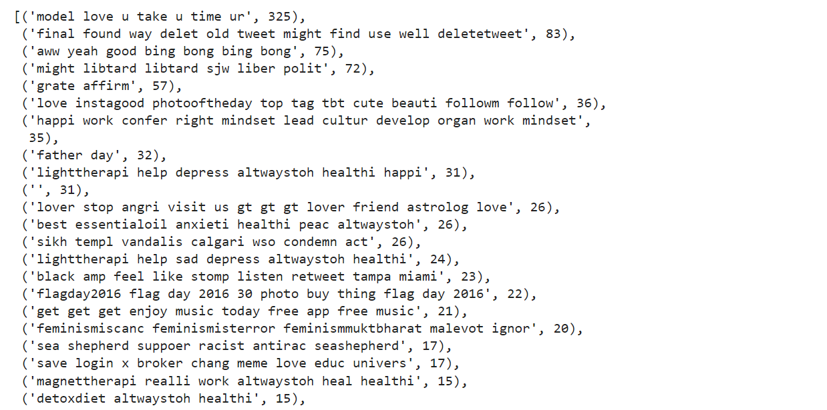
Data Modification
Removing Duplicate Data (I)
First we are going to find that whether we have any duplicate data(tweets) or not. And, in below picture we can see tweet and occurrence of that tweet in whole data.

Slide 10
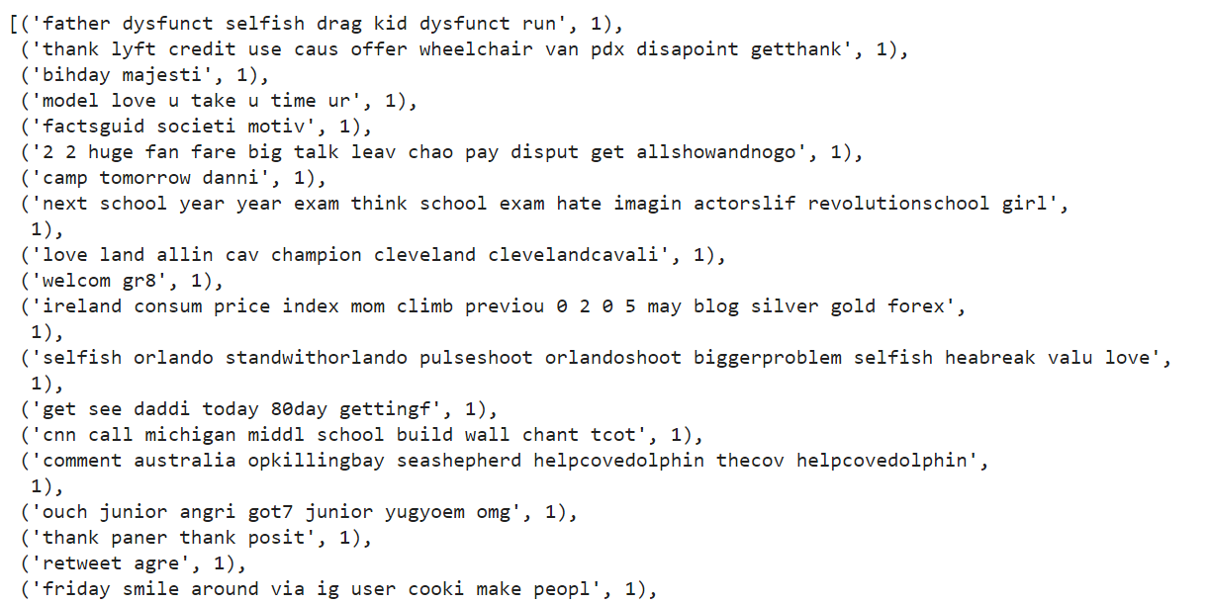
Data Modification
Removing Duplicate Data (II)
Now , you can see below the result after removing duplicate data(tweets). Every tweet has only 1 occurrence in dataset.

Slide 11
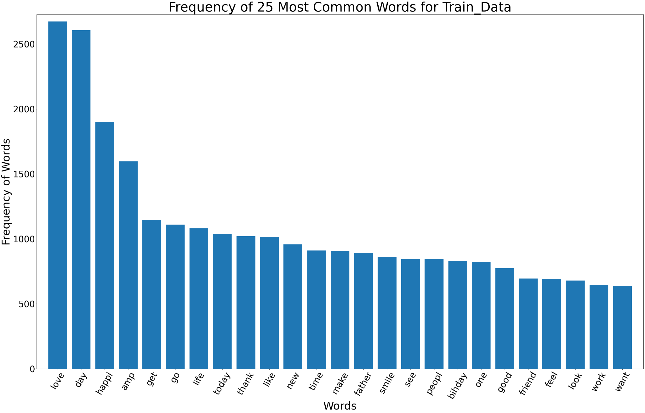
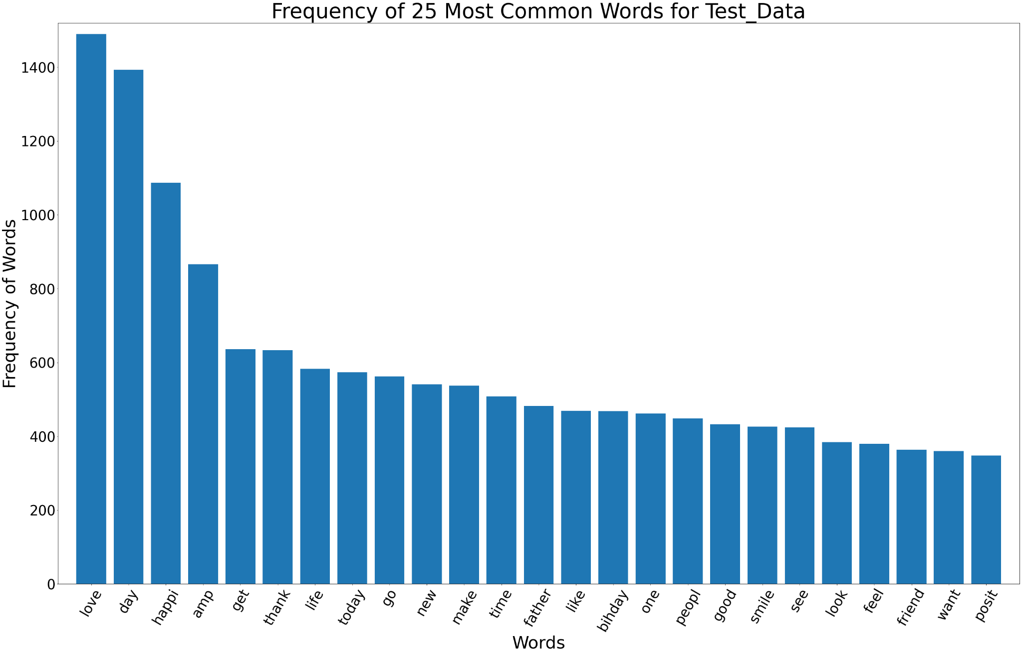
Frequency of word in data
In above graph we can see the 25 most common words in Training dataset and Test Dataset.
We can see that both the datasets have almost same most common words. For this reason we might get accurately trained model through which we can get high accuracy while testing and predicting results.

Slide 12
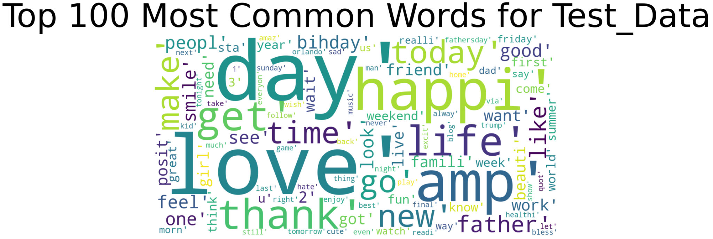
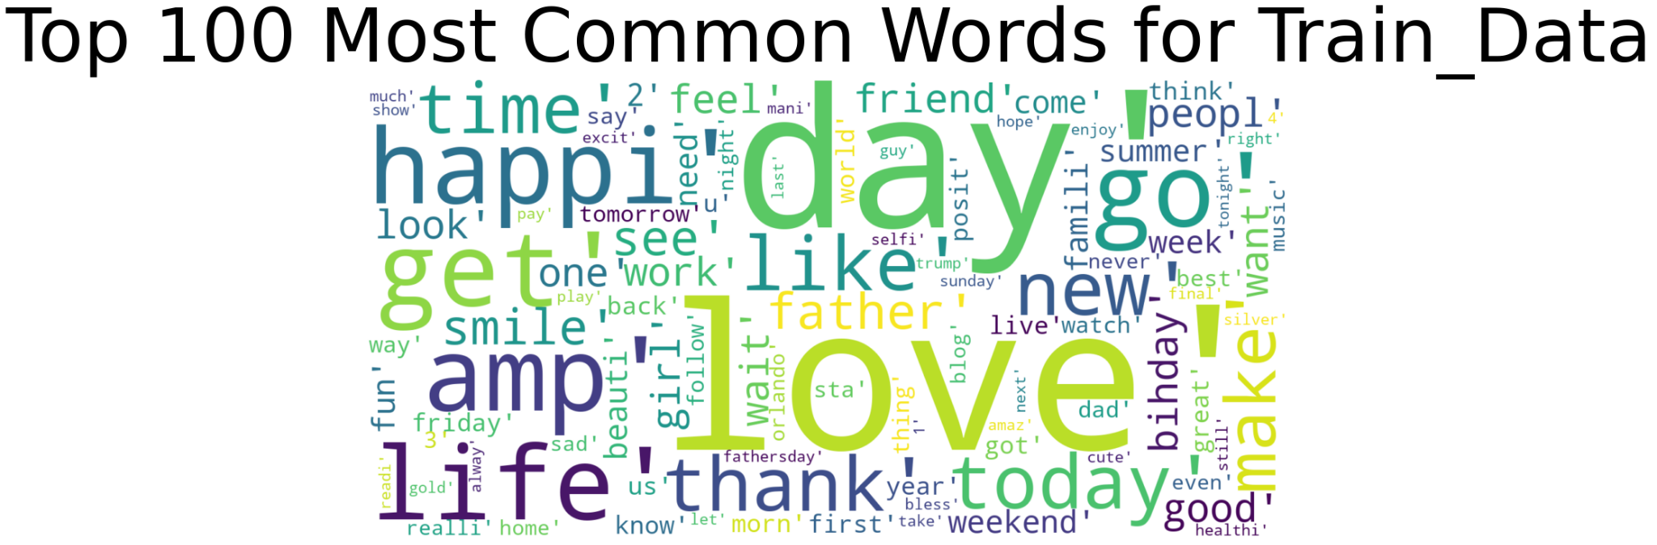
Frequency of word in data
Here we can 100 most common words in picture. Bigger the word most common the word.

Slide 13
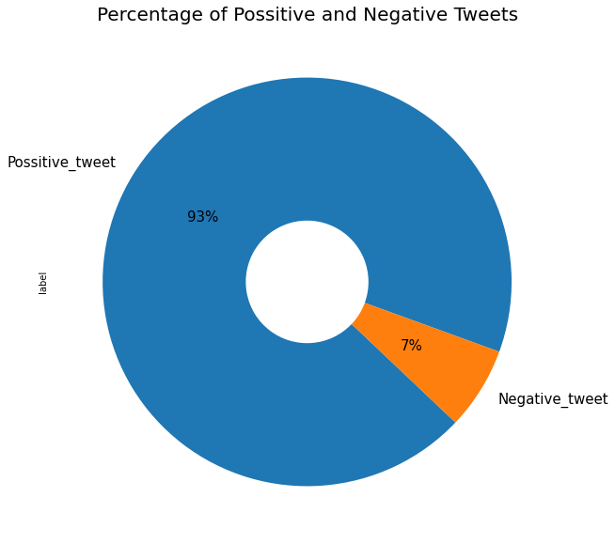
Data Exploration and visualization
Distribution ratio of positive and negative tweets in training data
From above chart we can see that we have extremely high number of positive(Non hateful) tweets. This can cause problem in prediction of our test data. Model trained with this dataset will be heavily biased to positive tweets means in most of the cases our model will predict that is is positive tweet even if it is not. So, we have make it 1:1 ratio with sampling method.
In sampling there is upsampling method in which it will generate data from our old dataset for e.g Here we have less negative tweets so it will create negative tweets to match number of positive tweets.

Slide 14
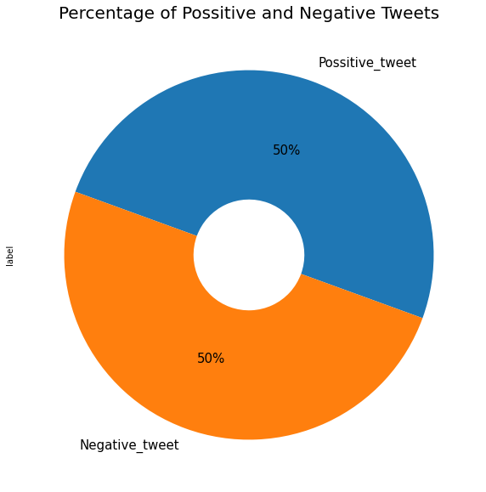
Data Exploration and visualization
Distribution ratio of positive and negative tweets in training data
After upsampling this is the result where we have equal number of positive and negative tweets.

Slide 15
Code Walkthrough
Step_1: Feature_Extraction:
First of all we need to convert text into 0s and 1s. For that we need to do feature extraction and for that we can use Bag of Word model by CountVectorizer, TFIDF, etc…
Here, we used CountVectorizer to count the frequency of word and convert text into 0s and 1s.

Slide 16
Code Walkthrough
Step_2:Transformer:
Transformer use to Transform a count matrix to a normalized tf or tf-idf representation so that we can use TfidfTransformer from sklearn.feature_extraction as shown in belove code.

Slide 17
Code Walkthrough
Step 3: Model Selection:
From analysing datasets we can clearly see that we have to classify that whether tweet is positive or negative. So, we have to use modern and advance classification machine learning models such as XGboost, Stochastic Gradient descent , Decision Tree , Random Forest Model etc.
But the Question is which classification model is more accurate in this dataset?
So, for that we developed model to determine the accuracy of all classification model.By that, we can say which model is more accurate in this data set.

Slide 18
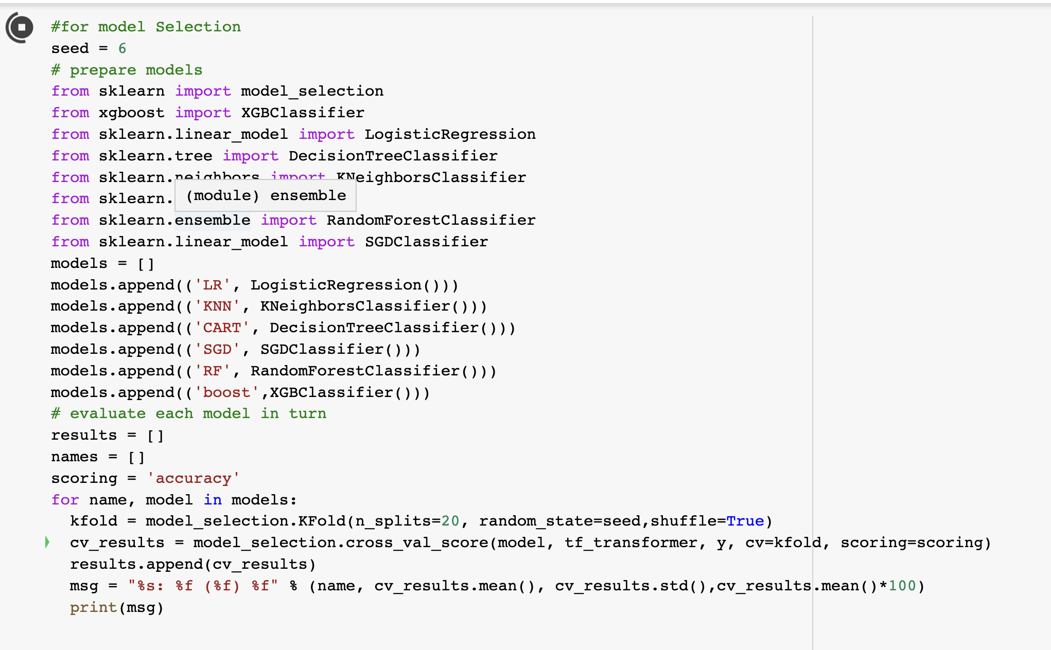
Code Walkthrough

Slide 19
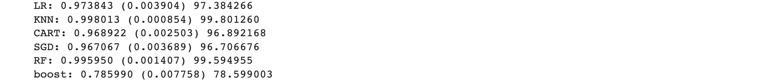
Code Walkthrough
From the output of above model we can clearly say which model is more accurate in this data set.
In XGboost model there is a very less accuracy as compare to other so we can’t select that model.while,other models have almost same accuracy but according to time taken by each model we can select Logistic Regression and SGD.But, SGD is optimized model and that model is more accurate on Large data set.in contradiction we don’t have larger data set so according to Data_size, time and accuracy Logistic Regression model is more suitable.

Slide 20
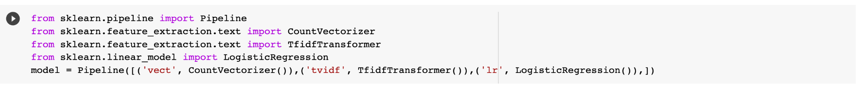
Code Walkthrough
Step 4: Model Building and Applying on Test data:
Using Sklearn Pipeline is a convenient way to enforce the steps with preprocessing steps and ensures the code's reproducibility. Unstable and inconsistent results for production models can significantly impact businesses if they are relying on machine learning models to make their decisions every day.Hence,we used pipeline in our code.

Slide 21
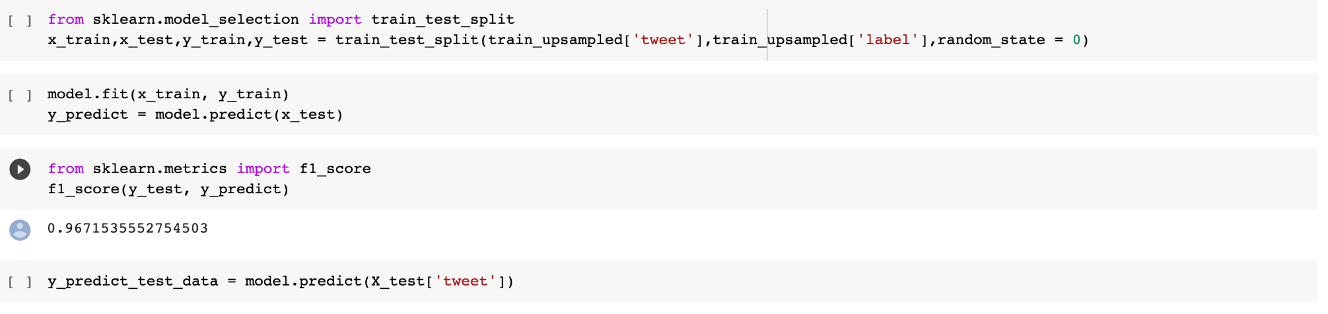
Code Walkthrough
Step 4: Model Building and Applying on Test data:
After that, We trained our model using train_data and applied it into Test_data and got almost 97% accuracy.

Slide 22
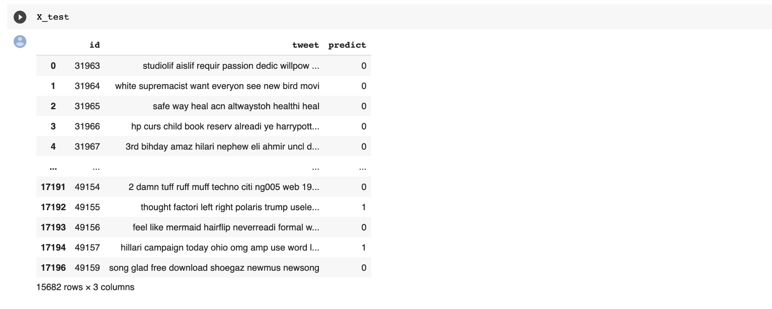
Code Walkthrough
Step 5: Prediction

Slide 23
Thank You

