Slide 1
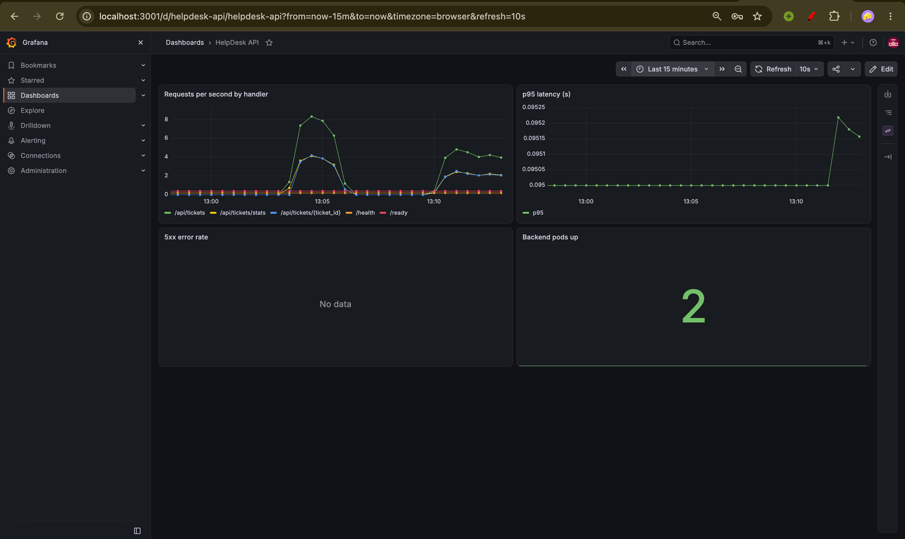
HelpDesk
An end-to-end DevOps capstone: from a laptop to a monitored Kubernetes cluster on AWS
Parth Taneja
Session 21 Final Capstone Project
github.com/parthtaneja0001/helpdesk-devops-capstone
Notes:
Introduce the project: HelpDesk is a support-ticket app, but the real subject of this presentation is how it is tested, packaged, secured, deployed to AWS and monitored automatically. Everything in this deck is backed by screenshots from the real run.

Slide 2
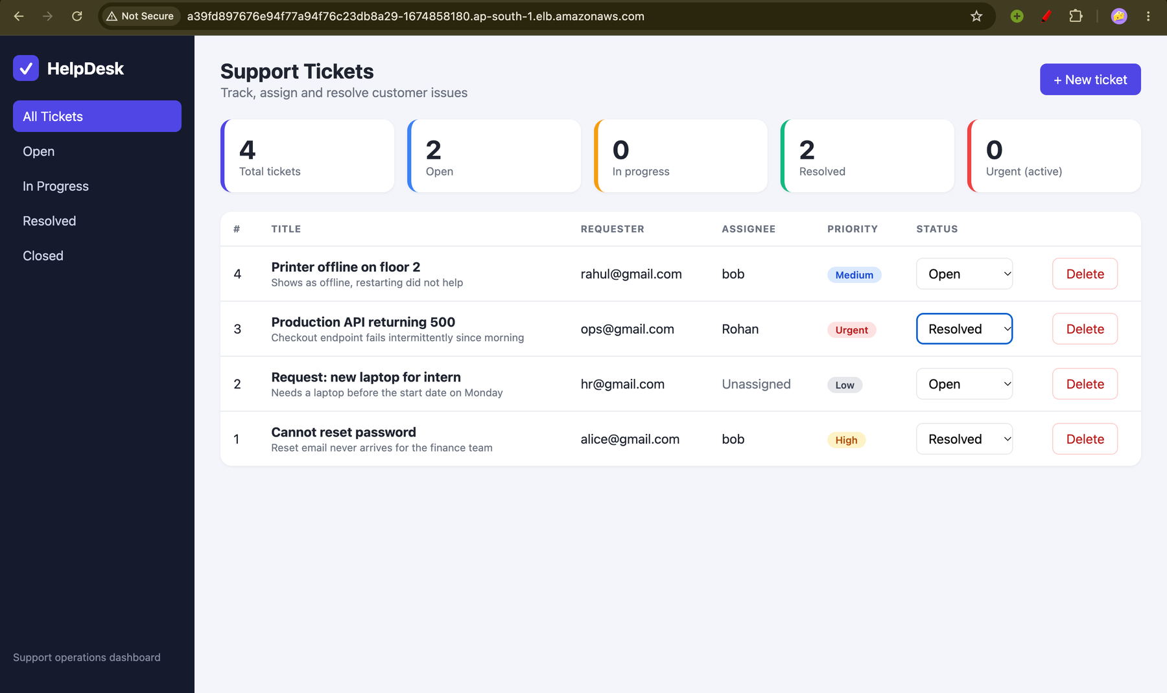
What is HelpDesk?
INTRODUCTION
A ticket tracker for support teams
Log an issue, set a priority, assign it, track it to closed
Live dashboard with totals, open, in progress, resolved and urgent counts
Ticket workflow
Open
In progress
Resolved
Closed
The running dashboard
Notes:
HelpDesk is a simple tool a support team would use. A customer reports a problem, the team logs it as a ticket, gives it a priority, assigns someone, and moves it through the workflow until it is closed. The dashboard at the top gives managers instant counts. The app itself is deliberately simple so the focus stays on the DevOps pipeline around it.

Slide 3






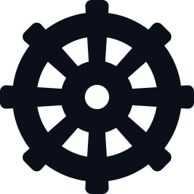

From laptop to the cloud
INTRODUCTION
Code
1
Test
2
Build
3
Scan
4
Write the app and commit it to Git
pytest checks the code on every push
Docker packages the app into images
Trivy blocks known vulnerabilities
Publish
5
Cloud
6
Deploy
7
Monitor
8
Images go to GHCR, tagged by commit
Terraform builds the AWS network and cluster
Helm installs the app on Kubernetes
Prometheus and Grafana show live health
Notes:
This is the whole project on one slide. A developer commits code. GitHub Actions tests it, packages it in Docker, scans it for security problems and publishes the image. Terraform builds the AWS network and Kubernetes cluster. Helm installs the app. Prometheus and Grafana watch it. Every step is automated, so any change follows exactly the same path.

Slide 4

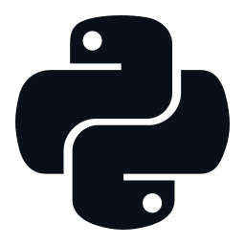
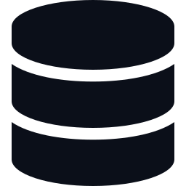
Tech stack at a glance
INTRODUCTION
Frontend
Backend
Database
React 18 + Vite, responsive CSS, served by Nginx
FastAPI, SQLAlchemy ORM, Alembic migrations
PostgreSQL 16 with a migrated tickets table
Containers
CI/CD and security
Cloud and ops
Docker images and a Docker Compose stack
GitHub Actions, GHCR registry, Trivy scanner
Terraform, AWS EKS, Helm, Prometheus, Grafana
Notes:
Each layer uses a mainstream, industry-standard tool. React and FastAPI are the application; PostgreSQL stores the data; Docker packages it; GitHub Actions and Trivy automate quality and security; Terraform and Kubernetes run it in the cloud; Prometheus and Grafana observe it.

Slide 5
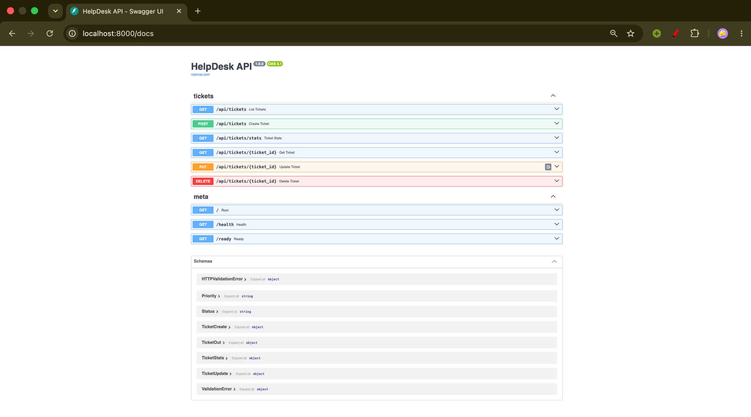
The backend API
APPLICATION AND QUALITY
Method | Path | Purpose
GET | /api/tickets | List and filter
GET | /api/tickets/{id} | Get one ticket
POST | /api/tickets | Create a ticket
PUT | /api/tickets/{id} | Update a ticket
DELETE | /api/tickets/{id} | Delete a ticket
GET | /api/tickets/stats | Dashboard counts
GET | /health /ready /metrics | Probes and metrics
Interactive Swagger documentation
An Alembic migration creates the tickets table automatically on startup.
Notes:
The FastAPI backend exposes a REST API. There are five CRUD endpoints for tickets plus a stats endpoint for the dashboard. Health, ready and metrics endpoints exist for Kubernetes and Prometheus. The tickets table is created by an Alembic migration that runs automatically when the container starts. Swagger documentation is generated for free by FastAPI.

Slide 6
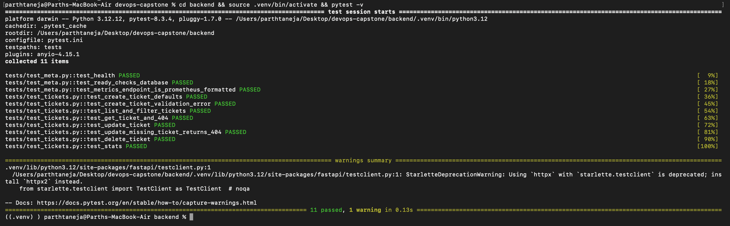
Automated testing
APPLICATION AND QUALITY
11
tests, all passing
3
areas: health, metrics, ticket CRUD
0
real databases touched (in-memory SQLite)
pytest -v: every test passes before any image is built
Notes:
Tests are the first quality gate. Eleven pytest tests cover health, readiness, metrics and the full create, read, update and delete cycle, including error cases. They run against an in-memory SQLite database so they never touch the real PostgreSQL. If any test fails the pipeline stops and no image is built.

Slide 7
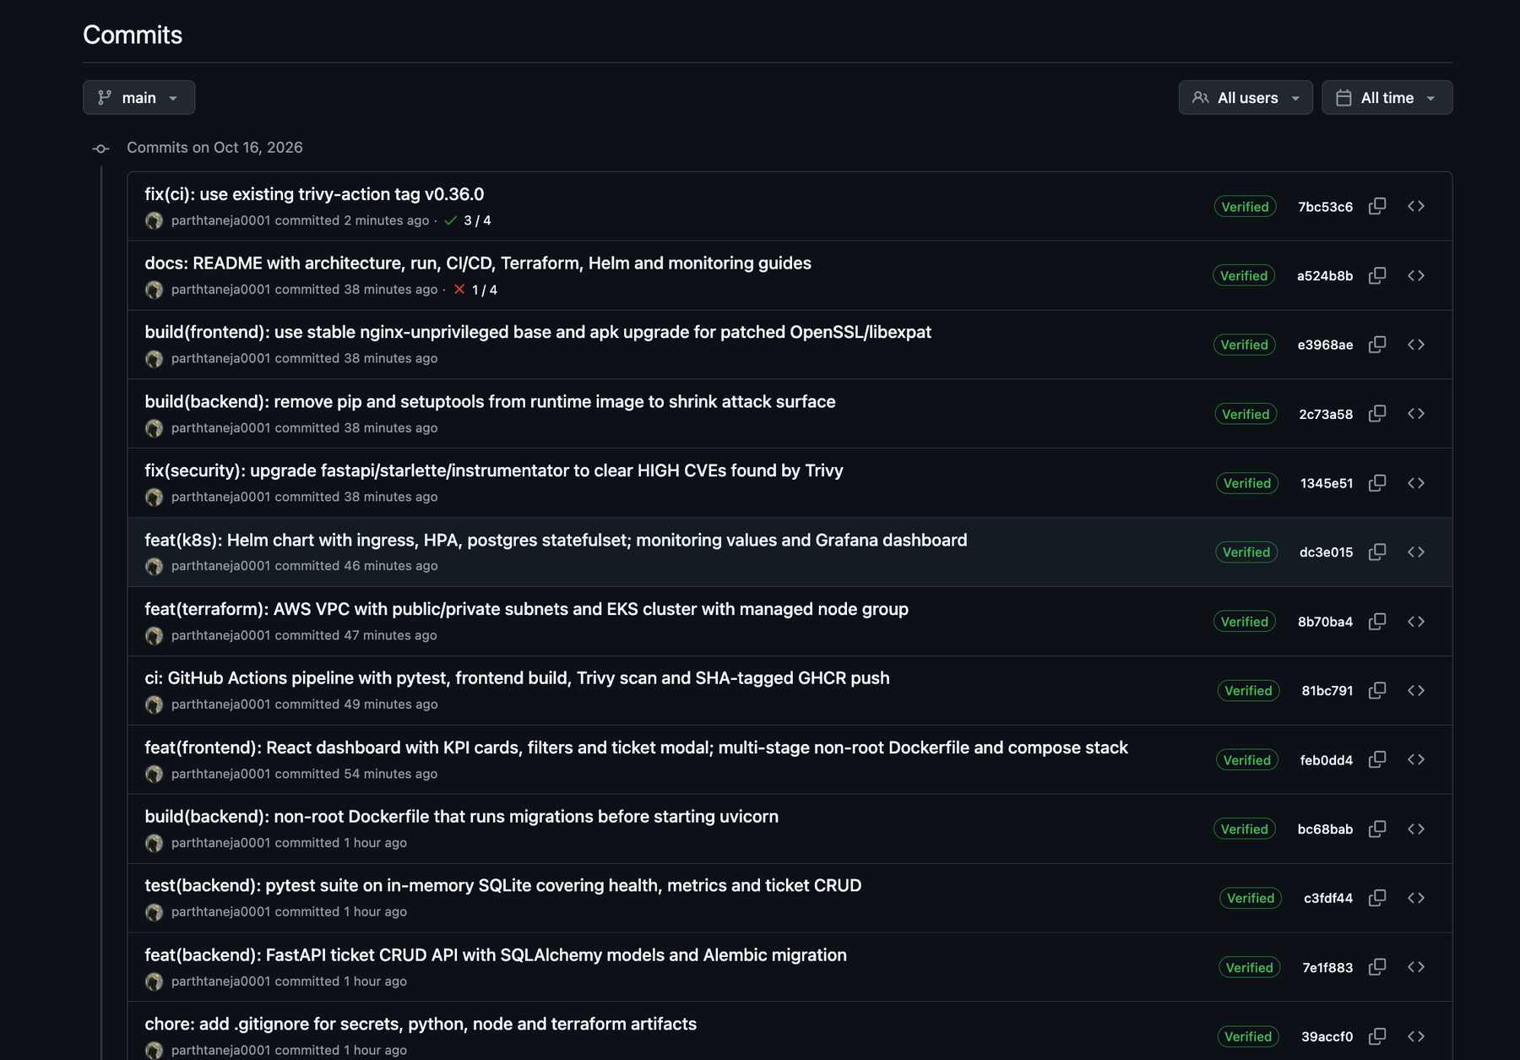
Git and GitHub
APPLICATION AND QUALITY
Public repo, main branch
20+ commits with clear messages: feat, fix, ci, docs, build, test
.gitignore keeps secrets, state and build files out
No credentials anywhere in the history
Commit history on GitHub
Notes:
Version control is the foundation of everything else. The repository is public, uses a main branch and clear conventional commit messages. The gitignore keeps secrets, virtual environments and Terraform state out of the repository, and no credentials were ever committed.

Slide 8
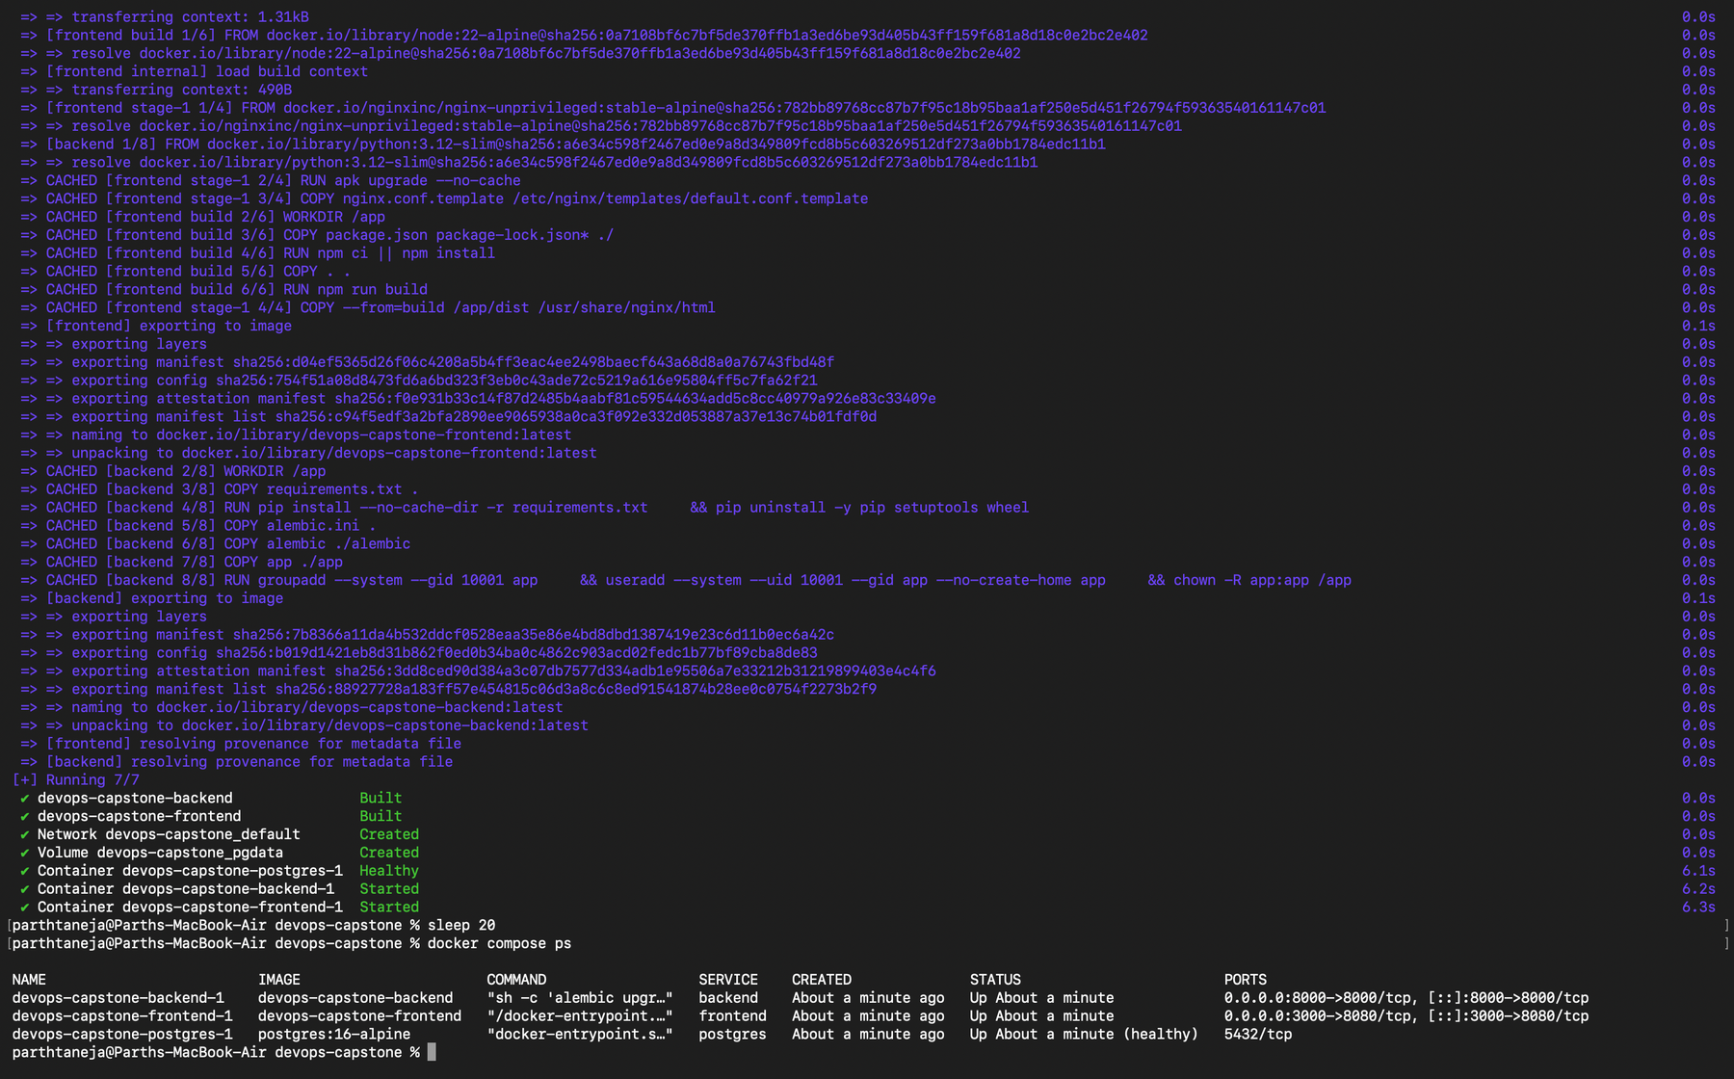

Docker containers
APPLICATION AND QUALITY
Backend image
Python 3.12 slim, runs as non-root (uid 10001), applies migrations then starts the API
Frontend image
Multi-stage: Node builds the app, Nginx serves it as non-root (uid 101)
postgres healthy, backend and frontend up
docker compose up --build starts all 3 services
Notes:
Docker packages each part of the app with everything it needs, so it runs the same everywhere. The backend image runs as a non-root user and applies the database migration before starting. The frontend uses a multi-stage build: Node builds the app, and only the finished static files go into a small Nginx image. Docker Compose starts frontend, backend and PostgreSQL with one command.

Slide 9
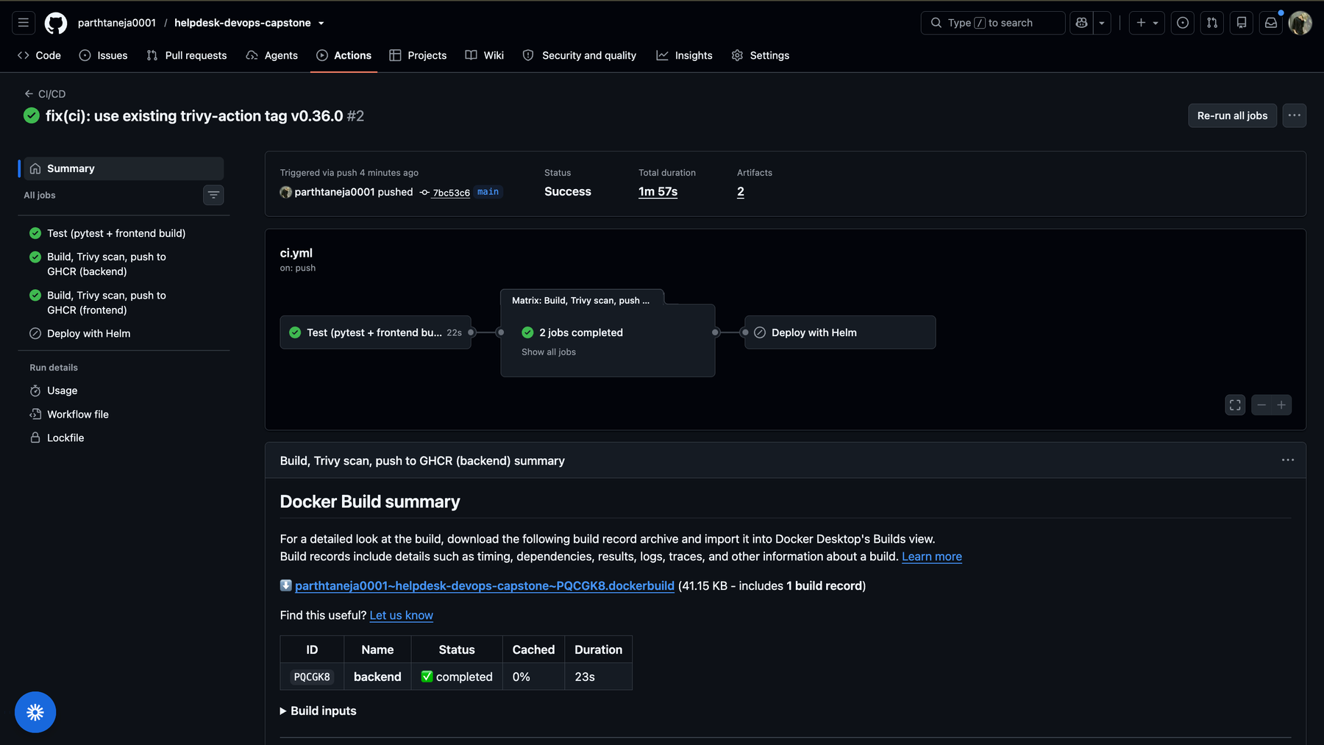
CI/CD pipeline
DELIVERY AND SECURITY
Test
Build
Trivy scan
Push to GHCR
Runs on every push to main
Stops the pipeline on a failing test or a HIGH/CRITICAL CVE
Scans before pushing, so a bad image never reaches the registry
A green run: test, build, scan and push
Notes:
GitHub Actions runs this pipeline on every push to main. First the tests and the frontend build. Then, for both images, it builds, scans with Trivy and only then pushes to the registry. If a test fails or a serious vulnerability is found, the pipeline stops and nothing is published.

Slide 10
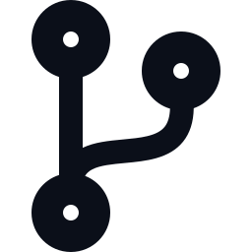


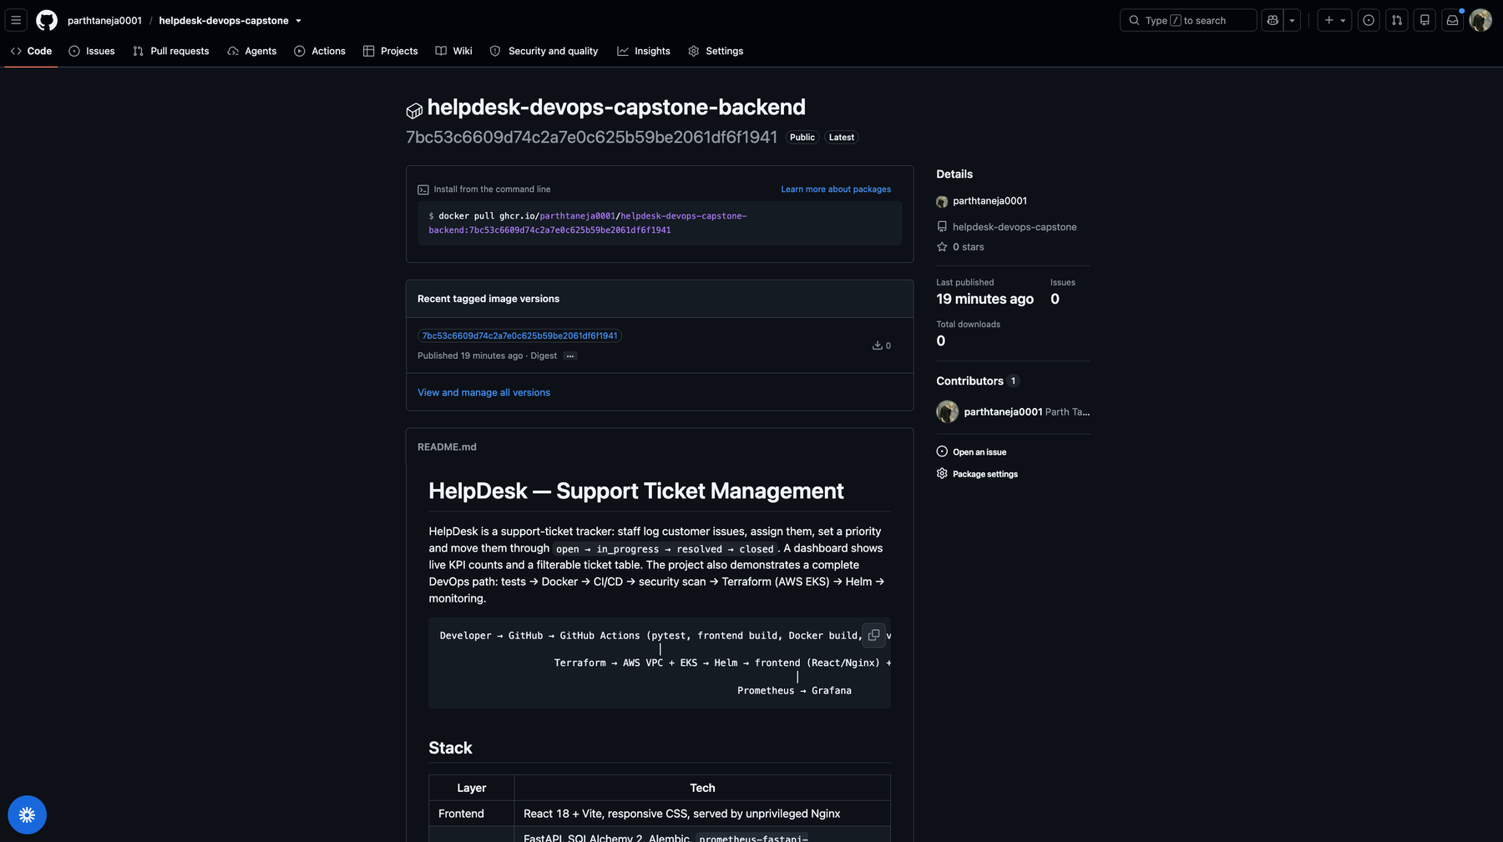
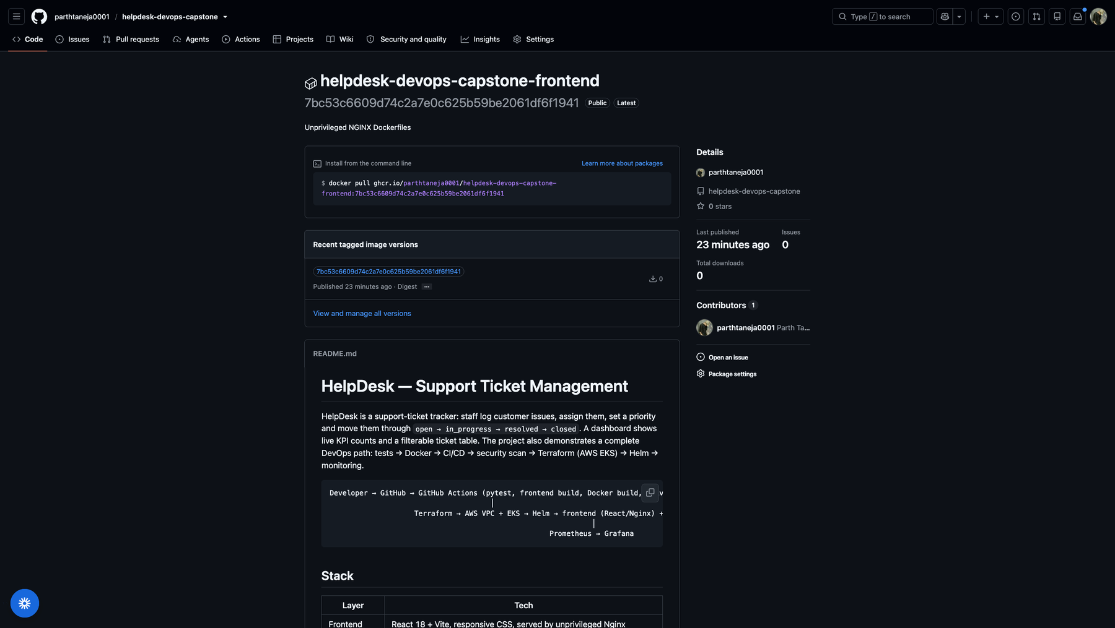
Container registry
DELIVERY AND SECURITY
Tag = commit SHA
Never :latest
Easy rollback
Trace any pod to its exact source commit
No ambiguity about what is deployed
Redeploy an older SHA in one command
Backend image in GHCR
Frontend image in GHCR
Notes:
Images are published to GitHub Container Registry. Every image is tagged with the full Git commit SHA instead of latest. That means any running pod can be traced back to the exact commit that built it, and a rollback is simply deploying an older SHA.

Slide 11
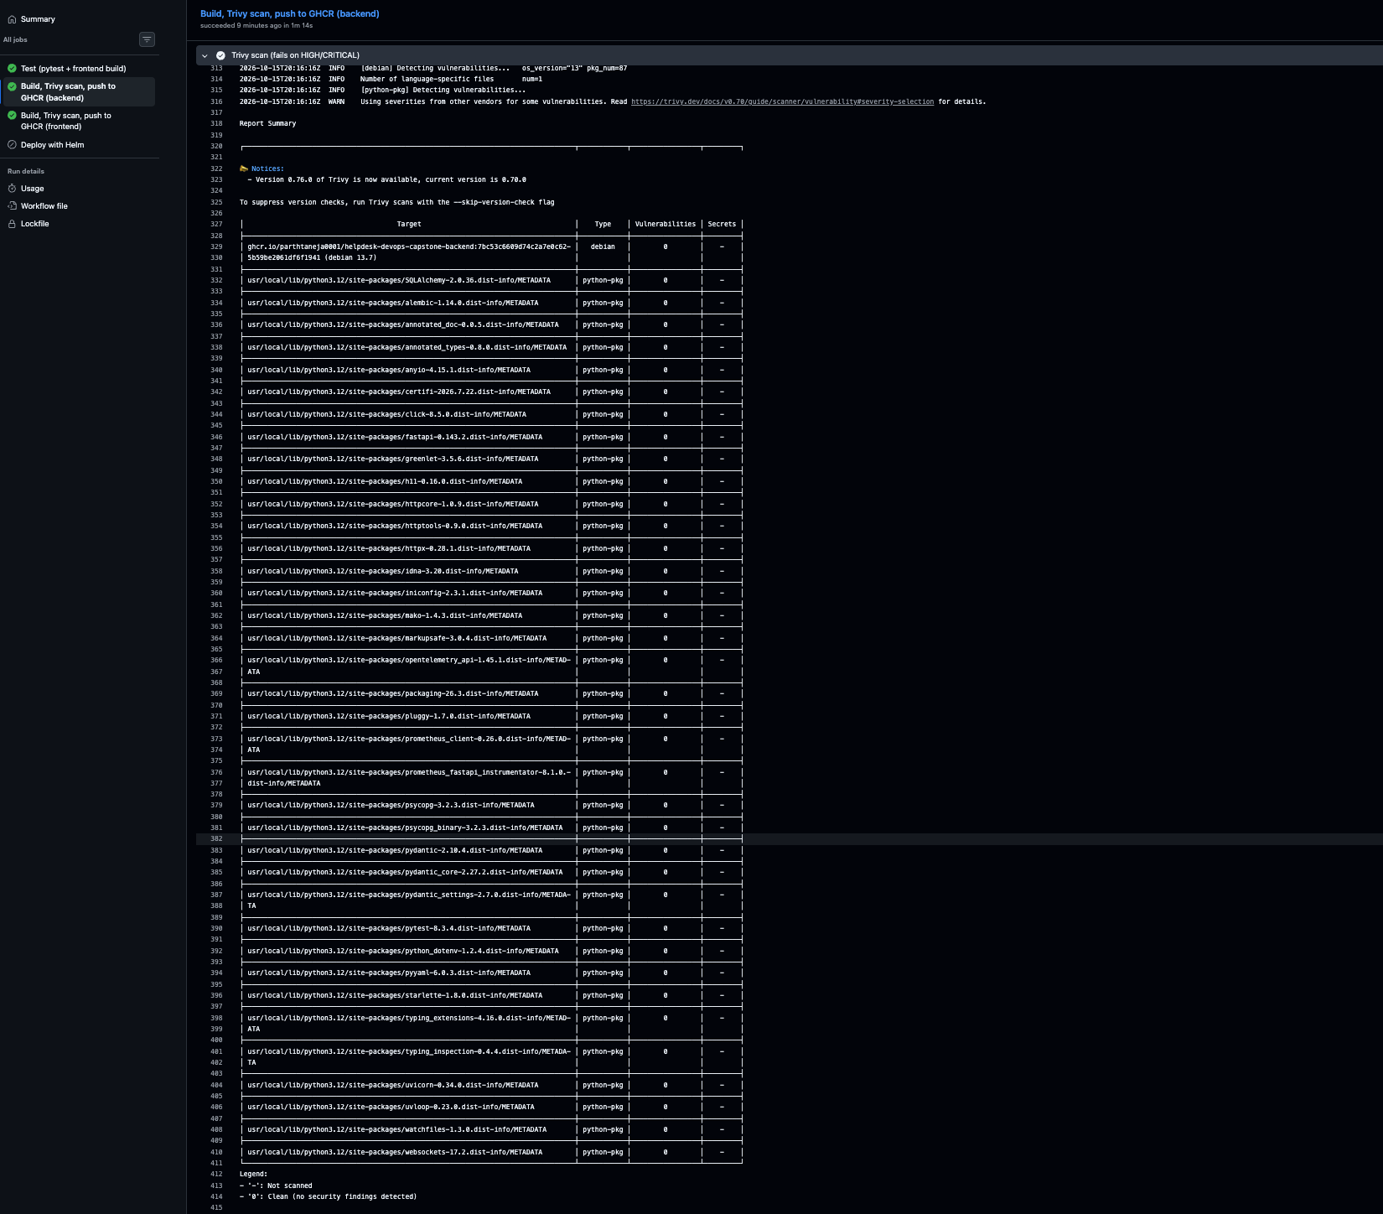
Security scanning with Trivy
DELIVERY AND SECURITY
Found
HIGH CVEs in old Starlette (CVE-2026-48818) and in Alpine OpenSSL and libexpat
Fixed
Upgraded FastAPI and Starlette, patched nginx base image, removed pip and setuptools
Result
0 HIGH and 0 CRITICAL; the pipeline fails on any new fixable finding
Trivy report: 0 vulnerabilities (backend)
Notes:
Trivy scans each image's operating-system packages and Python libraries against a database of known vulnerabilities. The first scan on my laptop found HIGH severity issues in an old Starlette version and in the Alpine base image. I upgraded the libraries, switched to a patched base image and removed unneeded tools. Both images now scan clean and the pipeline fails on any new fixable HIGH or CRITICAL finding.

Slide 12
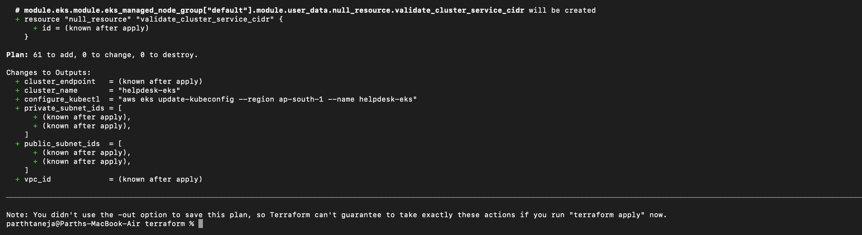
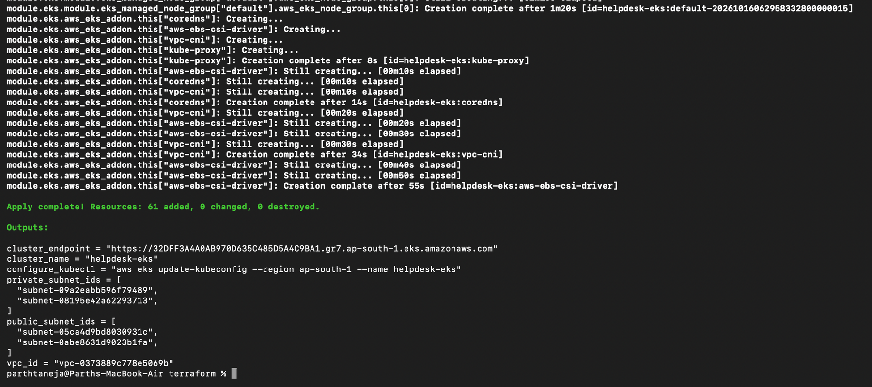
Infrastructure as code
CLOUD INFRASTRUCTURE
VPC 10.0.0.0/16 in ap-south-1 (Mumbai)
2 public subnets
Internet gateway, NAT gateway, load balancer
terraform plan: 61 resources to add
2 private subnets
2 worker nodes (m7i-flex.large)
EKS cluster, Kubernetes 1.31 + EBS CSI driver
terraform apply: complete
Notes:
Instead of clicking around the AWS console, Terraform describes the infrastructure in files. It creates a VPC with two public and two private subnets across two availability zones, a NAT gateway, and an EKS Kubernetes cluster with two worker nodes, plus the EBS driver for storage. Running terraform apply builds all 61 resources, and terraform destroy removes them again.

Slide 13
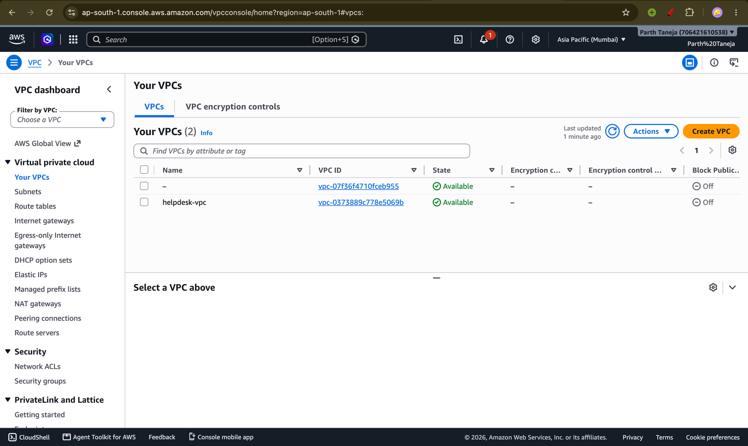
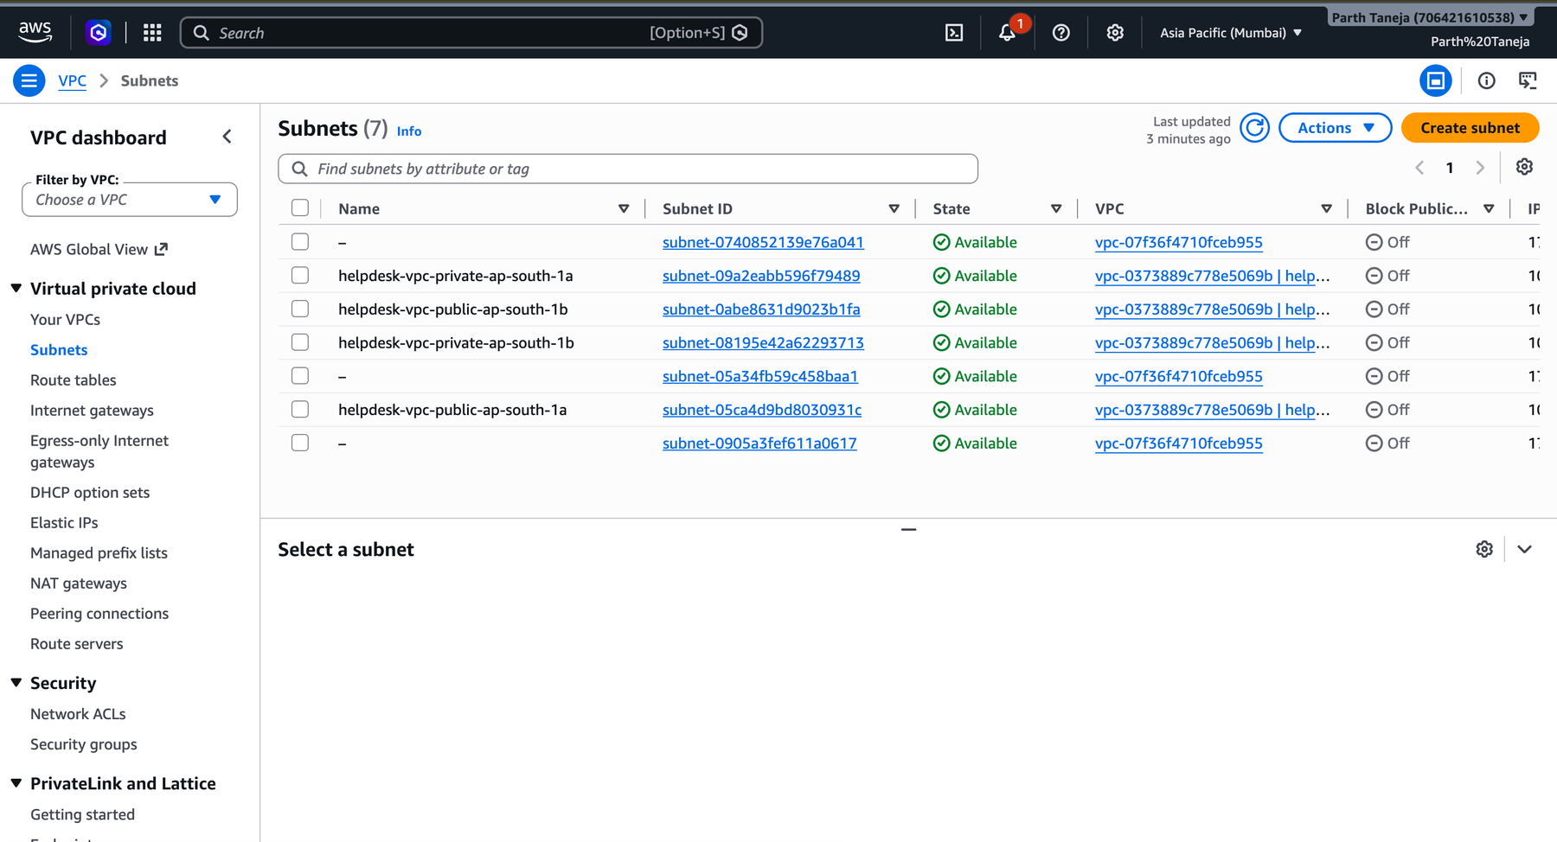
AWS proof: the network
CLOUD INFRASTRUCTURE
4 subnets: 2 public, 2 private
VPC helpdesk-vpc in ap-south-1
Everything here was created by Terraform, not by clicking in the console.
Notes:
These are screenshots from the AWS console in the Mumbai region. On the left, the VPC created by Terraform. On the right, its four subnets: two public and two private, spread over two availability zones.

Slide 14
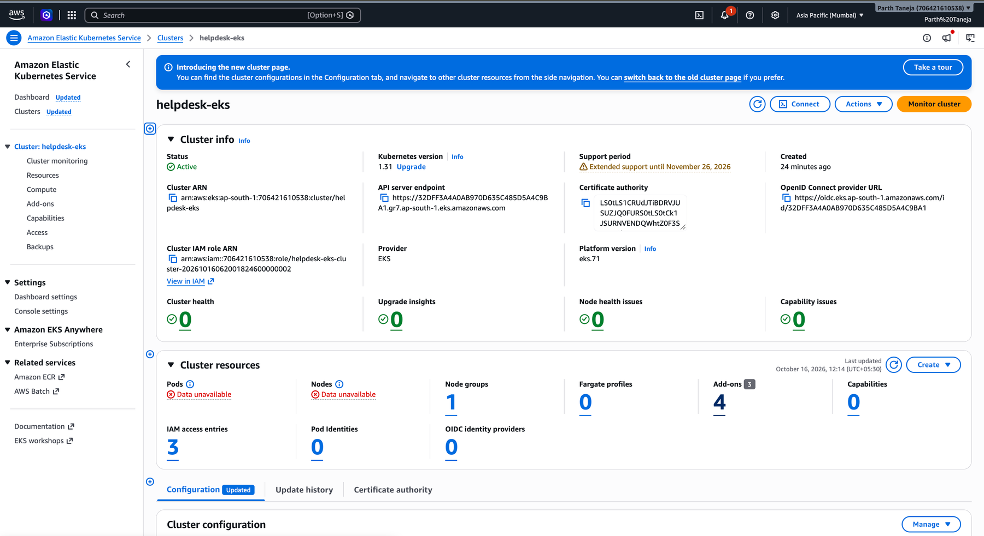
AWS proof: the cluster
CLOUD INFRASTRUCTURE
Status: Active
Kubernetes version 1.31
Managed node group with 2 worker nodes
EKS cluster in the AWS console
kubectl get nodes: both worker nodes are Ready
Notes:
The EKS cluster is Active on Kubernetes 1.31 with a managed node group. The terminal screenshot below shows kubectl confirming that both worker nodes are Ready. The infrastructure was later removed with terraform destroy.

Slide 15

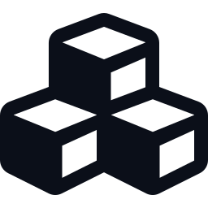



Kubernetes and Helm
RUNNING AND WATCHING
One Helm chart deploys everything with a single command
Namespace
Deployments
Services
Everything lives in the helpdesk namespace
Backend x2 and frontend x2, self-healing
ClusterIP gives stable internal names
Ingress
PostgreSQL
Autoscaling
/ goes to the frontend, /api to the backend
StatefulSet with a 2 GiB EBS volume
HPA scales the backend from 2 to 4 pods
Notes:
Kubernetes runs and heals the containers. A Helm chart packages all the Kubernetes resources so the whole application deploys with one command. The chart creates the backend and frontend deployments with two replicas each, internal services, an ingress that routes slash to the frontend and slash api to the backend, a PostgreSQL StatefulSet with a persistent volume, and an autoscaler for the backend.

Slide 16
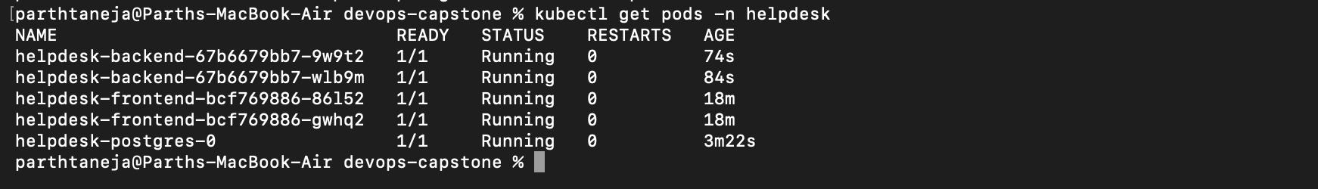
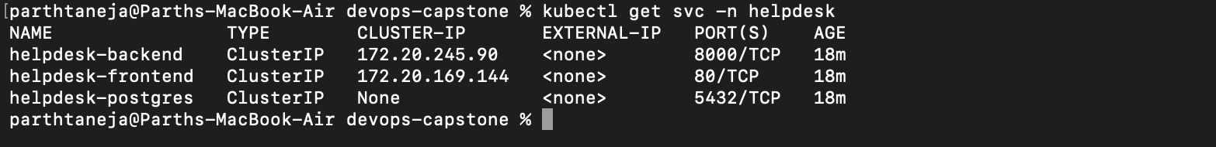
What is running
RUNNING AND WATCHING
kubectl get pods: all 5 pods Running
kubectl get svc: 3 ClusterIP services
helm list: release deployed
Notes:
Here is the live cluster. All five pods are Running: two backend, two frontend and one PostgreSQL. The three services are ClusterIP, which means they are reachable only inside the cluster. Helm shows the release as deployed.

Slide 17
Live on EKS
RUNNING AND WATCHING
Browser
Load balancer
Ingress
Frontend / Backend
PostgreSQL
HelpDesk served from the AWS load balancer
Notes:
This is the real application running on EKS and reached through the AWS load balancer address shown in the browser. The ingress controller sends slash to the React frontend and slash api to the FastAPI backend, which talks to PostgreSQL.

Slide 18
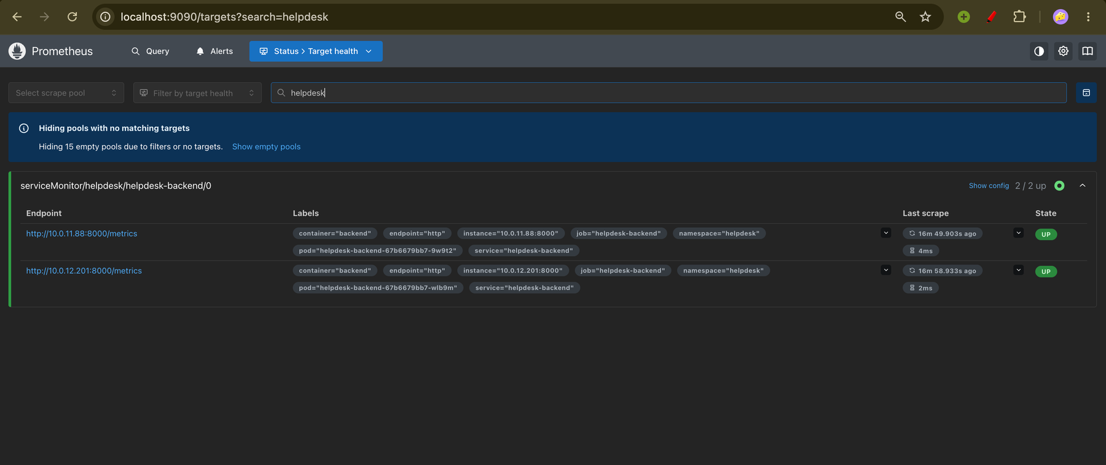
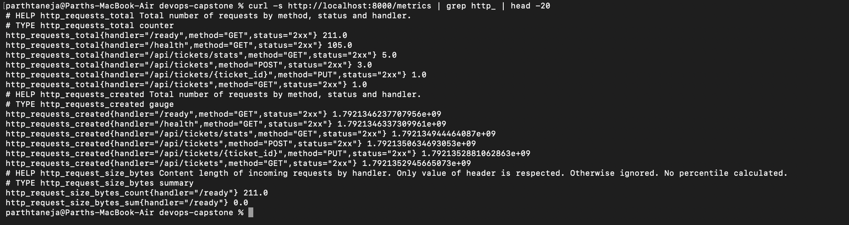
Observability: metrics
RUNNING AND WATCHING
App /metrics
Prometheus scrapes
Grafana charts
/metrics from inside the cluster
Prometheus targets: backend pods UP
Request counts, latency and in-flight requests, per endpoint
Notes:
The backend exposes a metrics endpoint in Prometheus format. A ServiceMonitor tells Prometheus to scrape it, and the Targets page shows both backend pods as up. Those numbers are what Grafana charts on the next slide.

Slide 19
Grafana dashboard
RUNNING AND WATCHING
Requests per second by endpoint
p95 latency (about 95 ms)
5xx error rate: no data means no server errors
Backend pods up: 2
Live panels during a load test
Notes:
This is the HelpDesk API dashboard populated by a load test. The top left shows requests per second for each endpoint, the top right the 95th percentile latency, and the stat shows two backend pods up. The 5xx panel shows no data, which is good news: the app returned no server errors.

Slide 20
The live demo flow
WRAP-UP
1
App running on EKS
2
Commit a small change
3
Push: pipeline runs
4
New SHA-tagged image in GHCR
5
helm upgrade rolls it out
The pipeline run from the demo
6
Pods are replaced one by one
7
Refresh: the change is live
Watch the recorded demo
Notes:
The recorded demo shows the whole loop. The app is running on EKS. I commit a small change and push. The pipeline tests, builds, scans and pushes a new image tagged with the commit. I roll it out with helm upgrade, Kubernetes replaces the pods one by one, and after a refresh the change is live.

Slide 21
Problems we solved
WRAP-UP
Problem | Fix
Trivy action tag not found in CI | Pinned the new tag format, v0.36.0
HIGH CVEs in the first scan | Upgraded libraries, patched base images
EKS nodes never started (free-tier account) | Switched to the m7i-flex.large instance type
Postgres pending: no default storage class | Added a gp3 class using the EBS CSI driver
AWS CLI crashed with a libexpat error | Pointed DYLD_LIBRARY_PATH at Homebrew expat
Notes:
Real projects hit real problems. Here are the ones I hit and how I fixed them: a renamed Trivy action tag, vulnerabilities in the first scan, a free-tier AWS account that rejected the default instance type, a missing default storage class on EKS, and a broken AWS CLI library on my laptop.

Slide 22
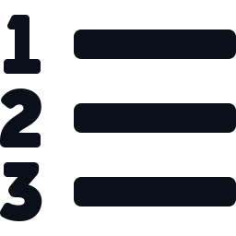


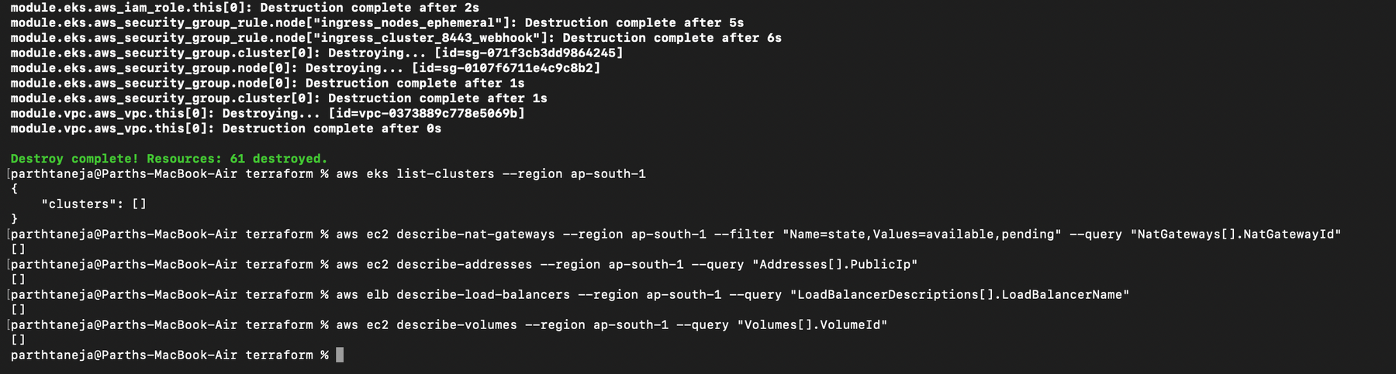
Cleanup and cost control
WRAP-UP
Right order
Verified
No surprise bill
Helm uninstall, delete volumes, then terraform destroy
No clusters, NAT gateways, IPs, load balancers or volumes left
Billing stops as soon as the resources are gone
terraform destroy: complete
Notes:
Cloud resources cost money, so everything was removed after the demo. Order matters: first uninstall the Helm releases so the load balancer and volumes disappear, then run terraform destroy. I then checked that no clusters, NAT gateways, elastic IPs, load balancers or volumes were left.

Slide 23

All 10 modules delivered
WRAP-UP
M1 Application
React, FastAPI, PostgreSQL, Alembic
M6 DevSecOps
Trivy gate, clean scans
M2 Testing
11 pytest tests on SQLite
M7 Terraform
VPC and EKS, plan, apply, destroy
M3 Git and GitHub
Public repo, clear commits
M8 Kubernetes and Helm
Chart, ingress, HPA, pods Running
M4 Docker
Non-root images, multi-stage, Compose
M9 Observability
Prometheus targets UP, Grafana
M5 CI/CD
Test, build, push, SHA tags
M10 Docs and demo
README, slides, recorded demo
Notes:
This slide maps every grading module to what was delivered. Each has matching evidence in the repository README: screenshots, configuration files and the recorded demo.

Slide 24
Thank you
Questions?
Repository
github.com/parthtaneja0001/helpdesk-devops-capstone
Recorded demo
Watch the walkthrough on Google Drive
Notes:
Close by thanking the audience. Point to the repository README, which contains every screenshot, and the recorded demo link. Invite questions.

