Slide 1

Mobile Application Development – CE526
Prepared By:- Dharvi kotak
Parth Teraiya
Dharm bhut Devyani Jagad

Slide 2

Fuel Management System
Give a brief overview of what you’ll cover in your presentation.

Slide 3
Application Descriptions :-
Nowadays, there are many companies are facing their company vehicles fuel management. I got idea to build that kind of application to solve that kind of problem.
In this application there are 3 phases: -
Add Fuel data to refuel the vehicles
Driver or Vehicles Information
Previously Fuel Recorded Data
First the register their information in this app with Driver name, password, phone number,
Driving License No. , Driver Unique ID.
A Fuel Record are handling app by companies in several ways.
In this application driver get their id and password by the companies and in this application driver add the fuel data when they refuel vehicles they are driving.
This application is also used for personal bases to record their fuel information of their vehicles.

Slide 4

Features :-
Add Fuel Details
Refueling time (Auto)
Current Odometer (KM)
Previous Odometer (KM)
Price/Total Cost
Auto Calculate Liters from Price and Total
Cost
Auto Calculate Mileage from both current and previous odometer fuel liters.

Slide 5
Hardware And Software Requirement :-
Minimum 4 GB RAM Required
OS Android 6 or Above
Any Android Processor
Frontend Language:- XML
Backend Language:- Java
Database:- SQLite

Slide 6
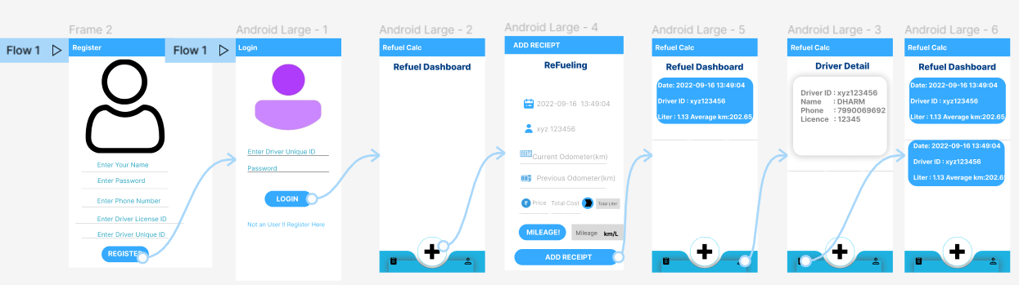
Wireframe

Slide 7
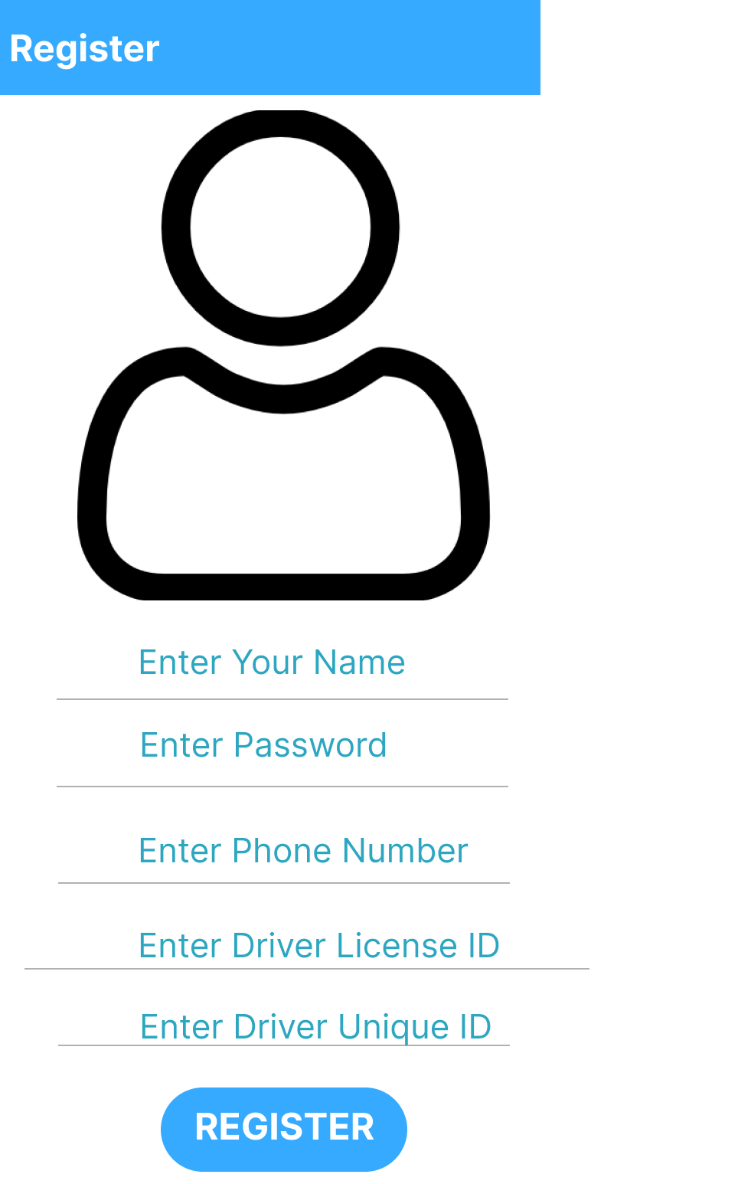
Components of Wireframe
EditText
You can add user personal information
Button

Slide 8
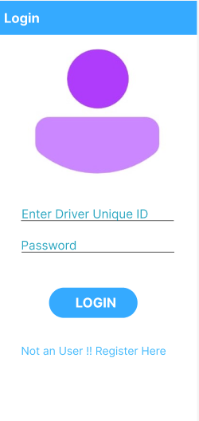
Image View
Show User Image
Text View
Enter user id password
Link
Those are not user they can register here.

Slide 9
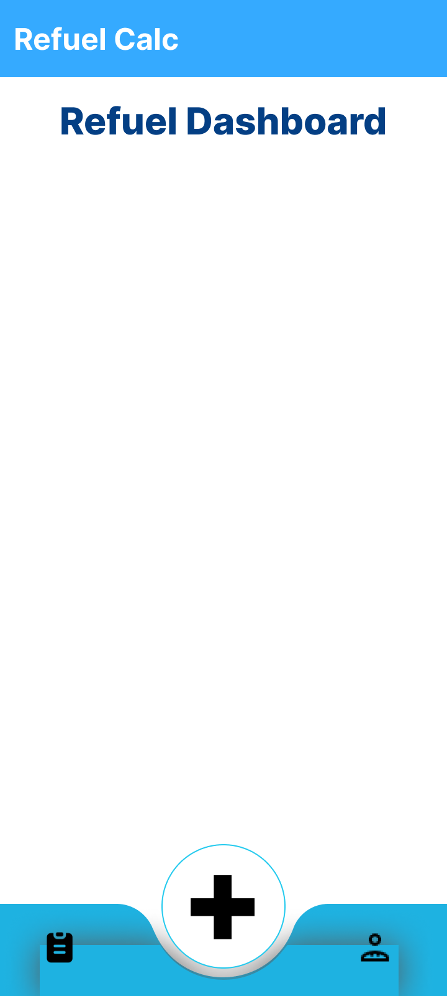
Frame layout
Floating action button
Add the refuling data
Receipt button
Driver details button

Slide 10
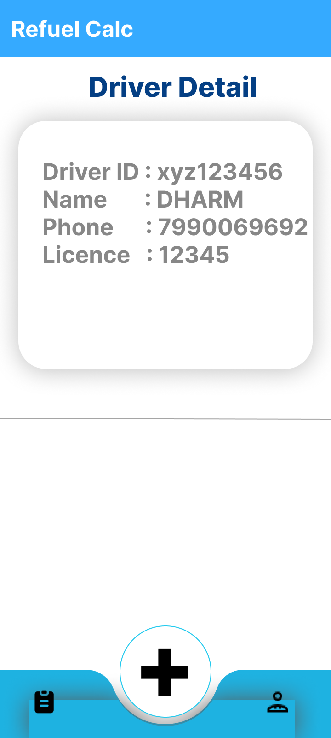
Text View

Slide 11
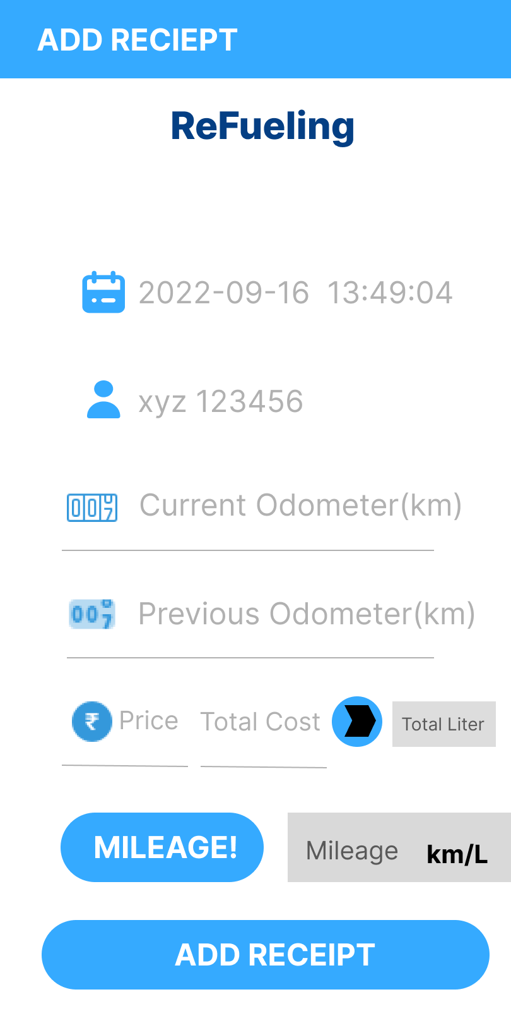
Edit Text
Button
Mileage Button
Mileage = Kilometers run/Amount of Fuel Used
Text View
Show total mileage
Recipt Button

Slide 12
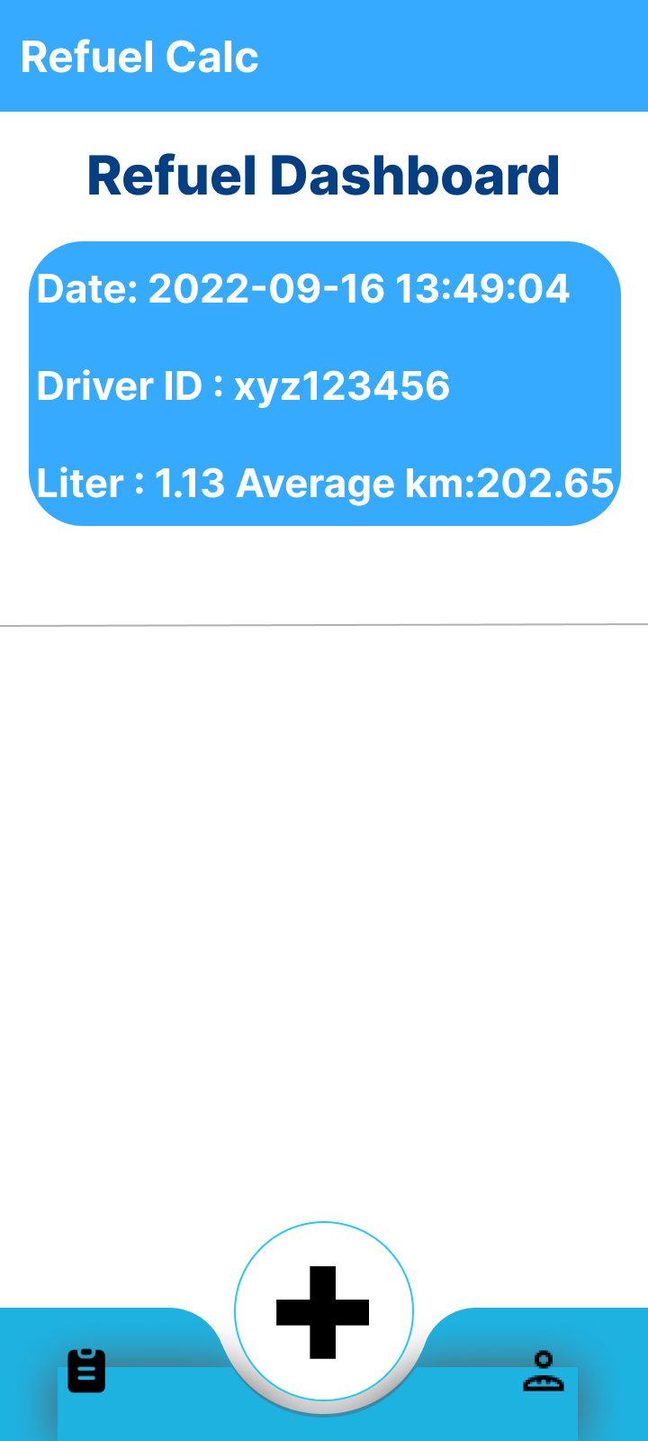
Card View
Show user’s refuelling data
Bottom navigation

Slide 13
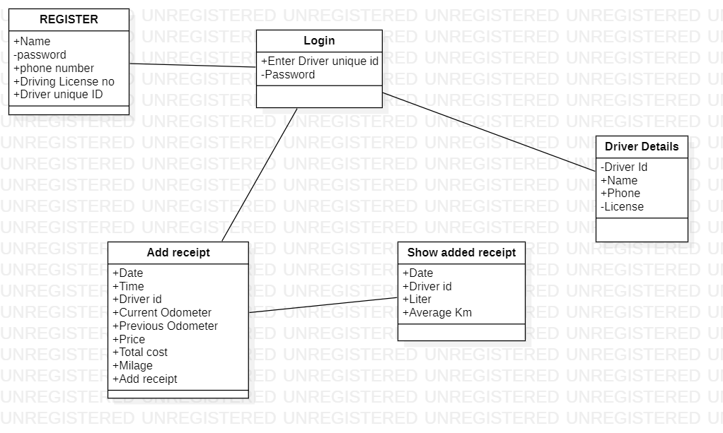
Class Diagram

Slide 14
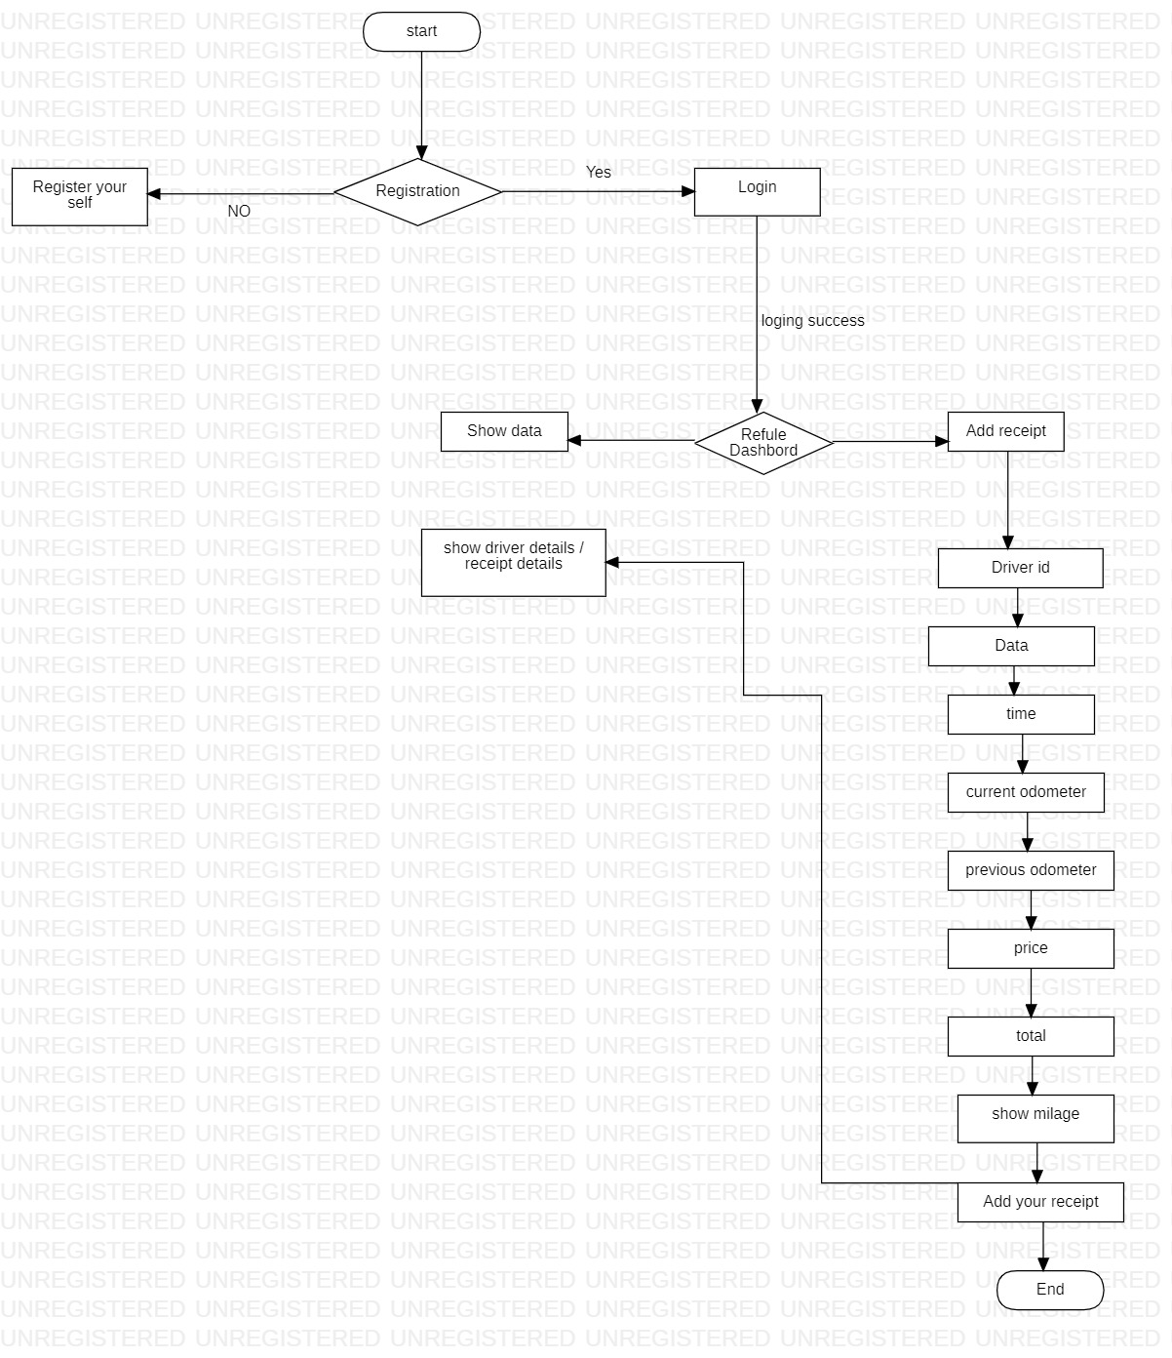
Flow Chart

Slide 15
Limitations
Take some time to enter fuel data.
Login when enter new record.
Network/Internet issue.

Slide 16

Future Enhancements
We can provide current location to destination location through google map API(application programming interface).
Add the current odometer image .
Whenever the vehicle is refuelling they enter the data that sent to the admin.

Slide 17
Thank You

