Slide 1

L.D.College of Engineering Information Technology Department
Team Members:
Shrey Parekh-170280116060
Parth Parmar-170280116062
Samarth Solanki-170280116113
Abhi Vekariya-170280116121
Project Guide:
Prof. Mital Panchal

Slide 2
Project Title
Discrete Entity Discernment and Motion Interpretation using Deep Neural Networks and Machine learning.

Slide 3
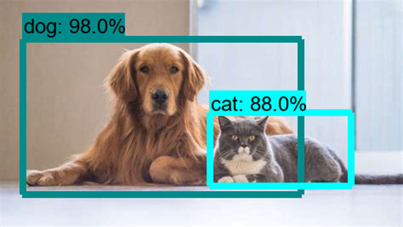
Project Plan
Entity discernment is a computer vision technique that works to identify and locate entities within an image or video. So specifically, this project bounding boxes around these detected entities, which allow us to locate where said entities are in (or how they move through) a given scene which is one of the main aim/plan of this project.

Slide 4
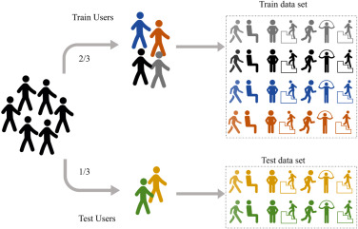
Motion Interpretation aims to recognise the motion and goals of one or more objects/persons from a series of observations on the objects' movement and the environmental conditions.
Also our project plan consists to have better accuracy with reducing the computational power for each models.

Slide 5
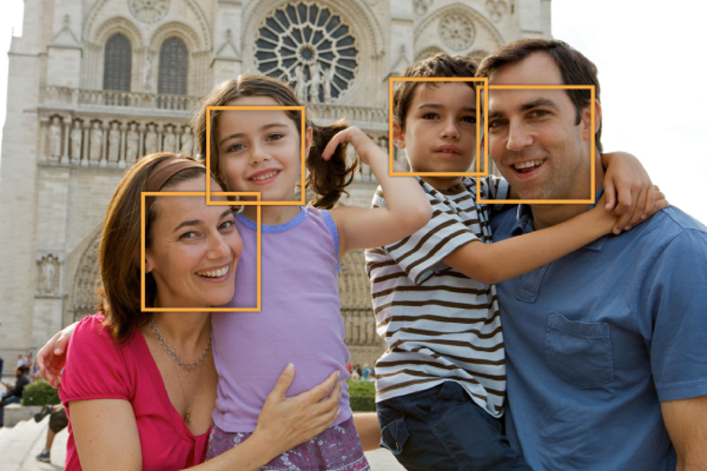
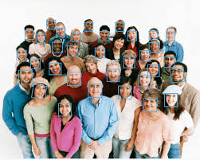
Project Features :
Face detection :
Popular applications include face detection and people counting. Have you ever noticed how facebook detects your face when you upload a photo? This is a simple application of object detection that we see in our daily life.
People Counting :
Entity discernment can be also used for people counting, it is used for analysing store performance or crowd statistics during festivals. These tend to be more difficult as people move out of the frame quickly (also because people are non rigid objects).

Slide 6

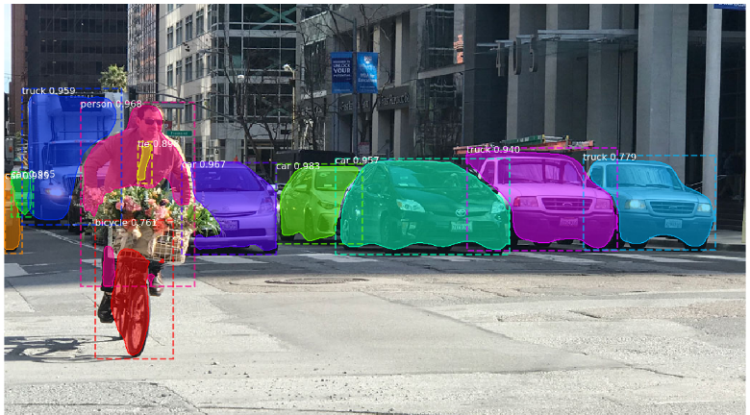
Manufacturing Industry :
Entity discernment is also used in industrial processes to identify products. Say you want your machine to only detect circular entities. Hough circle detection transform can be used for detection.
Online images :
Apart from these entity discernment can be used for classifying images found online. Obscene images are usually filtered out using entity detection.

Slide 7
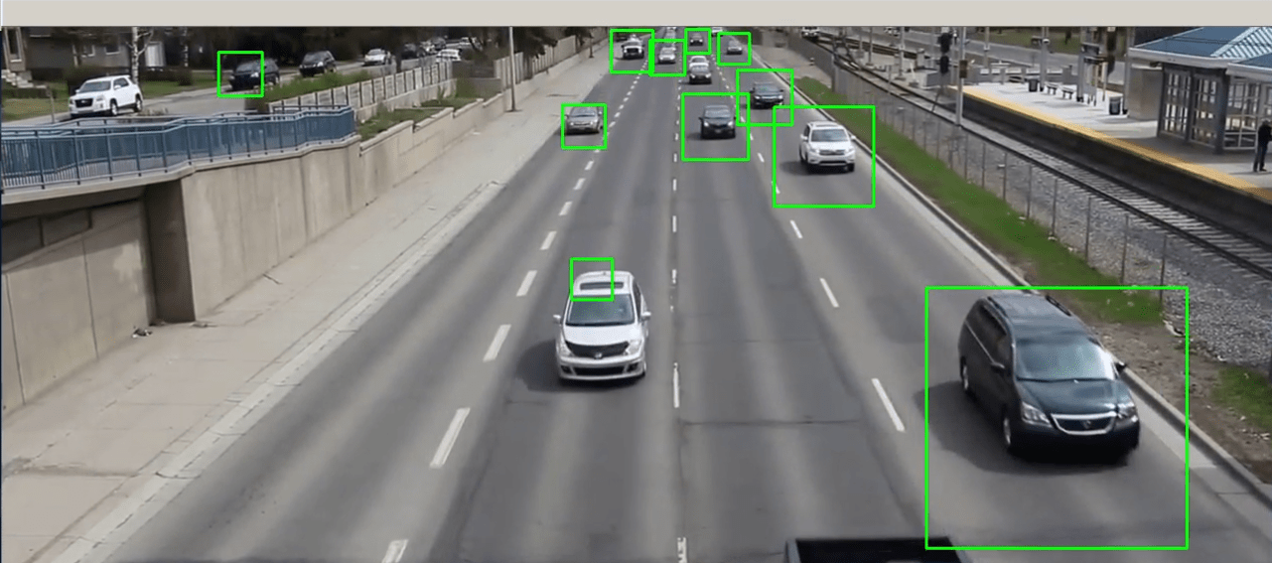
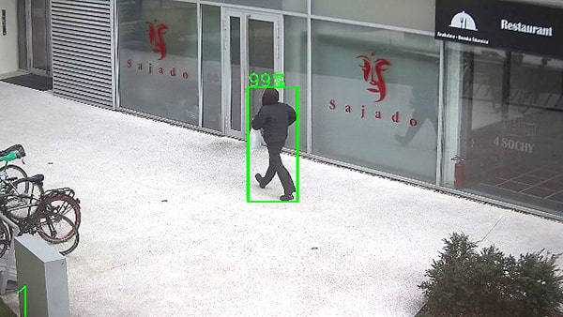
Vehicle detection :
Similarly when the entity is a vehicle such as a bicycle or car, entity discernment with tracking can prove effective in estimating the speed of the object. The type of ship entering a port can be determined by entity discernment(depending on shape, size etc). This system for detecting ships are currently in development in some European countries.
Security :
In the future we might be able to use Entity discernment to identify anomalies in a scene such as bombs or explosives (by making use of a quadcopter).

Slide 8
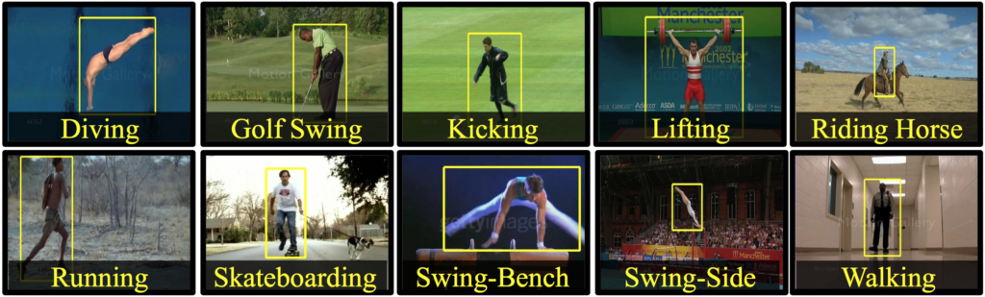
Motion Interpretation :
Motion interpretation is used in many applications such as surveillance, anti-terrorists, and anti-crime securities as well as life logging and assistance. Environment-based sensors are used to detect the users' interaction with the environment. interaction with objects that are also equipped with sensors.

Slide 9
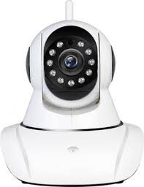
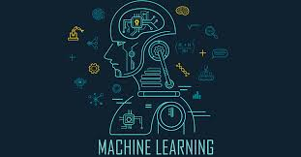



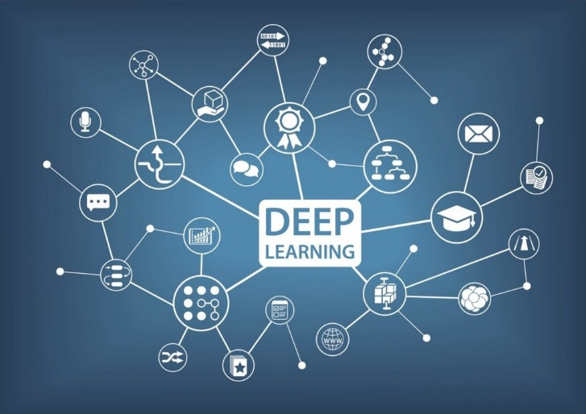

Technology And Tools:

Slide 10
Thank You

