Slide 1

Pipeline Inspection Mobile Robot for AI-enabled Crowd Management and Smart City Infrastructure Monitoring System
B.Tech project · Robotics and Automation / AI & ML
Aryan Sil · Ashmit Katale · Priyansh Pacheriwala · Parth Ubhe · Rajat Dwivedi
Symbiosis Institute of Technology, Pune · 2026–27
1

Slide 2
Why inspect sewers with a robot?
• Manual CCTV review is slow and exposes personnel to hazardous environments.
• Low light, blur and repetitive pipe texture make subtle defects hard to localize.
• The project joins a mobile camera platform, remote inference and a five-class detector.
2

Slide 3
Research questions and objectives
• Can a compact four-wheel platform obtain useful pipe-view footage?
• Can five frequent defect types be localized reliably on unseen inspection images?
• Do CLAHE or attention modules improve a controlled YOLO baseline?
• Build the prototype, compare detectors and expose image/video/live inference.
3

Slide 4
What prior work reports
Study | Method | mAP@50 | mAP@50:95 | Context
Huang et al. | YOLOv5s + involution/GSConv/CBAM/distillation | 80.5% | 48.7% | Six classes; 75 FPS reported
Sha et al. | Lightweight YOLOv8 cross-scale fusion | 83.6% | — | Different dataset; 1.95 M parameters
Hu et al. | SAW-YOLOv8l | 86.2% | 69.0% | Mixed Sewer-ML/industrial images
Automatic Detection | YOLOv4 + SPP + DIoU | 92.3% | — | 2,700 images; four classes
Our RF-DETR: 89.04% test [over 90% on train set] mAP@50, 73.85% test mAP@50:95 on v5. It exceeds some reported scores numerically, not in a matched benchmark; the YOLOv4 paper reports 92.3% on a different four-class set.
4

Slide 5
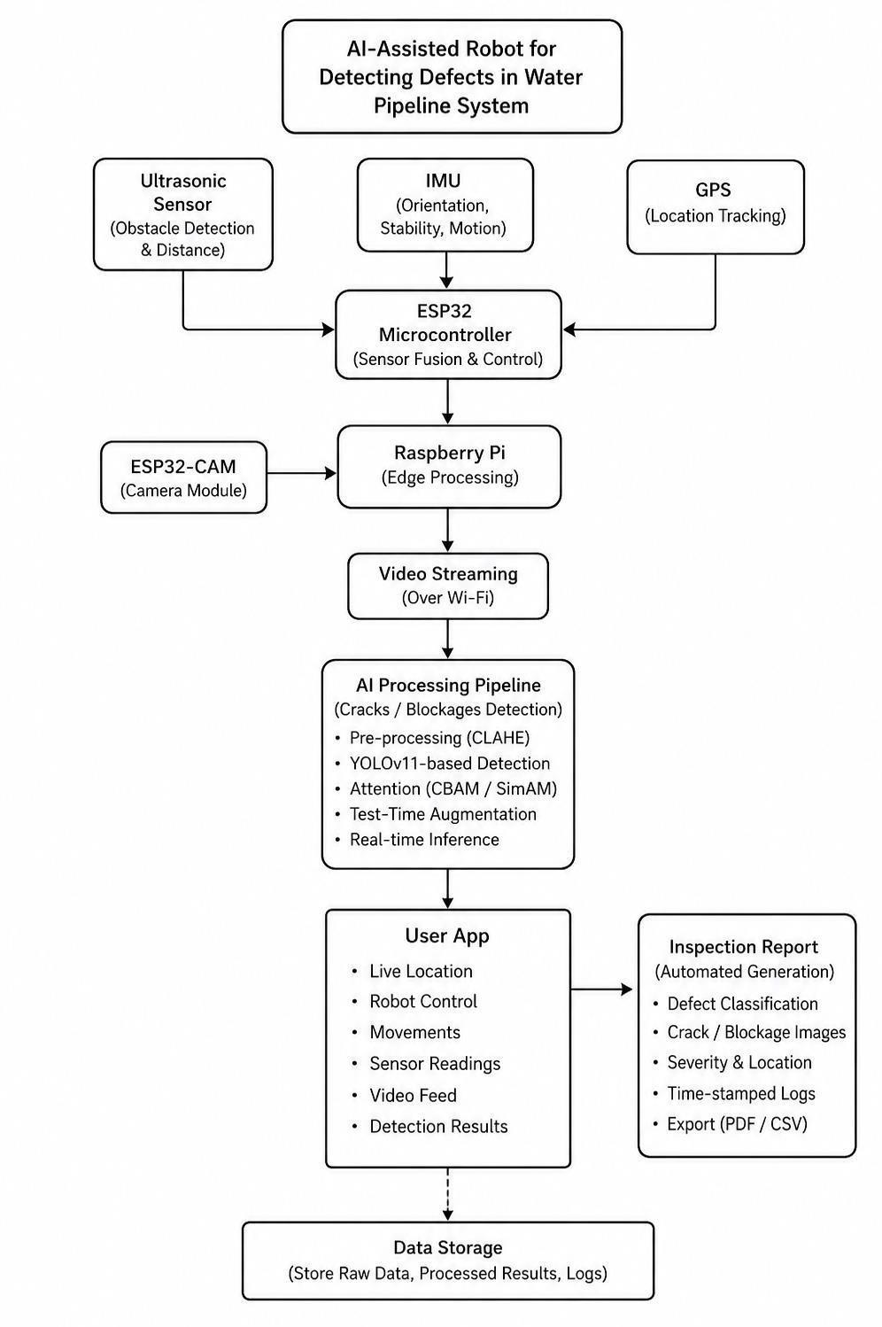
System concept and current implementation
• Proposed: locomotion → sensing/video → wireless link → AI detection → display/report.
• Implemented software: FastAPI image, video and live-camera inference with model selection.
• Robot-to-server field FPS and autonomous navigation remain unverified.
5

Slide 6
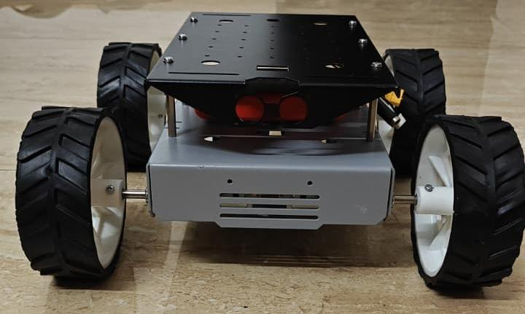
Built prototype
• Four-wheel chassis with geared-drive concept.
• Initial design includes controller, ultrasonic sensing and camera stream.
• Approximate materials budget: ₹13,750.
• Battery/runtime values in the proposal are estimates, not measurements.
6

Slide 7
Power budget: design estimate
Quantity | Source assumption | Estimated value
Drive | 4 × 12 V, 100 RPM geared motors | 27 kg·cm ≈ 2.65 N·m each
Speed | ω = 2πN/60 | 10.47 rad/s
Mechanical | P = τω | 27.7 W/motor; 110.8 W total
Electrical | 80% efficiency assumed | 138.5 W ≈ 12.48 A at 11.1 V
Battery | 11.1 V, 5,000 mAh, 3C | 15 A nominal continuous rating
7

Slide 8
Dataset Experimentation and Evolution:
Version | Decision | Research effect
v2 | Common five-class taxonomy; group-aware split | Reduced adjacent-frame leakage risk
v3 | Broader CCTV + close-up mixture | Exposed domain mismatch
v4 | Separated CCTV and close-up; tested CLAHE | Isolated viewpoint/contrast effects
v5 | Restored v2-style group split; excluded close-up domains | CCTV-focused 9,486 / 2,014 / 1,986 split
8

Slide 9
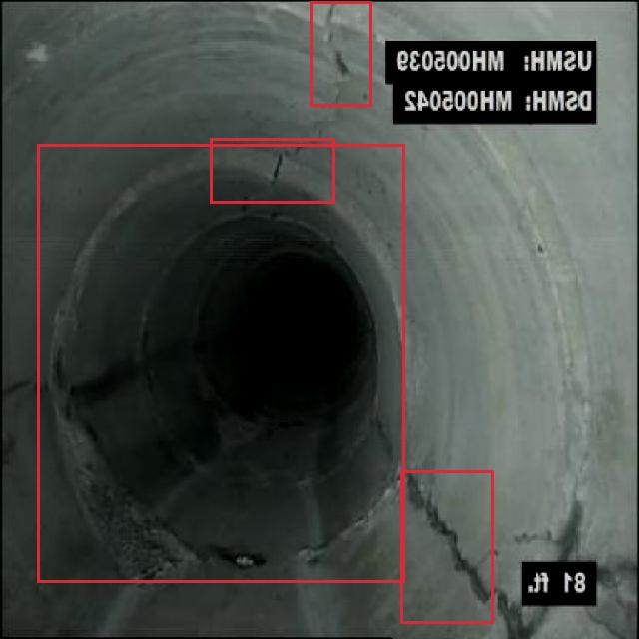
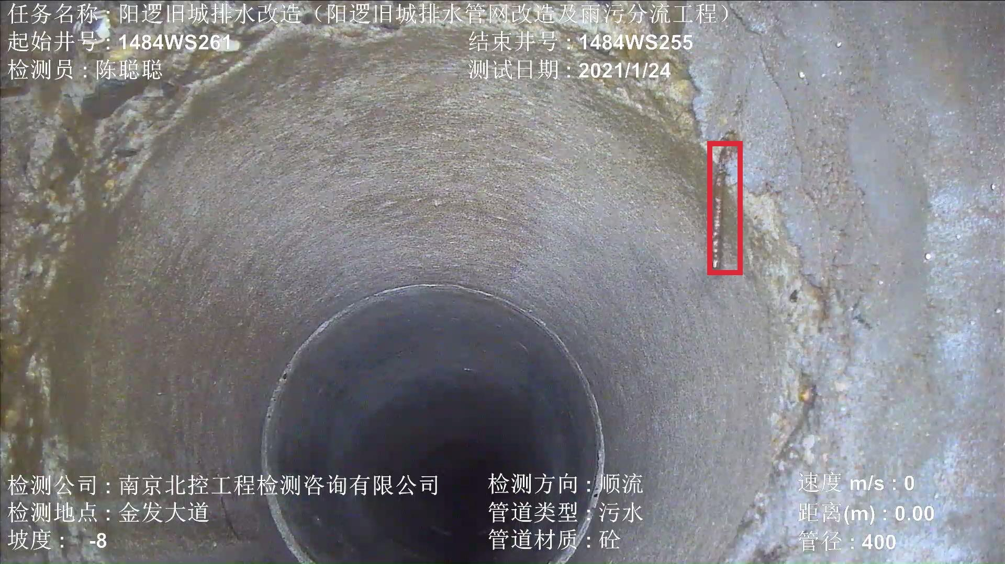
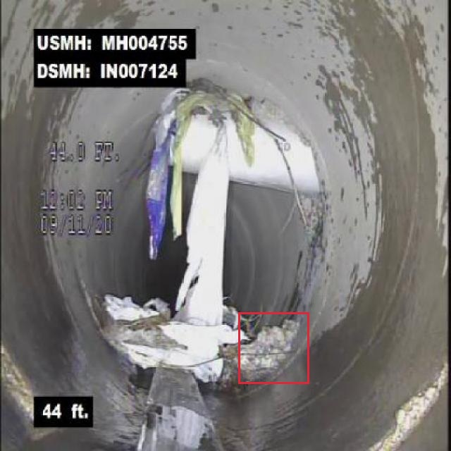
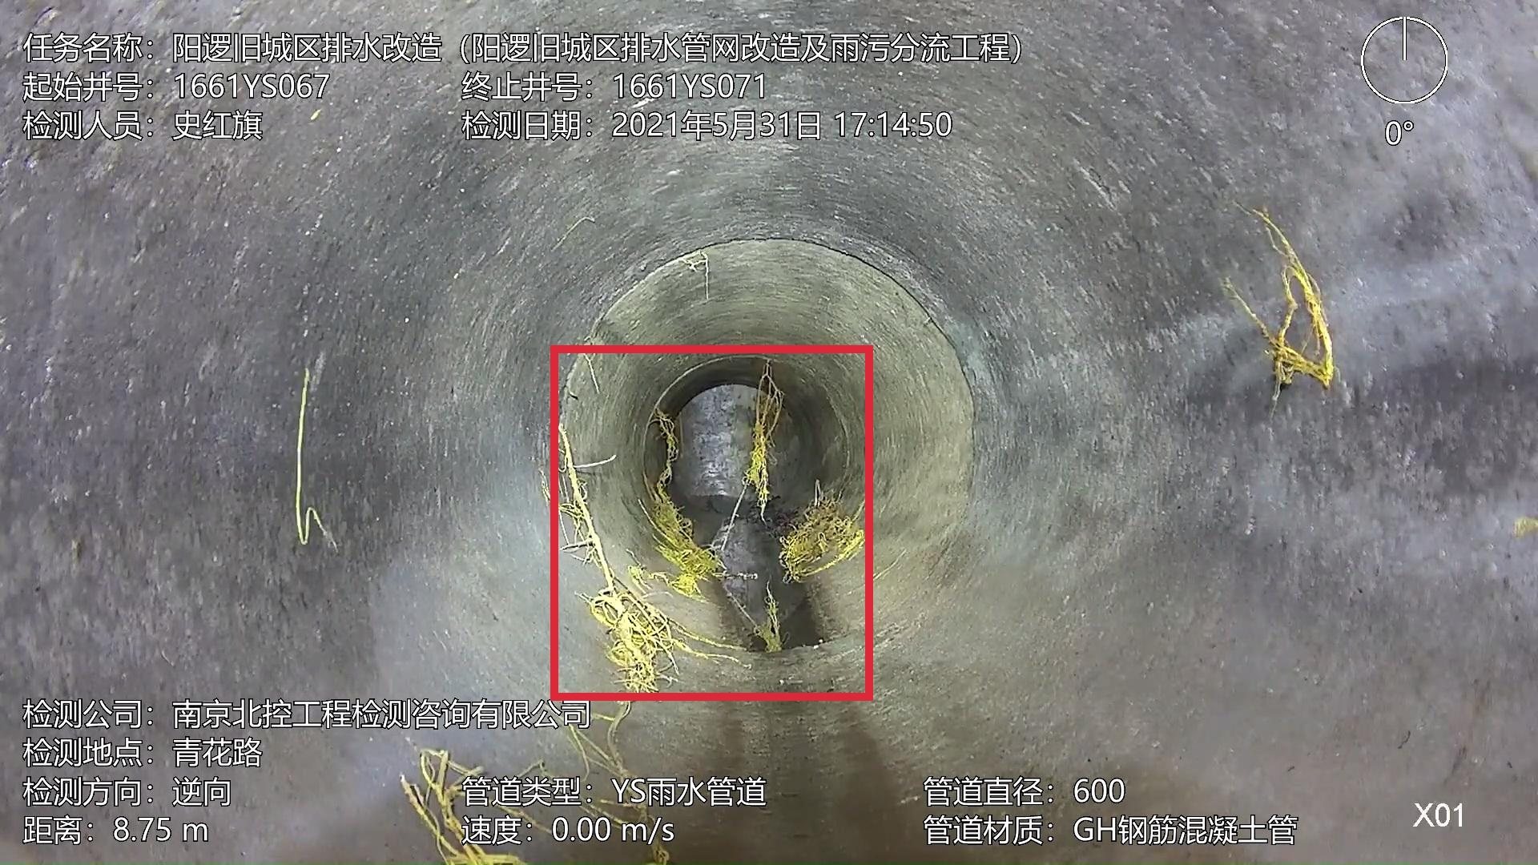
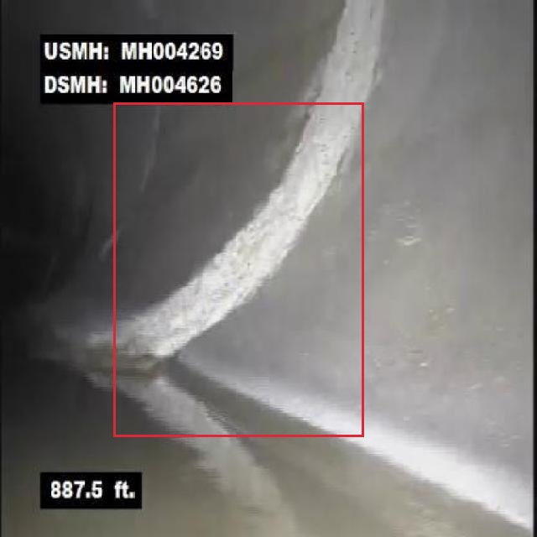
Model Inference Samples [Five detection classes]
crack
corrosion rust
sediment deposit
root intrusion
joint defect
Red boxes are ground truth, not predictions. One test image per class.
9

Slide 10
Preprocessing and experimental controls
• Normal v5 and offline CLAHE v5 share image/label identities; CLAHE adjusts Lab luminance (clip 2.0, 8×8 grid).
• YOLO26s: 640 px, 80 epochs, AdamW, cosine schedule, seed 0; HSV/translate/scale/flip/mosaic, final ten epochs without mosaic.
• RF-DETR Nano: 512 px, 50 total epochs, effective batch 16 with accumulation.
• Held-out test remains unchanged; model-selected deletion is not a valid benchmark.
10

Slide 11
Models actually evaluated
• YOLO26s baseline, SimAM, CBAM, SE, parallel SimAM+CBAM+SE.
• E3: P2 head + weighted PAN fusion. E5: directional residual P3 block.
• RF-DETR Nano: 40 and 50 total epochs. E6 ended at epoch 5 with OOM.
• Original YOLO11 baseline/CBAM/SimAM/combined curves are historical; checkpoints and exact metrics are unavailable, so no scores are fabricated.
11

Slide 12
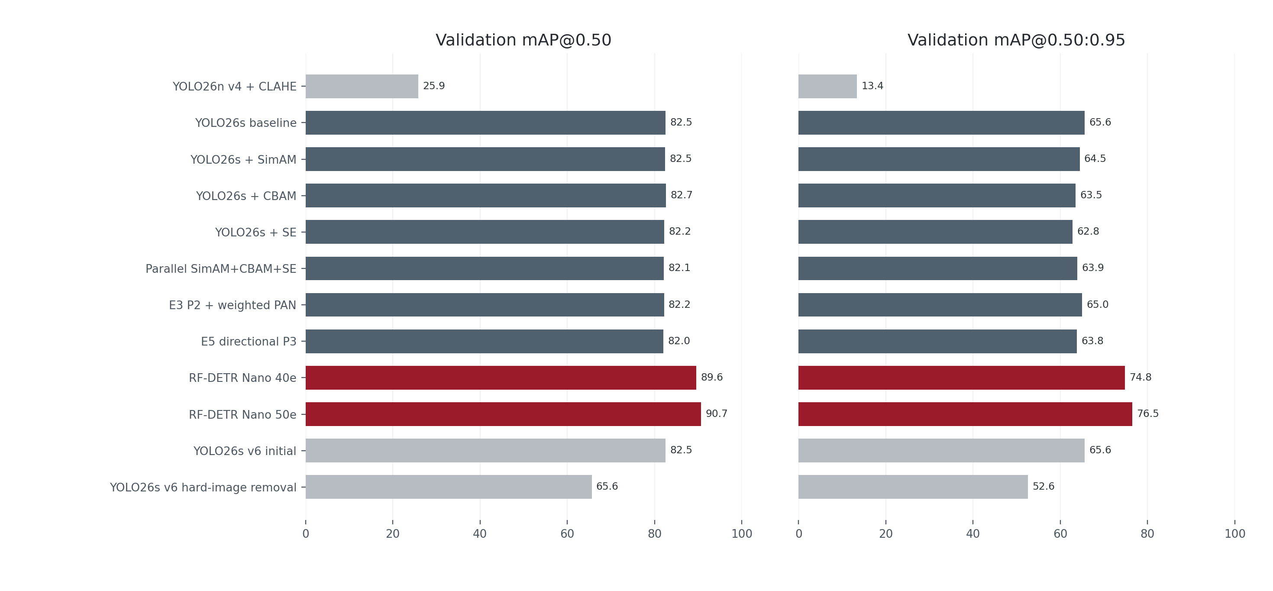
Completed model comparison · validation
12

Slide 13
Top Trained Model List
Model | Input | Precision | Recall | mAP@50 | mAP@50:95
RF-DETR Nano, 50e | normal / 512 | 86.34% | 83.89% | 89.04% | 73.85%
YOLO26s baseline, 80e | normal / 640 | 81.44% | 74.42% | 82.14% | 65.05%
YOLO26s E3[P2 head weighted fusion], 80e | normal / 640 | 78.40% | 74.66% | 80.78% | 63.83%
YOLO26s + CBAM, 80e | CLAHE / 640 | 78.50% | 74.24% | 81.55% | 62.50%
RF-DETR reaches 90.65% on validation, but 89.04% on held-out test. Cross-family evaluator/input differences remain.
13

Slide 14
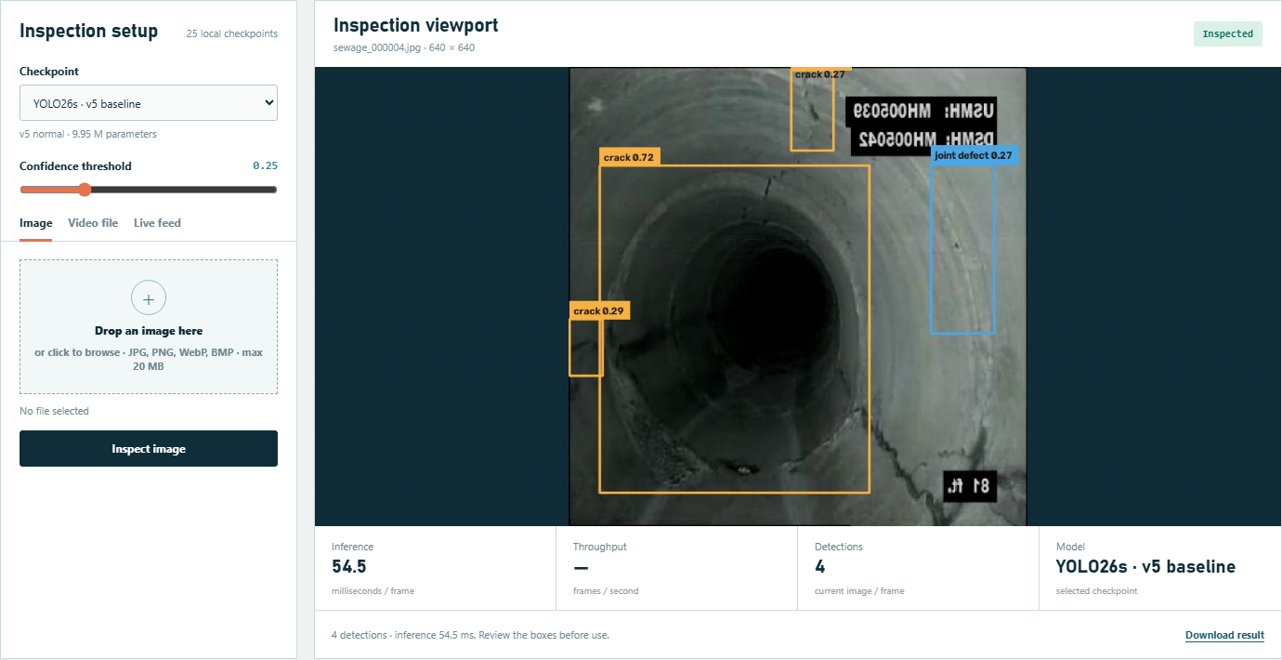
Web UI · image inspection
• Choose a local model and confidence threshold.
• Drop an image or select one of five test examples.
• Review annotated boxes, counts and model latency; download the result.
• Video file upload, frame stride, progress and annotated MP4 download.
• Browser webcam, USB camera and opt-in RTSP/HTTP stream sources.
• Live view reports detections, latency and delivered-frame FPS.
Actual local example inference shown. These boxes are predictions, not ground-truth labels.
14

Slide 15
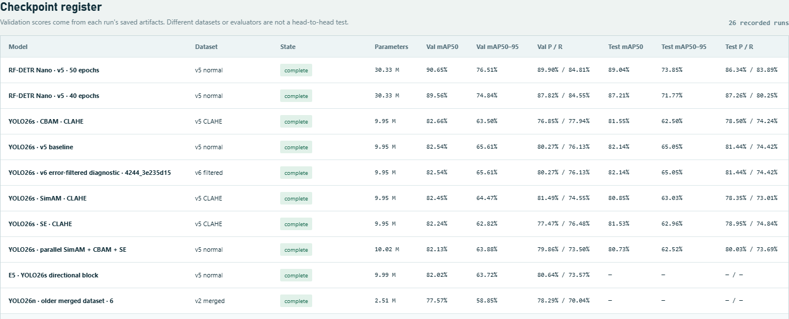
Web UI · checkpoint register
Local checkpoints are listed with availability, parameter counts and saved validation/test metrics. Different datasets and evaluators are not a head-to-head ranking.
16

Slide 16
References
Huang et al., Processes 2023 — https://doi.org/10.3390/pr11082508
Sha et al., PLOS ONE 2025 — https://doi.org/10.1371/journal.pone.0330677
Hu et al., Sustainability 2026 — https://doi.org/10.3390/su18083685
Automatic Detection, Appl. Sci. 2023 — https://doi.org/10.3390/app13074589
17

