Slide 1
SALES PERFORMANCE & CUSTOMER SEGMENTATION
A Deep-Dive Analysis of 992 Orders
and 947 Customers
Uncovering which customers drive revenue — and where to focus retention, marketing, and inventory effort
ApexPlanet Data Analytics
Deep-Dive Analytics & Interactive Dashboarding — Capstone Project
August 2026

Slide 2
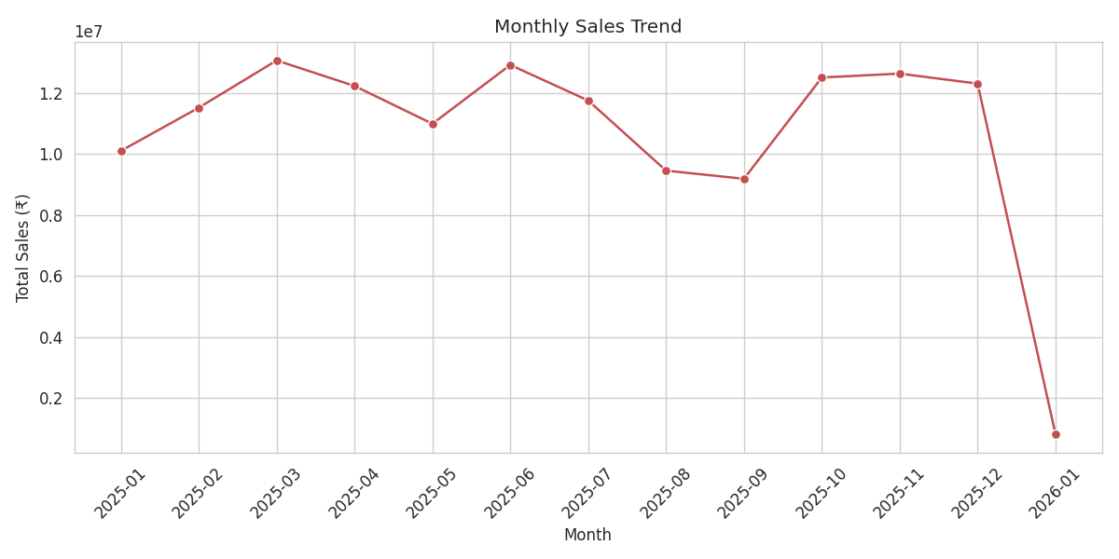
BUSINESS PROBLEM
Who drives the business — and why can’t we keep them?
The dataset covers ₹139.4M in revenue across 992 orders, but growth has been almost entirely acquisition-led. Leadership needs to know which customers actually drive revenue, and where retention, marketing, and inventory effort will have the greatest return.
1
Which customer segments actually generate the revenue?
Not every order carries equal weight — spend is concentrated somewhere.
2
Is the low repeat-purchase rate a red flag or noise?
The pattern: strong, choppy demand all year — with almost no repeat customers behind it.
Only 52 of 947 customers ordered twice — 5.5% repeat rate.
3
Which product category should marketing lean into?
Category mix varies sharply in revenue contribution.
ApexPlanet Data Analytics | Sales Performance & Customer Segmentation
2

Slide 3
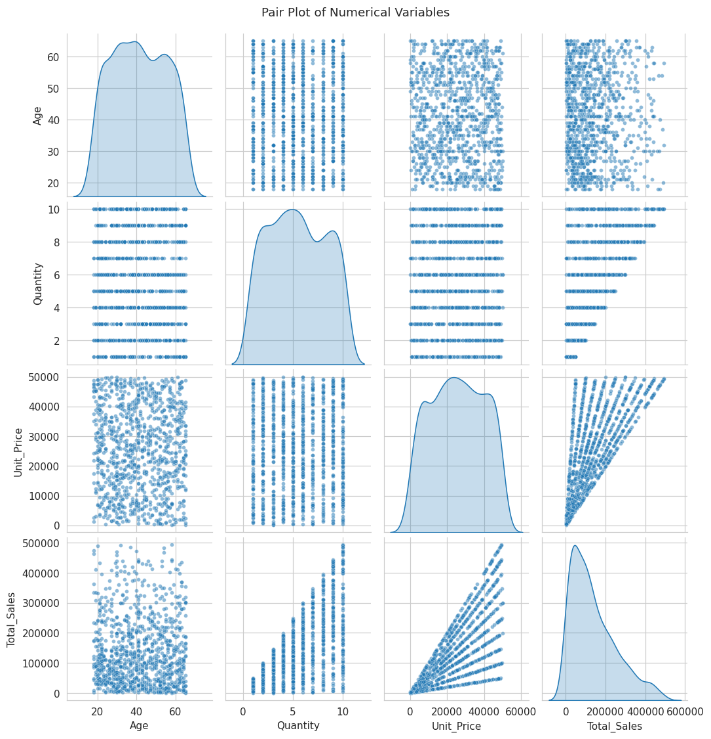
DATASET & METHODOLOGY
How the analysis was built
DATASET
Source
sales.csv · ApexPlanet Data Analytics
Period
Jan 2025 – Jan 2026
Records
1,000 rows analyzed → 992 unique Order_IDs · 947 unique customers
Variables
Order_ID, Order_Date, Customer, Age, Gender, City, Product, Category, Quantity, Unit_Price, Total_Sales
8 Order_IDs repeat across rows in the raw file; each row was kept as its own transaction, giving 992 unique order references.
ANALYSIS APPROACH
1
Data cleaning — whitespace, duplicates & outlier checks (IQR method)
2
Exploratory analysis — distributions, correlations, category & city breakdowns
3
K-Means segmentation on spend, quantity & age (k=4, chosen via elbow test)
4
Hypothesis testing — one-way ANOVA to validate segment differences
ApexPlanet Data Analytics | Sales Performance & Customer Segmentation
3

Slide 4
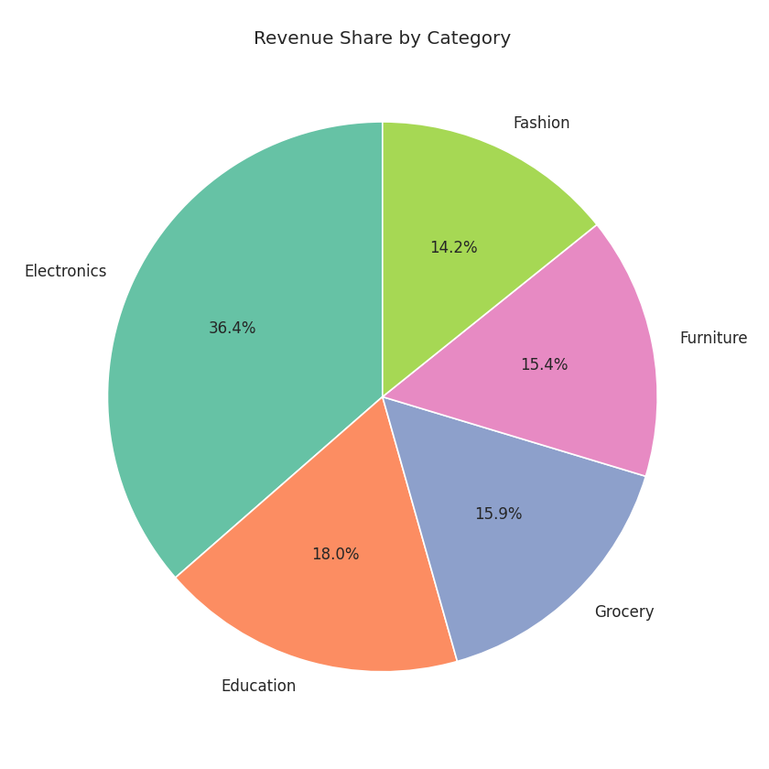
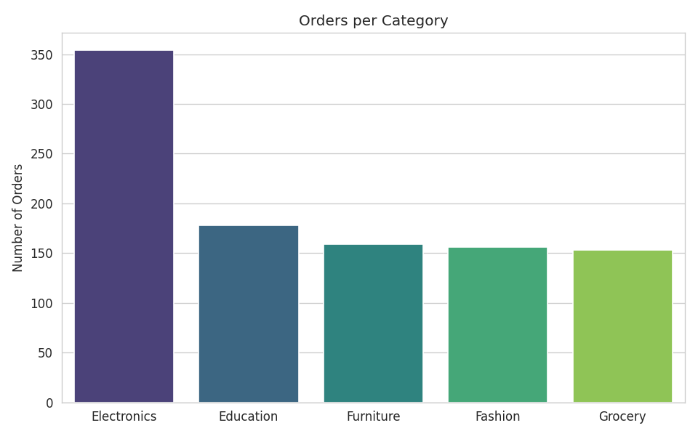
KEY KPI OVERVIEW
The business at a glance
₹139.40M
992
₹140.52K
5.48
52
Total Revenue
Total Orders
Average Order Value
Average Basket Size
Repeat Customers (5.5%)
992 unique order references from 1,000 analyzed rows (8 Order_IDs repeat in the source file).
Revenue share by category
Orders per category
ApexPlanet Data Analytics | Sales Performance & Customer Segmentation
4

Slide 5
FINDING 1 OF 3
Revenue is heavily concentrated in one segment
Premium Bulk Buyers are just 21% of orders — but 45% of revenue
Nearly 4× their proportional share of orders.
Avg order value ₹2,99,346 — double the next-highest segment.
Skew by age: high-value segments average ~48–49 yrs; low-value segments average ~30 yrs.
Losing this segment would be disproportionately damaging to revenue.
ApexPlanet Data Analytics | Sales Performance & Customer Segmentation
5

Slide 6
FINDING 2 OF 3
Electronics is a universal demand driver
Electronics leads every single customer segment
36.4% of total revenue — roughly double the next category (Education, 18.0%).
It ranks #1 by revenue in all four customer segments, not just one buyer type — a broad, structural demand driver.
Order value is jointly driven by price and quantity (r = 0.69 with Unit_Price, r = 0.65 with Quantity) — bundling higher-price, higher-quantity electronics is the clearest lever for lifting AOV.
354 of 1,000 orders (35%) fall in Electronics — the single largest order volume of any category.
ApexPlanet Data Analytics | Sales Performance & Customer Segmentation
6

Slide 7
FINDING 3 OF 3
The business is acquisition-led, not loyalty-led
5.5%
repeat-purchase rate
Only 52 of 947 customers placed a second order in 13 months.
Too thin a base for cohort/retention curves — which is why segmentation, not retention analysis, drove this deep-dive.
High one-time order values are already being captured — even a modest lift in repeat rate would compound quickly.
Revenue stayed strong through most months (₹9–13M/mo) with a dip in Aug–Sep and a partial final month (Jan 2026 data cutoff) — demand isn’t the issue.
ApexPlanet Data Analytics | Sales Performance & Customer Segmentation
7

Slide 8
BUSINESS HYPOTHESIS
Do the four customer segments really spend differently?
The segmentation splits customers into four groups by spend, quantity, and age. Before basing strategy on it, we need statistical evidence that these segments genuinely differ in order value — rather than being an artifact of the clustering algorithm.
H₀ — NULL HYPOTHESIS
H₁ — ALTERNATIVE HYPOTHESIS
The mean Total_Sales (order value) is equal across all four customer segments — Premium Bulk Buyers, Young High-Value Shoppers, Senior Budget Shoppers, and Young Budget Shoppers.
At least one segment has a mean order value that differs significantly from the others — confirming the segmentation captures a real behavioral difference in spend.
μ₁ = μ₂ = μ₃ = μ₄
At least one μᵢ ≠ μⱼ
Significance level: α = 0.05
ApexPlanet Data Analytics | Sales Performance & Customer Segmentation
8

Slide 9
STATISTICAL TEST
One-way ANOVA
WHY ANOVA
TEST SETUP
Comparing a continuous outcome (Total_Sales) across more than two independent groups (4 segments).
A t-test only handles two groups at a time; running six pairwise t-tests would inflate false-positive risk.
One-way ANOVA tests all four group means simultaneously with a single F-statistic and p-value.
Assumptions checked: independent observations, roughly continuous outcome, large sample per group (n ≥ 211 each) — satisfied by design of the dataset.
Dependent variable
Total_Sales (order value, ₹)
Grouping factor
Customer Segment (4 levels)
Group sizes
n = 249, 211, 240, 300
Test
One-way ANOVA (scipy.stats.f_oneway)
α (significance level)
0.05
Segment means compared: ₹66,411 · ₹2,99,346 · ₹1,57,204 · ₹73,241
ApexPlanet Data Analytics | Sales Performance & Customer Segmentation
9

Slide 10
STATISTICAL RESULTS
The segments are statistically distinct
550.63
< 0.001
3, 996
Reject H₀
F-statistic
p-value
Degrees of freedom
Result at α = 0.05
95% Confidence Intervals — Mean Order Value by Segment
Segment | n | Mean AOV (₹) | 95% CI (₹)
Premium Bulk Buyers | 211 | 2,99,346 | 2,86,612 – 3,12,080
Young High-Value Shoppers | 240 | 1,57,204 | 1,46,847 – 1,67,561
Senior Budget Shoppers | 300 | 73,241 | 67,096 – 79,386
Young Budget Shoppers | 249 | 66,411 | 60,623 – 72,198
How to read it
p < 0.001 is far below α = 0.05 — the difference in means is extremely unlikely to be due to chance.
There is statistically significant evidence that mean order value differs across the four customer segments.
ANOVA shows at least one segment differs — it does not by itself prove segment membership causes the difference in spend.
The 95% CIs and Tukey post-hoc test confirm the difference is real and pinpoint exactly which segment pairs drive it.
None of the four intervals overlap — each segment's true mean order value is estimated to a distinct range, reinforcing the ANOVA result visually.
Post-hoc — Tukey HSD pairwise test
5 of 6 segment pairs differ significantly (p < 0.001). The exception: Senior Budget vs. Young Budget Shoppers do not differ significantly (p = 0.667) — age-based budget buyers behave alike regardless of age.
ApexPlanet Data Analytics | Sales Performance & Customer Segmentation
10

Slide 11
BUSINESS IMPLICATIONS
What the result means for strategy
Because there is statistically significant evidence that mean order value differs across the four segments — confirmed by non-overlapping 95% CIs and Tukey post-hoc tests — leadership can confidently use these segments to guide resourcing, marketing, and retention decisions rather than treating all customers alike.
1
2
3
Resource allocation is justified
Differentiated messaging works
Forecasting improves
Premium Bulk Buyers can be prioritized for account management without risk that the group is statistically indistinguishable from the rest.
Since spend behavior genuinely differs by segment, tailored offers (loyalty vs. bundle vs. entry-level) should outperform one-size-fits-all campaigns.
Segment mix can now be used as a real explanatory variable in revenue forecasts, not just a descriptive label.
ApexPlanet Data Analytics | Sales Performance & Customer Segmentation
11

Slide 12
RECOMMENDATIONS & CALL TO ACTION
What the business should do next
1
Protect Premium Bulk Buyers
2
Go digital-first on Electronics for Young High-Value Shoppers
Stand up a dedicated loyalty / account-management track for the segment driving 45% of revenue from 21% of orders.
This segment combines strong spend with the longest customer lifetime — highest ROI for growth marketing.
3
Bundle to lift AOV in Budget segments
4
Make the 5.5% repeat-rate a top-line KPI
Senior & Young Budget Shoppers are 55% of orders but only 28% of revenue — use minimum-basket incentives.
Even a modest retention lift compounds fast, given the high one-time order values already captured.
Next step: pilot a Premium Bulk Buyer loyalty program next quarter and re-measure repeat-purchase rate in 90 days.

