Slide 1
TASK 4
DATA STORYTELLING & STATISTICAL VALIDATION
From Transactions to Truth
The FY2025 Retail Sales Story
A statistically validated narrative — ₹13.94 Cr in revenue, an interactive Power BI dashboard, and a hypothesis put to the test.
Business Narrative
Interactive Dashboard
Hypothesis Testing

Slide 2
How This Story Is Built
Three steps from raw transactions to a validated business recommendation.
01
1
02
2
03
3
Craft the Data Story
Build the Interactive Dashboard
Validate with Hypothesis Testing
Structure FY2025 findings into a narrative with a clear objective, analysis, and a call to action.
A Power BI dashboard lets stakeholders filter revenue by category, city, month, and customer segment.
Formulate a testable claim and confirm it statistically before it drives a marketing decision.
TASK 4
Data Storytelling & Statistical Validation • Slide 02

Slide 3
Executive Summary
Objective: synthesize FY2025 sales data into a business narrative and validate key patterns with statistical testing.
₹
#
⌀
n
₹13.94 Cr
992
₹1,39,399
52
Total Revenue
Orders Placed
Avg. Order Value
Repeat Customers
What the data shows
Electronics leads every category, generating over a third of total revenue.
Patna and Kolkata are the top-earning cities, narrowly ahead of Bengaluru and Mumbai.
Order value stays remarkably consistent across gender, weekday, and top categories.
Only 5.2% of customers are repeat buyers — a clear retention opportunity.
TASK 4
Data Storytelling & Statistical Validation • Slide 03

Slide 4
Where the Revenue Comes From
Electronics is the single largest driver of revenue, more than double any other category.
Category mix
Electronics
36.4%
354 orders
Education
18.0%
178 orders
Grocery
16.0%
153 orders
Furniture
15.4%
159 orders
Fashion
14.2%
156 orders
Top products: Laptop (₹2.54 Cr) and Mobile (₹2.53 Cr) together outsell every other single product.
TASK 4
Data Storytelling & Statistical Validation • Slide 04

Slide 5
Revenue Held Steady Through the Year
Monthly revenue for 2025 (₹ Crore) — a March peak, a seasonal Aug–Sep dip, and a strong Q4 recovery.
Reading the curve: Aug–Sep softness lines up with fewer orders overall, not lower order value — worth checking against seasonal promotions.
TASK 4
Data Storytelling & Statistical Validation • Slide 05

Slide 6
Revenue Is Broadly Spread Across Cities
No single city dominates — the top and bottom performing cities are within 31% of each other.
TASK 4
Data Storytelling & Statistical Validation • Slide 06

Slide 7
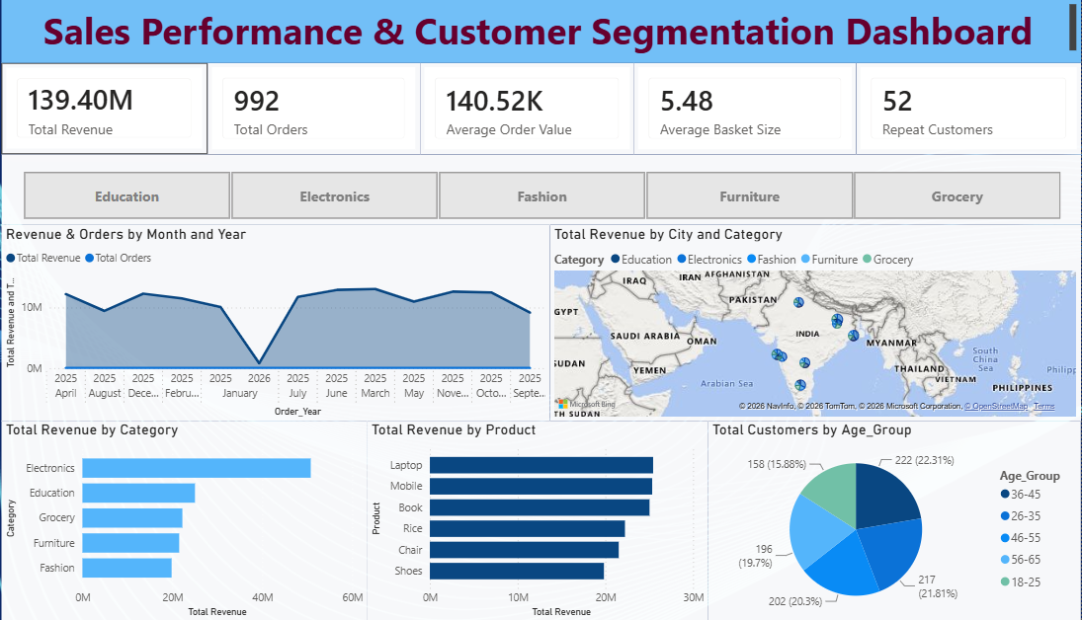
An Interactive Dashboard for Stakeholders
Built in Power BI so the sales, category, and customer story above can be explored live — not just read.
CAT
Category slicers
One click filters every visual by Education, Electronics, Fashion, Furniture, or Grocery.
TRD
Trend + volume
Revenue and order count plotted together by month, so growth and activity move as one story.
MAP
Geographic map
City-level bubbles sized by revenue, split by category, across the map of India.
Live view — filterable by category, city, month, and customer age band.
AGE
Age-group lens
5.48 items per basket on average; customers split fairly evenly across five age bands, 36–45 leading at 22.3%.
TASK 4
Data Storytelling & Statistical Validation • Slide 07

Slide 8
?
HYPOTHESIS TESTING
Do men and women really shop differently?
A recurring question from the merchandising team: should Electronics marketing be targeted by gender, or does everyone shop it equally?
NULL HYPOTHESIS (H₀)
ALTERNATIVE HYPOTHESIS (H₁)
A customer's gender and their likelihood of buying Electronics are independent — purchase rates are equal.
Gender and Electronics purchase rate are associated — the proportions differ between men and women.
Test used: Two-proportion Z-test | Significance level: α = 0.05

Slide 9
Result: A Statistically Significant Gap
Men buy Electronics at a meaningfully higher rate than women, at 95% confidence.
MALE CUSTOMERS
FEMALE CUSTOMERS
P-VALUE
38.4%
32.3%
0.046
buy Electronics (196 of 511 orders)
buy Electronics (158 of 489 orders)
z = 2.00 → below the 0.05 threshold
Business conclusion
We reject H₀: the gap is unlikely to be chance (p = 0.046 < 0.05).
The effect is real but modest — about 6 percentage points, not a dramatic split.
Recommendation: trial gender-weighted Electronics ad targeting, but validate with a live A/B test before reallocating major budget.
TASK 4
Data Storytelling & Statistical Validation • Slide 09

Slide 10
What Didn't Move the Needle
Four other hypotheses were tested — none showed a statistically significant difference, which is itself useful for pricing strategy.
Hypothesis
Test
Result
p-value
Avg. order value differs by gender
Welch's t-test
Not significant
0.495
Avg. order value differs, weekday vs weekend
Welch's t-test
Not significant
0.276
Electronics vs Grocery order value differs
Welch's t-test
Not significant
0.868
City and category preference are related
Chi-squared
Not significant
0.196
Why this matters: consistent order values across these segments mean pricing and promotions can stay unified — no need to fragment strategy by gender, day, or category on value alone. The real differentiator is what people buy, not how much they spend per order.
TASK 4
Data Storytelling & Statistical Validation • Slide 10

Slide 11
Recommendations & Next Steps
₹
Protect the core
A/B
Test before you target
Electronics and Education drive 54% of revenue — prioritize stock and service levels here first.
Pilot gender-weighted Electronics campaigns as a controlled A/B test to confirm the 6-point gap before scaling spend.
↻
Fix the retention gap
◱
Investigate the Aug–Sep dip
Only 5.2% of customers are repeat buyers — launch a loyalty or win-back program to lift lifetime value.
Revenue softened in Aug–Sep on lower order count, not lower ticket size — review seasonal promotion timing.

Slide 12
Thank you — Any questions.

