Slide 1

DATA ANALYST INTERNSHIP
Final Portfolio
A complete, end-to-end capstone — from raw data to statistically validated business recommendations
Presented by
Parth Varute
ApexPlanet Software Pvt. Ltd.
Data Analytics Virtual Internship Program

Slide 2




ABOUT ME
The person behind the portfolio
Education
B.Tech, Computer Science & Engineering — specialization in Data Science
Background
Strong foundation in Python, statistics, and database fundamentals built through coursework and self-driven projects
Parth Varute
Aspiring Data Analyst
Why Data Analytics
D Y Patil Technical Campus, Talsande
Faculty of Engineering & Management
Drawn to turning messy, real-world data into clear business decisions — this internship was the perfect hands-on proving ground
ApexPlanet Data Analytics Internship | Parth Varute — Final Portfolio
2

Slide 3



INTERNSHIP OVERVIEW
What this internship was all about
ORGANIZATION
ROLE
DURATION
ApexPlanet Software Pvt. Ltd.
Data Analytics Intern
60 Days · 5 Structured Tasks
MAIN OBJECTIVES
Work with a real-world sales dataset end to end — from raw file to boardroom-ready insight
Build fluency across the analytics stack: Python, SQL, BI dashboards, and statistical testing
Progress through 5 milestone tasks: Data Wrangling → EDA & BI → Deep-Dive Dashboarding → Storytelling → Capstone Portfolio
Package all work into a professional, public portfolio for future employers
ApexPlanet Data Analytics Internship | Parth Varute — Final Portfolio
3

Slide 4






SKILLS DEVELOPED
The analytics toolkit I built hands-on
Python
SQL
Excel
Pandas
NumPy
Data Visualization
Power BI
Git & GitHub
ApexPlanet Data Analytics Internship | Parth Varute — Final Portfolio
4

Slide 5


PROJECT 1 OF 4 · TASK 1
Sales Data Cleaning & Preparation
PROBLEM STATEMENT
KEY RESULT
The raw ApexPlanet sales export had missing values, duplicate order references, and inconsistent formatting — unusable for analysis as-is.
992 clean orders
From 1,000 raw rows → 992 unique, analysis-ready order records across 947 customers
APPROACH
• Built a full data dictionary documenting all 12 fields and their business meaning
• Profiled data quality: missing values, duplicates, outliers (IQR method)
• Standardized date formats and cleaned free-text category / city fields
• Engineered features and exported a final analysis-ready dataset
Records before vs. after cleaning
DATASET
TOOLS
sales.csv — 1,000 rows, 12 columns (Order_ID, Customer, Age, City, Product, Category, Total_Sales...)
Python, Pandas, Jupyter Notebook
ApexPlanet Data Analytics Internship | Parth Varute — Final Portfolio
5

Slide 6
PROJECT 2 OF 4 · TASK 2
Exploratory Analysis & SQL Business Insights
PROBLEM STATEMENT
KEY RESULT
Leadership needed fast, reliable answers to core business questions — top products, category performance, monthly trends — straight from the data.
36.4% revenue
Electronics emerged as the single largest revenue category — nearly double Education, the runner-up
APPROACH
• Ran descriptive statistics and univariate visualizations across all fields
• Wrote SQL queries answering 7 business questions using filtering, aggregation & joins
• Built multivariate views (scatter plots, heatmaps) linking spend, age & category
• Designed a static KPI dashboard mock-up to guide the Task 3 build
Revenue share by product category
DATASET
TOOLS
sales.csv — 992 cleaned orders, 947 customers
SQL, Python (Pandas, Seaborn, Matplotlib)
ApexPlanet Data Analytics Internship | Parth Varute — Final Portfolio
6

Slide 7
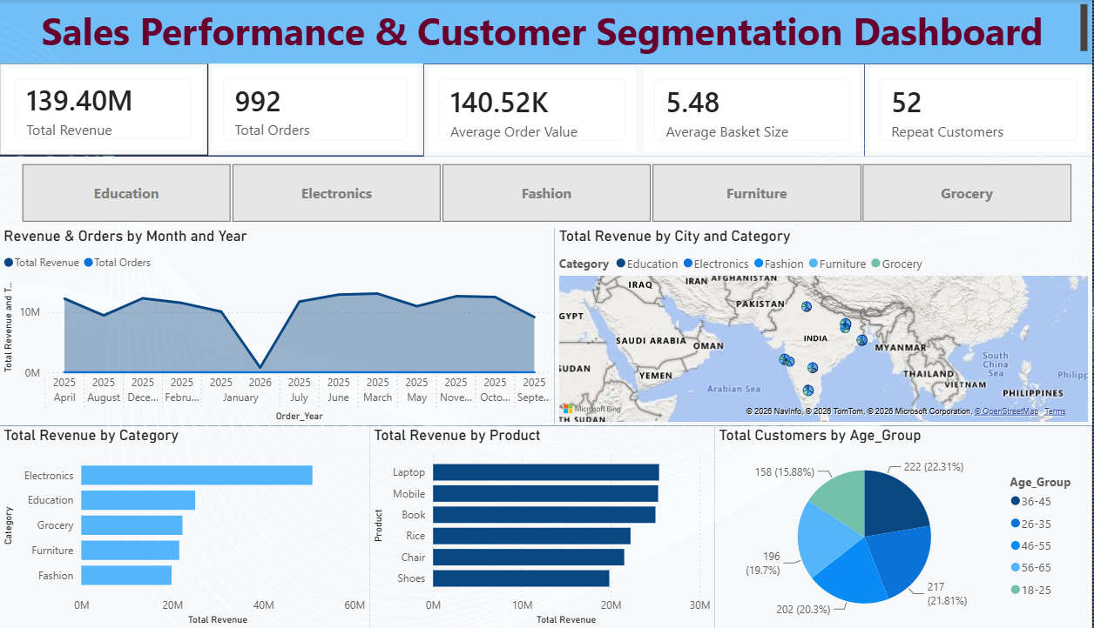
PROJECT 3 OF 4 · TASK 3
Customer Segmentation & Interactive Dashboard
PROBLEM STATEMENT
KEY RESULT
Which customers actually drive ApexPlanet's ₹139.4M in revenue — and where should retention and marketing effort be focused?
45% from 21%
Premium Bulk Buyers are just 21% of orders but drive 45% of total revenue — 2x the AOV of any other segment
APPROACH
• Defined 4 core KPIs: Revenue, AOV, Basket Size, Repeat-Purchase Rate
• Ran K-Means clustering (k=4, elbow method) on spend, quantity & age
• Built a functional, interactive Power BI dashboard surfacing all KPIs
• Enabled drill-down exploration by segment, category & city
Live Power BI dashboard
DATASET
TOOLS
992 orders · 947 customers · ₹139.4M total revenue
Python (Scikit-learn), Power BI
ApexPlanet Data Analytics Internship | Parth Varute — Final Portfolio
7

Slide 8
PROJECT 4 OF 4 · TASK 4
Statistical Validation & Stakeholder Storytelling
PROBLEM STATEMENT
KEY RESULT
Before basing strategy on the 4 customer segments, leadership needed statistical proof the spend differences were real — not a clustering artifact.
p < 0.001
F(3, 996) = 550.63 — segment differences are statistically significant, not chance. H₀ rejected.
APPROACH
• Formulated a testable hypothesis on mean order value across segments
• Ran a one-way ANOVA (scipy.stats.f_oneway) at α = 0.05
• Confirmed with Tukey HSD post-hoc pairwise comparisons
• Packaged findings into a stakeholder-ready narrative deck with a call to action
Mean order value by segment (₹)
DATASET
TOOLS
992 orders segmented into 4 groups (n = 211–300 each)
Python (SciPy), PowerPoint
ApexPlanet Data Analytics Internship | Parth Varute — Final Portfolio
8

Slide 9

KEY LEARNINGS
Eight capabilities I can now put to work
Data Cleaning
Exploratory Data Analysis
SQL Querying
Dashboard Development
Data Visualization
Business Insights
Git / GitHub Workflow
Presentation Skills
ApexPlanet Data Analytics Internship | Parth Varute — Final Portfolio
9

Slide 10

FINAL REFLECTION
From academic theory to practical analytics
This internship helped me bridge the gap between academic knowledge and practical data analytics. I gained experience working with real datasets, analyzing information, creating visualizations, and communicating insights to a business audience.
Moving through five structured tasks — from cleaning raw sales data to defending statistically validated recommendations — taught me that great analysis isn't just about the numbers. It's about asking the right business question first, and never losing sight of it.
Parth Varute · Data Analytics Intern, ApexPlanet Software Pvt. Ltd.
ApexPlanet Data Analytics Internship | Parth Varute — Final Portfolio
10

Slide 11


MY COMPLETE PORTFOLIO
Every task, one repository
The master repository brings together all five internship tasks — data dictionary, cleaning scripts, EDA notebooks, the interactive Power BI dashboard, statistical tests, and the final presentation deck — in one polished, professional reference.
GITHUB REPOSITORY
github.com/parthvarute09/ParthVarute-Data-Analyst-Portfolio
README overview & skills summary
Links to all 4 task-specific repos
Final presentation deck
Live Power BI dashboard link
SCAN TO VIEW
Live GitHub Portfolio
ApexPlanet Data Analytics Internship | Parth Varute — Final Portfolio
11

Slide 12


Thank You!
Let's Connect
GITHUB
github.com/parthvarute09
LINKEDIN
linkedin.com/in/parth-varute-49516a332
EMAIL
parthvarute2005@gmail.com
ApexPlanet Software Pvt. Ltd. | Data Analytics Internship 2026

