Slide 1
Healthcare Automation
Ankita Jha (002926812)
Pratik Hariya (002929941)
Parth Kataria (002964611)

Slide 2
Introduction
The major goal of creating this software is to give a forum for people to provide funding from Government or NGO. The systems maintains the entire workflow from Patient visiting the Doctor to Hospital referring the patient to Government or NGO to provide funding. The system also maintains the prescriptions provided by the doctor, test results from the Laboratory.

Slide 3
Problem Statement
The current system for requesting funds from Government or NGO is too manual.
People who are in need or who do not have the means to search for funds, may use our system which will help them ease their task of managing funds.
Currently, there is no system that maintains all the doctor visits, lab results, refers for funding and approves it.

Slide 4
Proposed Solution
1. Providing a digital service to reduce the time and effort required for this activity
2. An application is offered to a variety of organizations participating in each phase to assist them interact smoothly
3. Roles and tasks that are clearly specified to aid different personnel’s from various organizations representing their enterprises
4. User friendly UI to make it easier for users to traverse the application

Slide 5
Enterprises
Health Centre
Insurance Company
Government
NGO

Slide 6
Organizations
Accountant
Doctor
Lab
Blood Bank Manager
Insurance Agent
Insurance Policy Planner
Insurance Finance
Healthcare Officer
Secretary
Treasury
NGO Administrator
NGO Director

Slide 7
Roles
Accountant
Doctor
Lab
Blood Bank Manager
Insurance Agent
Insurance Policy Planner
Insurance Finance
Healthcare Officer
Secretary
Treasury
NGO Administrator
NGO Director

Slide 8
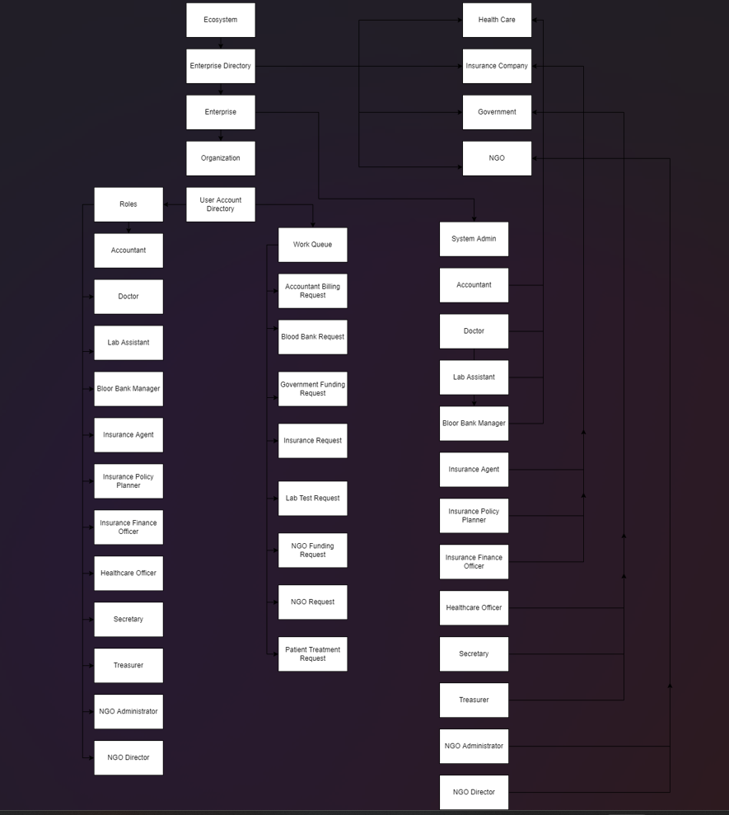
Block Diagram

Slide 9
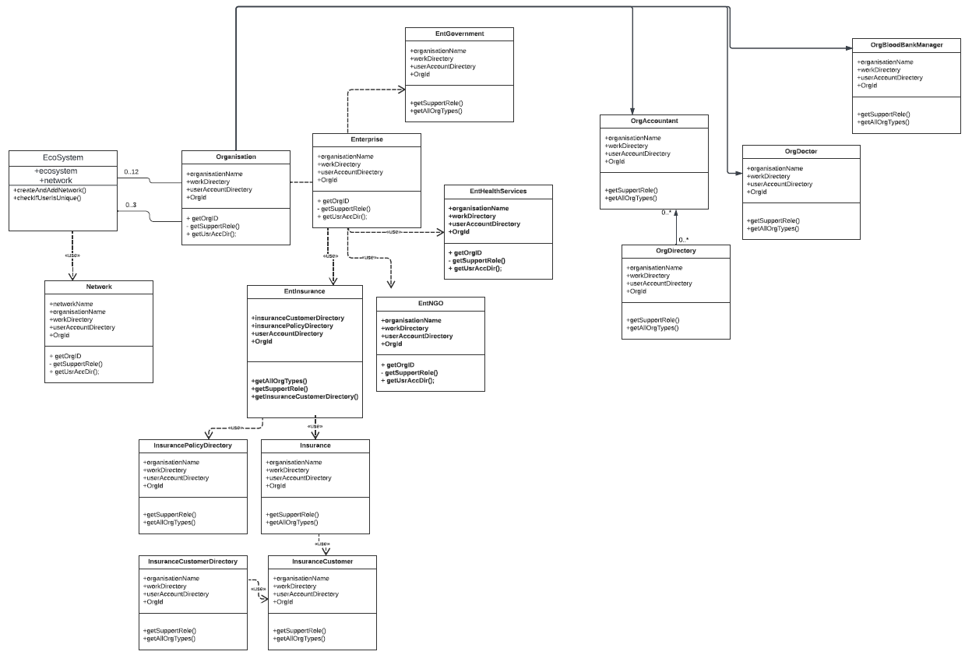
UML DIAGRAM

Slide 10
Thank You!

