Slide 1






As fuck
…Thus, we are going to talk about it.

Slide 2

I know what you’re thinking…

Slide 3


Slide 4

The Eval Function – A short pantomime
“It evaluates a string that is passed into it as code and automatically executes it.”
[Jackie Stephens] That’s not very secure
[Paul Reuphus] No, it’s not
[Jackie Stephens] That sounds like the opposite of secure
[Paul Reuphus] Very true
[Jackie Stephens] In fact I’ll bet if an attacker were to input some malicious system commands into a field that is handled by that function he (or she) could get the server to execute it, possibly resulting in a full system compromise.
[Paul Reuphus] Yeah, probably
(both kiss, passionately)
-by Floyd Wallis

Slide 5

Don’t use it

Slide 6


Slide 7

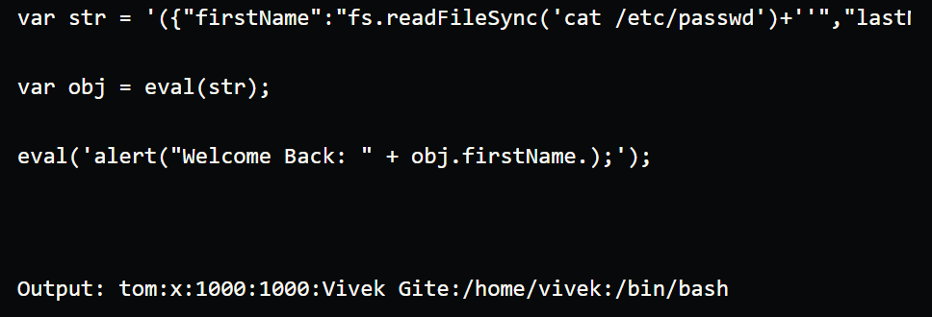
But what if I really want to?
Make sure the field is not accessible in anyway by an outside party
Instead use JSON.parse, which also evaluates strings into arbitrary code but in a more sanitary way
Heed these warnings or this could be you!

