Slide 1
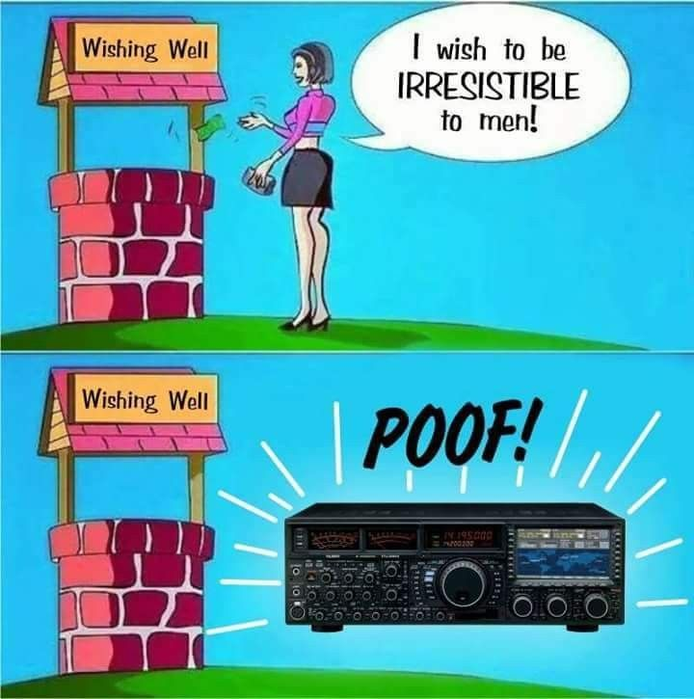
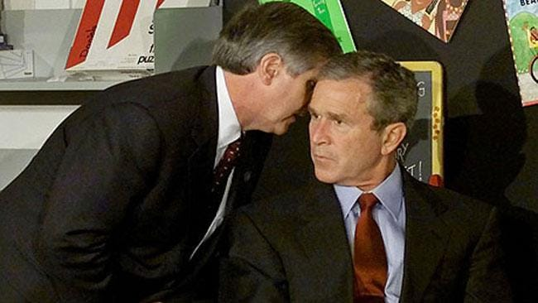
MR President, they hit the second radio tower

Slide 2

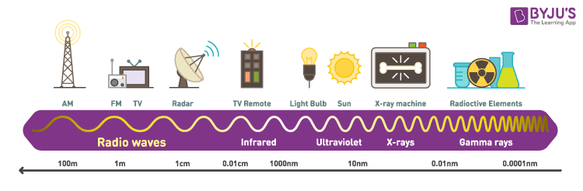
Radio waves have low frequency and low energy transfer over a long range
They can reflect off the atmosphere

Slide 3

A short video:
https://www.youtube.com/watch?v=NrwDRkDvdkw
I have only watched the intro to this video, but it had me buckled
No clue what it’s about
Might not even be short
We are watching all of it

Slide 4
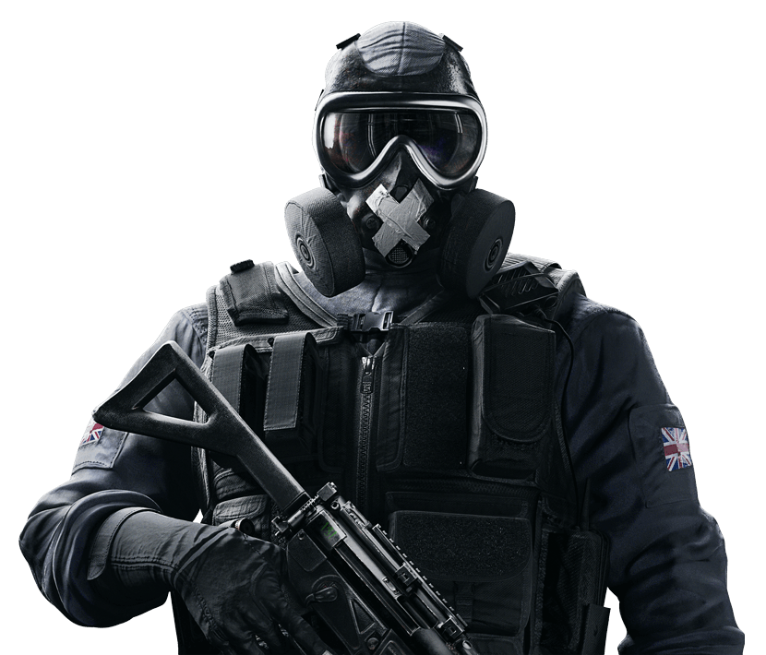

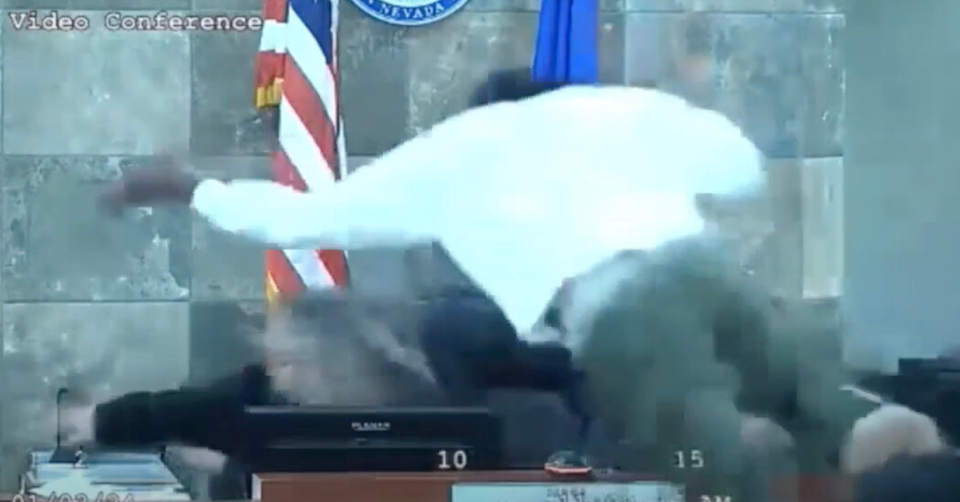
Nat’s bodged RF hacker
Nigel (my car is called Nigel)
Attack type | How it works | Targets
Replay Attack | A device intercepts a radio signal and stores it to replay the frequency | Key fobs, garage doors, access Cards
Signal Jamming | A device broadcasts noise on the same and similar frequencies to disturb genuine connections | Drones, communication channels, security systems
SDR-Based Eavesdropping | Unencrypted data that is transmitted over radio is intercepted | Wireless keyboards, baby monitors (don’t get any ideas, Brandon), communications
Relay Attack | A signal is cloned in one device, near the transmission and sent to another to exploit the target | Usually car keys that use keyless entry

Slide 5






Slide 6


Slide 7
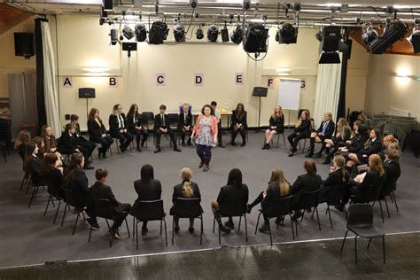

Slide 8


Relay:
Faraday Bags
Motion Detection
Ultra-Wideband (UWB) Technology (Next-Gen Keyless Entry)
Replay:
Rolling Code
Cryptographic handshakes
Time Synchronisation
Jamming:
Frequency Hopping Spread Spectrum
Increased Transmitter Power
Jemming Detection Systems

Slide 9
