Slide 1
















CIF analyzer
Pymatgen
Recap of remote Code Execution
How to find CVEs
AND an intro into the CEH cert

Slide 2
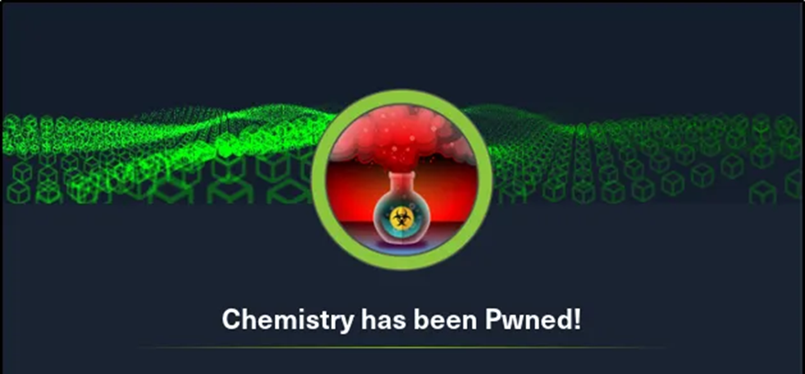
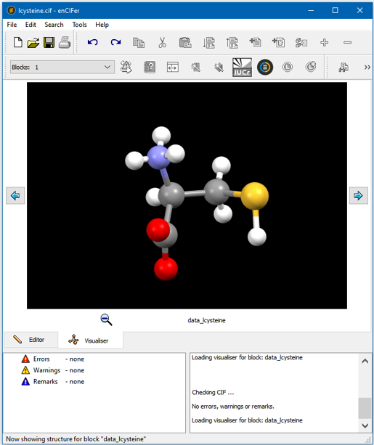
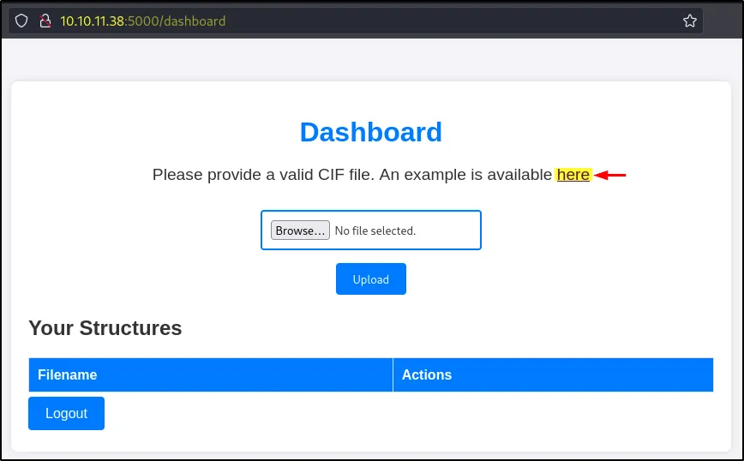

(you need one though)
(idk man, it’s just a file format)
A CIF or Crystallographic Information File is the standard format for storing crystallographic structural data. CIF information has a specific structure or format that needs to be followed to allow crystallographic programs to read the file.

Slide 3
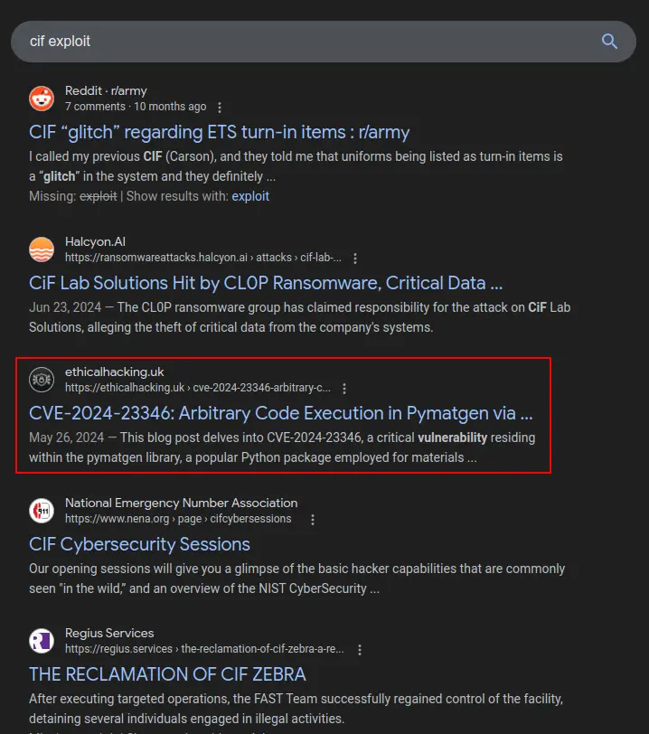


How to find
Literally just Google:
“<notable element> exploit”
Web template name
Weird file format
Keywords found on page
Literally just describe what there is to google or chatgpt

Slide 4



It takes input, runs a regex against it, and passes the result to eval. Comments saying that “should be fine to use eval here but be mindful for security reasons”.
If the user input is passed into this function (in this case as the CIF file), then it can lead to command execution.
“a robust, open-source Python library for materials analysis”
Vulnerability is in: pymatgen/symmetry/settings.py
basis_change = [
re.sub(r"(?<=\w|\))(?=\() | (?<=\))(?=\w) | (?<=(\d|a|b|c))(?=([abc]))", r"*", string, flags=re.X)
for string in basis_change
]
# should be fine to use eval here but be mindful for security
# reasons
# see http://lybniz2.sourceforge.net/safeeval.html
# could replace with regex? or sympy expression?
P = np.array([eval(x, {"__builtins__": None}, {"a": a, "b": b, "c": c}) for x in basis_change])

Slide 5



Remote Code Execution
Remote code execution (RCE) attacks allow an attacker to remotely execute malicious code on a computer. The impact of an RCE vulnerability can range from malware execution to an attacker gaining full control over a compromised machine.
Usually used in CTFs to execute a reverse shell script
.CIF file exploit
Netcat listener on host
Upload .CIF file exploit
Rev shell

Slide 6

Certified Ethical Hacker exam
The CEH (Certified Ethical Hacker) exam is a 4-hour, 125-question, multiple-choice exam that tests your knowledge of ethical hacking principles, techniques, and technologies, requiring you to demonstrate your ability to secure and protect computer systems.
Multiple choice
Super easy (apparently)
You can get it for free through the uni (option to sign up in final year)

Slide 7



