Slide 1




A box
Literally me :)

Slide 2


FTP is a perfectly reasonable protocol for transferring sensitive information
Does require authentication, however, it transfers data such as login credentials in plaintext over port 21. Sounds pretty secure to me.

Slide 3

Packet Capture
Packet sniffing tools are used to intercept network traffic and display them in a graphical user interface.
Format:
Global Header:
Metadata about the capture session.
Packet Records:
Timestamp, Packet Length, Packet Data
(headers + payload)

Slide 4

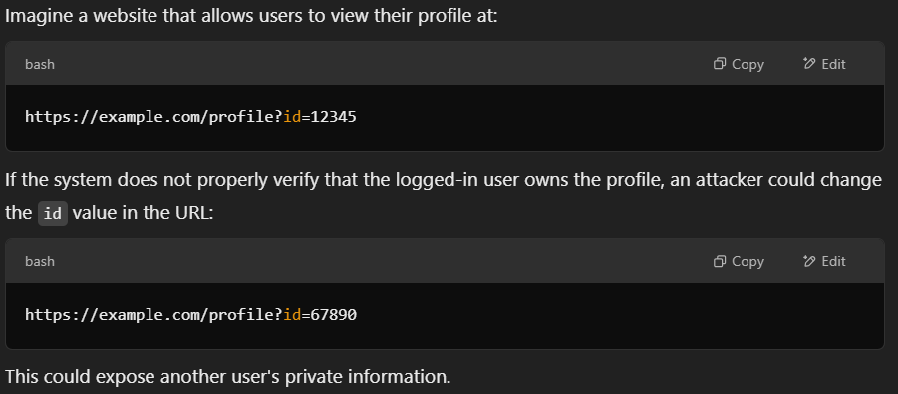

Insecure Direct Object Reference – When you can just change things in an input field by altering something like a URL

Slide 5















WinPEAS is a windows network enumeration tool
Run it by curling it onto the target
Produces a colour-coded analysis of misconfigurations on a network
Exploit and Priv Esc on that thang
Outputs Can Include:
Unquoted service paths
Modify the path to execute a malicious binary
Plaintext credentials
Extract plaintext passwords
Weak folder permissions
Replace an exe with something more devious
WinPeas
WINPEES

