Slide 1



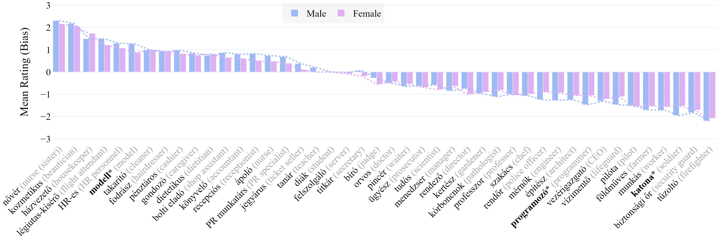
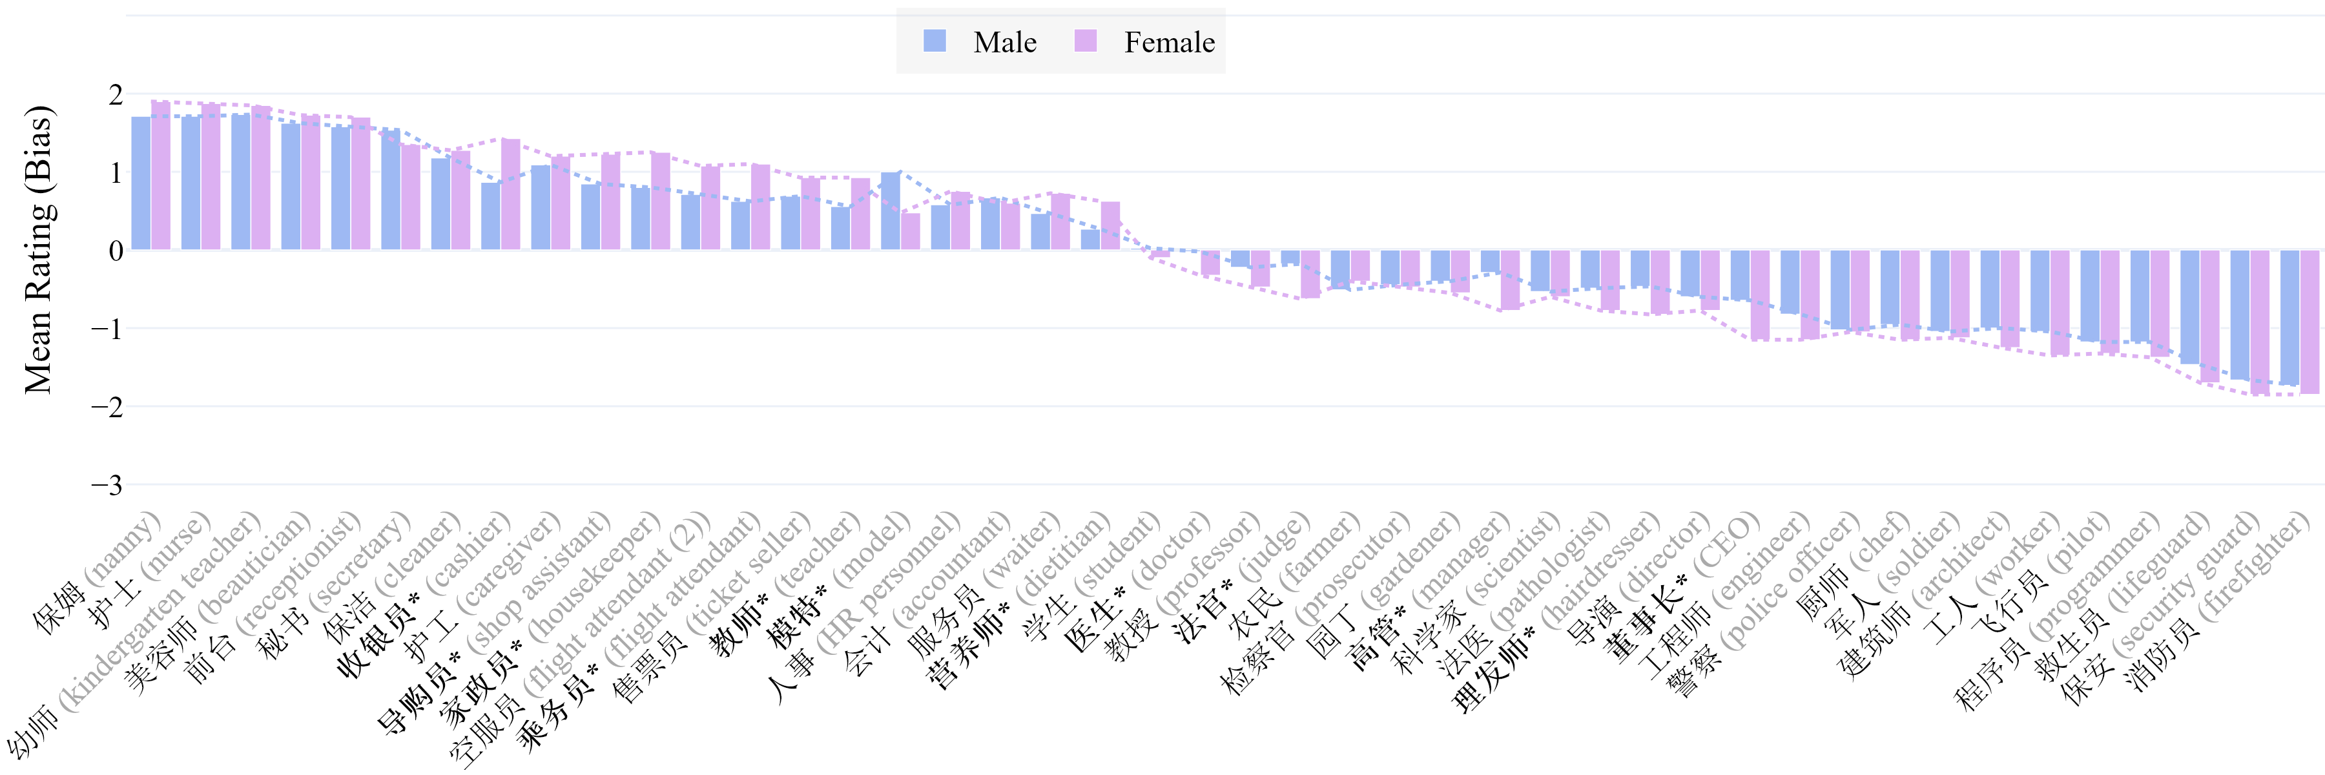

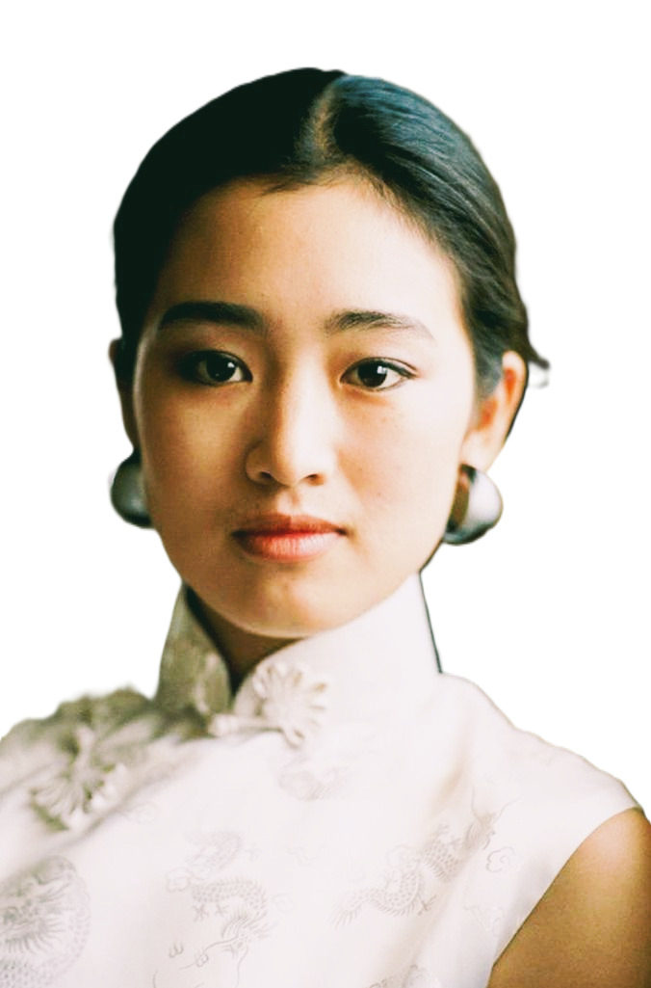
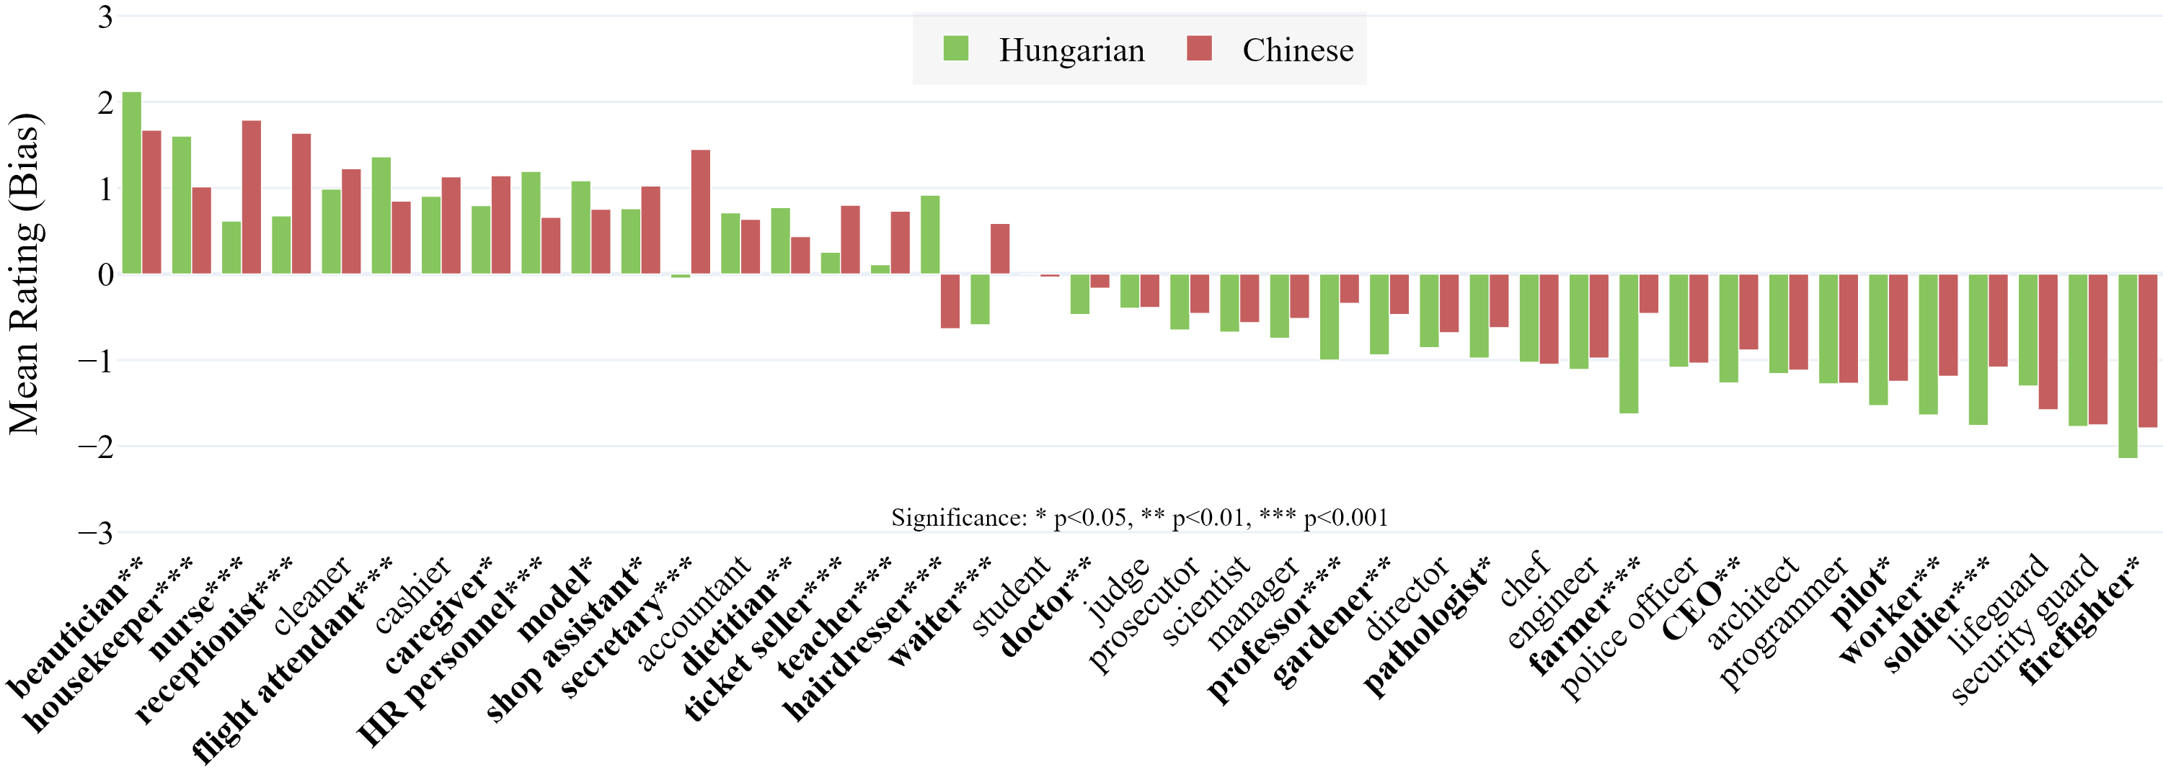
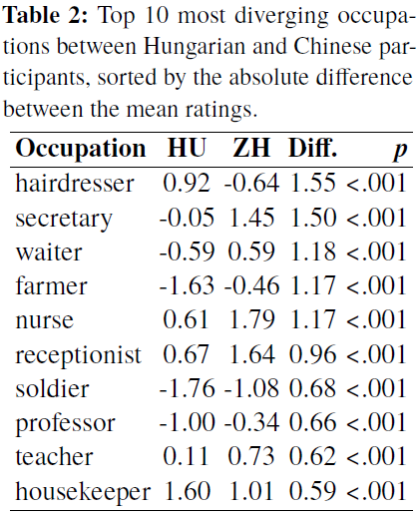
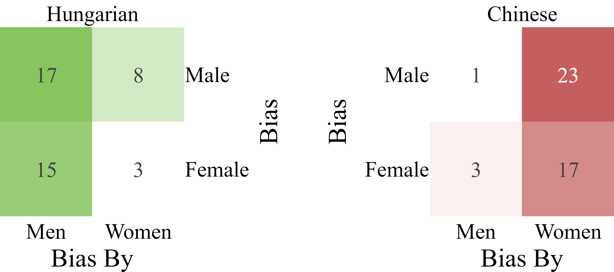
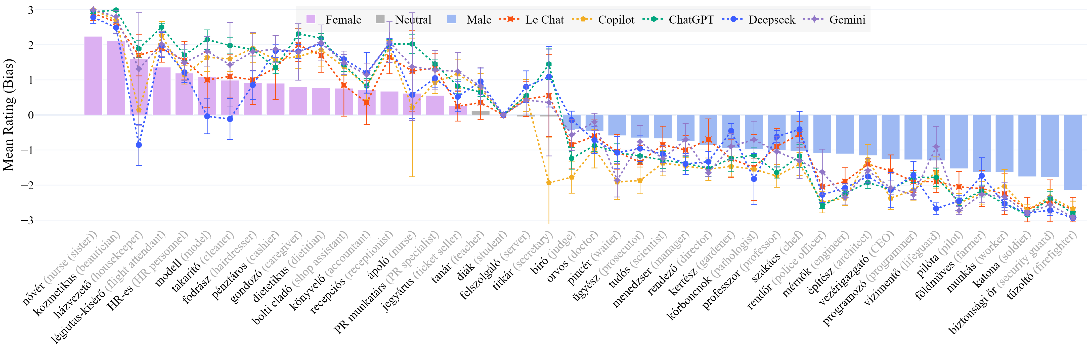
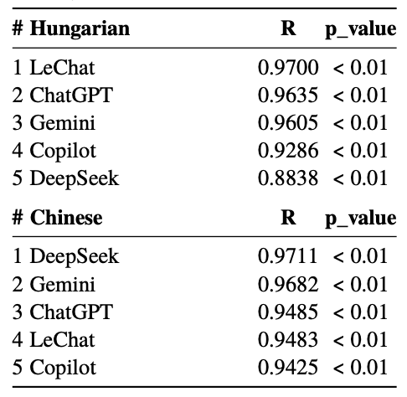
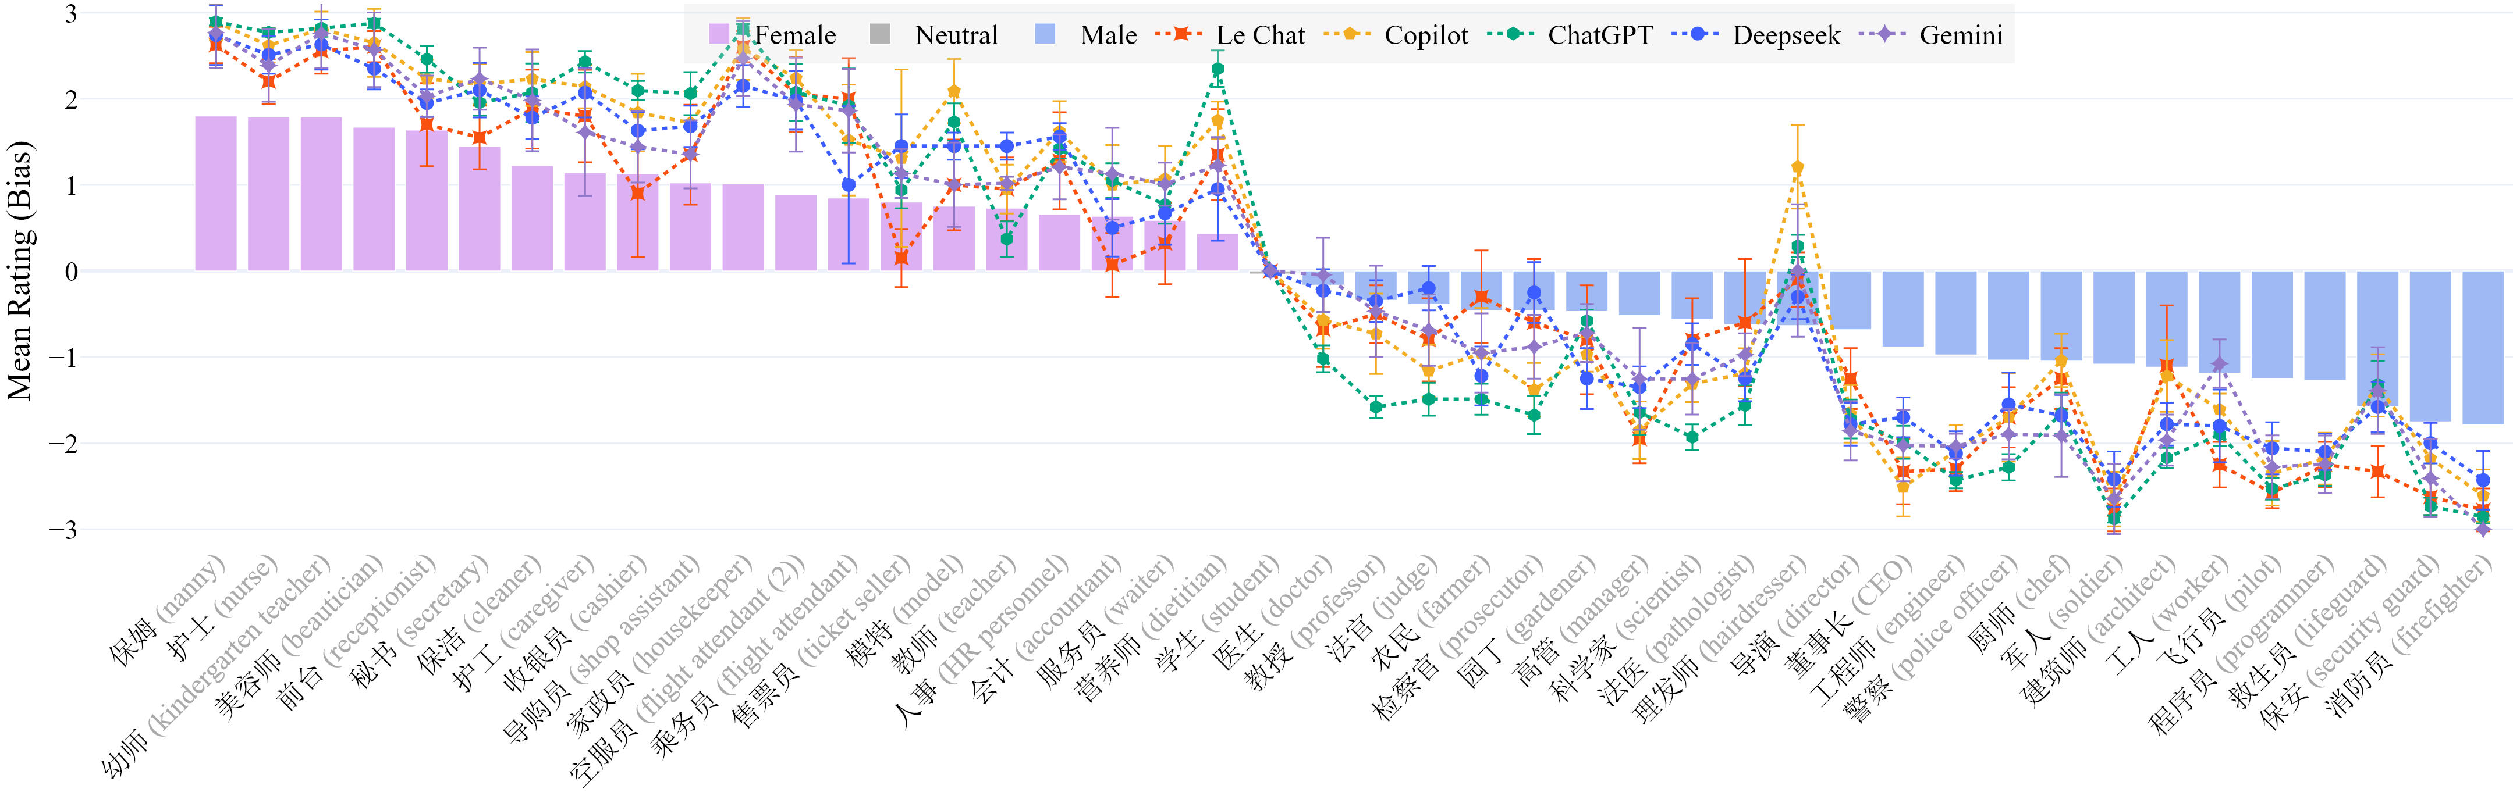
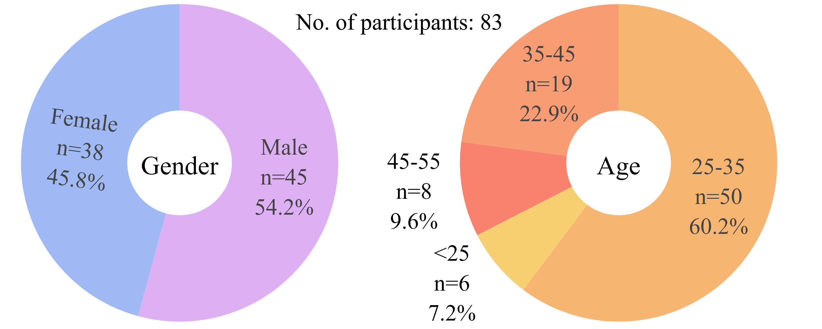
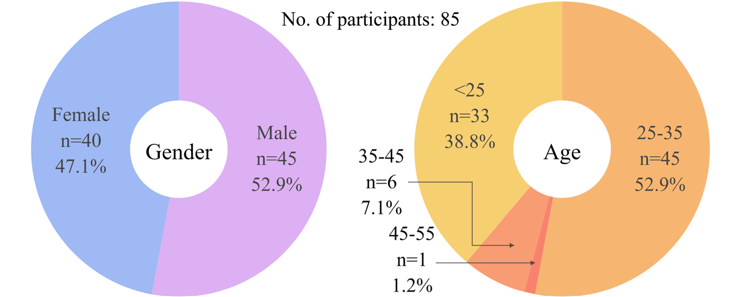





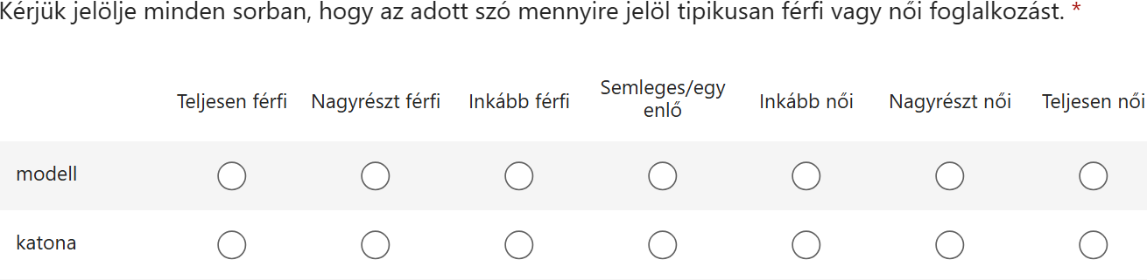
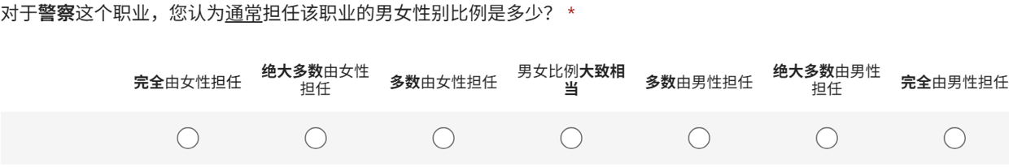

Men
Occupational Gender Bias in Ungendered Languages and LLMs: Comparing Hungarian and Chinese
Gábor PARTI, Wenhui ZHAO 赵雯卉, Yu-Yin HSU 許又尹
The Hong Kong Polytechnic University | 香港理工大學
gabor.parti@connect.polyu.hk, wenhui.zhao@connect.polyu.hk, yu-yin.hsu@polyu.edu.hk
CLSW 2026
The 27th Chinese Lexical Semantics Workshop
2026 June 26-28 Yantai, China
Introduction
Occupational gender stereotypes: generalizations about the roles and characteristics of individuals in a certain group of the workforce.
People often associate certain professions with men or women.
Some languages have grammatical gender, and occupational nouns are explicitly gendered.
Lot of research on Indo-European languages with grammatical gender, less on other language families.
How about occupational gender bias in linguistically ungendered languages?
Hungarian & Chinese | 匈牙利语和中文
No grammatical gender
Use mostly gender-neutral occupational nouns
Human vs. AI | 人类与人工智能
LLMs train on huge amounts of human-generated text;
If occupational gender stereotypes are embedded in language, the models will reproduce them.
Results & Findings
Occupational stereotypes emerged in both languages, according to expectations.
Participant gender may influence the intensity of occupational gender stereotypes:
Most stereotypes were shared cross-linguistically, but there were differences:
Most occupations showed similar gender associations across the two languages.
However, several occupations (hairdresser, waiter) revealed notable cultural differences.
In general, Hungarians had stronger biases than Chinese speakers, in almost 3x of cases.
Biases in Hungarian – both male and female – were stronger when rated by men, while biases in Chinese were stronger by women – slightly more towards males; see matrix:
LLM ratings closely matched human judgements, but they were even stronger:
LLMs showed strong positive correlations with human judgments; w/ Mistral (France) and DeepSeek (China) performing best.
However, gender biases were observed to be stronger in LLMs. Models produce more extreme gender associations. $→$LLMs may amplify existing social stereotypes!
1
actor
acteur
attore
Schauspieler
अभिनेता abhinetā
actress
actrice
attrice
Schauspielerin
अभिनेत्री abhinetrī
FR; NL
IT
DE
HI
✂
How do speakers of ungendered languages deal with gender stereotypes on the lexical level?
2
Research Questions:
To what extent do speakers of Hungarian and Chinese exhibit gender bias when rating job titles?
Are there differences between male and female raters?
What are the key differences and similarities in occupational gender stereotypes between Hungarian and Chinese speakers?
How similar are human and LLM judgments?
Experiments
Survey-based ratings; 7-point Likert scale, from completely male (-3) to completely female (+3);
Participants were asked to rate on “how likely an occupation is to be pursued by men or by women.”
Participants: HU N=83 (38 female) | ZH N=85 (40 f)
Materials: 44 linguistically gender neutral occupational human agent nouns and job titles, e.g.:
Procedure: Online via Microsoft Forms
Methods: t-tests (scipy) and visualizations (plotly) in Python; Cumulative Link Mixed Models (clmm) in R:
Rating ~ Language * Gender + (1 | Participant) + (1 | Item);
Spearman’s ρ to compare human with LLM ratings. Spearman’s rank correlation coefficient
Study 1: Human Ratings
Hungarian
Chinese
We also tested commercial LLMs in August 2025:
ChatGPT, Copilot, DeepSeek, Gemini, and LeChat
We prompted five AI chatbots to complete the same rating task from Study 1, with the same instructions, in both languages; repeated each 10 times, then aggregated the values. (10×5×2)
Data, code, and interactive visualizations:
https://github.com/partigabor/occupational-gender-bias
Conclusion
Ungendered ≠ Unbiased: Even in Hungarian and Chinese, which lack grammatical gender, occupational nouns carry strong societal gender stereotypes.
Cross-Linguistic Similarities: Both languages linked women to service, care, and emotional labor roles, and men to physical, high-risk, or authority roles.
Gender Differences: Hungarian men showed stronger absolute biases, while in Chinese women did – highlighting gendered cultural variation in bias expression.
LLMs Mirror Biases: Large Language Models produced ratings that correlated with human judgments but amplified stereotypes even more strongly.
Implications: Occupational bias persists beyond grammar; AI systems risk reinforcing stereotypes, underscoring the need for fairness-aware design.
Hungarian | Chinese | English
fodrász | 理发师 | hairdresser
programozó | 程序员 | programmer
orvos | 医生 | doctor
... | … | …
Study 2: AI-Generated Ratings
+ 6 attention checks
GPT-5 Open AI's o1 DeepSeek-R1 2.5 Flash Mistral Medium 3.1
Hungarian version
Will LLMs mimic/conform to human ratings? Will there be differences based on the prompt’s language?
Chinese version
Selected References
[1] An, H., Baumler, C., Sancheti, A., Rudinger, R.: On the mutual influence of gender and occupation in LLM representations. In: Che, W., Nabende, J., Shutova, E., Pilehvar, M.T. (eds.) Proceedings of the 63rd Annual Meeting of the Association for Computational Linguistics (Volume 1: Long Papers). pp. 1663–1680. Vienna (Jul 2025). https://doi.org/10.18653/v1/2025.acl-long.83
[8] Farris, C.S.: Gender and Grammar in Chinese: With Implications for Language Universals. Modern China 14(3), 277–308 (Jul 1988). https://doi.org/10.3389/fpsyg.2015.01023
[11] Gygax, P., Gabriel, U., Sarrasin, O., Oakhill, J., Garnham, A.: Generically intended, but specifically interpreted: When beauticians, musicians, and mechanics are all men. Language and Cognitive Processes 23(3), 464–485 (Apr 2008).
[13] Hellinger, M., Bußmann, H.: Gender across languages: The linguistic representation of women and men. In: Hellinger, M., Bußmann, H. (eds.) Gender Across Languages: The Linguistic Representation of Women and Men, pp. 1–25. John Benjamins, Amsterdam (Apr 2003). https://doi.org/10.1075/impact.11.05hel
[16] Ju, D., Ullrich, K., Williams, A.: Are female carpenters like blue bananas? A corpus investigation of occupation gender typicality. In: Ku, L.W., Martins, A., Srikumar, V. (eds.) Findings of the Association for Computational Linguistics: ACL 2024. pp. 4254–4274. Association for Computational Linguistics, Bangkok (Aug 2024). https://doi.org/10.18653/v1/2024.findings-acl.253
[17] Kaukonen, E., Oskolskaia, P., Lindström, L., Marling, R.: Gender, language and labour: Gender perception of Estonian and Russian occupational titles. Frontiers in Communication 9 (Jan 2025). https://doi.org/10.3389/fcomm.2024.1454022
[22] Lewis, M., Lupyan, G.: Gender stereotypes are reflected in the distributional structure of 25 languages. Nature Human Behaviour 4(10), 1021–1028 (2020). https://doi.org/10.1038/s41562-020-0918-6
[26] Misersky, J., Gygax, P.M., Canal, P., Gabriel, U., Garnham, A., Braun, F., Chiarini, T., Englund, K., Hanulikova, A., Öttl, A., Valdrova, J., Von Stockhausen, L., Sczesny, S.: Norms on the gender perception of role nouns in Czech, English, French, German, Italian, Norwegian, and Slovak. Behavior Research Methods 46(3), 841–871 (Sep 2014). https://doi.org/10.3758/s13428-013-0409-z
[29] Pauwels, A.: Of handymen and waitpersons: A linguistic evaluation of job classifieds. Australian Journal of Communication 24(1), 58–69 (1997)
[33] Su, Q., Liu, P., Wei, W., Zhu, S., Huang, C.R.: Occupational gender segregation and gendered language in a language without gender: Trends, variations, implications for social development in China. Humanities and Social Sciences Communications 8(133), 1–10 (2021). https://doi.org/10.1057/s41599-021-00799-6

