Slide 1
Hungarian Self-paced reading+ Visual world paradigm
Intro

Slide 2
Two experiments
Hungarian focus constructions – exclusivity vs. contrastivity
Testing if Hungarian focus is exhaustive by default, or if it can be contrastive.

Slide 3
Two experiments: 1
Hungarian focus constructions – exclusivity vs. contrastivity
Testing if Hungarian focus is exhaustive by default, or if it can be contrastive.
3 conditions, 18 items

Slide 4
Two experiments: 1
Hungarian focus constructions – exclusivity vs. contrastivity
Testing if Hungarian focus is exhaustive by default, or if it can be contrastive.
Ami a gyümölcsöket illeti Anna csak egy banánt evett.
which (relative) the fruits-ACC regards Anna only a banana-ACC ate-3SG
Regarding fruits, Anna ate only a banana.
Ami a gyümölcsöket illeti Anna tegnap egy banánt evett.
which (relative) the fruits-ACC regards Anna yesterday a banana-ACC ate-3SG
Regarding fruits, Anna ate a banana yesterday.
Tegnap reggel Anna többek között egy banánt evett.
yesterday morning Anna others among a banana-ACC ate-3SG
Yesterday morning Anna ate, among other things, a banana.

Slide 5
Two experiments: 1
Hungarian focus constructions – exclusivity vs. contrastivity
Testing if Hungarian focus is exhaustive by default, or if it can be contrastive.
exclusive
focus
contrastive
Ami a gyümölcsöket illeti Anna csak egy banánt evett.
which (relative) the fruits-ACC regards Anna only a banana-ACC ate-3SG
Regarding fruits, Anna ate only a banana.
Ami a gyümölcsöket illeti Anna tegnap egy banánt evett.
which (relative) the fruits-ACC regards Anna yesterday a banana-ACC ate-3SG
Regarding fruits, Anna ate a banana yesterday.
Tegnap reggel Anna többek között egy banánt evett.
yesterday morning Anna others among a banana-ACC ate-3SG
Yesterday morning Anna ate, among other things, a banana.

Slide 6
Two experiments: 1
Hungarian focus constructions – exclusivity vs. contrastivity
Testing if Hungarian focus is exhaustive by default, or if it can be contrastive.
exclusive
focus
contrastive
Ami a gyümölcsöket illeti Anna csak egy banánt evett.
which (relative) the fruits-ACC regards Anna only a banana-ACC ate-3SG
Regarding fruits, Anna ate only a banana.
Ami a gyümölcsöket illeti Anna tegnap egy banánt evett.
which (relative) the fruits-ACC regards Anna yesterday a banana-ACC ate-3SG
Regarding fruits, Anna ate a banana yesterday.
Tegnap reggel Anna többek között egy banánt evett.
yesterday morning Anna others among a banana-ACC ate-3SG
Yesterday morning Anna ate, among other things, a banana.

Slide 7
Two experiments: 2
Hungarian focus constructions – exclusivity vs. contrastivity
Testing if Hungarian focus is exhaustive by default, or if it can be contrastive.
Verbal directionality and social bias
Testing if gender/status/societal bias can change verb directionality

Slide 8
Two experiments: 2
Hungarian focus constructions – exclusivity vs. contrastivity
Testing if Hungarian focus is exhaustive by default, or if it can be contrastive.
Verbal directionality and social bias
Testing if gender/status/societal bias can change verb directionality
2 halves, 3 conditions, 18 items

Slide 9
Two experiments: 2
A szakács említette hogy a dolgozó kérkedett a főzőtudásával.
the chef mentioned that the worker boasted the cooking skill-3SG-INS
The chef mentioned that the worker boasted about his/her cooking skills.
A szakács említette hogy a dolgozó megdicsérte a főzőtudását.
the chef mentioned that the worker praised the cooking skill-3SG-DAT
The chef mentioned that the worker praised his/her cooking skills.
A dolgozó említette hogy a szakács kérkedett a főzőtudásával.
the worker mentioned that the chef boasted the cooking skill-3SG-INS
The worker mentioned that the chef boasted about his/her cooking skills.
Verbal directionality and social bias
Testing if gender/status/societal bias can change verb directionality
2 halves, 3 conditions, 18 items

Slide 10
Two experiments: 2A
self-directed
other-directed
self-directed-x
A szakács említette hogy a dolgozó kérkedett a főzőtudásával.
the chef mentioned that the worker boasted the cooking skill-3SG-INS
The chef mentioned that the worker boasted about his/her cooking skills.
A szakács említette hogy a dolgozó megdicsérte a főzőtudását.
the chef mentioned that the worker praised the cooking skill-3SG-DAT
The chef mentioned that the worker praised his/her cooking skills.
A dolgozó említette hogy a szakács kérkedett a főzőtudásával.
the worker mentioned that the chef boasted the cooking skill-3SG-INS
The worker mentioned that the chef boasted about his/her cooking skills.
Verbal directionality and social bias
Testing if gender/status/societal bias can change verb directionality
2 halves, 3 conditions, 18 items

Slide 11
Two experiments: 2A - verb
self-directed
other-directed
self-directed-x
other-directed-x
A szakács említette hogy a dolgozó kérkedett a főzőtudásával.
the chef mentioned that the worker boasted the cooking skill-3SG-INS
The chef mentioned that the worker boasted about his/her cooking skills.
A szakács említette hogy a dolgozó megdicsérte a főzőtudását.
the chef mentioned that the worker praised the cooking skill-3SG-DAT
The chef mentioned that the worker praised his/her cooking skills.
A dolgozó említette hogy a szakács kérkedett a főzőtudásával.
the worker mentioned that the chef boasted the cooking skill-3SG-INS
The worker mentioned that the chef boasted about his/her cooking skills.
Verbal directionality and social bias
Testing if gender/status/societal bias can change verb directionality
2 halves, 3 conditions, 18 items

Slide 12
Two experiments: 2B - gender
A pilóta úgy vélte hogy a professzor dicsekedett a kapcsolataival.
the pilot beleived that the professor boasted the connections-3SG-INS
The pilot believed that the professor had boasted about his/her connections.
A modell úgy vélte hogy a professzor dicsekedett a kapcsolataival.
the model beleived that the professor boasted the connections-3SG-INS
The model believed that the professor had boasted about his/her connections.
A pilóta úgy vélte hogy a modell dicsekedett a kapcsolataival.
the pilot beleived that the model boasted the connections-3SG-INS
The pilot believed that the model had boasted about his/her connections.
Verbal directionality and social bias
Testing if gender/status/societal bias can change verb directionality
2 halves, 3 conditions, 18 items

Slide 13
Two experiments: 2B - gender
male-male
female-male
male-female
A pilóta úgy vélte hogy a professzor dicsekedett a kapcsolataival.
the pilot beleived that the professor boasted the connections-3SG-INS
The pilot believed that the professor had boasted about his/her connections.
A modell úgy vélte hogy a professzor dicsekedett a kapcsolataival.
the model beleived that the professor boasted the connections-3SG-INS
The model believed that the professor had boasted about his/her connections.
A pilóta úgy vélte hogy a modell dicsekedett a kapcsolataival.
the pilot beleived that the model boasted the connections-3SG-INS
The pilot believed that the model had boasted about his/her connections.
Verbal directionality and social bias
Testing if gender/status/societal bias can change verb directionality
2 halves, 3 conditions, 18 items

Slide 14
Two experiments: 2B - gender
male-male
female-male
male-female
A pilóta úgy vélte hogy a professzor dicsekedett a kapcsolataival.
the pilot beleived that the professor boasted the connections-3SG-INS
The pilot believed that the professor had boasted about his/her connections.
A modell úgy vélte hogy a professzor dicsekedett a kapcsolataival.
the model beleived that the professor boasted the connections-3SG-INS
The model believed that the professor had boasted about his/her connections.
A pilóta úgy vélte hogy a modell dicsekedett a kapcsolataival.
the pilot beleived that the model boasted the connections-3SG-INS
The pilot believed that the model had boasted about his/her connections.
Verbal directionality and social bias
Testing if gender/status/societal bias can change verb directionality
2 halves, 3 conditions, 18 items

Slide 15
Two experiments: 2
Hungarian focus constructions – exclusivity vs. contrastivity
Testing if Hungarian focus is exhaustive by default, or if it can be contrastive.
Verbal directionality and social bias
Testing if gender/status/societal bias can change verb directionality
2 halves, 3 conditions, 18 items
The two will serve as each other’s fillers.
Stimuli is ready but needs checking.

Slide 16
Experiment design
1
Preview of image pair
+
Self-paced reading of sentence in fixed window
+
Choice from image pair
2
Preview of word pair
+
Self-paced reading of sentence in fixed window
Question
+
Choice from word pair
ET
ET

Slide 17
Experiment design
36 items x 3 conditions =108
108/3 groups = 36 items per pax
+ attention checks? Maybe 4?

Slide 18
Problems
After around 60-80 hours of PCIbex and 200-300 test runs, I can say that
PCIBex is a broken, unfinished, and unstable software.
Support is minimal, error messages are non-existent, documentation is porous.
Besides this, eye-tracking results have 0s, in every browser, every lighting, with or without glasses. Will try to dig in code more, but the tracker works and records time but not fixations. The problem is somewhere in my setup.
Eye-tracking testing is miserable. (You must calibrate every time to even try), but you cannot see what is going on, there are no logs or explanations, it’s in the background running on their servers.

Slide 19
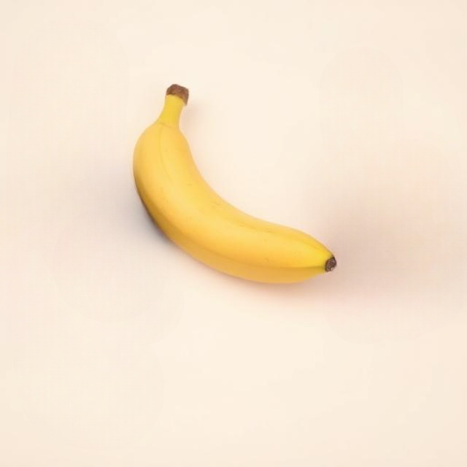
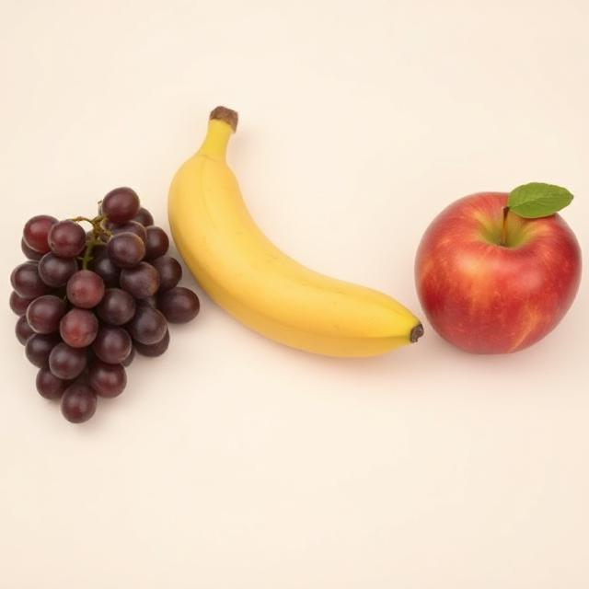
Thank you!

