Slide 1


Computer networks,
data communication and Internet
Introduction

Slide 2
Computer networks and data communication: summary
The following gives an overview of computer networks and data communication:
  The basic principles
  Local area networks
  National computers networks
  International computer networks
  The Internet
  Future impact of digital communication networks

Slide 3
Computer networks and data communication: prerequisites
Before using computer networks, you should ideally have some knowledge and skills related to
computer hardware
computer software

Slide 4

Data communication:
a definition
Interpersonal communication
  Telecommunication
    Broadcast
    Telephone
    Data communication
      Remote login
      File transfer
      Hypertext transfer
      Electronic mail
      ...

Slide 5
Data communication:
various views
User
(Applications)
Sociologist
(Sociological aspects)
Database producer
(Information)
Engineer
(Techniques)

Slide 6


Telecommunication:
digital versus analogue
Morse digital
Telephone analogue (or digital)
Data communication digital

Slide 7
Data communication:
which types of ‘data’?
        Digital information
    Multimedia / Hypermedia
Linear text
Hypertext
Sound
Static images
Video
Programs for computers
01

Slide 8
Data communication:
which types of ‘data’?
The same types of data (information) that can be stored and managed on a computer can be transferred over computer networks to one or several other computers.
So the networks form an important extension of the stand-alone computers.
“The network is the computer”

Slide 9
Data communication:
applications (Part 1)
Hard-copy transfer (Fax)
Online use of the processing power of a remote computer
Online access to information sources !
  library catalogues,
  bookshop catalogues,
  publisher’s catalogues,
  campus-wide and community information systems,
  (text or multimedia) databases,
  network-based journals, ...

Slide 10
Data communication:
applications (Part 2)
Software-downloading
Electronic mail from a person to one or several persons
Computer-network based interest groups
Online talking / chatting (IRC,...)
Video conferencing (Cu-seeme, ...)
Selling, shopping, buying,..
...

Slide 11
Computer network applications:
information and communication
1-way = information transfer = almost no interaction
publications by e-mail / Internet radio
file transfer
(gopher) / WWW based on http and static html pages
network services based on databases (input or searches)
e-mail communication / Usenet News
chat / telephony / video conferencing
N-way = communication = highly interactive

Slide 12
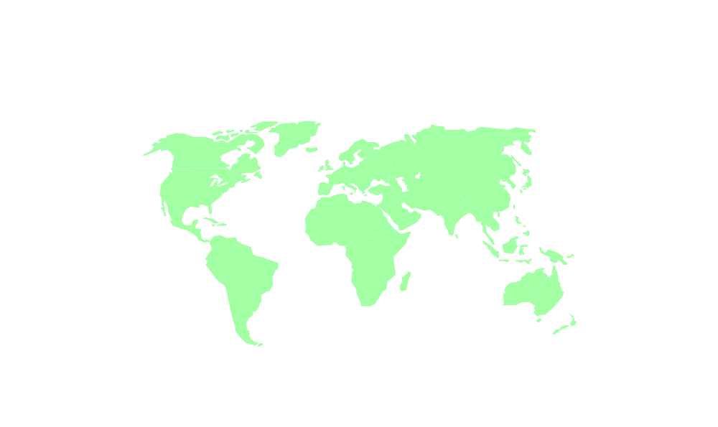
Computer networks:
an analogy
Traditional
Letter
Envelope
Mail-box
Post office
Roads
Networks
Hypermedia
Protocol
Client
Server
Networks

Slide 13

Data communication:
problems, difficulties, limitations
Low transfer speed
Technical complexity
☹

Slide 14
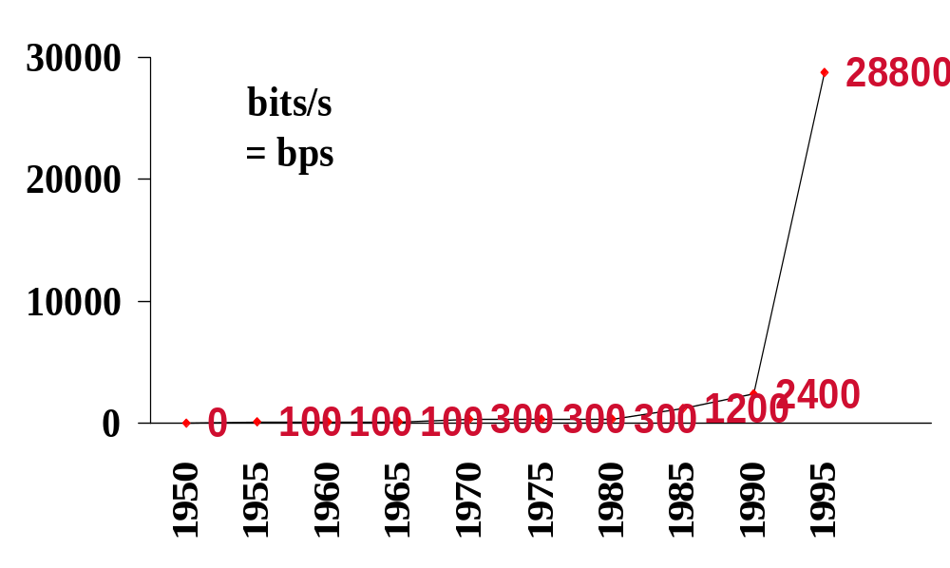
Data communication: maximum transfer rate over dial-up lines

Slide 15
Standards for asynchronous communication over dial-up lines
Maximum
transmission speed
(in bps = bits / second)
300
1 200
2 400
9 600
14 400
28 800
33 600
Standard
by the
CCITT
V21
V22
V22bis
V32
V32bis
V34
V34 plus
Year of
release
1995
1996
Comment
Made slower
standards obsolete

Slide 16
Data communication:
modems
description: MODulator-DEModulator: device to convert digital data signals into a suitable form for transmission along a telecommunications channel, and to convert them back upon receipt into machine readable form.
types
  (Acoustic coupler)
  Free standing box
  Board/card to plug-in
  microcomputer

Slide 17
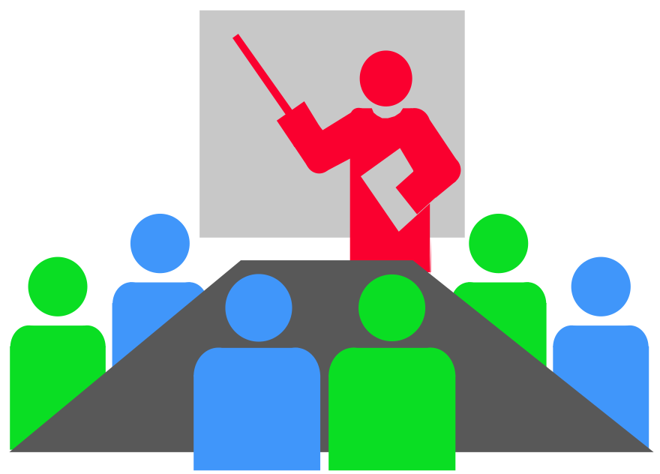
!? Question !? Task !? Problem !?
How long takes the transfer of
the contents of a 10 page ASCII document,
using data communication
via the voice telecommunication network
with a modern modem?
Notes:
1 page = 2000 bytes = 16 000 bits
10 pages = 160 000 bits
Modem at 28 000 bits/s
Conclusion: 6 seconds

Slide 18
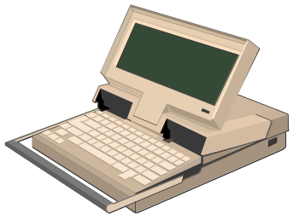
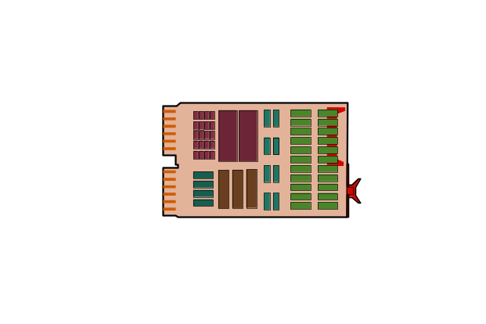

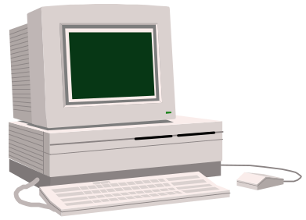
Data-communication:
Hard-copy transfer / Fax
FAX
FAX

Slide 19

Data communication:
trade offs
Cost
LAN
(short distance)
Dial-up/PAD
(low speed)
Speed
High volume
(high cost)
Distance

Slide 20

Computer network protocols:
definition
When 2 computer systems communicate via network, they do that by exchanging messages.
The structure of network messages varies from network to network.
Thus the message structure in a particular network is agreed upon a priori and is described in a set of rules, each defined in a protocol.

Slide 21
Computer networks,
data communication and Internet
Local Area Networks

Slide 22



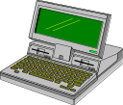
A local area
computer network: scheme

Slide 23
Data communication with a
server in a Local Area Network
(Terminal)
Microcomputer with
serial line
communications software /
terminal emulation software
Microcomputer with
network card and
network software
Network
server

Slide 24
!? Question !? Task !? Problem !?
Which applications
do you know
of server computers
in a Local Area Network (=LAN)?

Slide 25
Applications
of server computers in a LAN
Extra personal disk space for the users
Common files with programs and/or data for many users (e.g. an intranet)
Making files available from the institute to external users over the Internet (e.g. using ftp, gopher, WWW!)
Executing programs on the server
(e.g. using Unix or Windows NT or Windows 2000,
in multi-tasking / multi-user mode)
Electronic mail servers; Usenet servers;...

Slide 26
!? Question !? Task !? Problem !?
Do you have access to a LAN
in your organisation / institute /school / university?

Slide 27
!? Question !? Task !? Problem !?
Do you have personal disk space available,
through the LAN of your institute?

Slide 28
Examples
LAN software packages for homogeneous networks: examples
Intel compatible processors:
  LANtastic,
  Novell,
  Windows for Workgroups,
  Windows 95, Windows 98, Windows ME,
  Windows 2000, Windows XP...
  ...
Apple, ...

Slide 29
Examples
LAN software packages for heterogeneous networks: examples
Based on TCP/IP (protocol suite used in Internet)
For DOS:
  NCSA (= National Center for Supercomputing Applications) CUTCP, PC/NFS,...
For Windows 3.x:
  PC/NFS, PC/TCP, Trumpet TCP Manager,...
For Windows 95, 98,...: included!
For Windows NT, 2000,...: included!

Slide 30
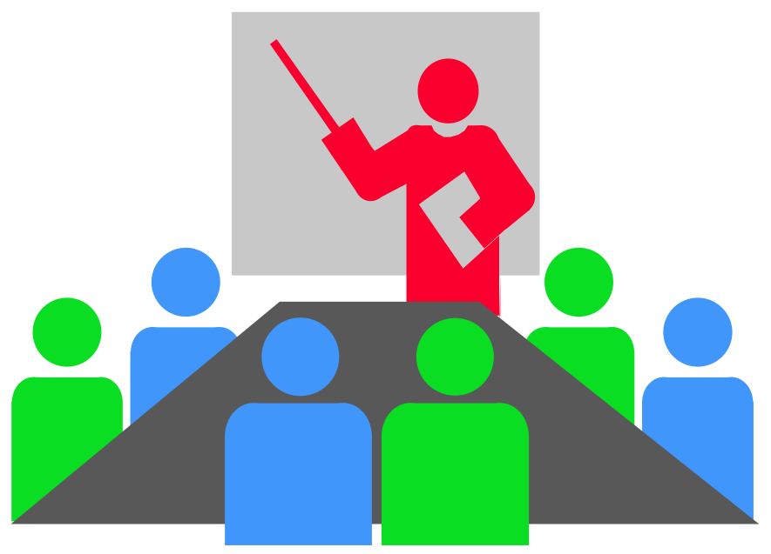
!? Question !? Task !? Problem !?
Which basic network software
can you use in your institute?

Slide 31
Computer networks,
data communication and Internet
Packet switching

Slide 32
Packet switching in data communication networks: definition
Communication is not through a continuous stream of bits, but in small packets.
Routing, the followed route,
may change during communication session.

Slide 33
Packet switching in data communication networks: scheme
= Computer = "Packet Switching Exchange"

Slide 34
!? Question !? Task !? Problem !?
Which are the benefits offered
by packet switching?

Slide 35
Packet switching in communications:
advantages
Economic usage/exploitation of existing communication lines in the network, resulting in
  less network congestion
  higher data communication speed
  lower cost
Less risk of interruptions due to breaks in a link of 2 nodes = higher reliability = less vulnerable
Possibility of error correction of individual packets

Slide 36
Packet switching protocols:
examples
TCP/IP in the Internet
X-25 in OSI networks
...

Slide 37
Computer networks,
data communication and Internet
National Wide Area Networks

Slide 38
National
Wide Area Networks
Public access national packet switching networks
Research computer networks
Public access made available by
Internet Service Providers
...

Slide 39
Computer networks,
data communication and Internet
International computer networks

Slide 40
Examples
International computer networks:
examples
National public data communication networks linked together
Internet
FidoNet
Bitnet / EARN
Usenet
...

Slide 41
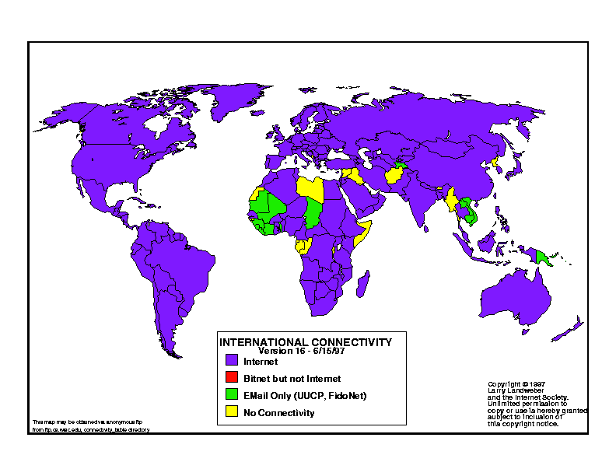
International connectivity
map

Slide 42
Computer networks,
data communication and Internet
The Internet data communication network

Slide 43
!? Question !? Task !? Problem !?
What is the Internet?

Slide 44
The Internet
data communications network (Part 1)
“Internet” is not well-defined.
A network of smaller networks:
The global collection of interconnected local area, regional and wide-area (national backbone) networks which use the TCP/IP suite of data communication protocols.
@

Slide 45
The Internet
data communications network (Part 2)
Links computers of various types.
Is constantly growing.
The analogy of a superhighway has been used to describe the emerging system of networked computers.
The Internet has no owner, and is not managed by one organization.
@

Slide 46


The Internet:
access from your Local Area Network
Your microcomputer
Local Area Network (LAN)
One of the national networks
The global Internet

Slide 47
Host computers in the Internet:
definition
A host (computer) is a domain name that has a unique IP address record associated with it.
Could be any computer connected to the Internet by any means.
For instance:
www.vub.ac.be
@

Slide 48
Internet data communication
layers and protocols (Part 1)
USER
Application programs
Application protocols:
smtp, pop, imap, nntp, telnet, ftp, gopher, http, cu-seeme,...
TCP = host to host transfer control protocol
IP = Internet protocol
different physical nets

Slide 49
Internet data communication
layers and protocols (Part 2)
USER
Client
Server
Computer
Computer
Client application programs
Server application programs
Application protocols
Application protocols
TCP
TCP
IP
IP
different physical nets

Slide 50
!? Question !? Task !? Problem !?
Why are most models/architectures
for data communication networks
named
“layer models/architectures”?
Notes:
Each layer communicates (only) with neighbouring layers.
In other words: each layer is shielded from most other layers by its neighbouring layers.
For instance: the user can be happy that he/she is only confronted with the application programs and not with the underlying technology.

Slide 51
!? Question !? Task !? Problem !?
Which advantages are offered by
a layer architecture in a computer system?
Notes:
Each layer communicates (only) with neighbouring layers.
In other words: each layer is shielded from most other layers by its neighbouring layers.
For instance: the user can be happy that he/she is only confronted with the application programs and not with the underlying technology.

Slide 52
Transmission Control Protocol / Internet Protocol (TCP/IP)
the main suite of transport protocols used on the Internet for connectivity and transmission of data across heterogeneous systems
“glue that holds the Internet together”
an open standard
available on most Unix systems, VMS and other minicomputer systems, many mainframe and supercomputing systems and some microcomputer and PC systems

Slide 53
TCP/IP
hardware
The most common hardware system / solution used for actual physical connections using TCP/IP in a Local Area Network is Ethernet, but TCP/IP will also run on Token-Ring, serial lines (modems, serial connections) and other systems as well.

Slide 54
TCP/IP:
Serial Line Internet Protocol (SLIP)
SLIP is a standard on the Internet for RS232 serial line and modem connectivity between two systems. This allows any one SLIP client to connect to a SLIP server to provide connectivity between different IP hosts.
Both systems must have TCP/IP stacks running.
SLIP packages are available for PC systems.

Slide 55
TCP/IP:
Point to Point Protocol (PPP)
successor to SLIP
built in operating system software Windows 95 and more recent versions

Slide 56
Internet application protocols / services based on the Internet (1)
telnet protocol for remote terminal login
ftp file transfer protocol
gopher communication using gopher menus
WAIS, Z39.50 for database searching
http hypertext transfer protocol (WWW)
        →

Slide 57
Internet application protocols / services based on the Internet (2)
smtp simple mail transfer protocol (e-mail)
to send messages
pop post office protocol (e-mail) to read e-mail messages
imap another protocol for reading e-mail messages
nntp network news transfer protocol in Usenet
...

Slide 58
Internet: addresses of computers
with the Domain Name System
Internet style = Domain name system
The Internet naming scheme consists of a hierarchical sequence of names from the most specific to the most general (left to right), separated by dots.
    computer.subdomain.domain.(country if not USA) OR
    n1.n2.n3.n4
    where n is
    a natural number
    (8-bit)

Slide 59
Examples
The Internet Domain Name System
DNS: examples
Belgium:
  ftp.vub.ac.be
  www.vub.ac.be
U.S.A.:
  dialog.com
  ftp.cs.widener.edu

Slide 60
Internet domain names
in the United States
Most Internet sites in the US, Canada and US overseas installations follow a breakdown into six generic domains:
  EDU: educational sites, such as universities
  COM: commercial sites, generally large corporations
  GOV: non-military government sites
  MIL: military installations
  ORG: non-commercial, non-network sites and gateways
  NET: other networks to which e-mail must traverse a gateway

Slide 61
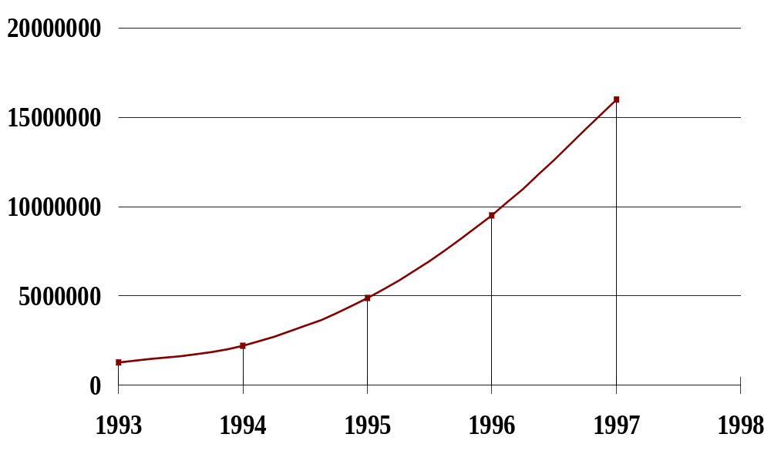
Internet: growth in number of hosts worldwide: linear plot
January of each year

Slide 62
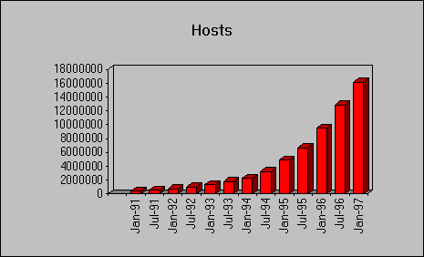
Internet: number of hosts 1991-1997
(plot downloaded from the net)
Source: http://www.nw.com/

Slide 63
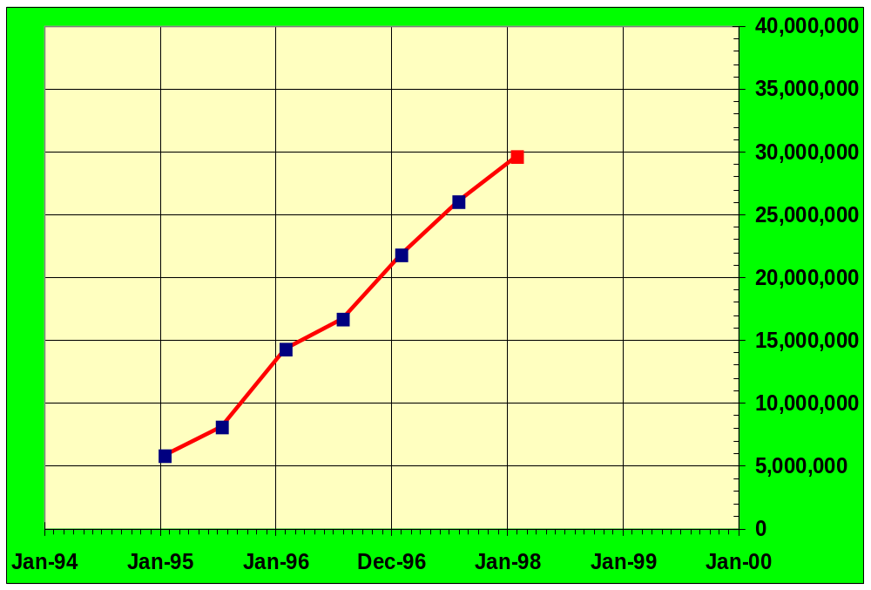
Internet: number of hosts 1994-1998
(plot downloaded from the net)
New survey data
Adjusted old survey data
Source data:
M. Lottor
Network Wizards
<www.nw.com>

Slide 64
Internet: the basic methods to connect
(Part 1)
Method 1: Connect your computer to
  the LAN of your institute, that includes a server computer connected to an Internet Service Provider, or
  an Internet Service Provider, using a a cable modem + a public cable network
Method 2: Dial from your computer into an external Internet Service Provider,
using a modem + the public voice telephone network
(Method 3: Connect your computer to an external Internet host that provides Internet services.)
Increasing power

Slide 65
Internet: the basic methods to connect
(Part 2)
Method 1:
full-time Internet host
Method 2:
part-time Internet host
(Method 3:
using another Internet host)
Increasing power

Slide 66
Internet: TCP/IP in
the basic methods to connect
Method 1: TCP/IP
between your computer and the rest of the Internet, at high speed.
Method 2: TCP/IP between your computer and the rest of the Internet, but speed limited by the modem and the telephone network
(Method 3: TCP/IP between the Internet host you connect to and the rest of the Internet, but not between your computer and that Internet host.)
Increasing power

Slide 67
Internet: trade offs in the basic methods to connect
Cost
(SLIP or) PPP
Shell-account
on a server
User interface
Direct access
Speed

Slide 68
Internet Service Provider
= ISP
Internet Service Providers provide their clients access to Internet + in many cases
  an email address / server
  space for a web site
  software tools to start
  training
  technical support
  an accessible location for a WWW site of the client
  assistance with WWW site design and promotion

Slide 69
!? Question !? Task !? Problem !?
How to select an
Internet services/access provider?
How to evaluate
Internet services/access providers?

Slide 70
!? Question !? Task !? Problem !?
How are you connected
to the Internet?
What is the name of
your Internet access provider?

Slide 71
The Core Internet and
the Consumer Internet
Core Internet = all computers that can provide interactive Internet services (such as telnet, ftp, gopher, http,...)
using server programs
Consumer Internet = all computers that can use interactive Internet services, using client programs
(such as WWW browsers)

Slide 72
!? Question !? Task !? Problem !?
Which ways of data communication
do you know
to access online information systems?

Slide 73
Microcomputer -- external computer: some ways of data communication
Micro-
computer
Tele-
phone
Voice telecommunication network
Modem
ISDN
TelePAD
LAN
Public data
comm. network
External
computer
Local
PAD
Gateway computer system
Private/academic data comm.
network (e.g. Internet)
Leased, fixed communication line
Intern Extern

Slide 74
Computer networks,
data communication and Internet
The future impact
of digital communication networks

Slide 75
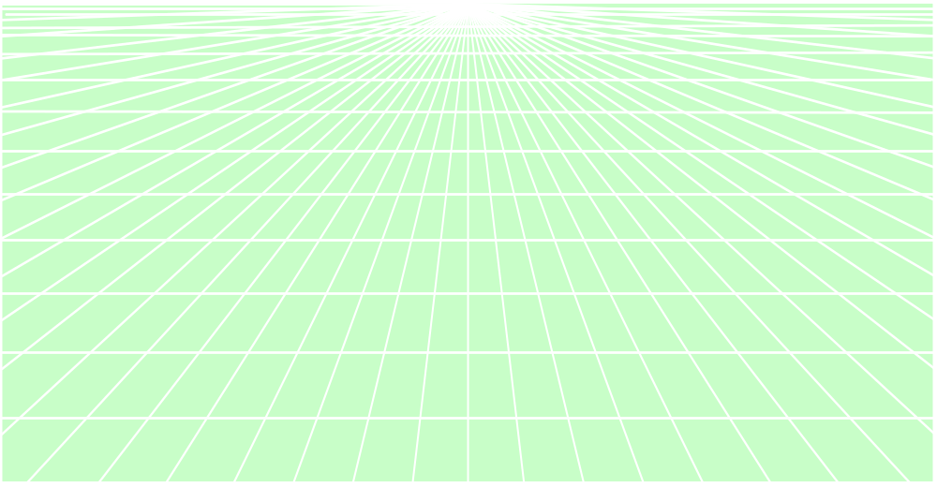
Future impact of
digital communication networks
Extreme scenarios:
Boom scenario: evolution to ‘computopia’
Doom scenario: evolution to a digital ‘brave new world’

Slide 76
Computer-based communication: boom scenario
Evolution to ‘computopia’
International, interpersonal communication increases, using the international computer communication networks.
Information gap (between information rich and information poor) disappears: access from everywhere (even from developing countries) to internationally available information.
Capitalism and repression disappear.

Slide 77
Computer-based communication: doom scenario
Evolution to a digital ‘brave new world’
Face-to-face, interpersonal communication disappears.
Information gap
(between information rich and information poor)
becomes larger.
Capitalism uses the evolving techniques for increased control and repression.

Slide 78

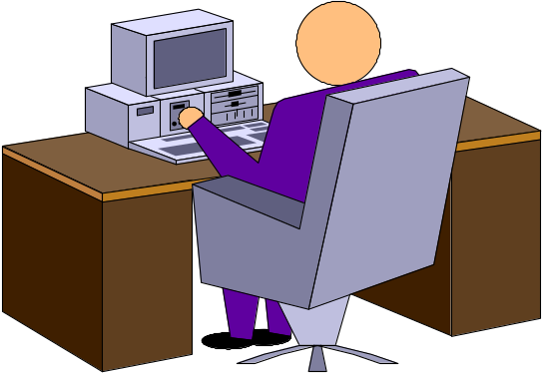
The world of information
from your desktop

Slide 79
Computer networks, data communication and Internet
Data transfer rate
between components of computer systems

Slide 80
Data transfer rates: introduction
The speed of delivery of information = data transfer rate.
This is always limited by the weakest component.
High quality graphics, audio, animation, video,… typically require a high transfer speed.
When a transfer system (medium, channel,…) is used (shared) by more than one user, the effective, practical transfer rate decreases of course.

Slide 81
!? Question !? Task !? Problem !?
Compare transfer rates
in computer networks
with the transfer rates
of CD-ROM systems.

Slide 82
Data transfer rate of various computer systems/media
Type
14.4 kbits/s modem
28.8 kbits/s modem
ISDN
T1 Internet line
1x CD-ROM
Ethernet
24x CD-ROM
USB
Transfer rate
1.8 KB/s
3.6 KB/s
7-16 KB/s
30 –200 KB/s
150 KB/s
1 000 KB/s
3 600 KB/s
12 000 KB/s

