Slide 1

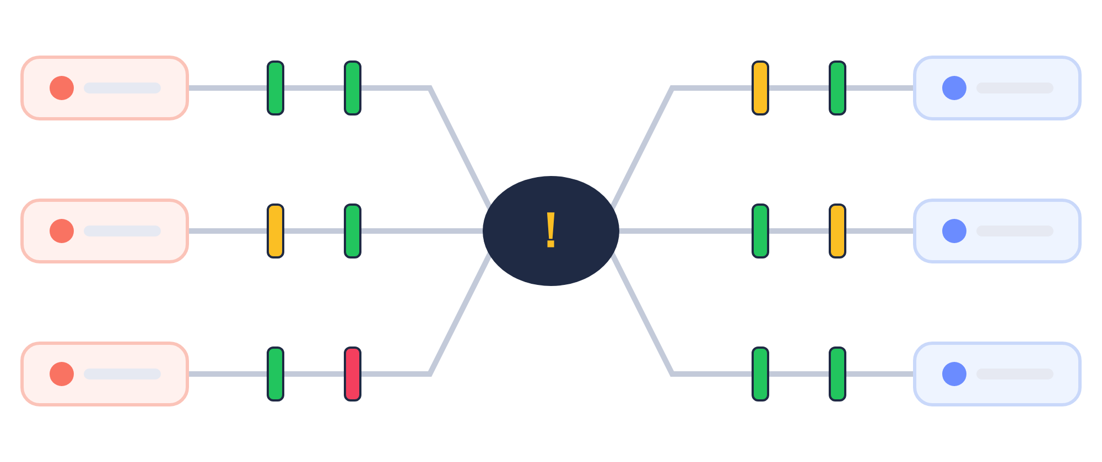
SpaceRisk
See every risk — from the team floor to the boardroom.
Friendly ISO 31000 risk management with bowties, barriers and a monthly rhythm.

Slide 2
Risk registers die in spreadsheets
Updated once a year, read by nobody
Controls are listed, never tested
Executives see numbers, not barriers
Projects and teams keep separate lists

Slide 3
SpaceRisk in one sentence
Teams keep their risks and barriers alive every month — and leaders see the whole picture as bowties, heat maps and money.

Slide 4
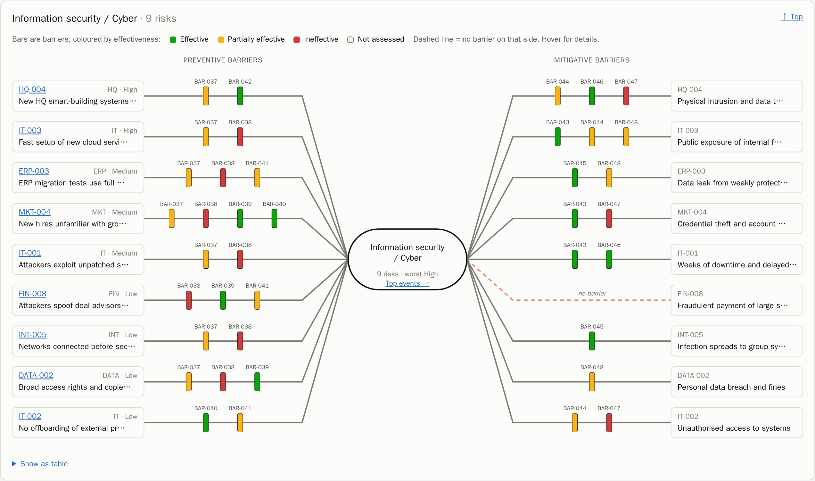
The bowtie: one risk on one page
Threats → preventive barriers → top event → mitigative barriers → consequences
Barriers coloured by effectiveness
Gaps shown as dashed red lines

Slide 5
From team to CEO
Team member
Team lead
CEO / CISO
Logs new risks and reviews existing ones.
Checks the team's barriers and attests the monthly return.
Gets the executive summary, heat map and financial view — as PDF or PowerPoint.
Barrier owners confirm every month that their controls still work — or flag them before they fail.

Slide 6
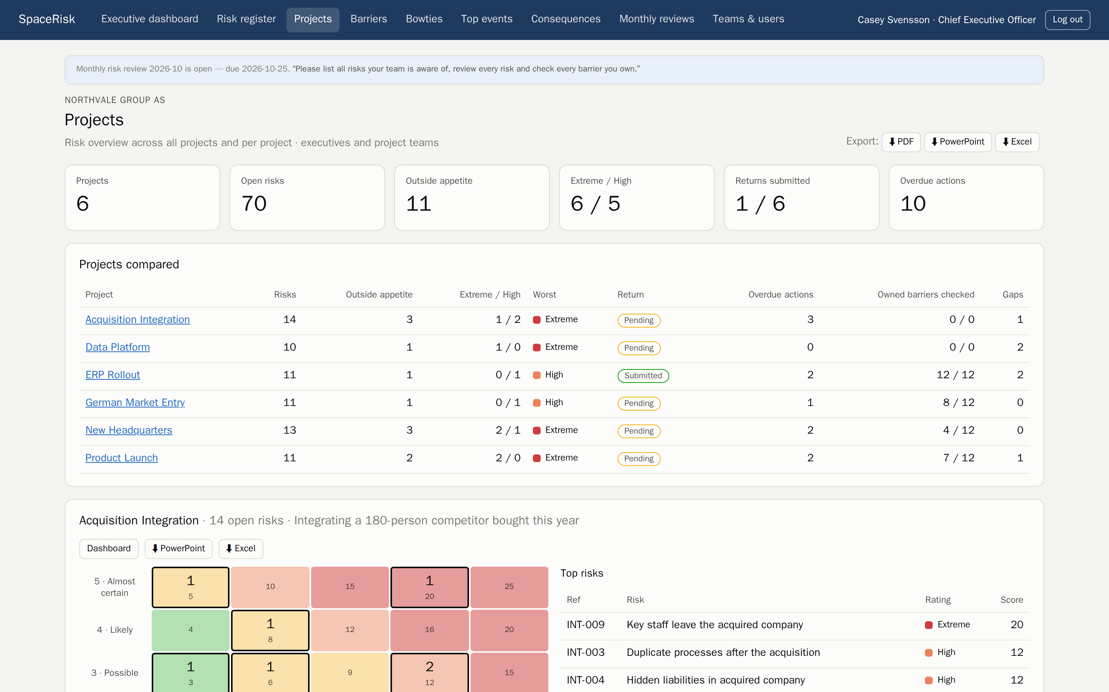
From project team to project manager
• Every project is a team with its own risks
• Project managers submit the monthly return
• All projects side by side, exportable

Slide 7
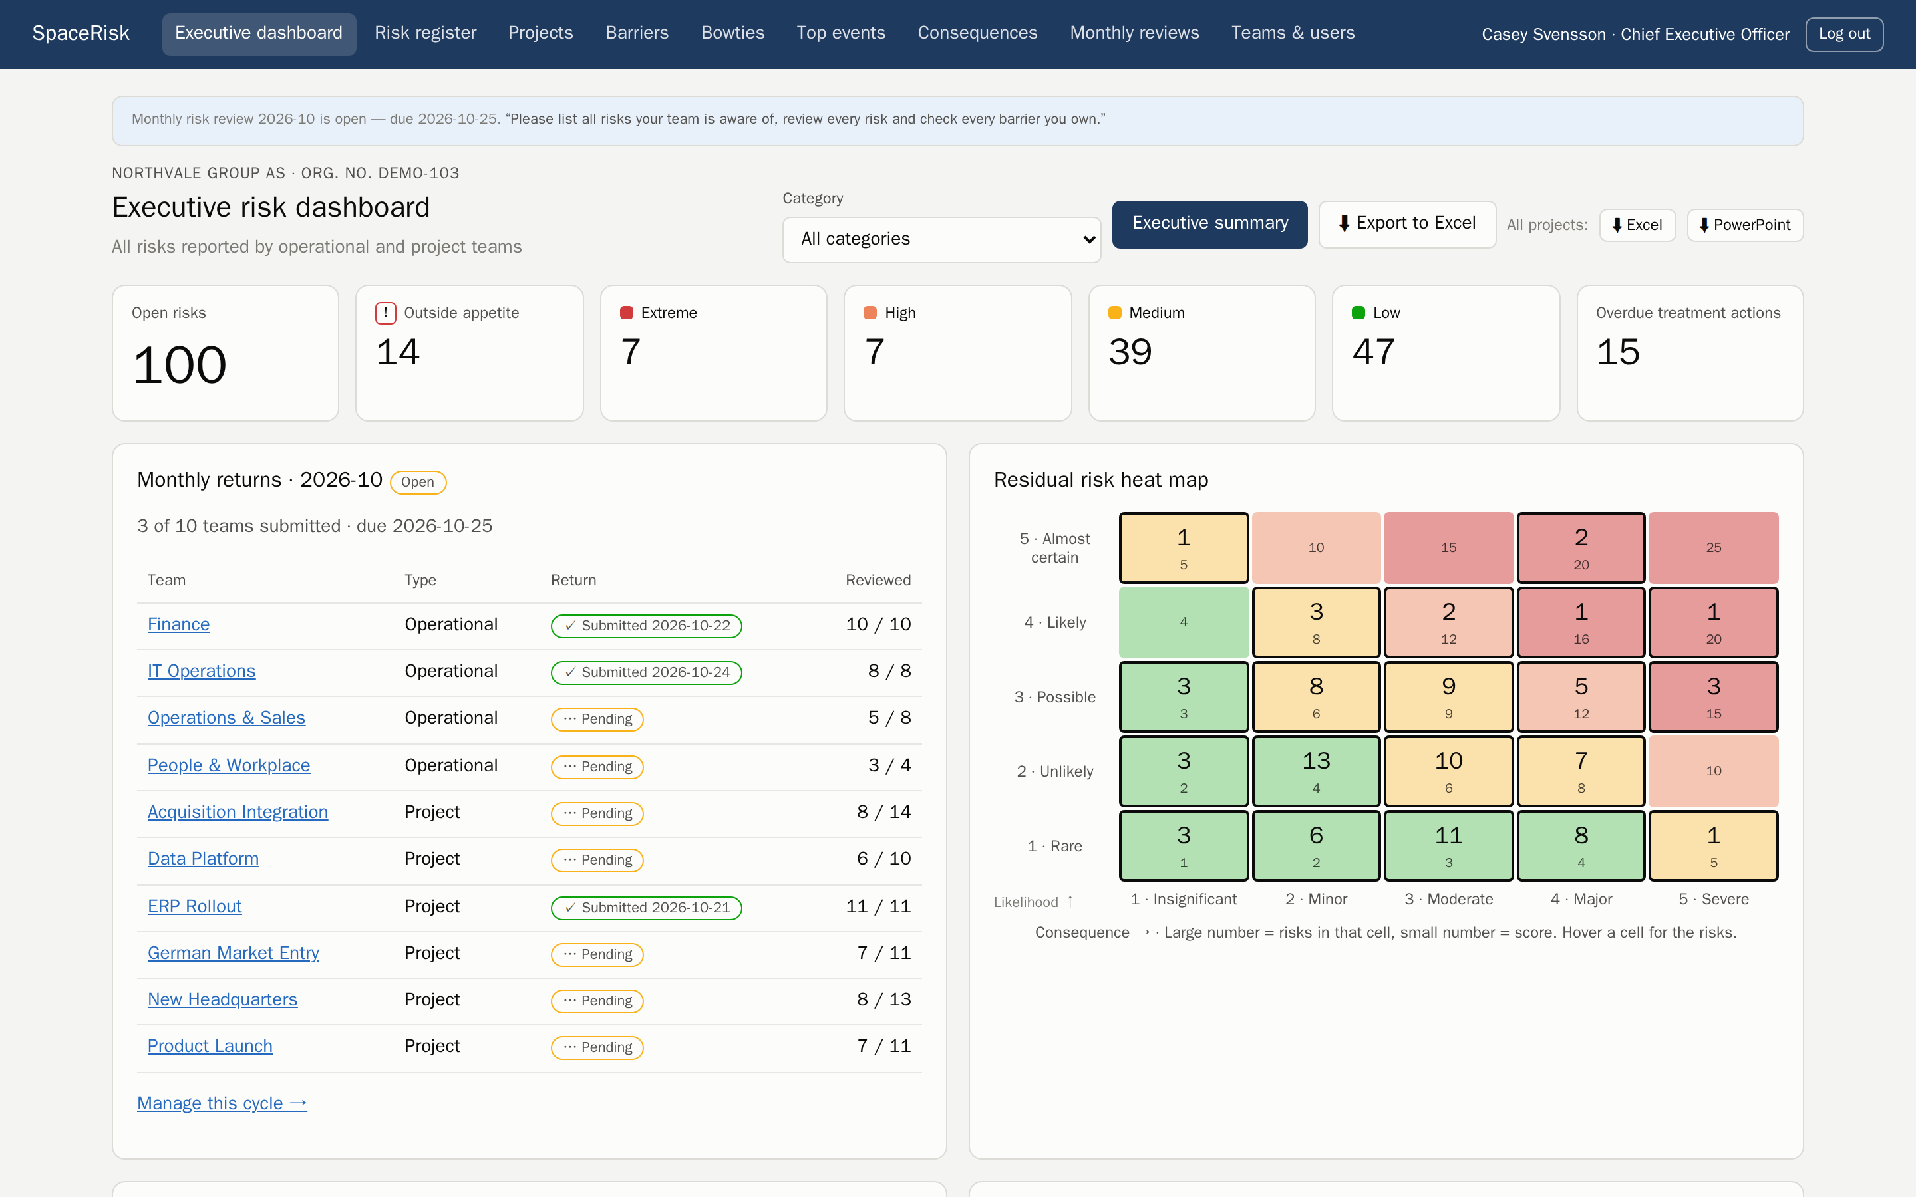
A monthly rhythm that sticks
• Every risk reviewed, every owned barrier checked
• Returns can only be submitted when the work is done
• Trends show whether risk is going up or down

Slide 8
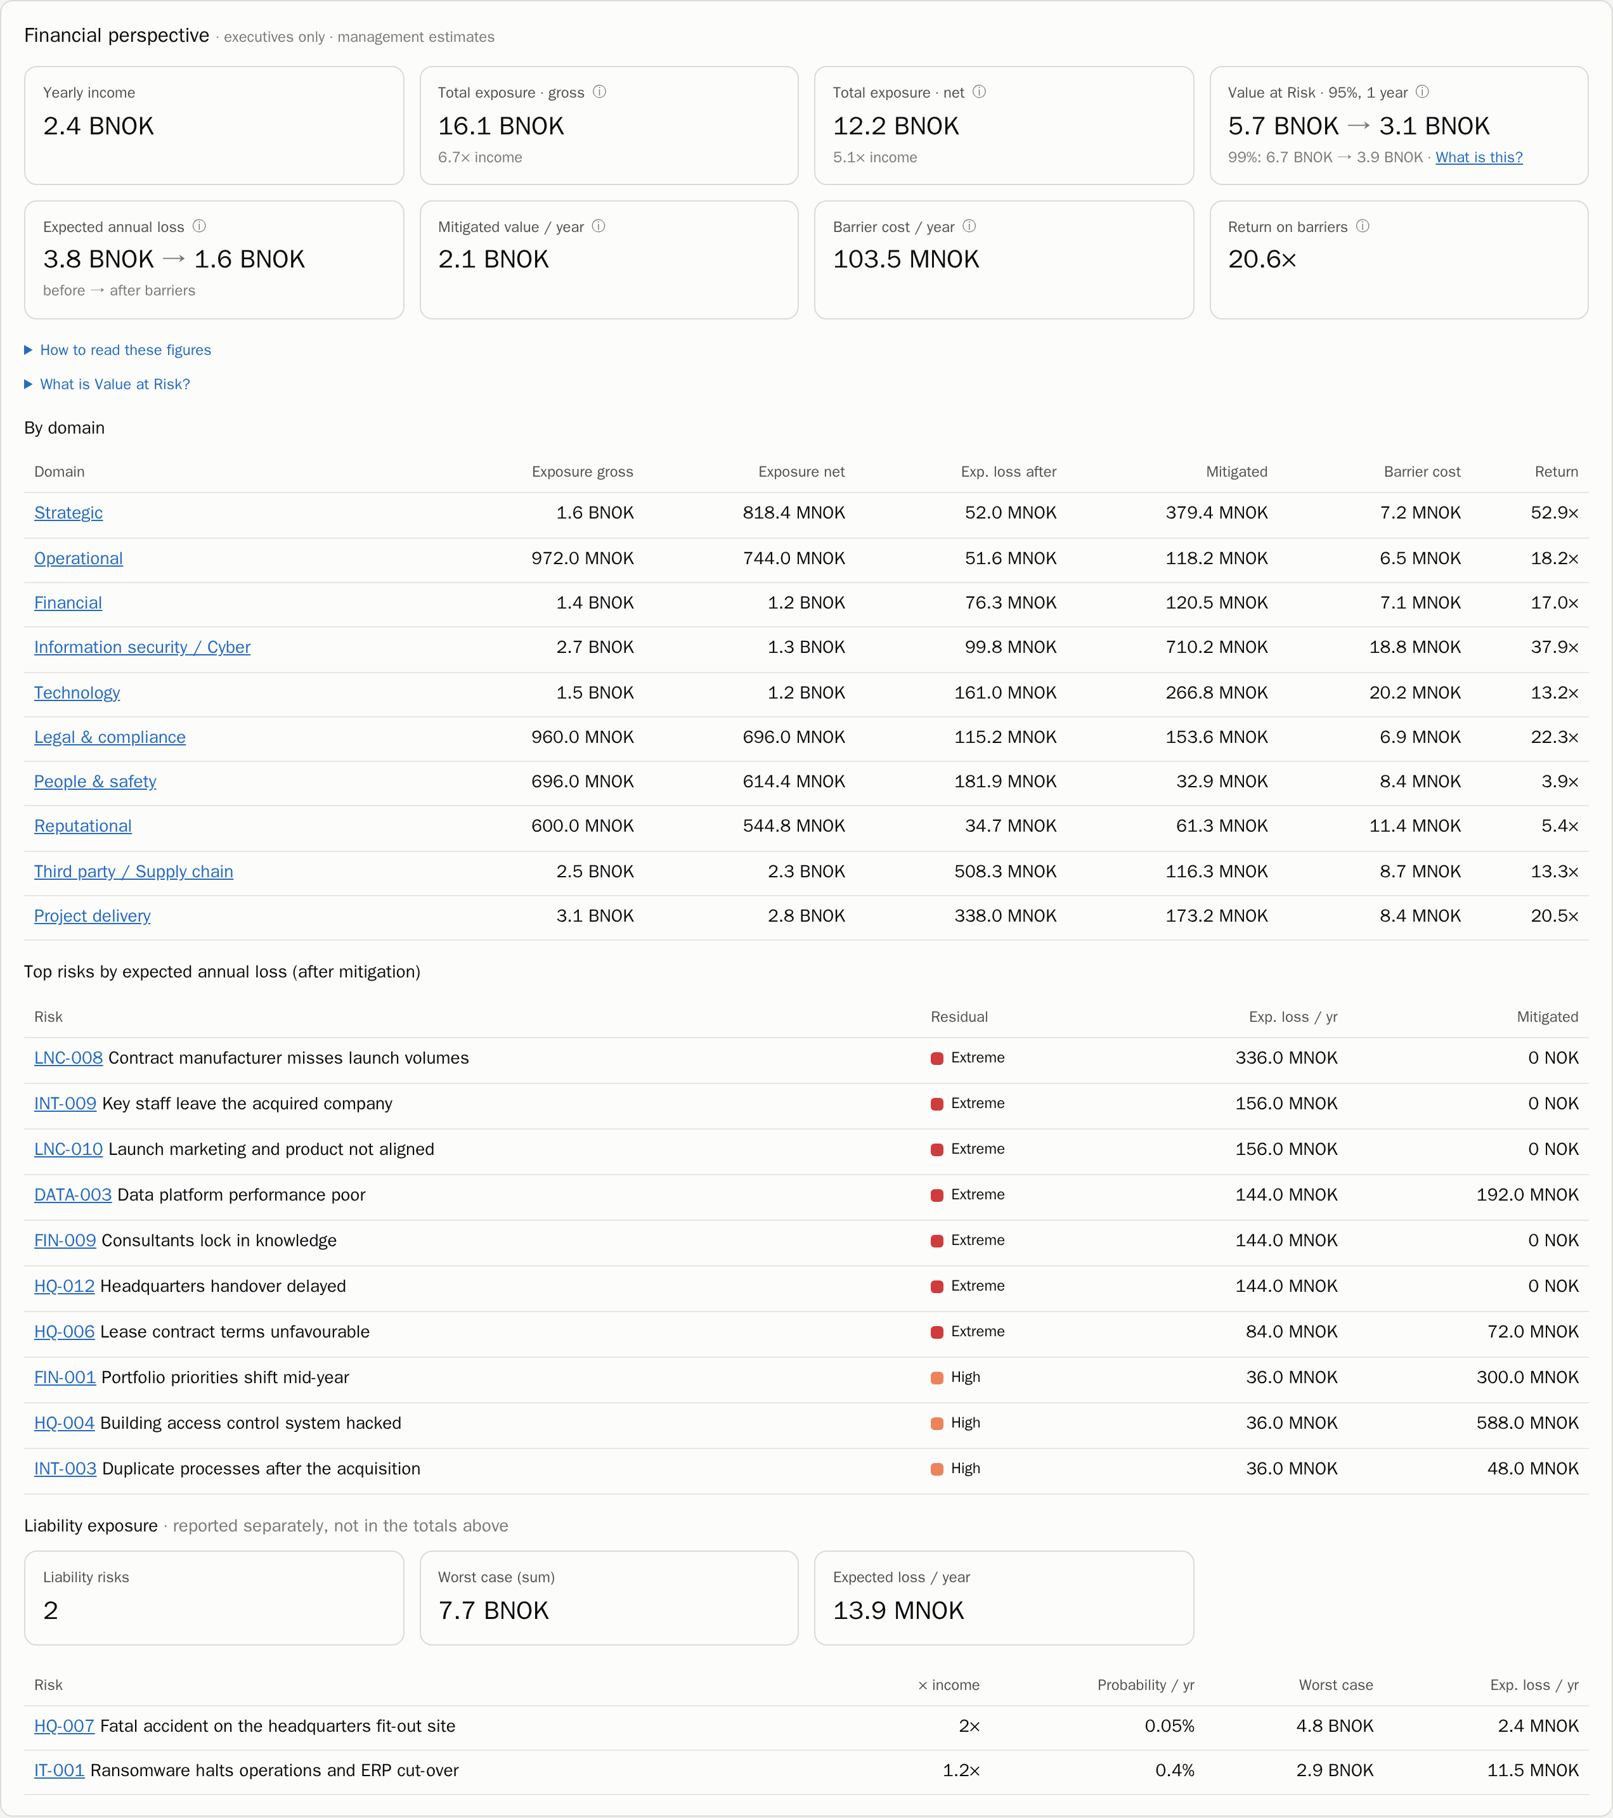
Risk in money
• Total exposure, Value at Risk and expected annual loss
• Before and after barriers
• Return on every krone spent on controls

Slide 9
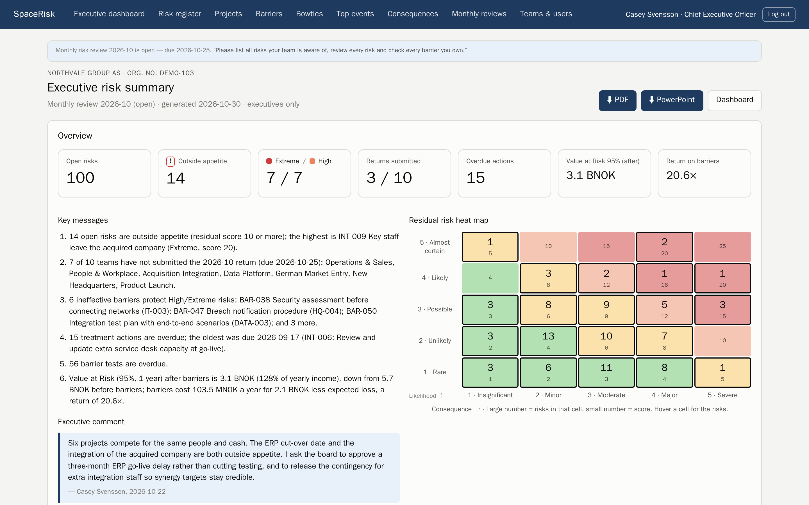
Ready for the board
• Executive summary with key messages and your comment
• PDF, PowerPoint and Excel for every page, team and project

Slide 10
Built for your sector
93 realistic showcase companies
From hospitals and airlines to oil platforms and hedge funds
Load one in a click on a fresh install

Slide 11
Get started
Self-hosted on Cloudron
Your data stays with you
Load a showcase and invite your teams today

