Slide 1



Blazor
Borošak Robert robert.borosak@rathmann.hr

Slide 2
Blazor is a framework for building interactive client-side web UI with .NET
Share server-side and client-side app logic written in .NET.
Render the UI as HTML and CSS for wide browser support, including mobile browsers.
Write code in C# instead of JavaScript.
Leverage the existing .NET ecosystem of .NET libraries.
Benefit from .NET's performance, reliability, and security.
Stay productive with Visual Studio on Windows, Linux, and macOS.
Build on a common set of languages, framewks, and tools that are stable, feature-rich, and easy to use.

Slide 3
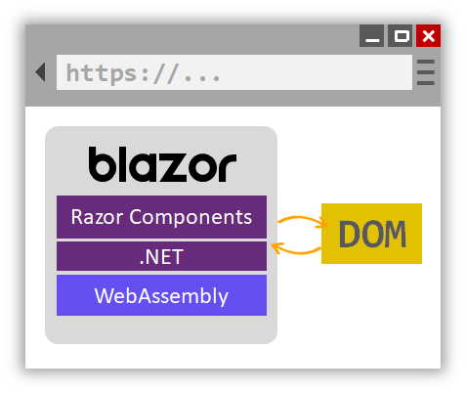
Blazor WebAssembly
C# code files and Razor files are compiled into .NET assemblies.
The assemblies and the .NET runtime are downloaded to the browser.
Blazor WebAssembly bootstraps the .NET runtime and configures the runtime to load the assemblies for the app. The Blazor WebAssembly runtime uses JavaScript interop to handle DOM manipulation and browser API calls.
The size of the published app, its payload size, is a critical performance factor for an app's useability. A large app takes a relatively long time to download to a browser, which diminishes the user experience. Blazor WebAssembly optimizes payload size to reduce download times:
Unused code is stripped out of the app when it's published by the Intermediate Language (IL) Linker.
HTTP responses are compressed.
The .NET runtime and assemblies are cached in the browser.

Slide 4
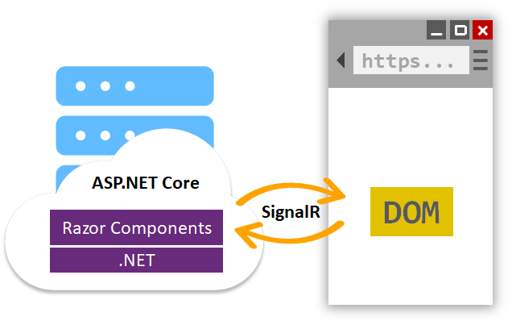
Blazor Server
Blazor decouples component rendering logic from how UI updates are applied. Blazor Server provides support for hosting Razor components on the server in an ASP.NET Core app. UI updates are handled over a SignalR connection.
The runtime handles sending UI events from the browser to the server and applies UI updates sent by the server back to the browser after running the components.
The connection used by Blazor Server to communicate with the browser is also used to handle JavaScrip

Slide 5
Supported platforms
Blazor WebAssembly
Blazor Server
Browser | Version
Microsoft Edge | Current
Mozilla Firefox | Current
Google Chrome, including Android | Current
Safari, including iOS | Current
Microsoft Internet Explorer | Not Supported†
Browser | Version
Microsoft Edge | Current
Mozilla Firefox | Current
Google Chrome, including Android | Current
Safari, including iOS | Current
Microsoft Internet Explorer | 11+

Slide 6
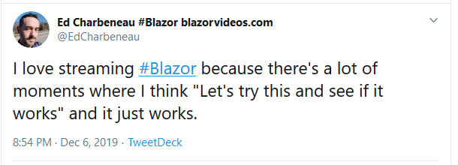


Slide 7
Useful links
https://github.com/AdrienTorris/awesome-blazor
https://blog.stevensanderson.com/
https://gitter.im/aspnet/Blazor
https://chrissainty.com/blazor/
Today’s demo: https://github.com/partyelite/BlazorOverview

Slide 8
Demo

