Slide 1
Empirical Data to Determine Transonic Drag Coefficient Land Simulation, Experimentation, and Wargaming (LSEW)
UNCLASSIFIED
Oleg Mazonka
2016

Slide 2

Empirical Data to Determine Transonic Drag Coefficient
UNCLASSIFIED
Input Data
Army
DST Group
Detection and Identification
System Capabilities
Land Operations Research
Behaviour
Weapon – Target Interaction
External ballistic model
Land Simulation, Experimentation, and Wargaming
Traditional
V&L Modelling
Data Fidelity
Our Models
Combat Simulators
Combat Simulators
Combat Simulators
Combat Simulations
Data Breadth
Notes:
Relative simplicity (input data & models)
Traceability
Fit for purpose
Common framework

Slide 3
Empirical Data to Determine Transonic Drag Coefficient
UNCLASSIFIED
Content
Drag coefficient
External ballistic model
Drag function parametrisation
Optimisation

Slide 4
Empirical Data to Determine Transonic Drag Coefficient
UNCLASSIFIED
Drag coefficient
Work produced by air friction
Energy to accelerate air
 | Drag force
 | Drag coefficient
 | Air density
 | Body cross section
 | Velocity

Slide 5
Empirical Data to Determine Transonic Drag Coefficient
UNCLASSIFIED
External ballistic model
Fit-for-purpose simple to use model
Projectile length and cross section area
Muzzle velocity
Supplementary ballistic data
Included in the model
3D trajectory
Earth’s curvature
Altitude: air density and temperature
Optional
Range and cross wind
Air turbulence
Not included
6DOF; spin effects: gyroscopic, Magnus, Coriolis effects
Non-spherical Earth

Slide 6
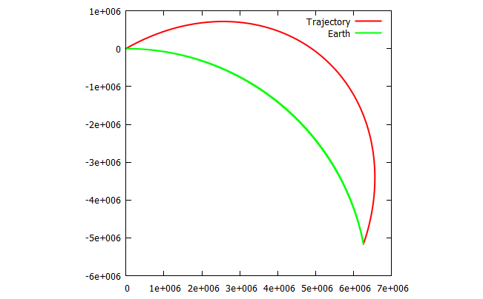
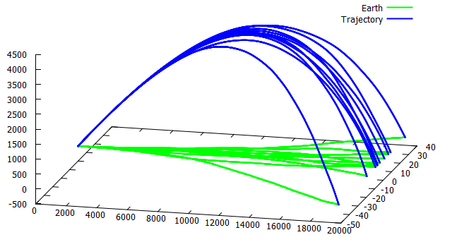
Empirical Data to Determine Transonic Drag Coefficient
UNCLASSIFIED
External ballistic model
Gravitational force
Drag and front wind force
Side wind force
Air turbulence
A projectile shot at 30° at 7000 ms⁻¹ with no drag. The green line represents the earth surface.
M107 projectile shot at 30° with air turbulence parameter on. Ten trajectories are shown.

Slide 7
Empirical Data to Determine Transonic Drag Coefficient
UNCLASSIFIED
External ballistic model
Gravitational force
Drag and front wind force
Side wind force
Air turbulence
G – Gravitational constant
M_{E} – the Earth’s mass
R_{E} – the Earth’s radius

Slide 8
Empirical Data to Determine Transonic Drag Coefficient
UNCLASSIFIED
External ballistic model
Gravitational force
Drag and front wind force
Side wind force
Air turbulence
m – mass of the projectile
μ – Mach number
c_{r} – speed of sound
ρ_{r} – air density
c_{r} – function of temperature T;
ρ_{r} – function of T, sea level pressure, molecular weight of air, universal gas constant, and free-fall acceleration constant;
T – function of sea level temperature, altitude, and temperature lapse rate

Slide 9
Empirical Data to Determine Transonic Drag Coefficient
UNCLASSIFIED
External ballistic model
Gravitational force
Drag and front wind force
Side wind force
Air turbulence
A_{f} – frontal cross section area
A_{s} – side cross section area
ω – angle between trajectory and air flow
w – range wind
Law of cosine defines the angle at which the air hits the projectile

Slide 10
Empirical Data to Determine Transonic Drag Coefficient
UNCLASSIFIED
External ballistic model
Gravitational force
Drag and front wind force
Side wind force
Air turbulence
assuming side drag coefficient to be 1 (side cylinder)
m – mass of the projectile
A_{s} – side cross section area
w_{Z} – side wind

Slide 11
Empirical Data to Determine Transonic Drag Coefficient
UNCLASSIFIED
External ballistic model
Gravitational force
Drag and front wind force
Side wind force
Air turbulence
Modelled as a Wiener process
Derived from fluctuation-dissipation relation
δ – time step of integration
f₀ – strength of turbulences (m/s)

Slide 12
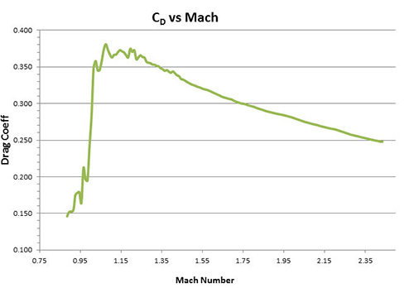
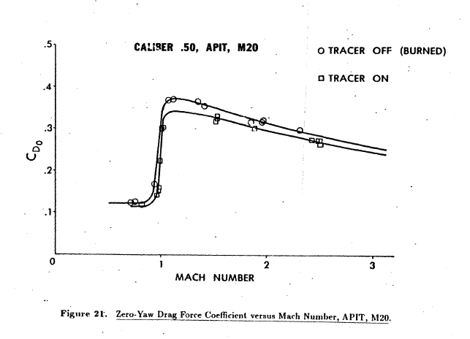
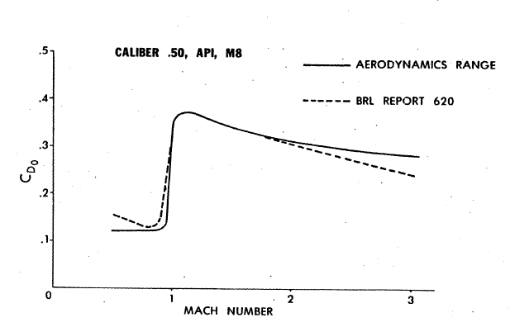
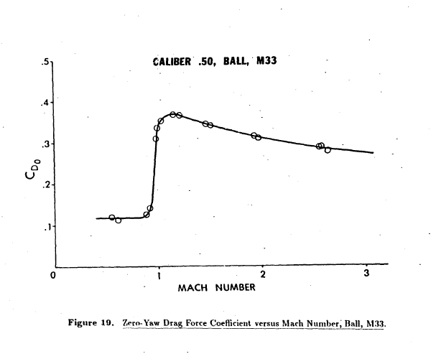
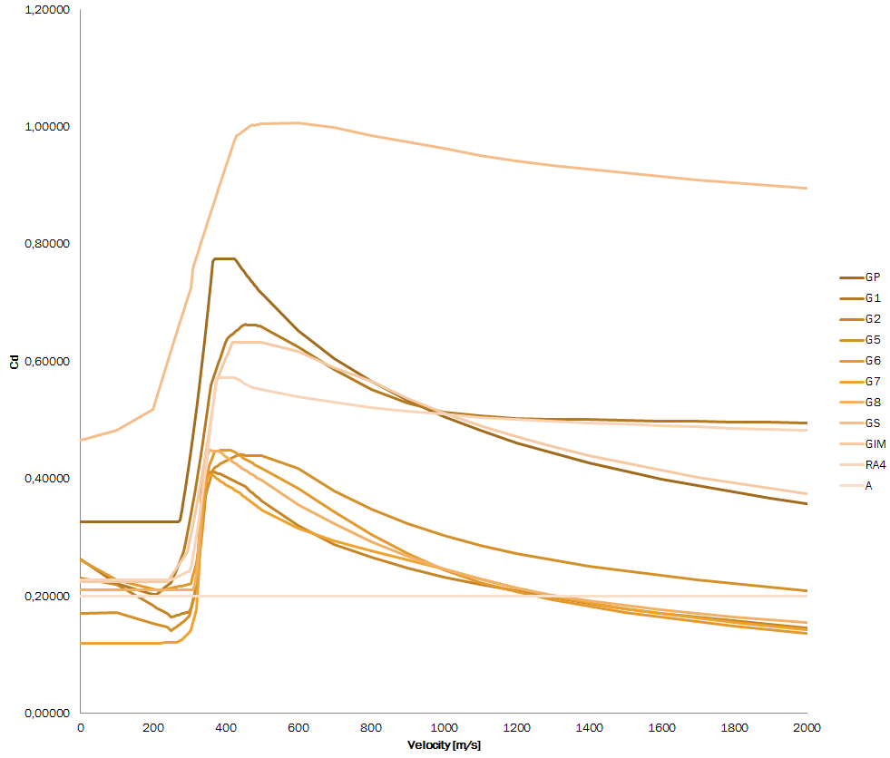
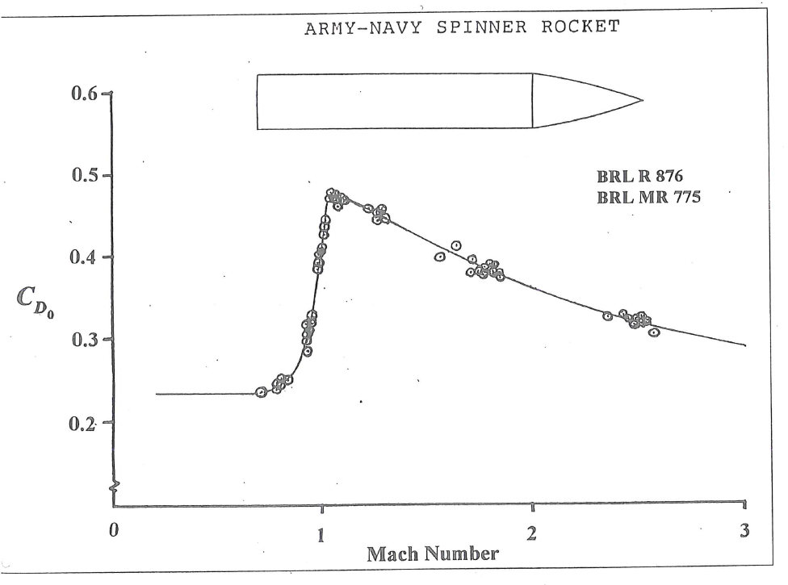
Empirical Data to Determine Transonic Drag Coefficient
UNCLASSIFIED
Drag function

Slide 13
Empirical Data to Determine Transonic Drag Coefficient
UNCLASSIFIED
Drag function
v – air flow velocity
u – air molecule thermal velocity
m₀ – mass of air molecule
n – molecule density
ρ – air density
n_{U} – rate of exchange due to u
n_{V} – rate of exchange due to v
S_{e} – effective surface area
A_{e} – effective cross area

Slide 14
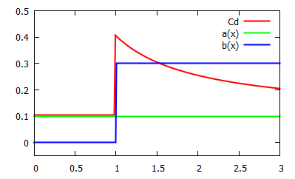
Empirical Data to Determine Transonic Drag Coefficient
UNCLASSIFIED
Drag function
μ – Mach number
α, β – some functions of μ
α=0.1
β=0.3 (>1)

Slide 15
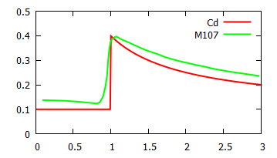
Empirical Data to Determine Transonic Drag Coefficient
UNCLASSIFIED
Drag function
Simplistic C_{d} - red line, and experimental data for M107 155mm howitzer projectile – green line

Slide 16
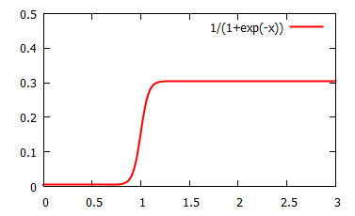
Empirical Data to Determine Transonic Drag Coefficient
UNCLASSIFIED
Drag function
Hypothesis: functions α and β change little below and above sonic barrier
Smooth step function
Parametrisation

Slide 17
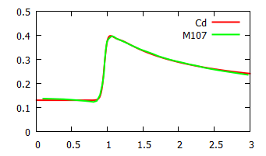
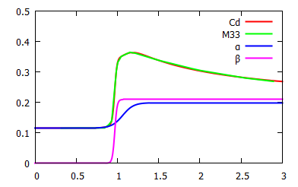
Empirical Data to Determine Transonic Drag Coefficient
UNCLASSIFIED
Drag function
Function C_{d} fit to experimental data with smooth step transition function
Function C_{d} fit to experimental data Ball M33 Cal .5. Functions α and β are shows as well.

Slide 18
Empirical Data to Determine Transonic Drag Coefficient
UNCLASSIFIED
Optimisation
Given empirical data, find trajectories corresponding to records
Find corresponding values of calculated trajectories
Compare the values to the original data
Modify drag function parametrisation to improve the result
Repeat
R Angle Fall topH topR Time Vf
-----------------------------------------------------
100 - 0.0667 0.03 51 0.15 623
300 0.2333 0.3000 - 162 0.52 -
500 - 0.8000 1.3 - 1.04 334
600 - 1.1500 2.3 344 1.35 304
800 1.1000 2.1000 5.5 468 2.05 266
V Max
------------
207.3 3900
234.7 4800
268.2 6100
310.9 7800
371.9 9700

Slide 19
Empirical Data to Determine Transonic Drag Coefficient
UNCLASSIFIED
Optimisation
[C_{d}] – parameters of C_{d} o
x – input data
y – calculated values
R Angle Fall topH topR Time Vf
-----------------------------------------------------
100 - 0.0667 0.03 51 0.15 623
300 0.2333 0.3000 - 162 0.52 -
500 - 0.8000 1.3 - 1.04 334
600 - 1.1500 2.3 344 1.35 304
800 1.1000 2.1000 5.5 468 2.05 266
V Max
------------
207.3 3900
234.7 4800
268.2 6100
310.9 7800
371.9 9700
R Angle Fall topH topR Time Vf
-----------------------------------------------------
100 0.0833 0.0667 0.03 51 0.15 623
300 0.2333 0.3000 0.34 162 0.52 459
500 0.4833 0.8000 1.3 282 1.04 334
600 0.6667 1.1500 2.3 344 1.35 304
800 1.1000 2.1000 5.5 468 2.05 266
V Max
------------
207.3 3900
234.7 4800
268.2 6100
310.9 7800
371.9 9700

Slide 20
Empirical Data to Determine Transonic Drag Coefficient
UNCLASSIFIED
Computational considerations
Global optimisation is done over the utility function U which is the result of other optimisation algorithms
Level of computational noise
Trajectory integration has to be fast
Energy conservation in integration can be used as guidance for integration computational error
Potential energy must be calculated with

Slide 21
Empirical Data to Determine Transonic Drag Coefficient
UNCLASSIFIED
Summary and conclusion
External ballistic model uses fit-for-purpose easy to use approach without sacrificing fidelity hidden from the user
Drag function is parametrised by splitting into two components
Global optimisation is used to match empirical ballistic data by modifying the drag function
The code is written in C++, is open source, and can be found on Github.

