Slide 1
Estimating Transonic Drag (Optimisation and Parametrisation) Land Simulation, Experimentation, and Wargaming
UNCLASSIFIED
Oleg Mazonka
2017
Notes:
Good morning. My name is Oleg Mazonka and I would like to present a quite generic mathematical problem which came from a ballistic model
Next
First, I would like to say a couple of words about who we are and why this work is important to us.

Slide 2


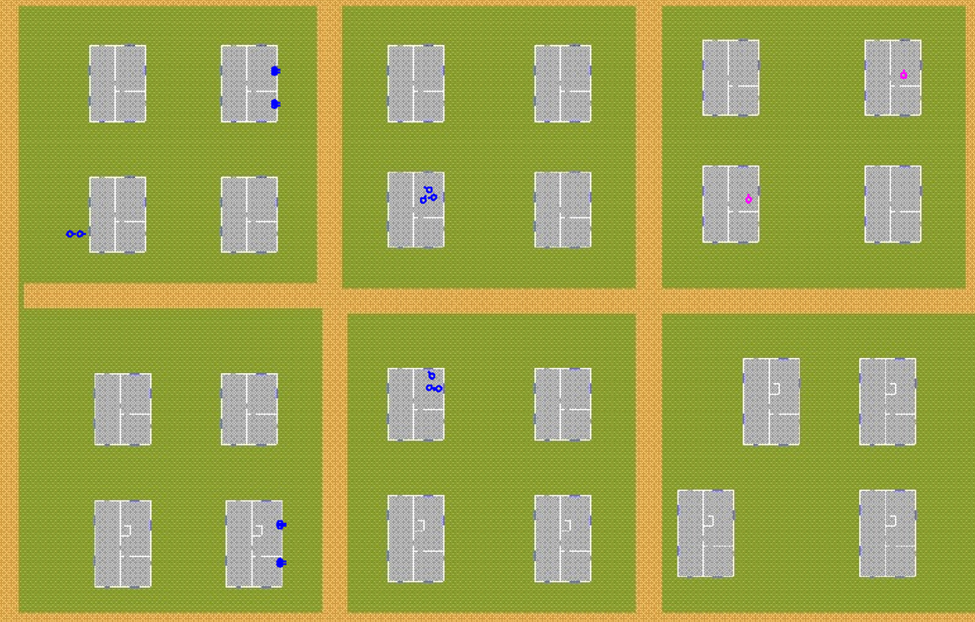
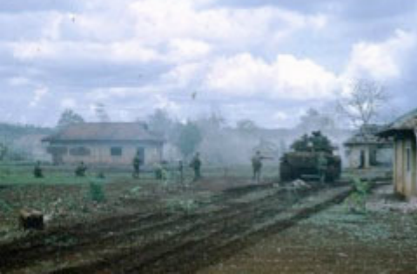
Estimating Transonic Drag
UNCLASSIFIED
Binh Ba village, Vietnam 1969
External ballistic model
Notes:
We are a part of Defence Science and Technology Group or DSTG.
The DSTG provides expert advice and support for a range of military problems such as the conduct of military operations, the tactics, techniques and procedures for capabilities currently within the active force, impacts of force structure changes and the acquisition of future Defence capabilities.
I work at the Land Simulation and Wargaming group which is part of Land Capability Analysis which focusses predominantly on areas of research in support of the Australian Army.
In support of our research our area has a high reliance on the use of combat simulations. These simulations require a large amount of input data to accurately portray how entities inside the simulation behave and interact. Given the lack of data available due to a range of reasons we generally obtain this data in turn from other models representing the physical or performance properties of real entities.
Next
One of these models is the external ballistic model.

Slide 3
Estimating Transonic Drag
UNCLASSIFIED
(?) Estimating Drag Function
Limited Empirical data
If Drag function is solved then we have a full ballistic model that reproduce the empirical data and able to generate any ballistic trajectories.
Core Ballistic Model
Notes:
Core ballistic model generates ballistic trajectories
Drag function has great impact on a trajectory
Drag function is unknown, but some trajectory data may exist
The problem is to fund drag function that satisfy empirical data
Next
What is the general problem?

Slide 4
Estimating Transonic Drag
UNCLASSIFIED
Parametrisation and Optimisation problems
Defines
Helps
Helps
Core Ballistic Model
Other areas of usage:
* E.g. Experimental design
. . .
Notes:
The problem narrows down to a function parametrisation and black box optimisation problems
The solutions may be used in different areas
The core ballistic model defines the detailed requirements to Optimisation
Next
Core Ballistic Model

Slide 5
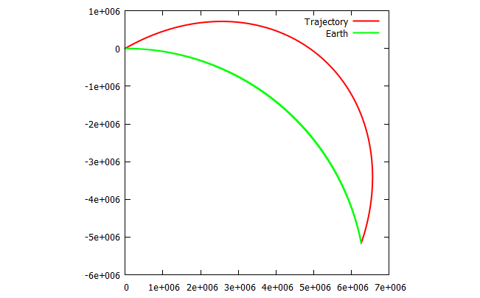
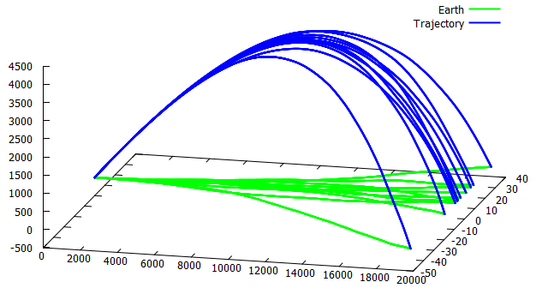
Estimating Transonic Drag
UNCLASSIFIED
Included in the model
3D trajectory
Earth’s curvature
Altitude: air density and temperature
Range and cross wind
Air turbulence
Not included
6DOF; spin effects: gyroscopic, Magnus, Coriolis effects
Non-spherical Earth
A projectile shot at 30° at 7000 ms⁻¹ with no drag. The green line represents the earth surface.
M107 projectile shot at 30° with air turbulence parameter on. Ten trajectories are shown.
Notes:
the external ballistic model should include features that require easily obtainable parameters about the projectile such as mass, cross section area and muzzle velocity;
and can exclude factors such as the earth rotation or projectile rotation as they require higher level data to be known to run the model.
The model uses only 3 degrees of freedom because including orientational degrees of freedom requires more data about physical characteristic on the projectile and initial 6D momentum (not just the muzzle velocity).
Moreover fluid dynamics is complex and since our model focuses on deducing the drag coefficient function out of available ballistic data, it is out of scope of the model to derive the drag coefficient from the fluid dynamics.
We include into the model the Earth’s curvature and altitude air changes since that does not make the models usability any more restrictive.
The wind influence and air turbulences are also included because they are important for realistic results.
References to a non-spherical Earth are not included because that would require knowledge of the geo position and direction of projectiles trajectory.
Next
Drag force and drag coefficient

Slide 6
Estimating Transonic Drag
UNCLASSIFIED
Drag coefficient
Work produced by air friction
Energy to accelerate air
 | Drag force
 | Drag coefficient
 | Air density
 | Body cross section
 | Velocity
Notes:
What is Drag coefficient?
(follow the slide)
Important – if it is constant drag force grows quadratically with velocity
This is not a constant especially when v=c
Next
How does it change with velocity?

Slide 7
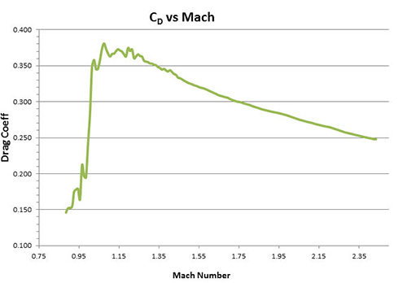
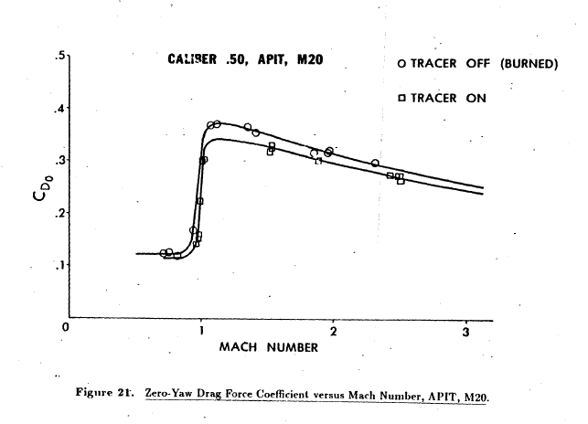
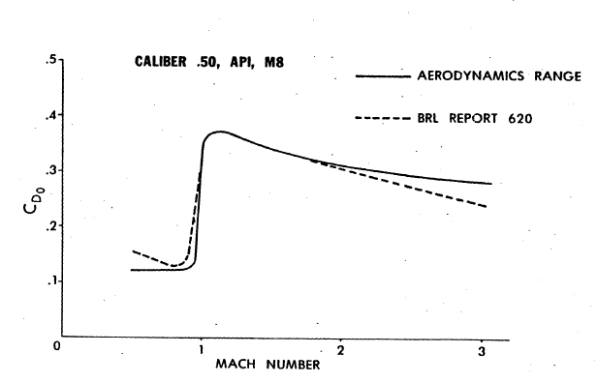
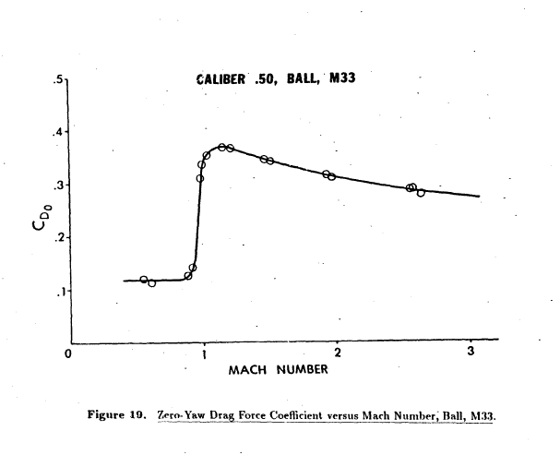
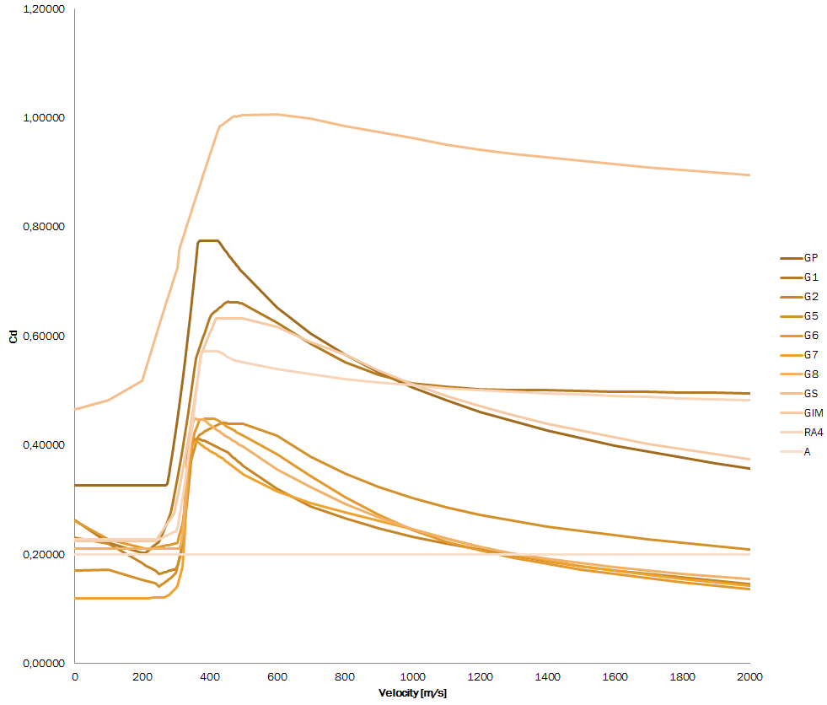
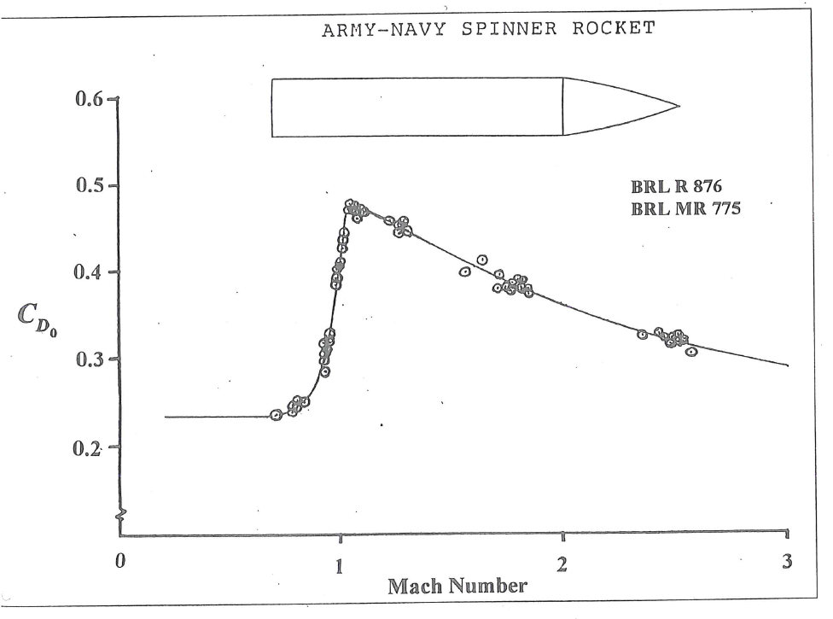
Estimating Transonic Drag
UNCLASSIFIED
Drag function
Notes:
Explain Mach
Empirical data on drag function for different projectiles
Next
Trajectory and position on the drag curve

Slide 8
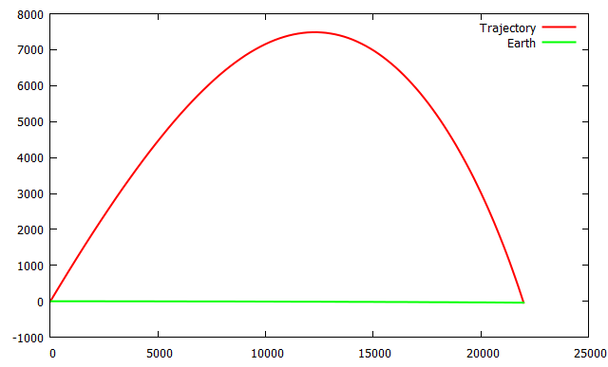
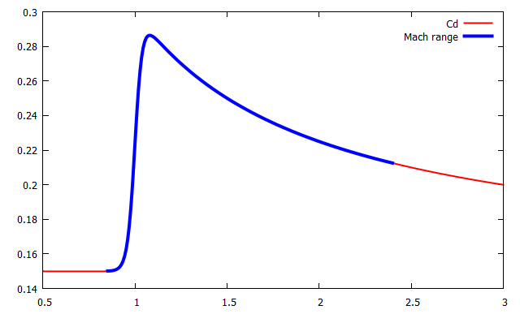
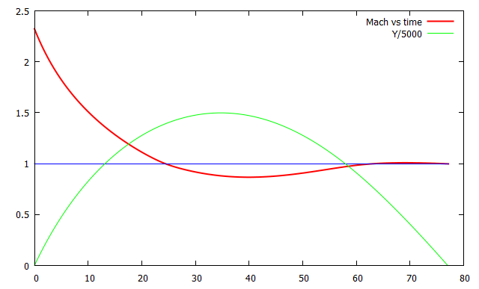
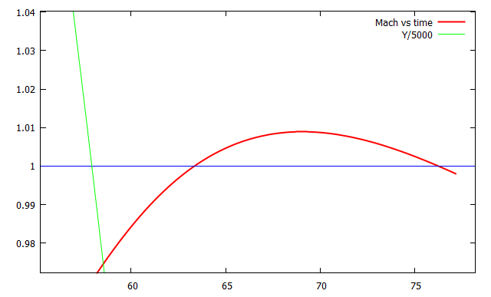
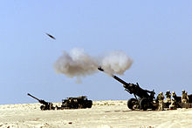
Estimating Transonic Drag
UNCLASSIFIED
Example: M107 155mm, m=35kg, v₀=790m/s, at 45°
Notes:
(follow the slide)
Next
Schematic representation of the core model

Slide 9
Estimating Transonic Drag
UNCLASSIFIED
Physical parameters
Cd function
Ballistic model
Trajectories
Notes:
Box with inputs and outputs
Next
Empirical trajectory data

Slide 10
Estimating Transonic Drag
UNCLASSIFIED
R Angle Fall topH topR Time Vf
-----------------------------------------------------
100 - 0.0667 0.03 51 0.15 623
300 0.2333 0.3000 - 162 0.52 -
500 - 0.8000 1.3 - 1.04 334
600 - 1.1500 2.3 344 1.35 304
800 1.1000 2.1000 5.5 468 2.05 266
V Max
------------
207.3 3900
234.7 4800
268.2 6100
310.9 7800
371.9 9700
Empirical data
Trajectories
Notes:
Empirical data in different forms
Next
Match and compare trajectories

Slide 11
Estimating Transonic Drag
UNCLASSIFIED
Physical parameters
Cd function
Ballistic model
Trajectories
Utility function
Match and Compare
Empirical data
Trajectories
Notes:
Matching is an expensive operation (relative to trajectory generation)
Next
Include empirical data into the model

Slide 12
Estimating Transonic Drag
UNCLASSIFIED
Physical parameters
Cd function
Ballistic model
Trajectories
Utility function
Match and Compare
Empirical data
Trajectories
Notes:
The whole model includes empirical data and matching and comparing trajectories
Next
Black Box

Slide 13
Estimating Transonic Drag
UNCLASSIFIED
Black Box
Cd function
Value of Utility function
Drag function parametrisation
Optimisation of Black Box function
Notes:
Input – drag function represented as a list of numbers. Output – a scalar value. Goal is to guess input to minimise output
Next
Parametrisation

Slide 14
Estimating Transonic Drag
UNCLASSIFIED
Drag function parametrisation
Simple parametrisation with points
Attempt to use physical properties
Notes:
We tried two types of parametrisation
Next
Alpha parametrisation

Slide 15
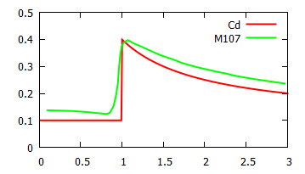
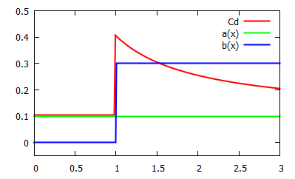
Estimating Transonic Drag
UNCLASSIFIED
Drag function
μ – Mach number
α, β – some functions of μ
α=0.1
β=0.3 (>1)
experimental data for M107 155mm howitzer
Notes:
(follow the slide)
Next
Smoothing

Slide 16
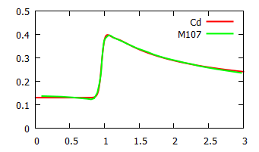
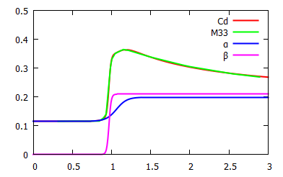
Estimating Transonic Drag
UNCLASSIFIED
Drag function smoothed by logistic function
Function C_{d} fit to experimental data with smooth step transition function
Function C_{d} fit to experimental data Ball M33 Cal .5. Functions α and β are shows as well.
Notes:
Now function is parametrised by 7 parameters
Next
Has it solved the problem?

Slide 17
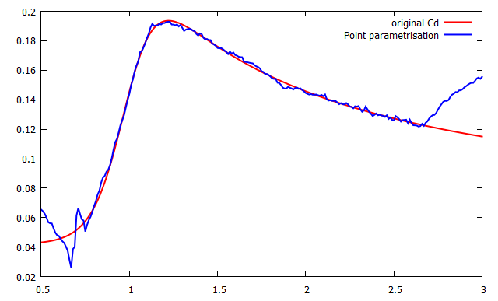
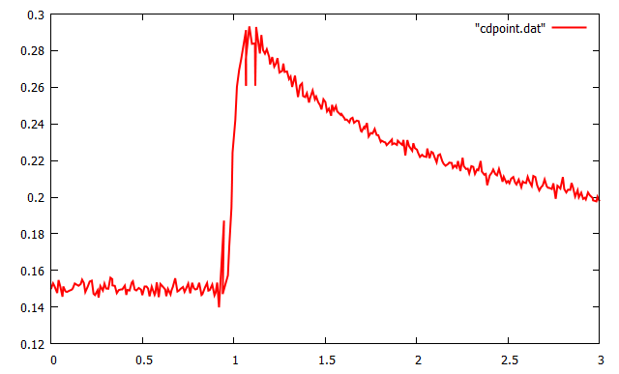
Estimating Transonic Drag
UNCLASSIFIED
Difficulties with drag function parametrisation – dependence on data
Under-parametrised
Over-parametrised
Notes:
Conclusion on parametrisation
Fixed number degrees of freedom for the drag function is no good because the empirical data may come in small or big amounts
We do not know how to parametrise Cd so it is adequate to amount of empirical data
Next
Optimisation

Slide 18
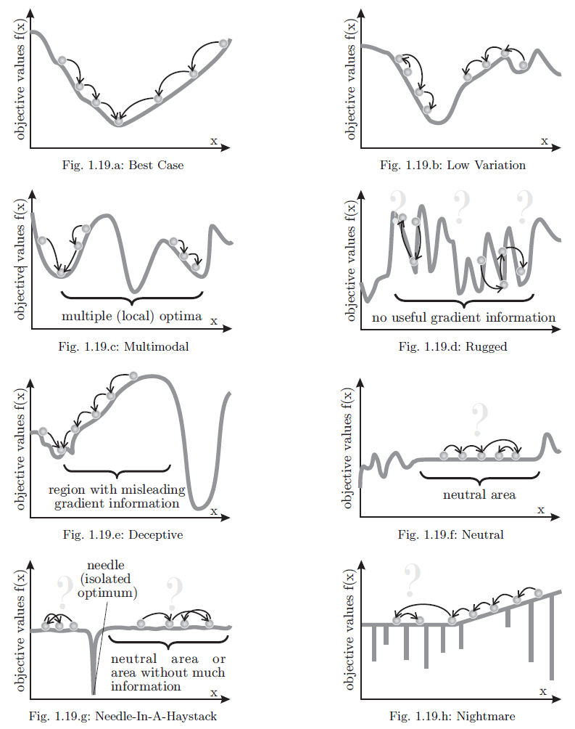
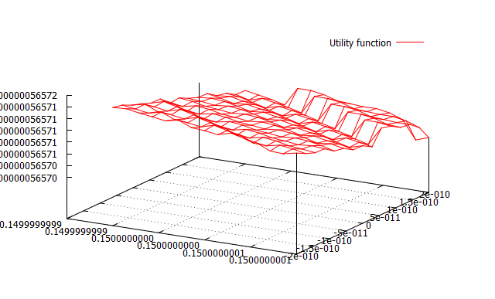
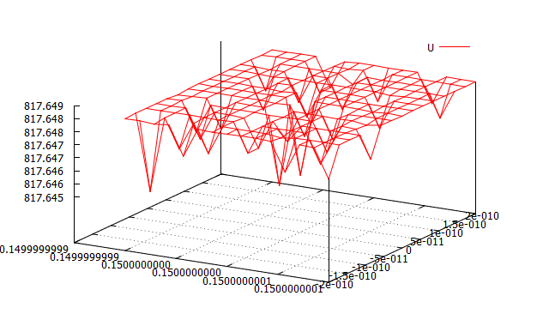
Estimating Transonic Drag
UNCLASSIFIED
Optimisation of Black Box function
Multidimensional space
Global minimum
Expensive evaluation
Neutral subspaces
Jump discontinuous surface
Notes:
There are some conditions to the optimisation
Multidimensional space – narrow valleys
Global minimum – exploitation vs exploration
Expensive evaluation – due to underlying process of matching trajectories
Neutral subspaces – if drag function is over-parametrised
Jump discontinuous surface – due to underlying optimization
Conclusion on optimisation
Requires manual work
Requires initial good guess
Requires upfront knowledge of noise level – bad
Next
Conclusion

Slide 19
Estimating Transonic Drag
UNCLASSIFIED
Why this is important for us?
Robust algorithms of Cd parametrisation and Optimisation would make the model build the best match of drag function for different munitions
Cd Parametrisation and Optimisation
Core Ballistic Model
Other areas of usage:
* E.g. Experimental design
. . .
Notes:
Robust algorithms of Cd parametrisation and Optimisation would make the model build the best match of drag function for different munitions
Next
If time allows
Usage of optimisation algorithm in Experimental design

Slide 20
Estimating Transonic Drag
UNCLASSIFIED
Using optimisation in Experimental design for Combat Simulations
Combat simulations is an expensive function

Slide 21
Estimating Transonic Drag
UNCLASSIFIED
A simple example: “Capture the flag”
Explore space in different points: Speed vs Stealth
Speed
Stealth
Notes:
Explain the game
Explain the goal
Next
Optimisation algorithm exploration

Slide 22
Estimating Transonic Drag
UNCLASSIFIED
“Capture the flag”
Optimisation algorithm would explore only the most interesting areas of space
Speed
Stealth

Slide 23
Estimating Transonic Drag
UNCLASSIFIED
Cd Parametrisation and Optimisation
= ??? =
Core Ballistic Model
Other areas of usage:
* E.g. Experimental design
. . .
Notes:
Questions

