Slide 1
Finding business insights in the Northwind database
A catalog of suggestions for improving sales and business practices

Slide 2

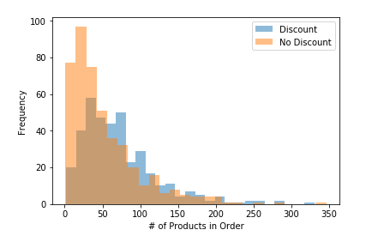
How do order discounts affect the number of products a customer purchases?

Slide 3
Any level of discount increases the number of units sold.

Slide 4
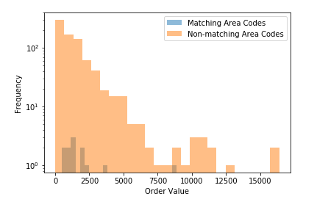
Do employees with the same area code as their customers sell a greater value of products?

Slide 5
Employees with area codes matching their customers do not sell a greater value of products.

Slide 6
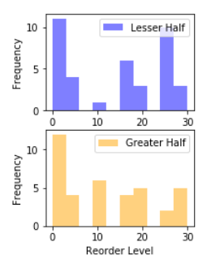
Do more popular products have different reorder thresholds than less popular ones?

Slide 7
Product popularity does not have a relationship with reorder threshold

Slide 8
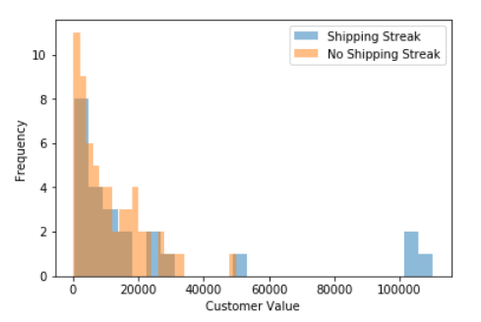
Do customers that are loyal to the same shipping company have a higher lifetime value than other customers?

Slide 9
Customer loyalty to shipping companies does not signal higher lifetime value.

