Slide 1
Modeling the Relationship between Landsat Imagery and OpenStreetMap Data

Slide 2
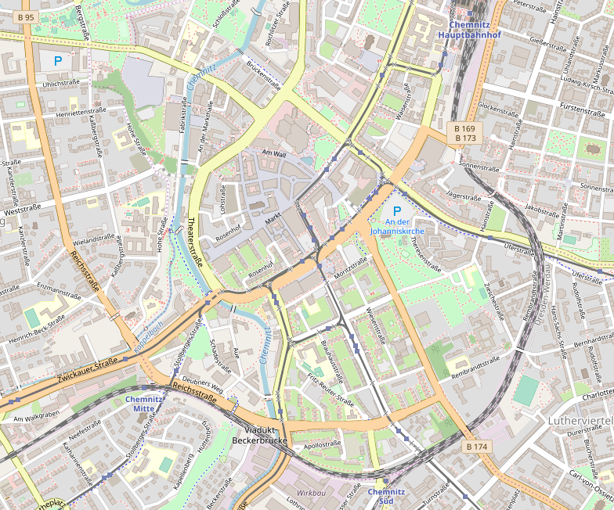
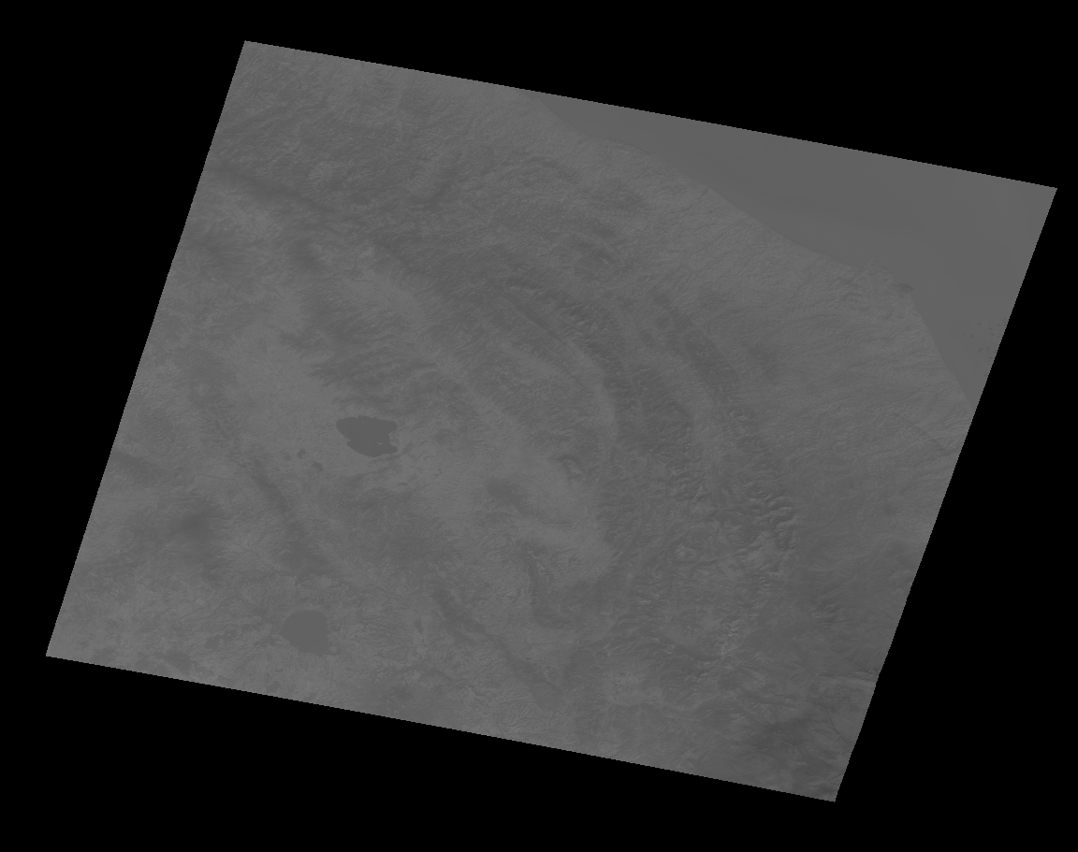
Question
Can be determined about a civilization from satellite imagery?

Slide 3
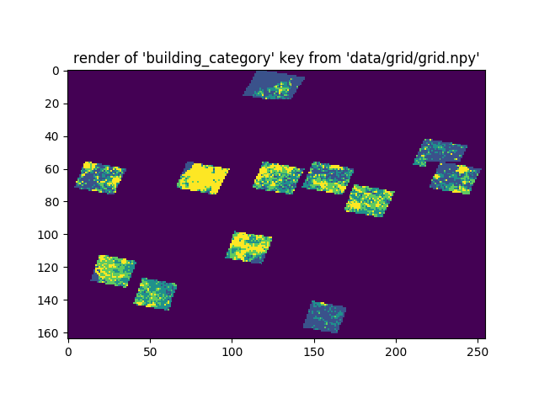
Proxies for Civilization
Buildings
Roads
Lack of greenery

Slide 4
Training Area
Europe has better OSM data than any other part of the world
Koppen Climate Classification similar to parts of United States and China
Large land area

Slide 5
Categories of Civilization
Desolate (0-20 buildings/km)
Rural (21-65 buildings/km)
Suburban (66-135 buildings/km)
Urban (>135 buildings/km)

Slide 6
Results
Validation accuracy of >42% with four civilisation categories
Similar accuracy when checked against the test set

Slide 7
Applications
Testing areas of USA and China to determine expected civilization level versus mapping level
Global heatmap of actual vs expected mapping level
Other tools to focus OSM mapping efforts

