Slide 1
To Do Project
By Parth Patel

Slide 2
Introduction
My Approach
Identifying the MVP
Jira
Set up Github
Create a strong back-end
Create a front end and link
Test

Slide 3
My Journey
Spring
HTML, CSS, JS
Java
Selenium
SonarQube

Slide 4
My Sprint Plans
Split the sprints into 2:
Back end
Front end

Slide 5
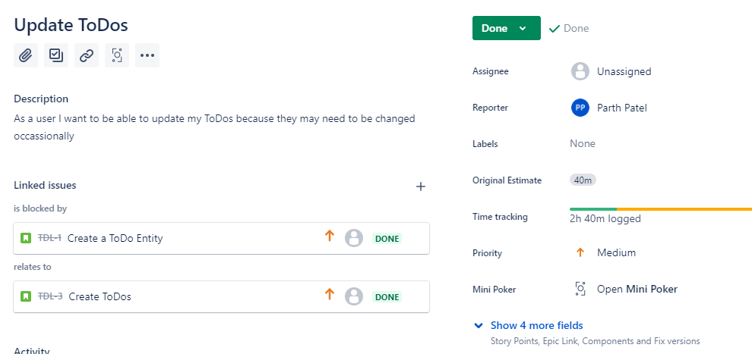
Example User Story

Slide 6
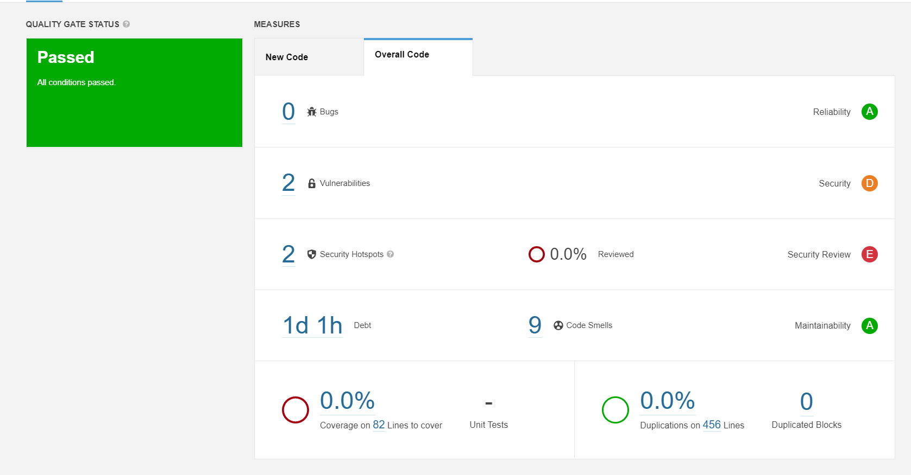
SonarQube

Slide 7
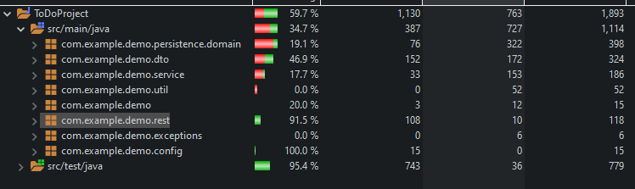
Testing
Source code test coverage – 59.7%

Slide 8
Demo

Slide 9
Sprint Retrospective
What was achieved
Crud Implementation
Unit Testing
Front End Implementation
What was missed
Selenium Testing
Integration Tests
What went well and how can I improve?

Slide 10
Conclusion
What to take forward
Refine my use of Jira and Github
Keeping working with what worked
Improve the areas where I know I missed the mark

Slide 11
Thank you!
Any questions?

