Slide 1

Food Brand Understand Customer Trends
Team 01

Slide 2

OUR TEAM
Parul Gautam
Rohan Raj
Sindhu Priya
Vinaykumar
Under the Guidance of
Mentor Pavithra Kannan

Slide 3



Contents
01
Introduction
02
Agenda
Style
Key components
04
Dashboard
05
Conclusion

Slide 4
Introduction
The dataset is a comprehensive record of customer transactions collected over six months (Jan – Jun 2024).
It captures purchase behavior, demographics, and feedback, which can help in understanding customer preferences and improving sales strategies
Provides insight into customer buying patterns across different regions and demographics.
Helps in analyzing product demand, sales trends, and channel performance.
Useful for business decision-making in pricing, promotions, and customer engagement.

Slide 5
FUTURE SCOPE
Expand dataset with real-time inputs
Apply predictive models for trend forecasting
Build personalized recommendations for customers
Help brands in menu planning & marketing strategy

Slide 6
Project Overview :
The project focuses on analyzing the Unique Balaji Dataset, which contains customer transaction data.
It aims to extract insights about sales trends, customer demographics, and product performance.
Goal: Enable data-driven decision-making to optimize sales and enhance customer satisfaction.
Core Functionalities :
Data Preprocessing
Descriptive Analysis
Product Analysis
Feedback & Rating Analysis
Visualization Insights for Business
Outcome :
Comprehensive understanding of customer purchasing behavior.
Identification of top-performing products and key regions for growth.
Insights into preferred payment methods and order channels.
Recognition of customer pain points through feedback analysis.
Creation of visual dashboards and reports for decision-makers.

Slide 7
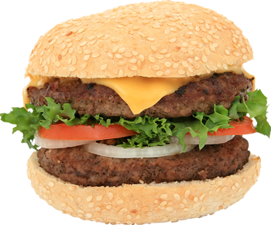
Key Components Covered :
Customer Details: ID, Age, Gender, Location, Region.
Order Details: Date, Item Name, Category, Subcategory.
Financial Information: Price, Discount, Transaction Amount.
Feedback and Ratings: Quality and service feedback with ratings.
Purchase Behavior: Channels used (Mobile App, Website, In-store),
Payment Type (Cash, Online).

Slide 8
Business Use Cases :
Customer Segmentation: Age, Gender, Region analysis
Product Performance: Best-selling items
Sales Trends: By time, region, channel
Feedback Analysis: Sentiment and quality improvement

Slide 9
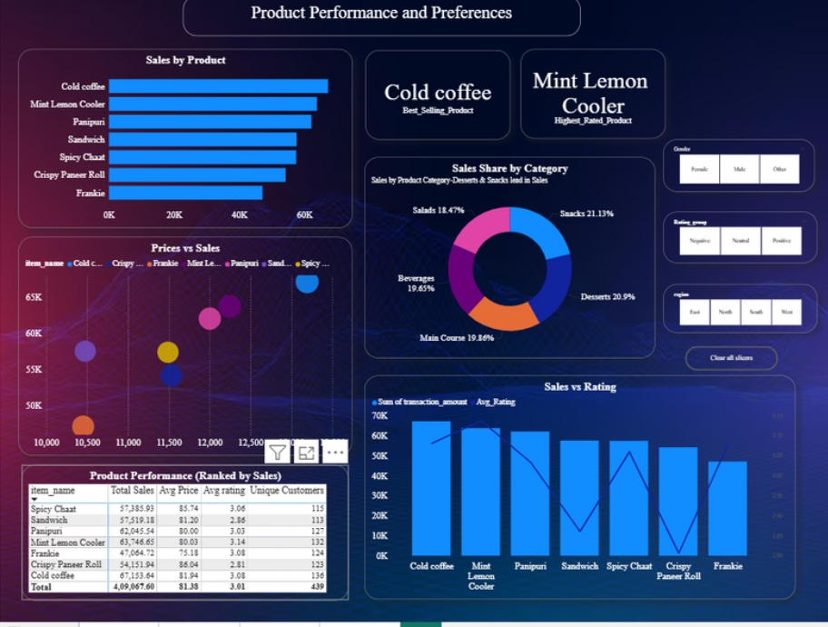
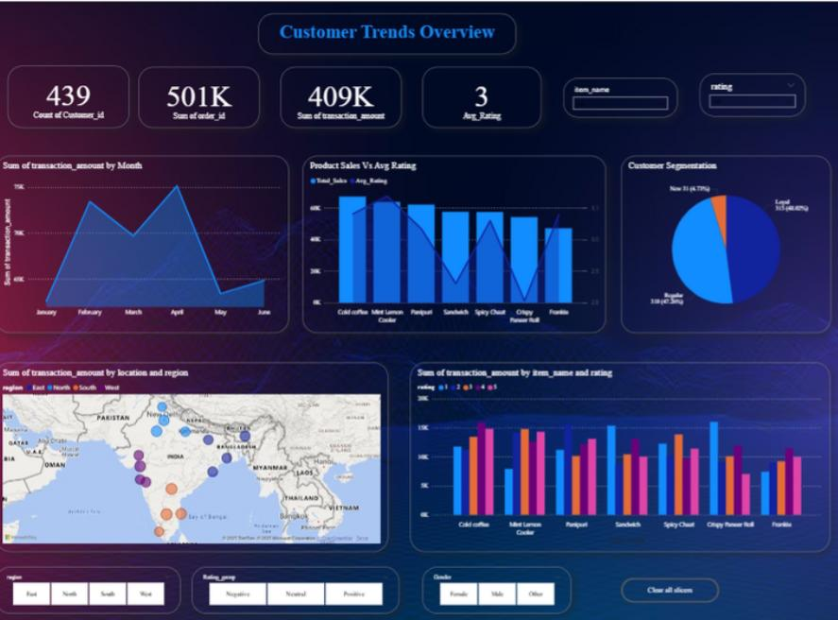
Visual Insights
2015
2016
2018
2019

Slide 10
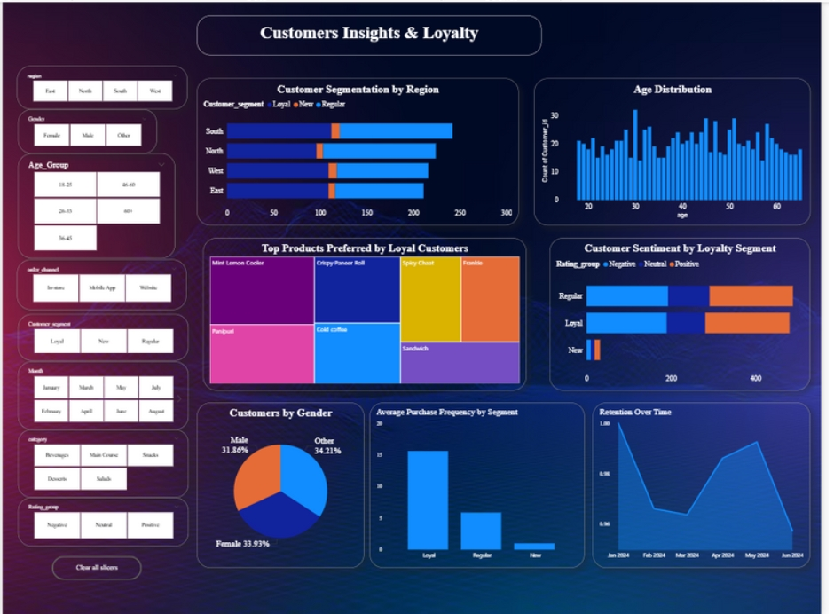
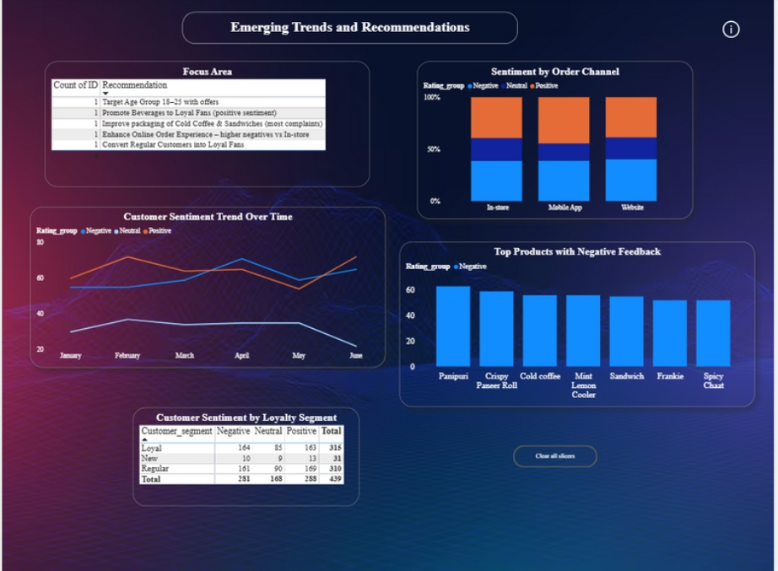

Slide 11
Conclusion
The dataset provides valuable insights into customer behavior, product performance, and operational efficiency.
Leveraging these findings can improve customer satisfaction, boost sales, and enhance competitive advantage.
The inclusion of customer feedback and ratings allows for quality assessment and improvement of customer satisfaction.
By analyzing this data, businesses can identify top-performing products, understand regional demand variations, and optimize inventory management.
The dataset can serve as a foundation for predictive analytics, such as :
Sales Forecasting
Churn Prediction
Personalized Marketing Recommendations

Slide 12
Thank you

