Slide 1
Nagios

Slide 2
Download Nagios
Open the browser and go to https://www.nagios.org/downloads/nagios-core/
Click Nagios XI Download
Click "Download Now" for Windows
Click "Download Now" for Open Virtualization Format
Skip the form
OVA file will be downloaded

Slide 3
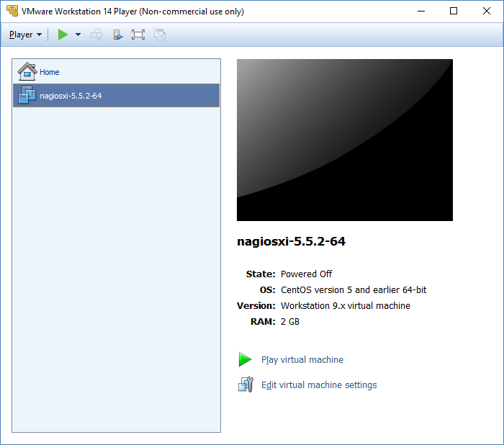
Setup Nagios UI
Pre-requisite: Disable Hyper-V option(Control Panel > Programs > Turn Windows features on or off >De-select Hyper-V > Restart the machine)
Launch VMware Workstation
Click Player > File > Open > Import Nagios ova file from machine > Import
It may take some time, once file import is finished then Nagios image will be displayed in VMWare Workstation
Click "Play virtual machine“

Slide 4
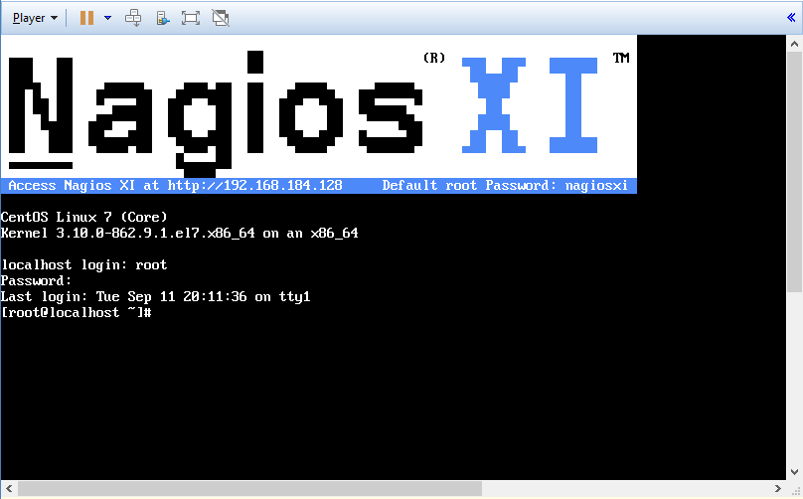
Setup Nagios UI
Nagios terminal will be launched, login to it by entering username(root) & password(nagiosxi)

Slide 5
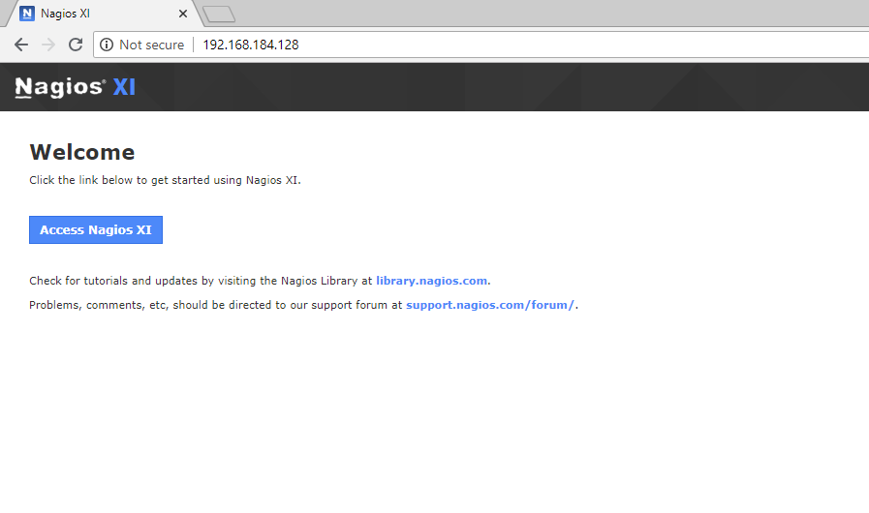
Setup Nagios UI
Launch Nagios ip address(e.g. 192.168.184.128) in browser
Nagios XI will be launched on browser

Slide 6
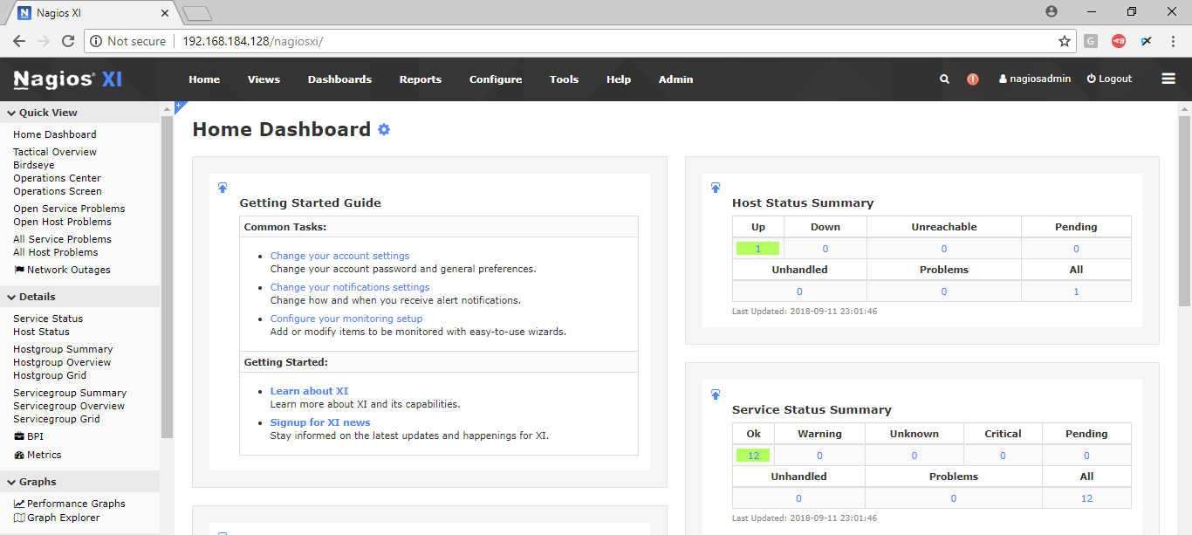
Setup Nagios UI
Click Access Nagios XI > Next
Finish Install
Click "Login to Nagios XI“ > Login to NagiosXI by using given U/N & P/W
Accept License Agreement > Submit > Click "End tour" on alert
You will be reached to Nagios XI Dashboard

Slide 7
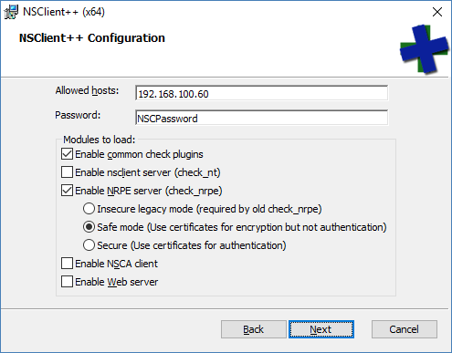
Setup Windows Server
Nagios Dashboard > Go to Configure > Configuration Wizards > Click Windows icon > Click Windows Server
Enter your machine's ip address > Next
Click Agent Download 64-Bit link[e.g. Download v0.4.4 (64bit)]
Once file is downloaded, run the installer to install it
Note: During installation, you need to enter your machine ip address & enter a secure password.
Once installation finished, make sure your service status is running[Launch Run > Launch services.msc > Go to NSClient++ (x64)]

Slide 8
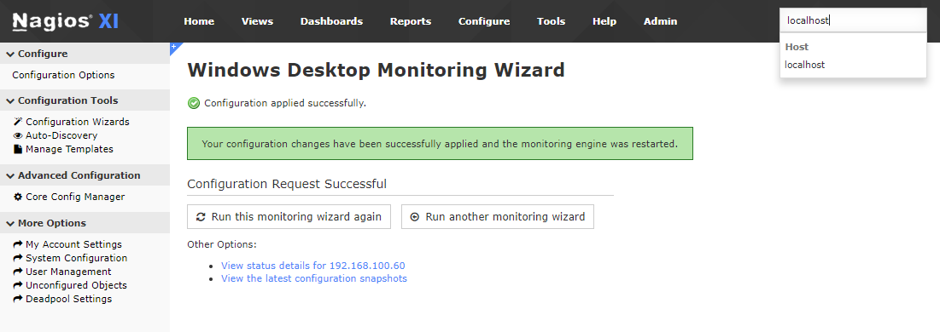
Setup Windows Desktop
Nagios Dashboard > Go to Configure > Configuration Wizards > Click Windows icon > Click Windows Desktop
Enter your machine's ip address > Next
Enter the Agent password(e.g. NSCPassword) > Next > Finish
Click Search icon at right-top section > Select localhost

Slide 9
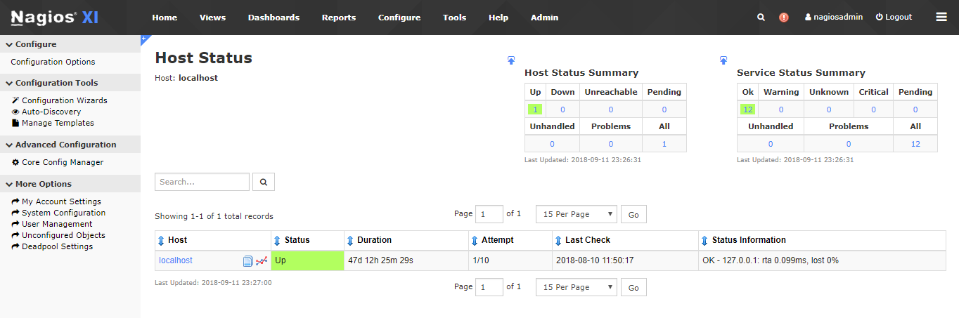
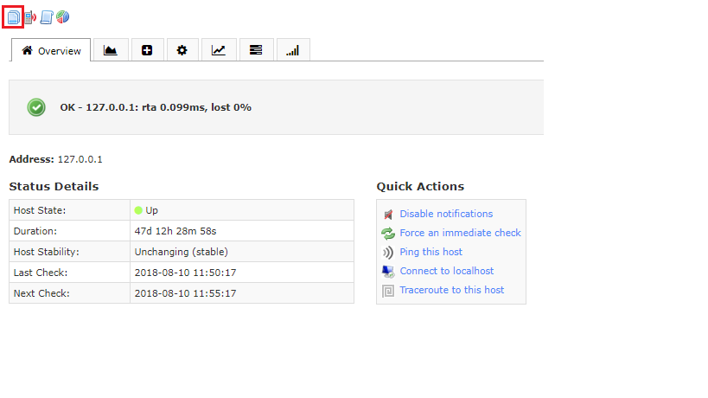
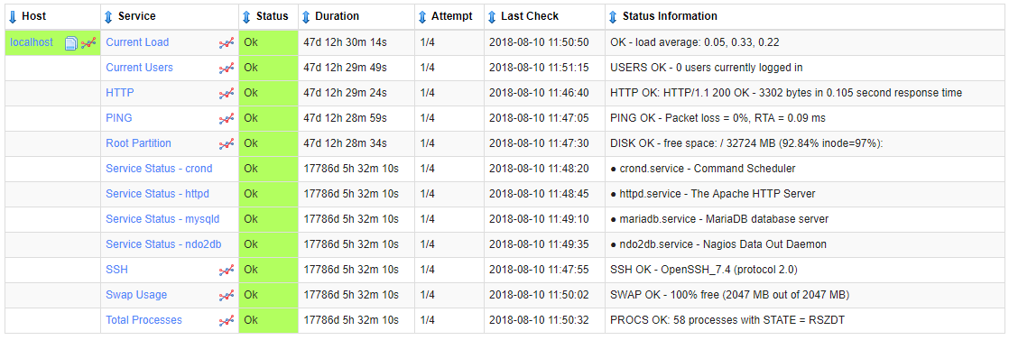
Windows Monitoring
Click localhost
Click View Current Status icon
Now you can monitor your windows machine processes

