Slide 1
ChatGPT Use Case in Python
- by Parul Chaudhari (Data Scientist at Fractal)

Slide 2
Table of Contents
Table of contents
Introduction to the OpenAI & ChatGPT
GPT Model Family
GPT Model Key concept
Custom ChatGPT in Jupyter Notebook
Q & A

Slide 3

Brief about me..
My name is Parul Chaudhari
Data Scientist @ Fractal
~6 years of work experience (Ex – VMware & Accenture)
MS in NLP from LJMU, UK
Expertise in Tradtional ML & DL, conversational AI, Intelligent Automation
Exploring & Learning new technologies, Music

Slide 4
OpenAI and ChatGPT
Brief about me..
OpenAI is an AI research and Development company that creates models and makes them accessible to all through APIs.
Gathers Information in large amount
Accessible through API with some price points
Research and Designs Algorithms for training
Create Models
GPT
Codex & DALL-E, Many more
Understand Natural Language
Generate Text or Code for user given custom prompts
ChatGPT is a language model developed by OpenAI. It is based on the GPT (Generative Pre-trained Transformer) architecture, specifically GPT-3.5 & above.
designed to generate human-like text responses and engage in interactive conversations with users.
trained on a vast amount of text data from the internet, allowing it to learn patterns, grammar, and context.
understand and generate coherent responses, making it suitable for a variety of conversational tasks.
powerful tool for building chatbots, virtual assistants, and other conversational agents. It can be used to answer questions, provide explanations, offer recommendations, simulate characters, and much more.

Slide 5
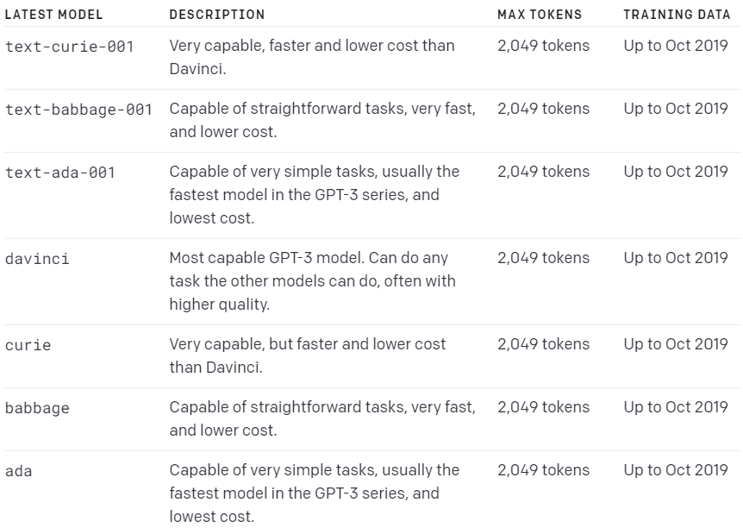
GPT- 3 Models
Brief about me..
GPT-3.5 models can understand and generate natural language or code. Our most capable and cost effective model in the GPT-3.5 family is gpt-3.5-turbo which has been optimized for chat but works well for traditional completions tasks as well.

Slide 6
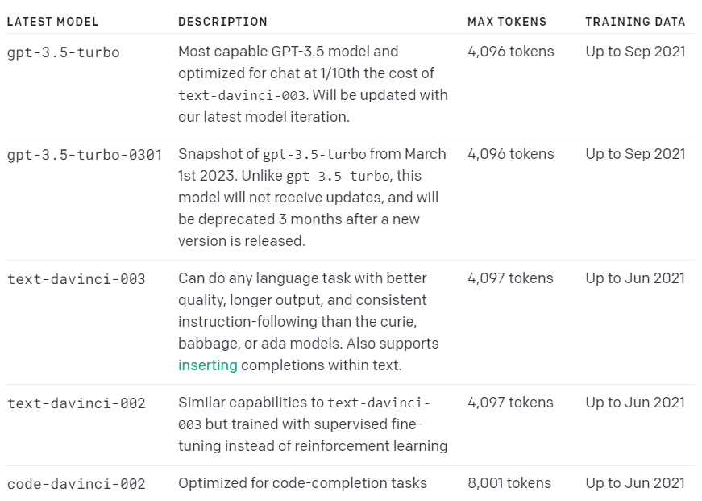
GPT- 3.5 Models
Brief about me..
GPT-3.5 models can understand and generate natural language or code. It’s the most capable and cost effective model in the GPT-3.5 family is gpt-3.5-turbo which has been optimized for chat but works well for traditional completions tasks as well.

Slide 7
GPT Model Family
Brief about me..
Davinci - Most capable model that can do any task better than other GPT models but have high cost . These tasks could be text summarization, code generation, response for complex intent.
Curie – Good for sentiment analysis, complex classification
Babbage – Good for simple classification and semantic searching
Ada – Great at parsing text and address correction

Slide 8
GPT : text-Davinci-003
Brief about me..
It is built on a transformer architecture with reinforcement learning. Transformers are a type of deep learning model architecture that has proven to be highly effective in various natural language processing tasks. They consist of multiple layers of self-attention mechanisms and feed-forward neural networks.
Conversation with human like responses with quality as it can understand most complex language patterns
Text Generation
Text Classification
Transformation
Completion

Slide 9
ChatGPT : Key concepts
Brief about me..
Prompts
Tokens
Temperature
Optimization – Provide Examples with good quality data as what you provide while model learning period, similar responses you will get
Prompt you give to model, and response you get from the prompt given
Model process text input by taking it down into smaller units called tokens
1 Token ~ 4 char
75 Words ~ 100 Tokens
If limit is 4000 tokens then 3000 words can be used in prompts for fine tuning
$0.02 for 1000 token
Parameter can range from 0 to 1
The more close to 1 means less risk or more accuracy in generating response for given prompt, though it will not creative enough

Slide 10
Environment Setup & Notebook Links Custom ChatGPT Use Case Jupyter Notebook

Slide 11
DataHour : Q&A

Slide 12
Thank you!

