Slide 1

Life Expectancy Prediction Using Medical Parameters, Smoking and Drinking Habits – An AI based Approach
By:
Parul Bhutani Wadhwa
Snehal Kathiriya​

Slide 2
Introduction
The goal of this project is to create an innovative AI based model that determines the life expectancy of an individual based on a comprehensive set of medical parameters along with their smoking and drinking habits. Predicting life expectancy can be of a significant importance for healthcare, insurance, and public health policies. Using a combination of data processing, feature engineering and model training, we aim to create a highly accurate predictive model capable of determining an individual’s remaining years of life.

Slide 3
Data Analytics & Exploration
Categorical
Understanding
Data Imbalance
Data Filtration
Converted all continuous values of medical parameters to categorical
Understanding the data and choosing the right approach
Checking for data Imbalance
Filtered data for the people who drink and smoke

Slide 4





Approach
Input
Synergize scalable e-commerce
Data Pre-processing
Disseminate standardized metrics
AI Model Selection
Coordinate e-business applications
Unsupervised Learning
Foster holistically superior methodologies
Supervised Learning
Deploy strategic networks with compelling e-business needs

Slide 5
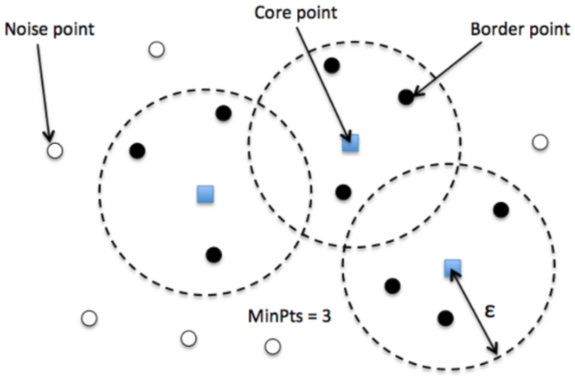
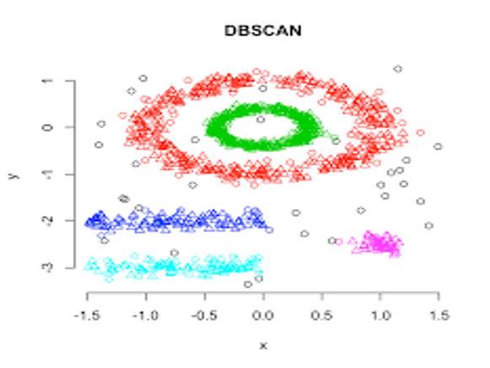
DBSCAN Density Based Spatial Clustering of Applications with Noise.

Slide 6
DBSCAN Clusters Formation
Remove Unwanted Columns
Converting categorical columns using One-Hot Encoding
Final cluster output joined with original dataset ready to be used for supervised learning.
Run DBSCAN algorithm and generate output.
Preprocess data using MinMaxScaler.
127 clusters were formed and named.
Verifying average ages of people suffering from various diseases from internet, clusters were defined with age formulas.

Slide 7
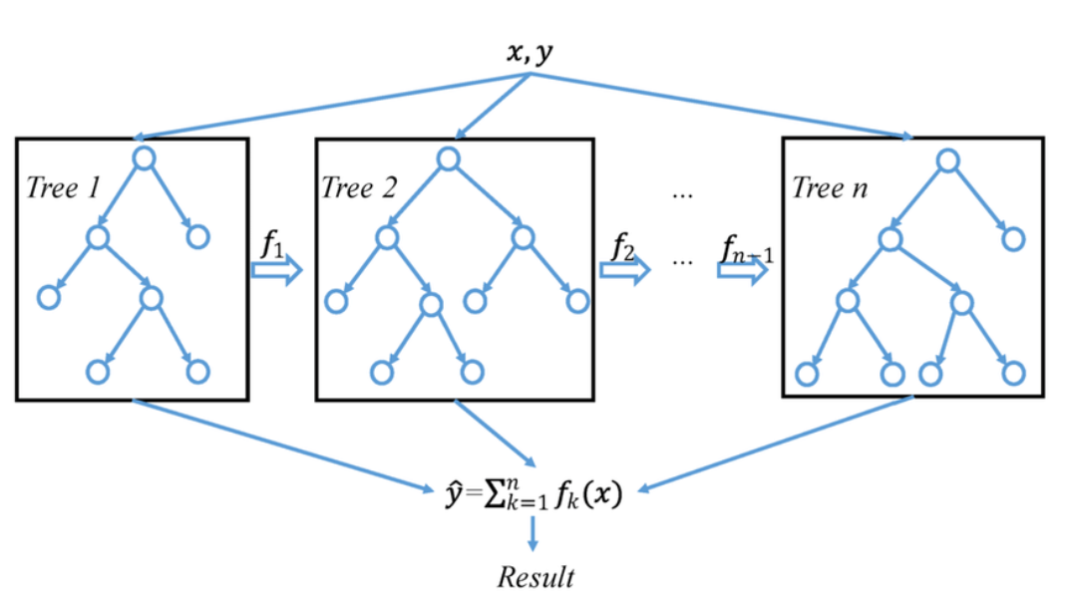
XGBoost Regressor XGBoost is a powerful approach for building supervised regression models.

Slide 8
AGE Prediction
Data preprocessing using One-Hot Encoding
Data imbalance corrected using Oversampling on minority samples.
Running XGBOOST algorithm and predicting age.
Unwanted columns removed.
Validating model using Learning Curve and Validation Curve.
Predicting model using unseen or user defined data.
Saving model for UI interface.

Slide 9
Benefits
Personal health Improvement
Medical Decision Support
Insurance and Mediclaim Companies

Slide 10



Limitations
Limited Dataset due to confidentiality restrictions.
The exclusion of physically active people and those on medication further limits our predictions.
The prediction is limited to people who are chain smokers and alcoholic.

Slide 11
Conclusion
In Conclusion, our project on life expectancy prediction, based on a small sample of data, has provided important insights into the relationship between medical data, lifestyle changes, and life expectancy. The limited nature of the data, collected through rigorous analysis and confidentiality, shapes our findings, and highlights the need for careful interpretation.

Slide 12
References
Khatri, V. S. (n.d.). Flask vs Django: Which Python Web Framework to Use in 2023? Hackr.io. https://hackr.io/blog/flask-vs-django
GeeksforGeeks. (2023, January 10). XGBoost for regression. https://www.geeksforgeeks.org/xgboost-for-regression/
Fig. 3 A general architecture of XGBoost. (n.d.). ResearchGate. https://www.researchgate.net/figure/A-general-architecture-of-XGBoost_fig3_335483097
Chauhan, N. S. (n.d.). DBSCAN Clustering Algorithm in Machine Learning - KDNuggets. KDnuggets. https://www.kdnuggets.com/2020/04/dbscan-clustering-algorithm-machine-learning.html
DBSCAN: density-based clustering for discovering clusters in large datasets with noise - Unsupervised Machine Learning - Easy Guides - Wiki - STHDA. (n.d.). http://www.sthda.com/english/wiki/wiki.php?id_contents=7940

