Slide 1
Housing Price Prediction By Parul Bhutani Wadhwa Snehal Kathiriya

Slide 2
Project analysis slide 5
Agenda
Data Exploration
Feature Engineering
Data Splitting
Model Selection
Model Training
Model Evaluation
Hyperparameter Tuning
Model Testing

Slide 3
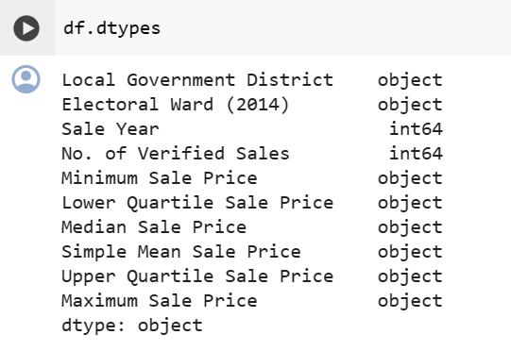
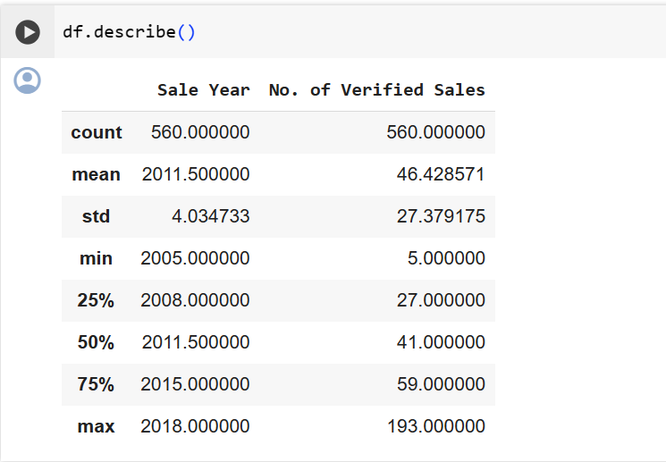
Project analysis slide 11
We can see the certain outliers below
Data Exploration
If we attempt to remove the outliers, we will lose some of the important information and the accuracy will decrease.

Slide 4
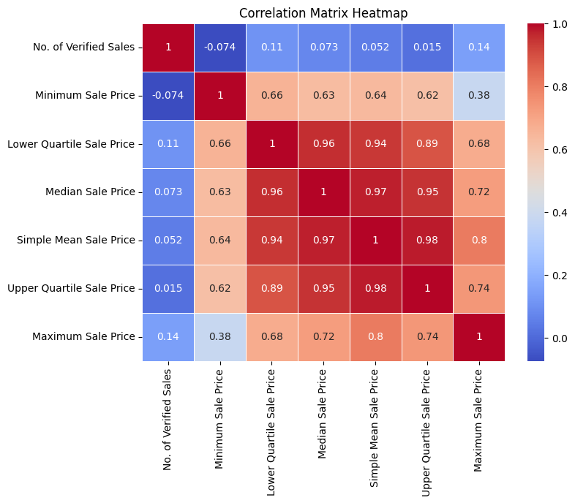
Project analysis slide 5
Data Exploration
The heat map shows that there is a poor correlation between the Sale Year and almost all the other characteristics. Therefore, we can remove this column from the heat map. We will also remove the Local Government District from the heat map as it is the same in all the samples.

Slide 5
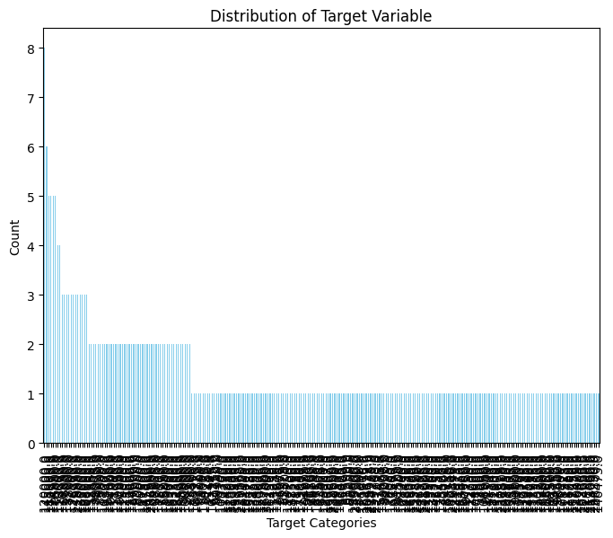
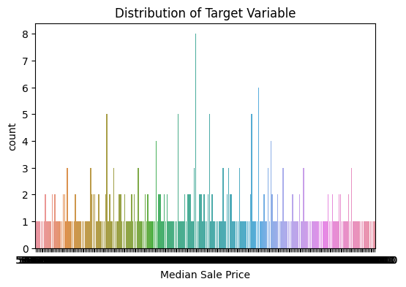
Project analysis slide 5
Data Exploration
Visualizing distribution of Target Variable

Slide 6
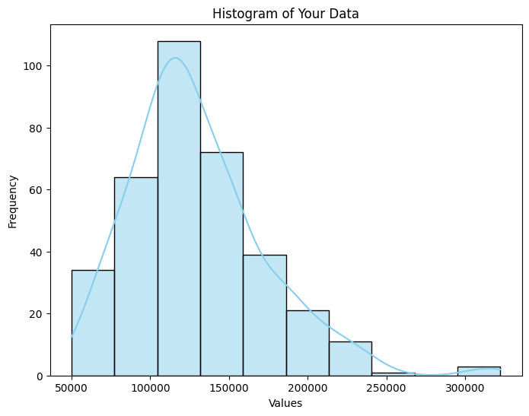
Project analysis slide 5
Data Exploration
Visualizing Skewness for target feature

Slide 7
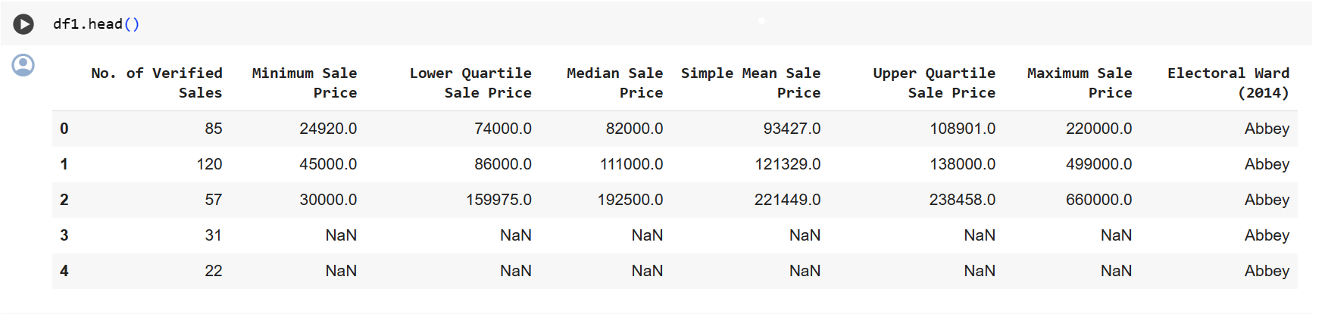
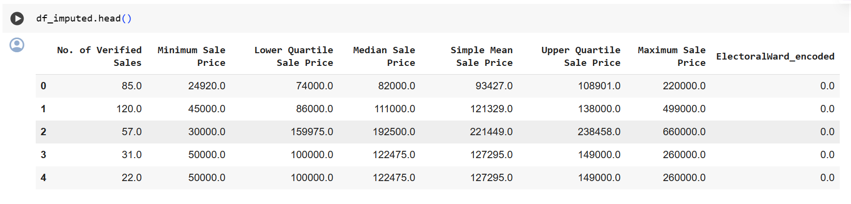
Project analysis slide 5
Feature Engineering

Slide 8
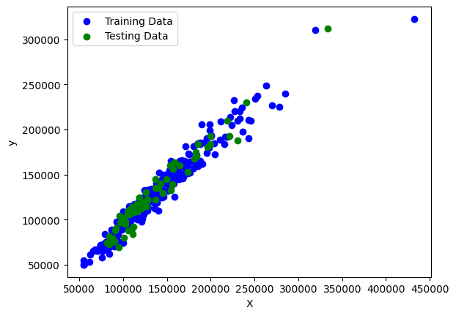
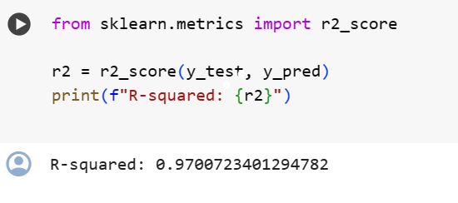
Project analysis slide 5
Data Splitting

Slide 9
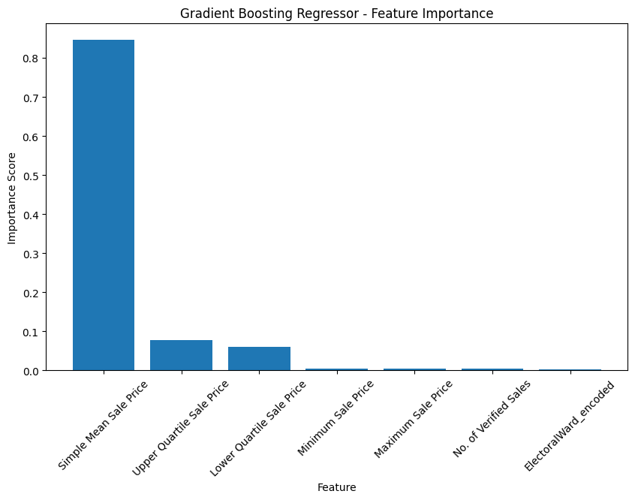
Project analysis slide 5
Model Selection
Gradient Boosting Model
Mean Squared Error: 40439026.56899344
R-squared: 0.963520356640347

Slide 10
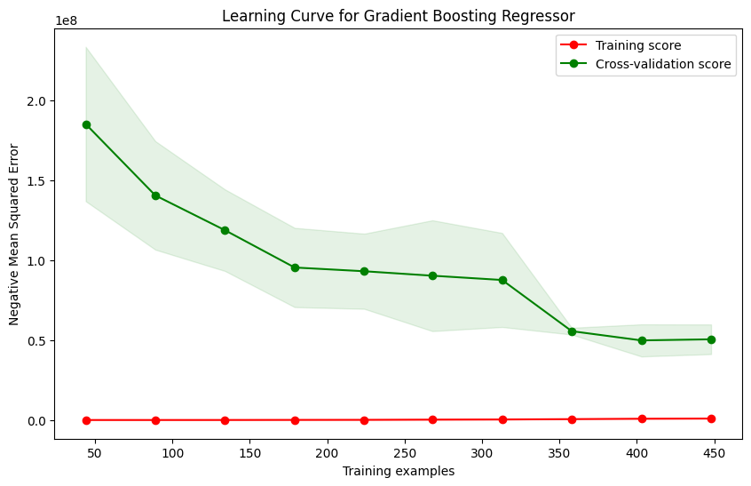
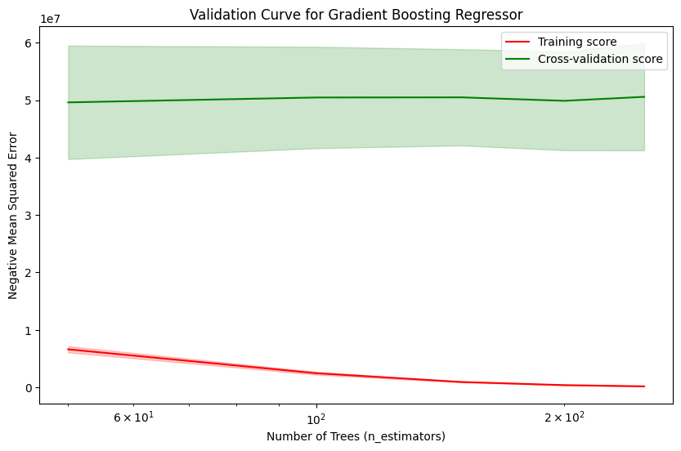
Project analysis slide 5
Model Selection

Slide 11
Project analysis slide 5
Model Selection
KNN Regressor Model
ElasticNet Model
R-squared:0.8884277193931618
Ridge Model
R-squared: 0.9691533156377994
R-squared: 0.9691534797109131
SVR Model
R-squared: -23624110.152808033

Slide 12
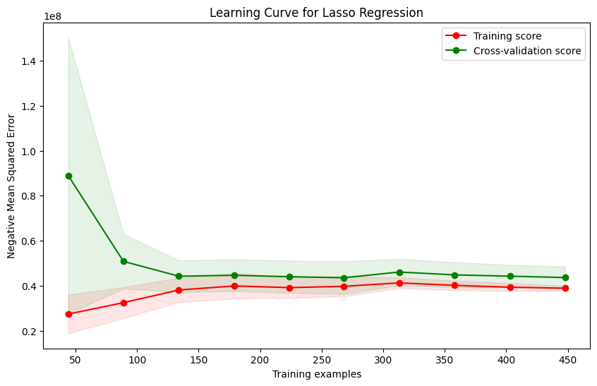
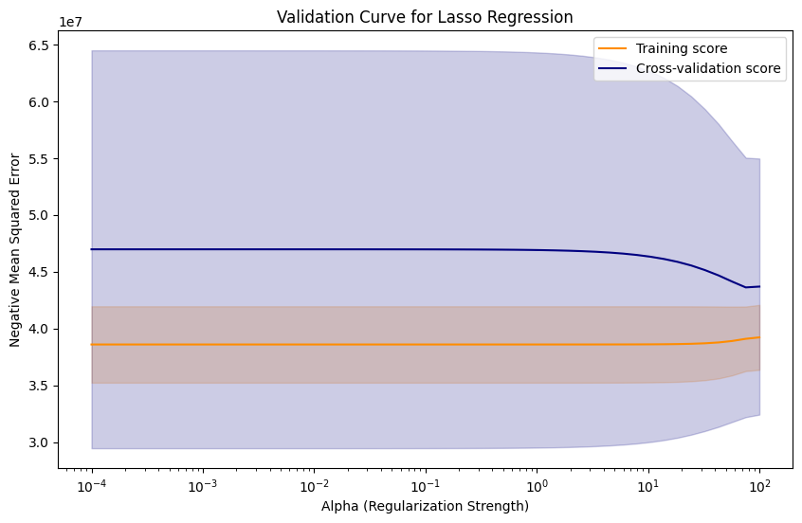
Project analysis slide 5
Model Selection
Lasso Model
R-squared:0.9691533290348714
All the models tested provided similar level of accuracy, but the learning curve and the validation curve of the Lasso Model contributed to justify the accuracy level. Therefore, among all the models, the Lasoo model performance should be selected.

Slide 13
Thank You

