Slide 1



Gold Price Forecasting
P-111 Group 2
Mentors- Kartik & Dhanyapriya
04/05/2022
Team members:
Gourangee S Dhanagare
Rahul Chauhan
Arman N Soni
Parul yadav
Prathik Mohan
Notes:
‹#›
‹#›
‹#›
‹#›

Slide 2
Business Objective
Notes:
‹#›

Slide 3
Business Objective :
Forecast or Predict the Gold Price for the next 30 days using a suitable forecasting model from the given dataset from client.
End Goal: Forecasting Model will be used by Gold import/ export companies to understand metal price movements and accordingly set their revenue expectations.
Notes:
‹#›

Slide 4
Dataset Details & Initial Statistics
Notes:
‹#›

Slide 5

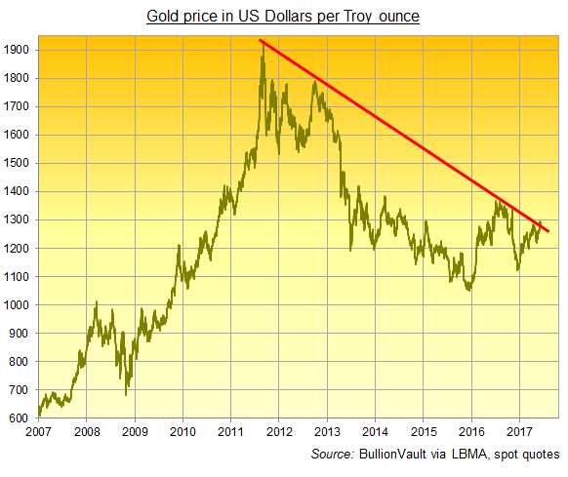
Dataset Details
- Dataset of Gold Prices already provided.
1. Uni-variate Data: Date and Price
2182 Entries
From Date: 1st January 2016
To Date: 21st December 2021
Minimum Gold Price: 2252/-
Max Gold Price: 4966/-
2. Observations Taken is on a Daily basis
3. Prices during all holidays are also included
4. Only last month – December 2021, 21 days of data is present.
Notes:
‹#›

Slide 6
Exploring/EDA on Initially Raw Data (Uncleaned data)
Why? In-depth understanding of what raw data we have in hand.
Notes:
‹#›

Slide 7
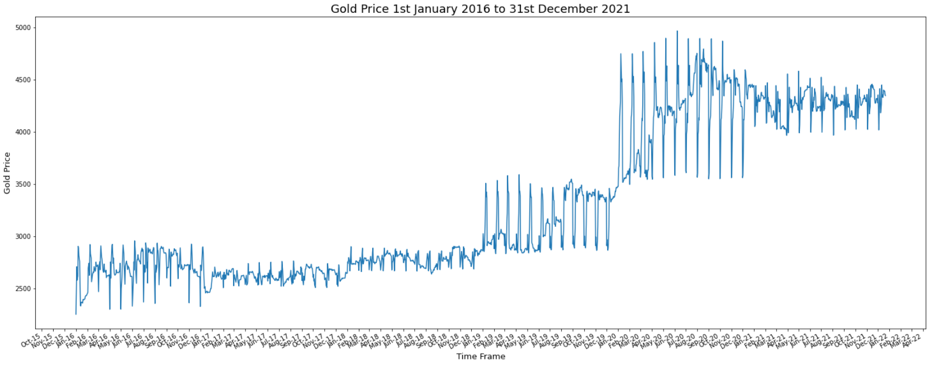
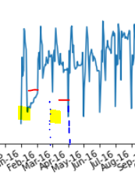
Exploring/EDA on Initially Raw Data (Uncleaned data)
Plot 1
Observation: 1. Price increases at the start of month and
reduces towards the end of month
2. Clear distinction between yearly price (groups) fluctuations
Notes:
‹#›

Slide 8
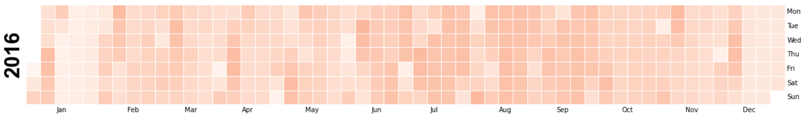
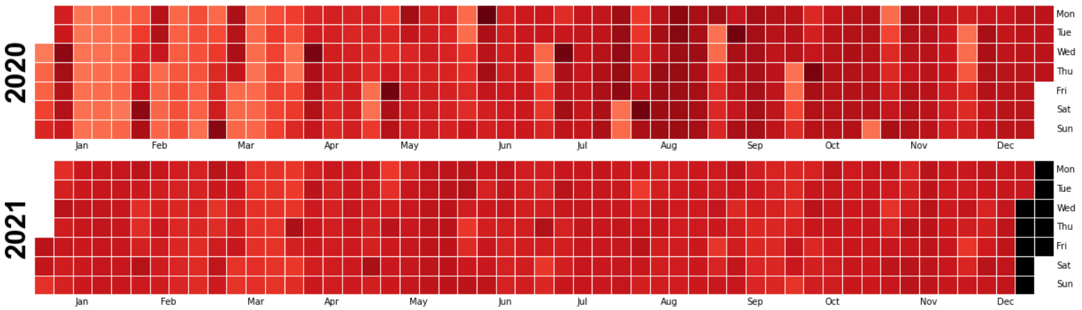
Exploring/EDA on Initially Raw Data (Uncleaned data)
Plot 2
Observation: Gold Price → Exponential rise from 2016 to 2021
Example: 2252/- in Jan 2016, 4346/- in Dec 2021
Notes:
‹#›

Slide 9
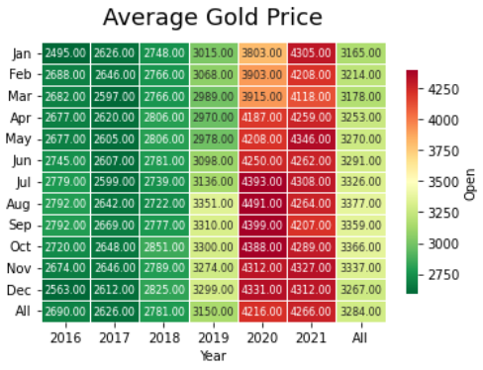
Exploring/EDA on Initially Raw Data (Uncleaned data)
Plot 3
Observation: - The 'ALL' column shows consistent average
over all months over the years.
- End of Year months prices are comparatively high
Notes:
‹#›

Slide 10
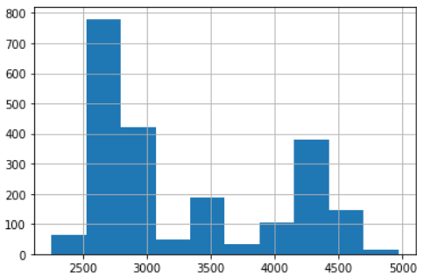
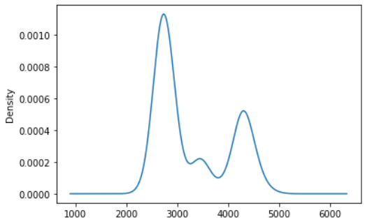
Exploring/EDA on Initially Raw Data (Uncleaned data)
Plot 4
Observation: In last 5 years, price of gold was more between
2500/- to 2750/-.
Notes:
‹#›

Slide 11
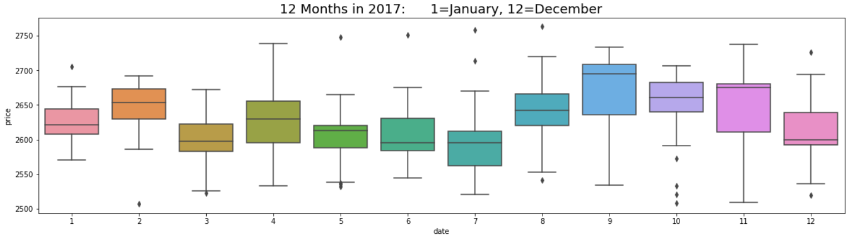
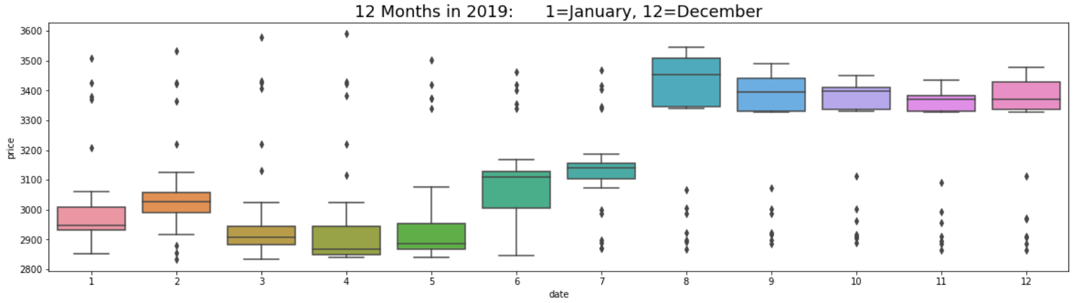
Exploring/EDA on Initially Raw Data (Uncleaned data)
Plot 5
Observation: More spread of data with outliers in
2019 than any other year.
Notes:
‹#›

Slide 12
Project Architecture
Our Project Flow
Notes:
‹#›

Slide 13
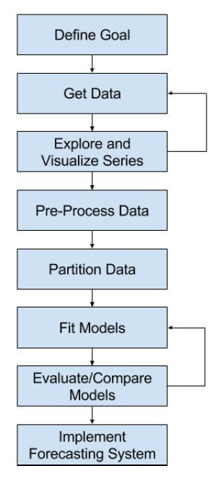
Details:
Dataset Provided
Initial Exploration of RAW data performed
Pre-processing includes cleaning of data
Partitioning 1-year (365 days) for validation and rest for train & test
Walk forward Validation
Attempted Multiple Models
Notes:
‹#›

Slide 14
Data Cleaning
Notes:
‹#›

Slide 15
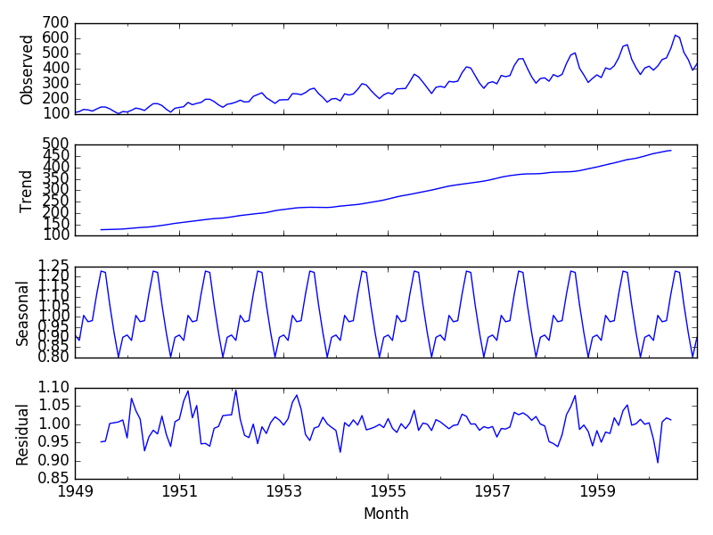
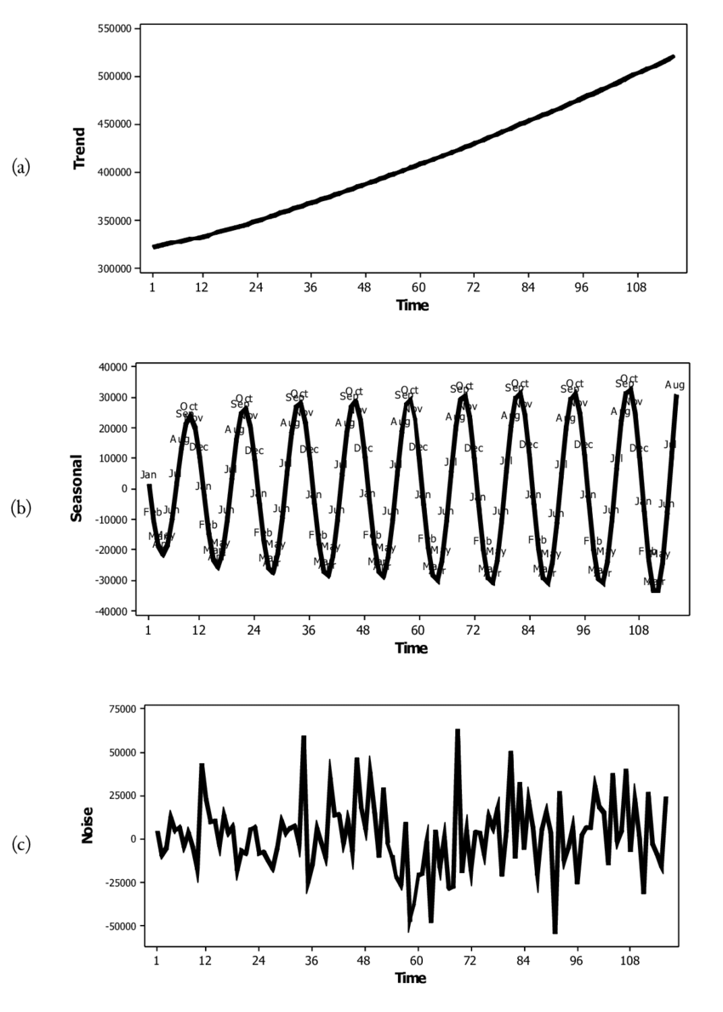
Data Cleaning - Making data Stationary
Time Series data has 4 components:
Level
Trend
Seasonality
Noise
Notes:
‹#›

Slide 16
Data Cleaning
We removed unwanted components for forecasting models by:
Using Differencing (ADF test to verify) to remove trend and seasonality
Power Transforms - linear and quadratic to remove noise and Box-Cox Transformation
Moving Average for Smoothing (MA Model)
Proper selection of p,d,q values using ACF and P-ACF plots & Hyperparameter Grid search
p = lag value
d = order of differencing
q = size of moving average window
Notes:
‹#›

Slide 17
ACF and P-ACF Plots
Notes:
‹#›

Slide 18
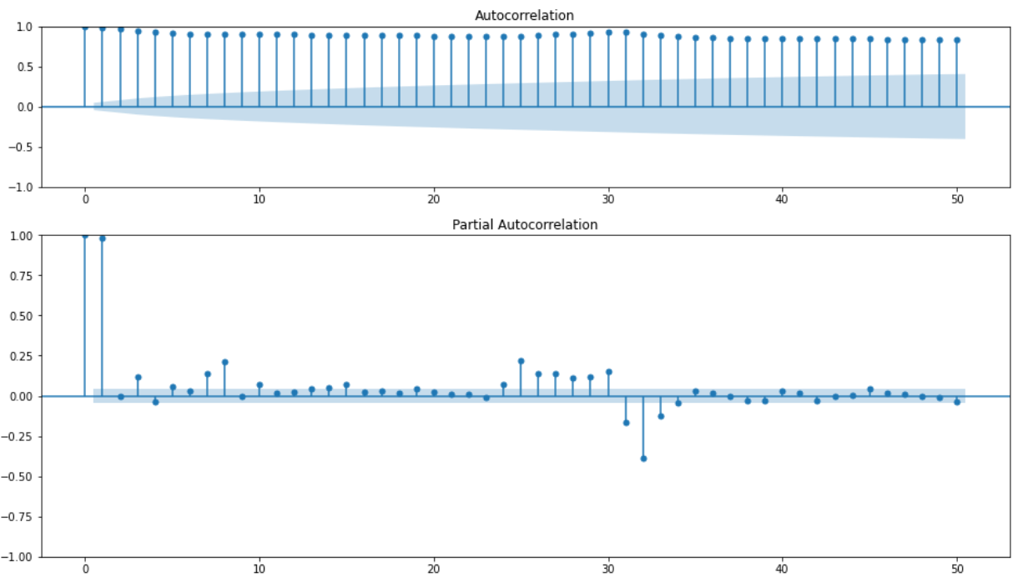
ACF and P-ACF plots (First 50 days lag)
Notes:
‹#›

Slide 19
Models Attempted
Notes:
‹#›

Slide 20
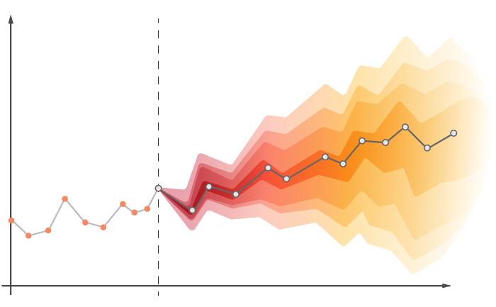
Models Attempted
Baseline Model - Naive/Persistent model
Holt-Winters
Simple Exponential Method
Holts winter exponential smoothing with additive seasonality and additive trend
Holts winter exponential smoothing with multiplicative seasonality and additive trend
Moving Average
ARIMA
Notes:
‹#›

Slide 21
Model Selection & Evaluation
Notes:
‹#›

Slide 22

Model Selection based on Results
Baseline Model - Naive/Persistent model RMSE 148
Holt-Winters MAPE = 29.9
Simple Exponential Method MAPE = 6.34
Holts winter exponential smoothing with additive seasonality and additive trend. MAPE = 1.4 [We selected this model]
Holts winter exponential smoothing with multiplicative seasonality and additive trend MAPE = 4
ARIMA MAPE = 2.09
Notes:
‹#›

Slide 23
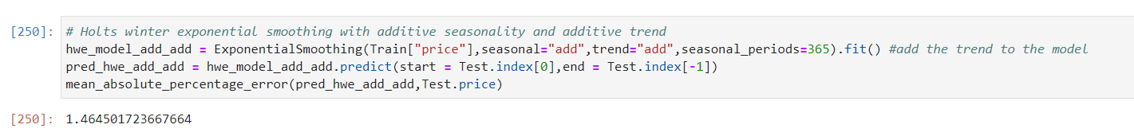
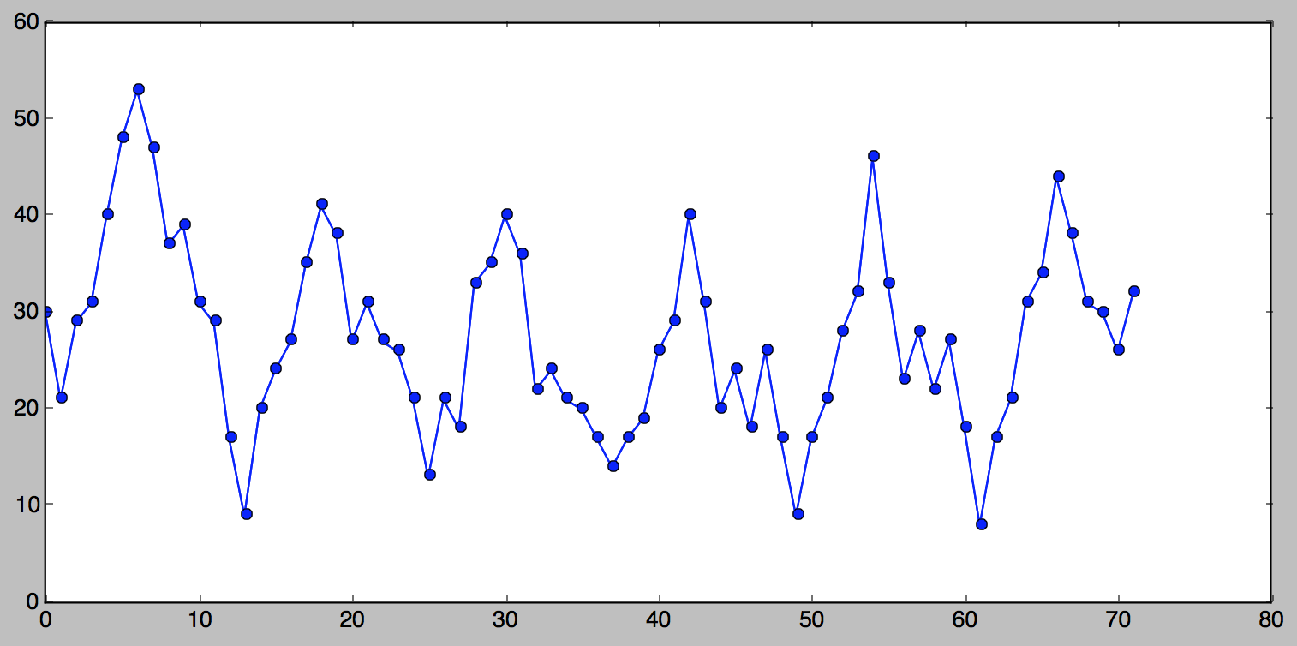
Holt’s Winter method
The Holt-Winters forecasting method applies a triple exponential smoothing for level, trend and seasonal components. A Holt-Winters model is defined by its three order parameters, alpha, beta, gamma. Alpha specifies the coefficient for the level smoothing. Beta specifies the coefficient for the trend smoothing.

Slide 24
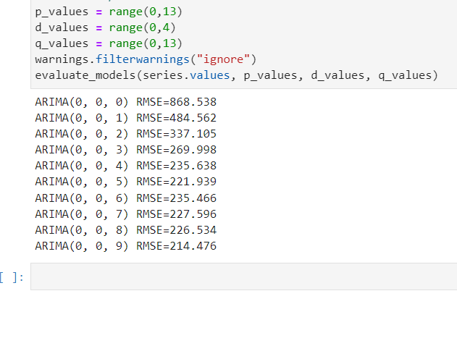
ARIMA Grid Search for best hyper parameterization
MAPE for ARIMA we got: 2.09 for (2,1,11)
Loop Ran from:
p from range
0 to 13
d from range
0 to 4
q from range
0 to 13
Notes:
‹#›

Slide 25
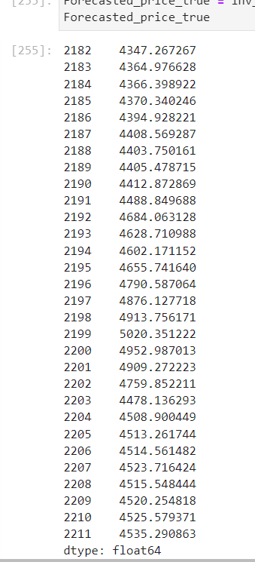

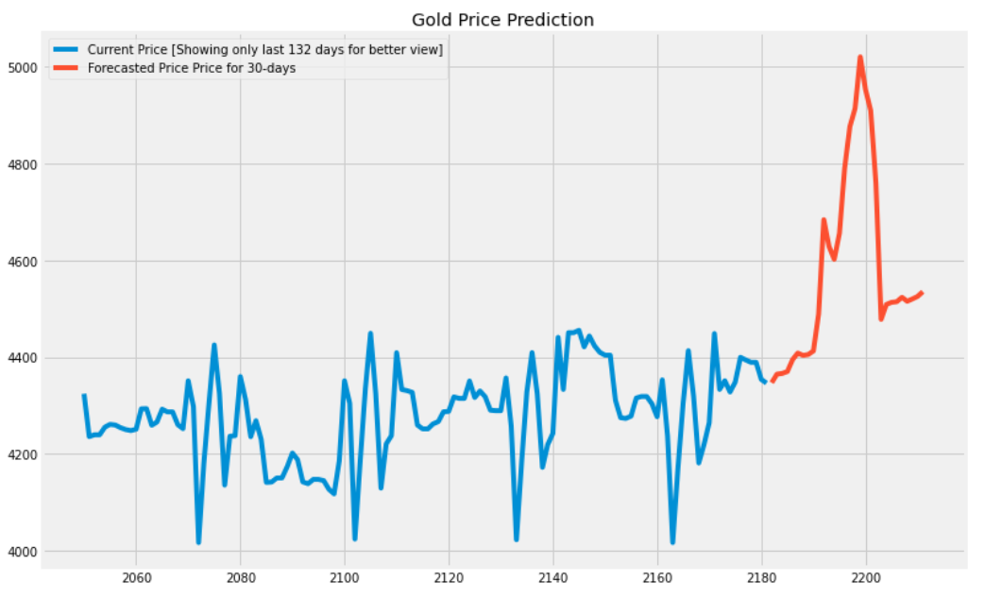
Forecasted Values for 30 days
Given data: 0 to 2181
Predicted data: 2182 to 2211

Slide 26
Model Deployment
Notes:
‹#›

Slide 27
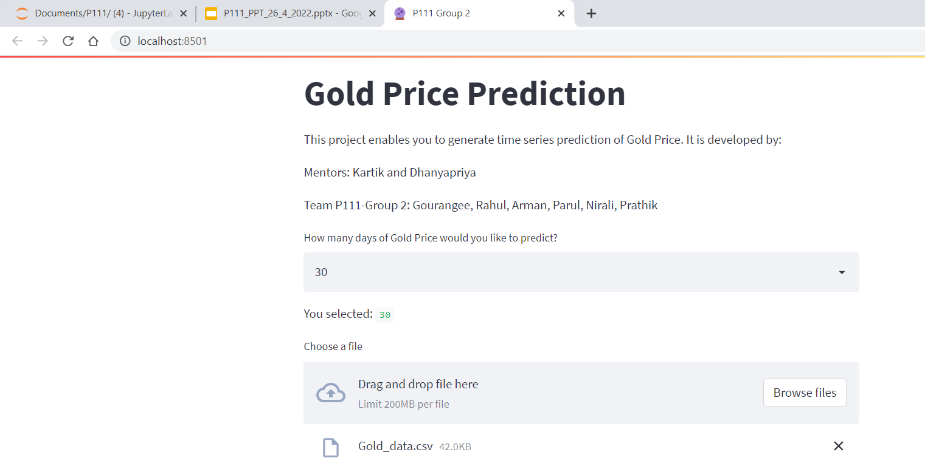
Screenshot 1
Notes:
‹#›

Slide 28
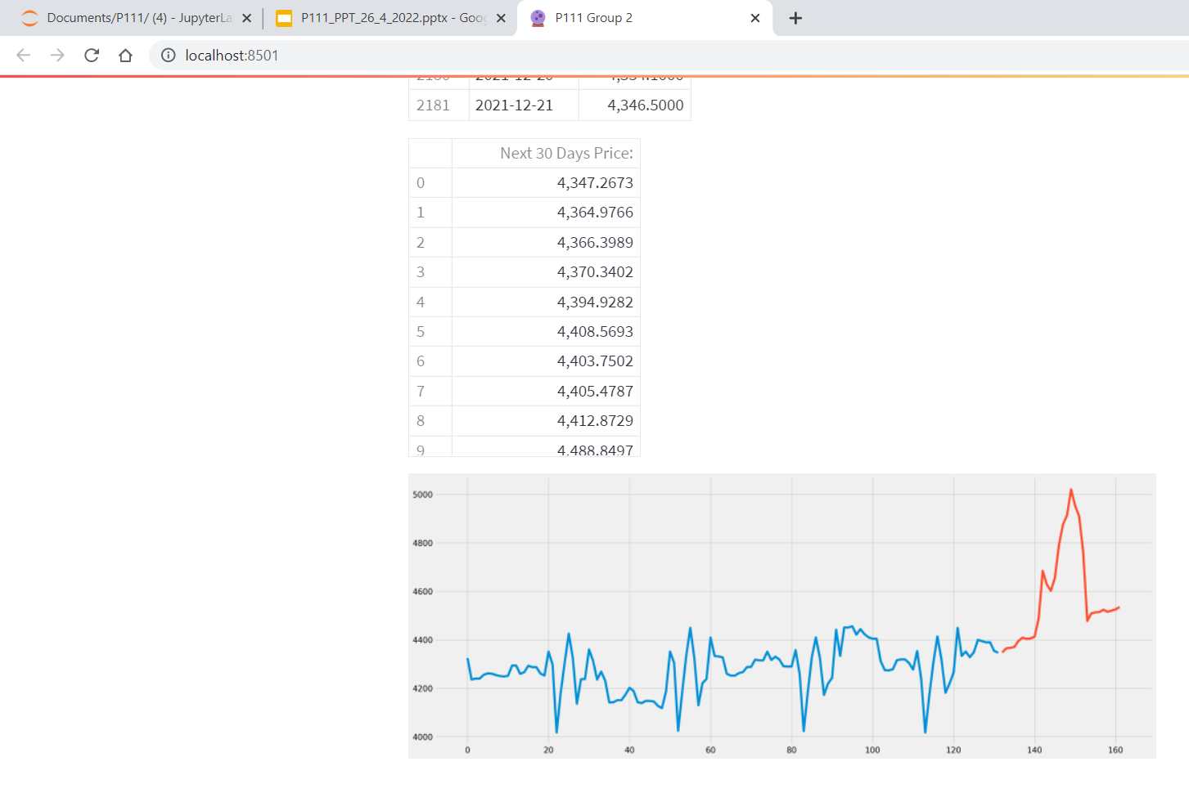
Screenshot 2
Notes:
‹#›

Slide 29
Challenges Faced
Notes:
‹#›

Slide 30
Challenges faced
Identifying data Conversions during operations (when to use what data type?).
Converting data from Series object to dataframe object, Arrays to Series, Dataframe with/wo indexes, conversions of date to datetime objects, Visualizations needing different data types etc.
Deployment attempted in Flask, but due to lack of HTML knowledge with team could not complete it on time.
How did we overcome?
1. Experimenting with different data types
Referring official documentations
Help from forums
Help from Kaggle and Stack Overflow
Trial and Error
2. Continued to use streamlit for now.

Slide 31
Thank you
Notes:
‹#›

