Slide 1
PRINT PAY

Slide 2
PROBLEM STATEMENT
In college, students frequently need to print assignments, reports, and other academic materials. These tasks often require students to visit local printout shops. However, a major issue arises when network connectivity at these shops fails during the payment process. This network instability causes delays, inconveniences, and, in some cases, prevents students from completing their transactions in a timely manner. This situation creates complications, delays and frustration for both students and print shop owners.

Slide 3
AIM
Print Pay is designed to ensure uninterrupted payments at printout shops during network failures by using a point-based currency system. Users preload points into their accounts, enabling seamless transactions without reliance on third-party apps, with funds transferred directly to shop owners.

Slide 4
SOFTWARE REQUIREMENTS
1) HTML
2) CSS
3) JavaScript
4) Node.js
5) Figma
6) Arduino IDE

Slide 5
HARDWARE REQUIREMENTS
1) ESP-WROOM-32
2) RFID-RC522 Reader
3) RFID Tag
4) Breadboard
5) Male to Male Jumper Wires
6) USB type A to Micro USB cable

Slide 6
PROCEDURE
Attach RFID-RC522 and ESP-WROOM-32 on the breadboard, and connect them with jumper wires, as shown in the circuit diagram.
Connect the ESP32 with the laptop USB port through USB type A to Micro USB cable. This will provide our hardware power supply.
Open Arduino IDE, and enter the code.
Verify and run the code. Once its compiled, open the Serial Monitor.
Tap the RFID Tag on the RFID Sensor, and it will read the UID of the RFID Tag.

Slide 7
FEATURES
Print Pay uses points-based system
Users can preload points into their accounts
It is Secure and Reliable
Only authorized users can access their accounts
Allows payments even during network failures
Ensures Prompt Payment for print shop owners

Slide 8
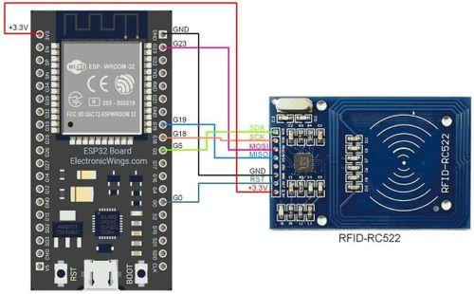
CIRCUIT DIAGRAM

Slide 9
CIRCUIT CONNECTIONS
RFID-RC522 | ESP-WROOM-32
VSS | 3.3V
GND | GND
SDA | D5
SCK | D18
MOSI | D23
MISO | D19
RST | D4

Slide 10
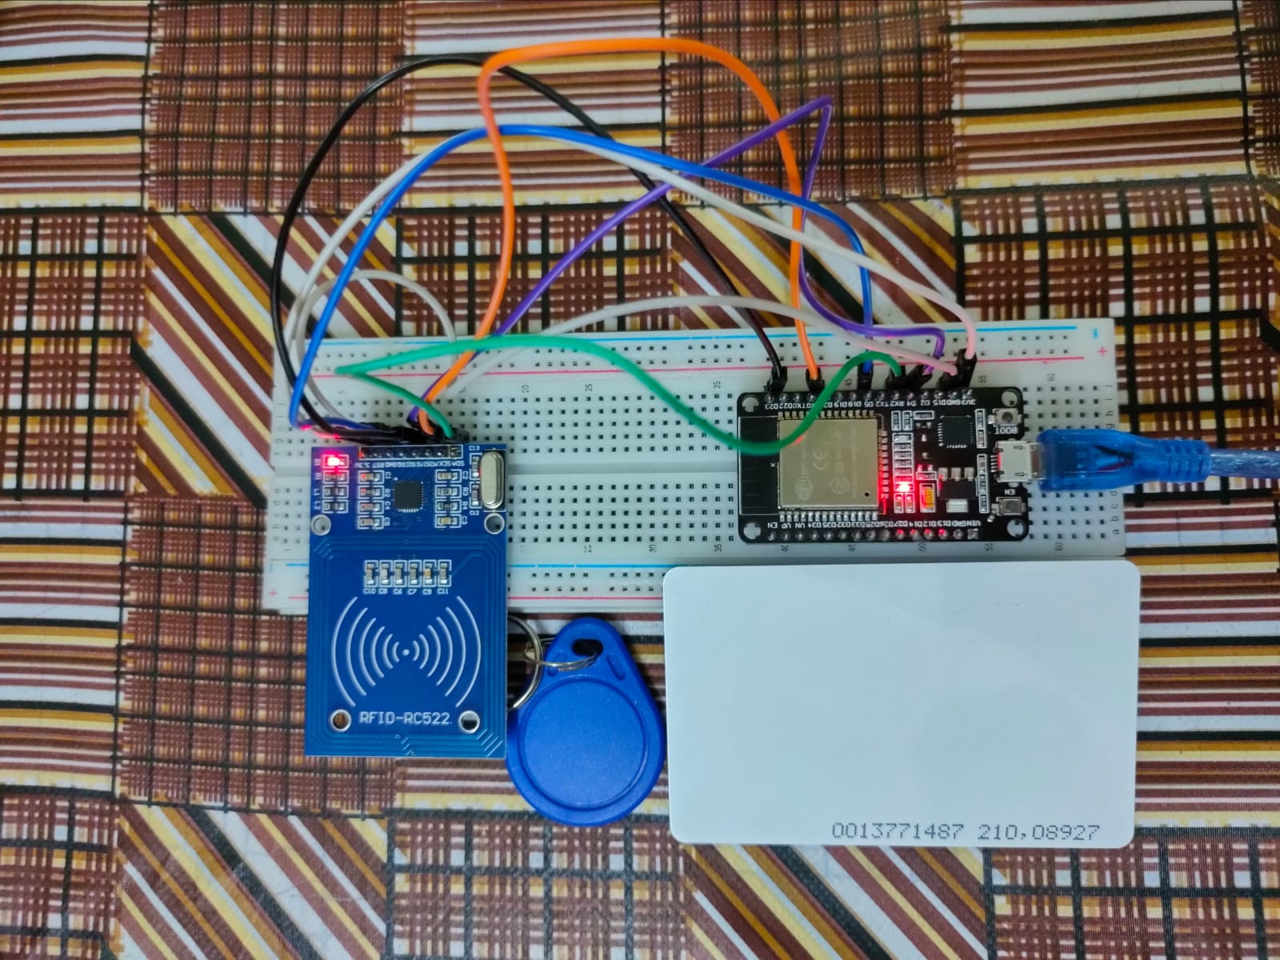
HARDWARE SETUP

Slide 11
CODE
#include <SPI.h>
#include <MFRC522.h>
// Defining the pins for the RC522 RFID module
#define SS_PIN 5 // SDA
#define RST_PIN 4 // RST
#define LED_PIN 2 // Defining the onboard LED pin
MFRC522 rfid(SS_PIN, RST_PIN); // Creating an instance of the MFRC522 class

Slide 12
CODE
#include <SPI.h>
#include <MFRC522.h>
// Defining the pins for the RC522 RFID module
#define SS_PIN 5 // SDA
#define RST_PIN 4 // RST
#define LED_PIN 2 // Defining the onboard LED pin
MFRC522 rfid(SS_PIN, RST_PIN); // Creating an instance of the MFRC522 class

Slide 13
void setup() {
// Initializing serial communication for debugging
Serial.begin(115200);
while (!Serial) {
// Waiting for the serial connection to be established (if needed)
}
// Initializing SPI bus
SPI.begin();
// Initializing the RFID reader
rfid.PCD_Init();
Serial.println("RFID reader initialized. Scan your RFID tag/card...");

Slide 14
// Setting up the LED pin
pinMode(LED_PIN, OUTPUT); // Define the LED pin as output
digitalWrite(LED_PIN, LOW); // Ensure the LED is off initially
}
void loop() {
// To look for a new RFID tag/card
if (!rfid.PICC_IsNewCardPresent()) {
// If no card is detected, continue the loop
return;
}

Slide 15
// Attempting to read the detected card's serial number (UID)
if (!rfid.PICC_ReadCardSerial()) {
// If reading fails, continue the loop
return;
}
// To print the UID (Unique ID) of the detected card/tag
Serial.print("Card/Tag Detected! UID: ");
for (byte i = 0; i < rfid.uid.size; i++) {
// Print each byte of the UID in hexadecimal format
Serial.print(rfid.uid.uidByte[i] < 0x10 ? " 0" : " ");
Serial.print(rfid.uid.uidByte[i], HEX);
}
Serial.println();

Slide 16
// Blink the LED to indicate detection
digitalWrite(LED_PIN, HIGH); // Turn the LED on
delay(200); // Wait for 200 milliseconds
digitalWrite(LED_PIN, LOW); // Turn the LED off
// Put the card/tag to an idle state to stop reading the same card repeatedly
rfid.PICC_HaltA();
rfid.PCD_StopCrypto1();
}

Slide 17
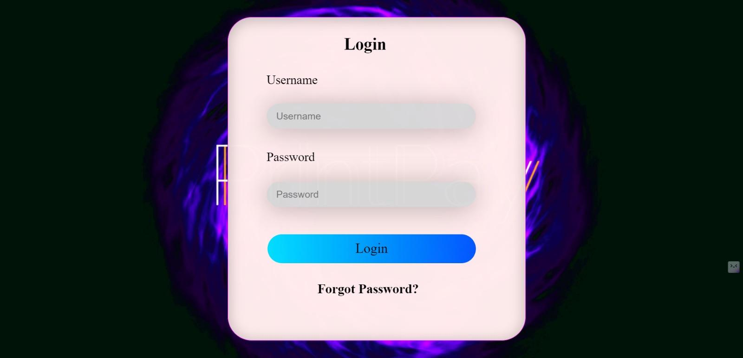
Fig 1 - Login Portal

Slide 18
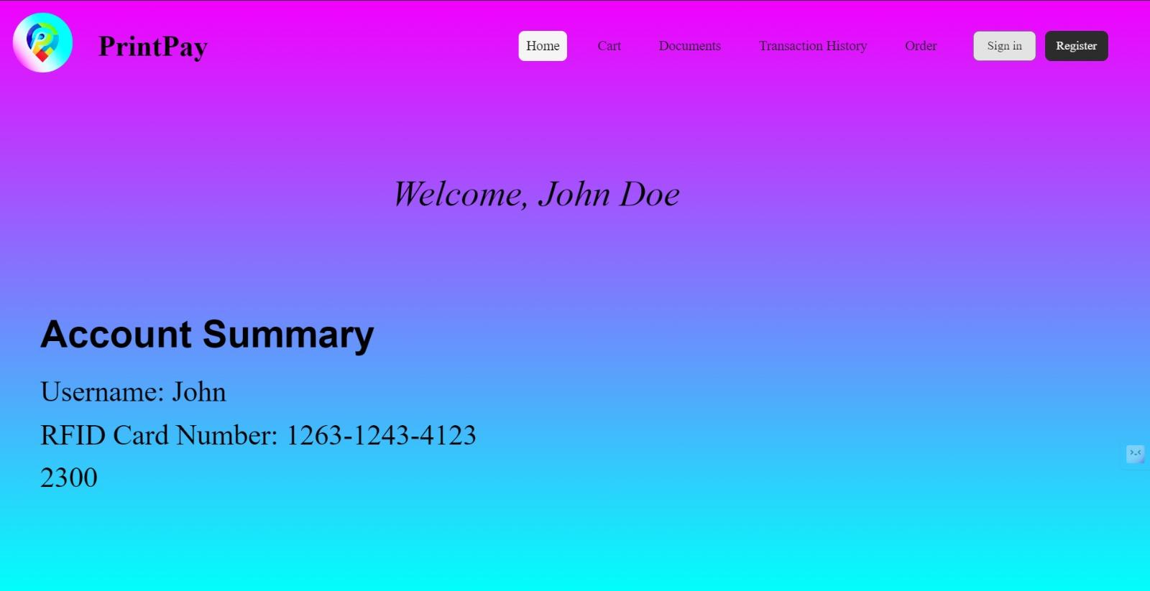
Fig 2 - Dashboard

Slide 19
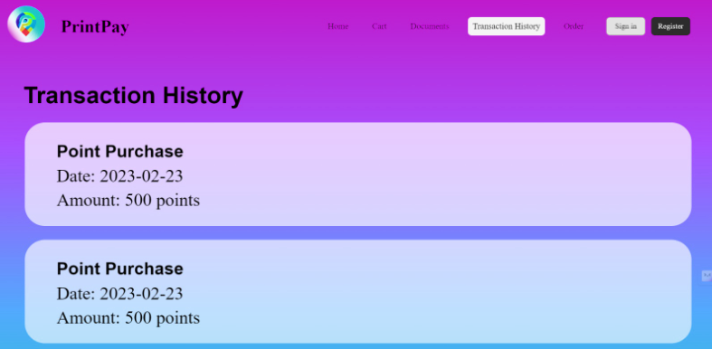
Fig 3 - Transaction History

Slide 20
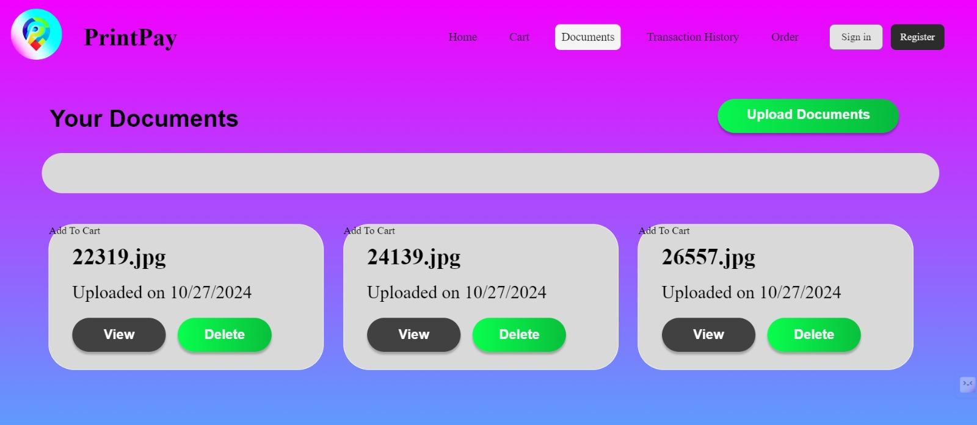
Fig 4 - Your Documents

Slide 21
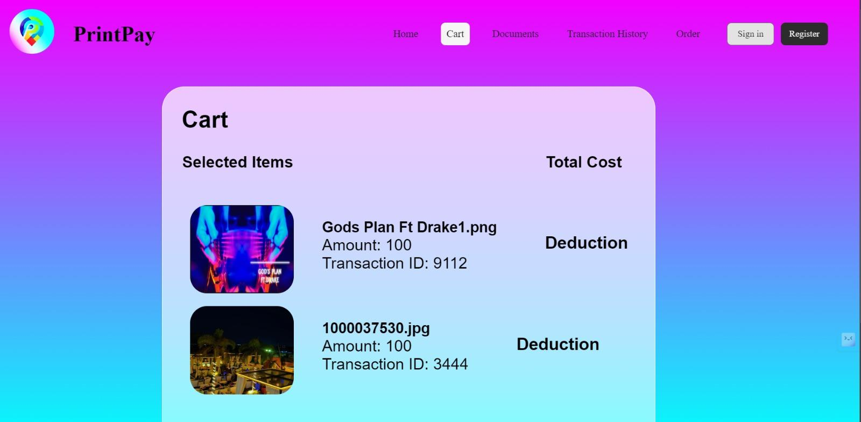
Fig 5 - Cart

Slide 22
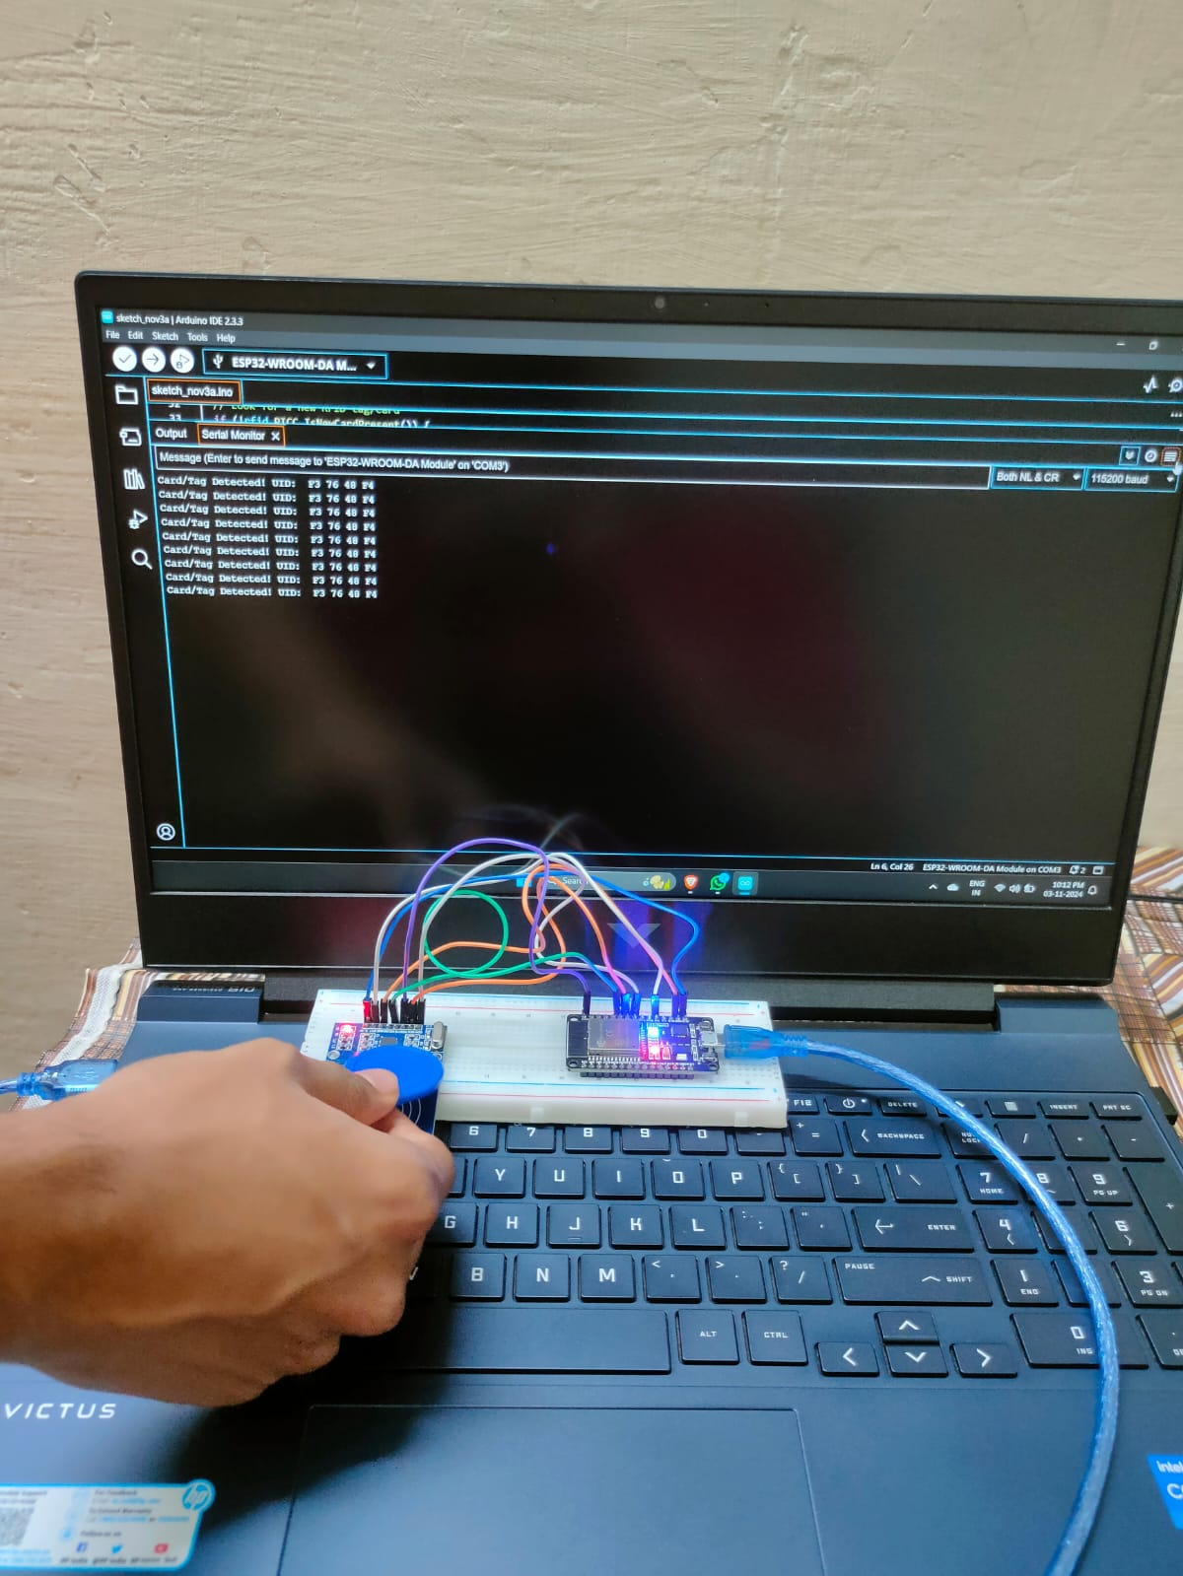
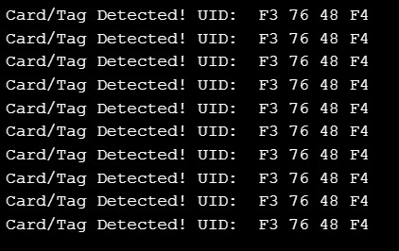
OUTPUT

Slide 23
CONCLUSION
In conclusion, Print Pay simplifies the interaction between students and print shop owners, providing a reliable, secure, and efficient system for managing print services and payments. With the implementation of this platform, the common challenges associated with traditional payment methods can be eliminated, paving the way for a more convenient and streamlined process.

Slide 24
RESULT
We have successfully implemented Factory Automation system project, by showing an Access Control implementing project, using ESP-WROOM-32 and RFID-RC522 Reader.

Slide 25
TEAM MEMBERS
Pranav Mahajan (RA2211032010001)
Boggarapu Dhanush (RA2211032010023)
Saksham Virmani (RA2211032010038)

